Slide 1
The Revolutions Of 1848
“The turning point at which history failed to turn.”
-George Macaulay Trevelyn, Cambridge University Historian, 1937

Slide 2
Key Questions
Lecture Outline
Why Revolutions in 1848?
What were the goals?
How did the revolutions play out in France and Germany?
Why did the revolutions fail? Where did they succeed?
What lasting impact did revolutions have on Europe…and the world?
Causes of 1848 Revs
Rev in France
Rev in Germany
Frankfurt Parliament
Why did revs fail?
Legacy

Slide 3
Historicism & The Hegelian Dialectic
History advances through conflict
One phase of history creates its opposite, out of which emerges something new.
ex: absolutism/democracy
Thesis
Antithesis
George Wilhelm Friedrich Hegel
1744-1803
Synthesis

Slide 4
Causes of 1848 Revolutions: Long Term
Industrialization
Challenged rulers
Challenges artisan class
Rapid urbanization
Population doubled in18th C.
Food supply problems
Ideological Challenges
Liberalism, nationalism, democracy, socialism
Romanticism
Repressive Measures
Carlsbad Decrees
Secret police created in many European states

Slide 5
Causes of 1848 Revolutions: Short-Term
Agricultural Crises
Poor cereal harvests
Prices rose 60% in a year
Potato blight → Ireland
Prices rose 135% in a year
Financial Crises of 1837
Investment bubbles burst → railways, iron, coal
Unemployment increased rapidly
Working & middle classes now joined the misery of the urban and agricultural peasantry

Slide 6
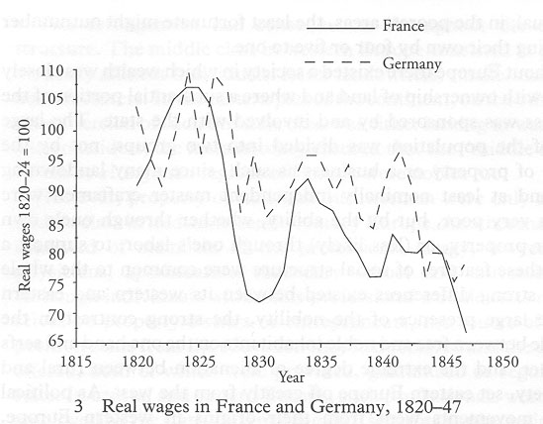

Slide 7
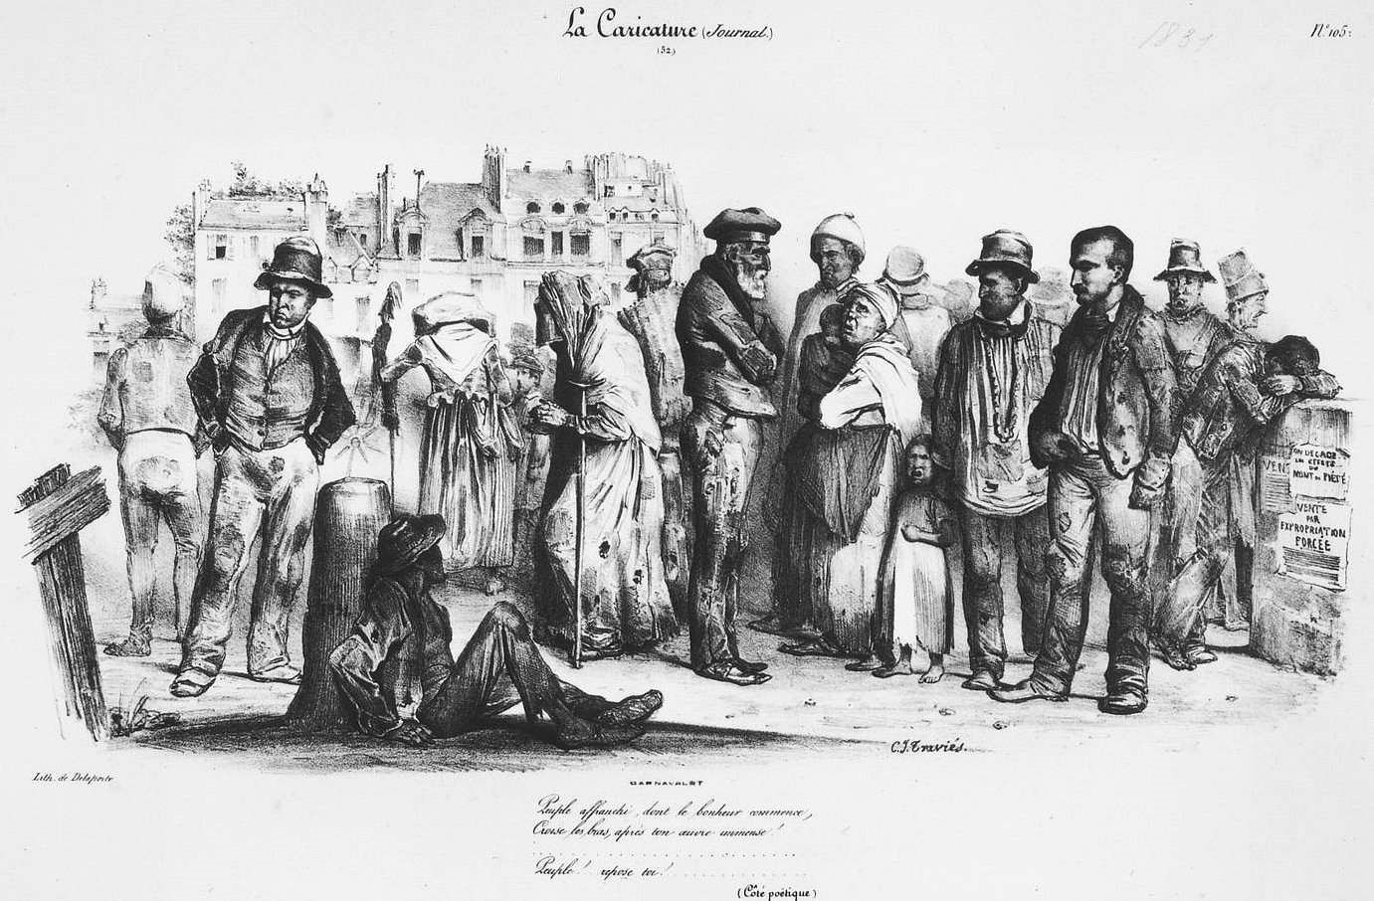
“A Free People, Whose Happiness Begins” (French cartoon, October 1831)
Masons, artisans, and other manual workers hoping desperately that someone will hire them for the day.
A sarcastic commentary having created a "free" people, free of property and free of employment.
Notes:
Charles Joseph TRAVIES DE VILLERS, "A 'Free' People whose Happiness Begins" (cartoon published in LA CARICATURE, 1831, in the Carnavalet Museum). SOURCE: www.histoire-image.org
“ Peuple affranchi ” Workers remained vulnerable after the July Revolution to unemployment and hardship. Martin Nadaud described the labor exchange on the Place de Grève during a slump in the building trade as "the last remnant of the old slave markets of antiquity," with people held in bondage by the fear of hunger. Here we see masons, artisans, and other kinds of manual workers hoping desperately that someone will hire them for the day. In this cartoon published in 27 October 1831, the young Charles-Joseph Traviès de Villers (1804-1859) showed himself to be a careful observer of the dress and behavior of the workers of Paris. The cartoon is intended as a sardonic commentary on celebrations of the revolution of 1830 by Delacroix and others for having created a "free" people --these people are free only of property and free of steady employment.

Slide 8
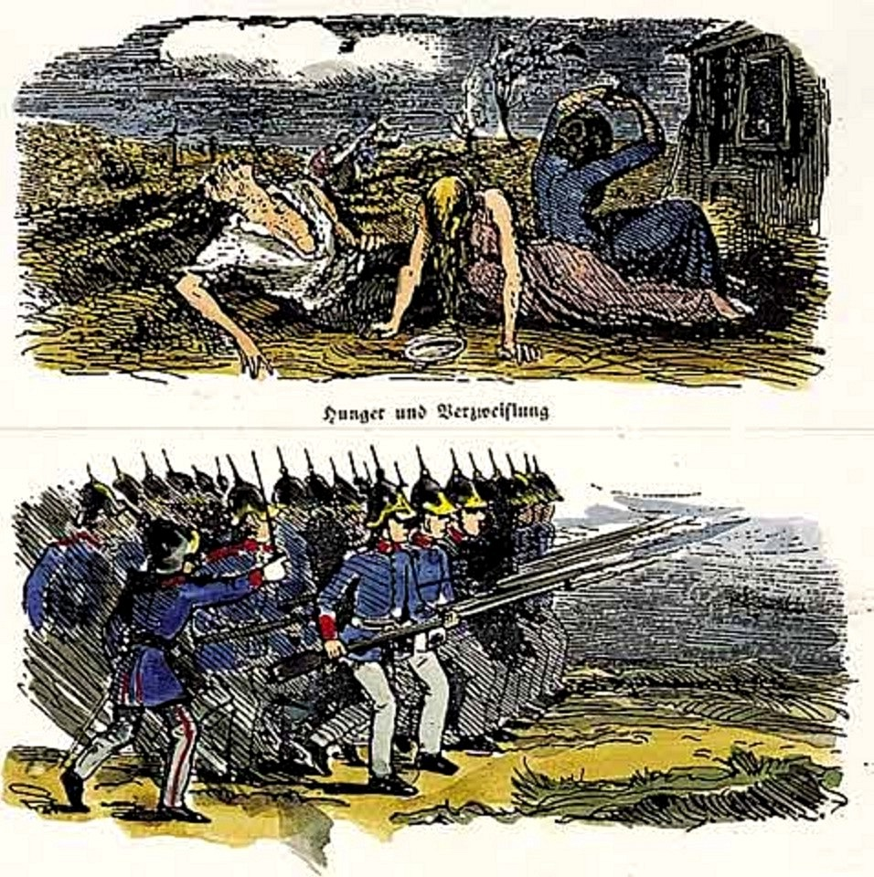
“Hunger and Despair”
“Government Assistance”
(Satirical cartoon, Berlin, 1847)
Notes:
An engraving from the "Fliegenden Blättern,” published clandestinely on the eve of the revolution of 1848, reminds its audience of the governments response to the distress of the Silesian weavers. From www.preussen-chronik.de.

Slide 9
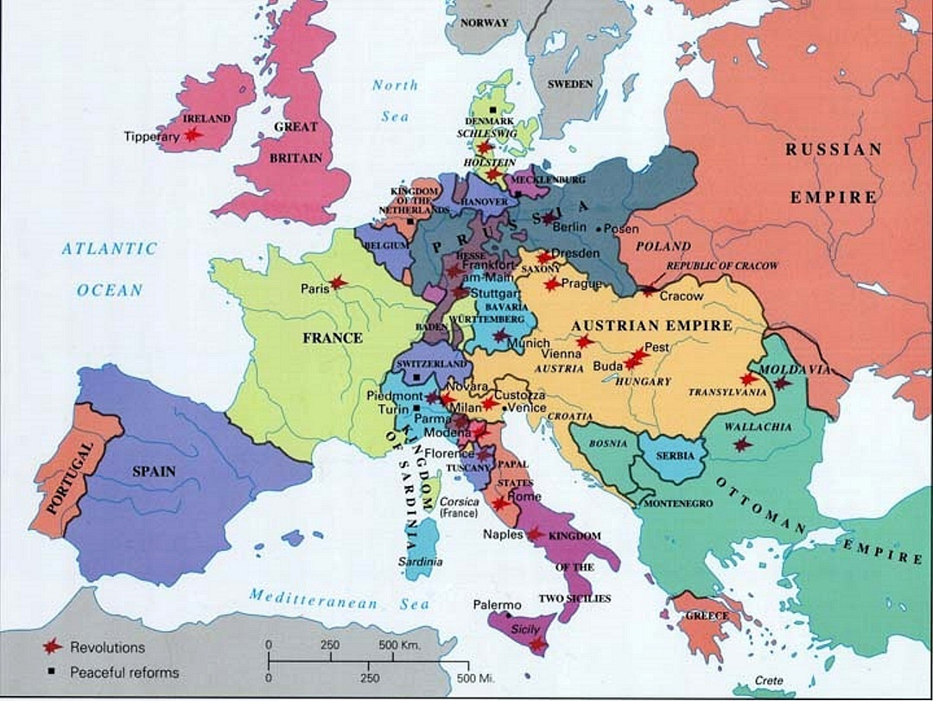
Spread of popular uprisings in 1848
Feb 22: Paris
Feb 27: Baden
Mar 13: Vienna
Mar 15: Budapest
Mar 18: Berlin
Mar 18: Milan
Mar 19: Munich
May 3: Dresden
June 9: Bucharest
Notes:
SOURCE: http://www.uiowa.edu/~c016003a/map1848.jpg

Slide 10
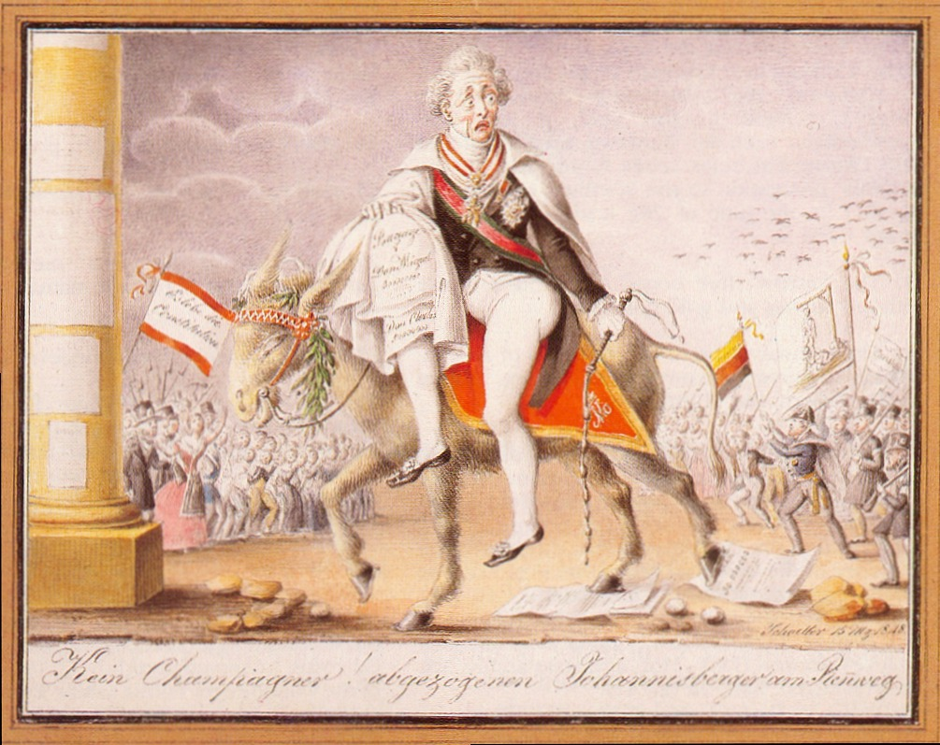
J.C. Schoeller, “Caricature of Metternich’s Flight,” 1848
The caption notes that there will be no more champagne for this famous bon vivant
Hostile crowds wave the new colors of a united Germany, an image of Metternich hanged in effigy, and a banner saying "Long live the constitution!"
Notes:
Johann Christian Schoeller, "Caricature of Metternich's Flight," 1848, watercolor in the Historical Museum of the City of Vienna (from Waissenberger, VIENNA, 1815-1848, p. 49). Metternich's villa was destroyed on 14 March 1848, and he and his family were compelled to flee through Prague, Dresden, Hanover, and Amsterdam; everywhere they encountered jeering crowds until they were able to reach England five weeks later. The caption notes that there will be no more champagne for this famous bon vivant. The hostile crowds wave the new colors of a united Germany, an image of Metternich hanged in effigy, and a banner saying "Long live the constitution!"

Slide 11
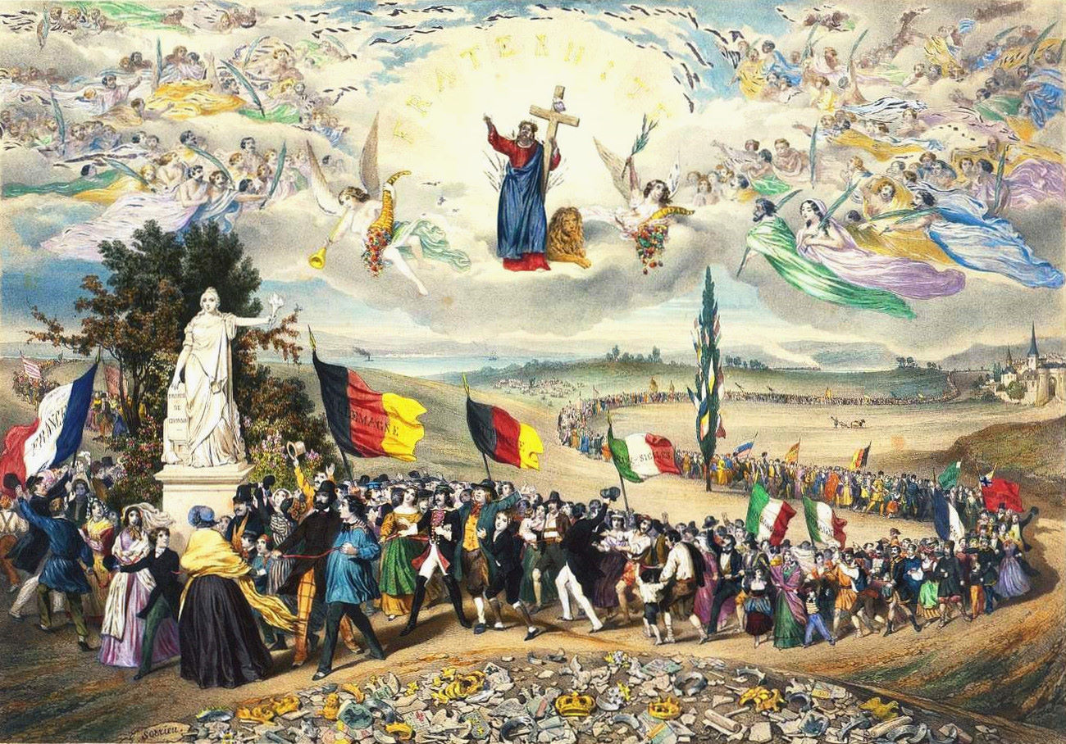
“The Universal, Democratic, and Social Republic: The Pact”
Christ blesses the union of all the feuding nations of Europe who march past a liberty tree to assemble around the statue of the Republic.
Notes:
Frédéric SORRIEU, “La République universelle démocratique et sociale - Le Pacte.” Musée Carnavalet (www.histoire-image.org). Christ blesses the union of all the feuding nations of Europe, who march past a liberty tree to assemble around the statue of the republic. The artist correctly guesses the colors adopted shortly thereafter by the Frankfurt Assembly for a flag for a united Germany, but it is followed by the flags of the three largest Italian states; the flags of Hungary and Bohemia follow.

Slide 12
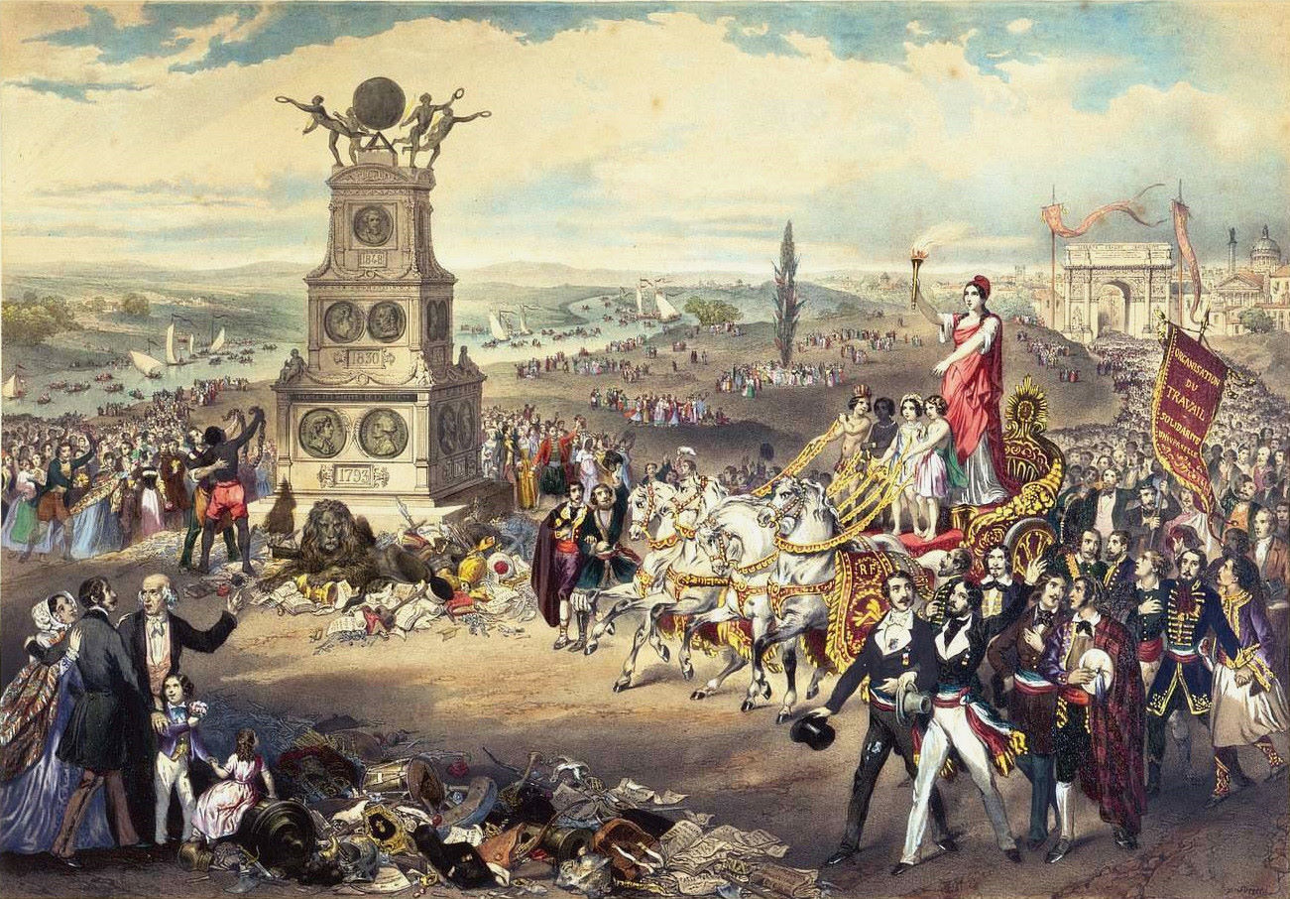
“The Triumph of the Universal, Democratic, and Social Republic” (children of the 4 continents drive the chariot; slaves are freed)
Notes:
From the Carnavalet Museum in Paris (www.histoire-image.org). The universal republic is a goddess on a chariot whose reins are held by children from the four major continents. The procession leaves from Paris toward an imaginary monument celebrating the three French revolutions. At the foot of the monument a slave rejoices in his freedom, finally decreed for all French colonies on 27 April 1848, and a lion, representing the mighty People, crushes the agents of militarism.

Slide 13
Not Coherent, Organized Revolutions
Different reasons for revolutionary activities
Reactions to long and short-term causes
Competing ideologies in different countries
Different revolutionary leaders and goals in different countries
Some countries had no revolutions:
England
Russia
France had a substantial revolution….

Slide 14
FRANCE

Slide 15
Reign of Louis-Philippe (1830-1848)
Post-Rev French government lost stability in 1814, after Louis XVIII died
“Three Glorious Days” of 26–29 July 1830: Charles X forced to abdicate
Under the “Bourgeoisie Monarch” Louis-Philippe, industrialization flourished. BUT…
Urban workers suffered
Only landholders, a mere 1%, could vote
Alexis de Tocqueville: "We are sleeping together in a volcano... A wind of revolution blows, the storm is on the horizon."
Frustration finally erupted in February 1848 when a cross-class alliance overthrew Louis-Philippe

Slide 16
The February Revolution
Working class & liberals unhappy with King Louis Philippe, esp. with his minister, Francois Guizot, who opposed electoral reform
Since political protest was illegal, “Reform Banquets” were created among the middle class to raise funds for an opposition. Naturally, they were outlawed.
Paris Banquet banned
Troops opened fire on peaceful protestors
Barricades erected; looting
National Guard defected to the radicals
Louis Philippe lost Paris and abdicated on 24 Feb 1848

Slide 17
Paris: To the Barricades Again!

Slide 18
Prince Louis: Not Too Steady!
Victor Hugo & Miguel de Girardin try to raise Louis upon a shield, December 11, 1848

Slide 19
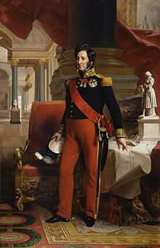
Louis Philippe, “The Pear,” 1848
→
Deteriorating

Slide 20
Provisional Government
Alphonse Lamartine - poet & liberal, now President of the Second Republic, believed in the “Rights of Man”:
Vote, free speech, property, secular education

Slide 21
Provisional Government
Goals of Second Republic:
Universal suffrage: elections on 23 April 1848
Unemployment relief – through National Workshops
10-hour workday
New Republican constitution
Abolish slavery
Abolish the death penalty
Conservatives & liberals were suspicious of Republicanism. Reminiscent of the Reign of Terror?
Urban-Rural Divide – urbanites more radical

Slide 22
The Coalition Splits: Mar-May
The conflicts between liberals & socialists over:
Timing of elections to Constituent Assembly
Costs of government social programs (violating laissez-faire?)
Question of whether we can have liberty for all men and still have a system based on private property

Slide 23
The Coalition Splits: Mar-May
Growing social tensions between the working class & the bourgeois middle class regarding:
The nature of work
National Workshop Program
The right to unionize
Wages

Slide 24
The Coalition Splits: Mar-May
23 April 1848 – Elections to National Assembly. Moderate Republicans won.
15 May 1848 – Parisian workmen, feeling their social democracy slipping away, invaded the Assembly and proclaimed a new Provisional Government.
suppressed by the National Guard
leaders arrested
May 1848 – Marked the end of the truly revolutionary period of the Revolution.
Party of Order wins majority to turn back the clock. But to when?

Slide 25
June Days: 23-26 June
The Party of Order closed the Right to Work workshops
23 June, 200,000 Paris proletarian protested
General Cavaignac, who just returned from French Algeria, was given 125,000 soldiers to quell the revolt. It took him two days!

Slide 26
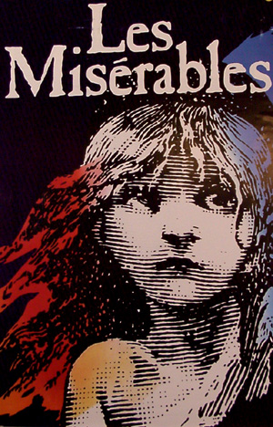
June Days: 23-26 June
Victor Hugo’s Les Miserables was based on June Days
June Days marked an important departure in revolutionary politics:
The new struggle: bourgeoisie vs. the working classes.
Karl Marx: “Only after baptism in the blood of the June insurgents did the tricolor become the flag of the European revolution—the red flag.”

Slide 27
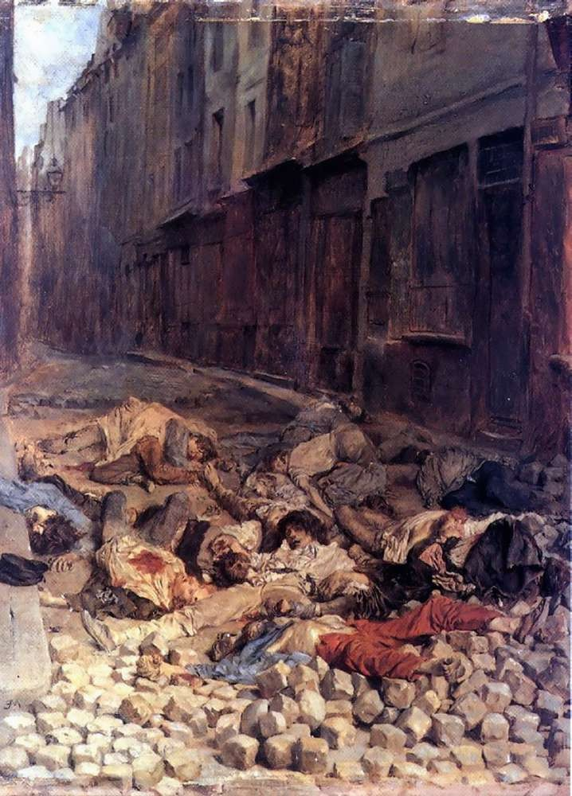
Ernest Meissonier, “The Barricade,” aftermath of the June Days of 1848
Notes:
The artist was appalled by what he witnessed of the suppression of the June Days. He asked one officer of the Mobile Guard who was carrying out summary executions, "Are all of them guilty then?" The reply: "I can assure you that not more than one-fourth of them are innocent." This painting suggests a terrible reproach, since none of those just shot is bearing arms.

Slide 28
After the June Days in France
4 Nov. 1848 – Second French Republic proclaimed
10 December 1848 – Presidential Elections held. Nephew of Napoléon Bonaparte, Louis-Napoléon, won
The various classes of France each had different visions of what a return to the days of Napoleon Bonaparte would mean and they supported Louis Napoleon for different reasons. His greatest support came from the peasantry.
December 1848 Elections in France
Louis Napoleon Bonaparte 5,500,000
Louis-Eugène Cavaignac 1,500,000
Ledru-Rollin (Radical) 371,000
Raspail (Socialist) 36,000

Slide 29
After the June Days in France
2 December 1851 – Louis-Napoléon’s coup d’état, dissolved the National Assembly
2 December 1852 – Louis-Napoléon assumed the title of Emperor Napoléon III. Emperor until 1870.
Conservative order re-established.
Karl Marx: "History repeats itself: the first time as a tragedy, the second time as a farce."

Slide 30
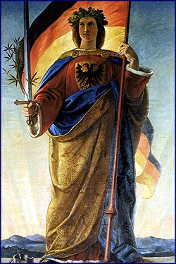
The German States

Slide 31
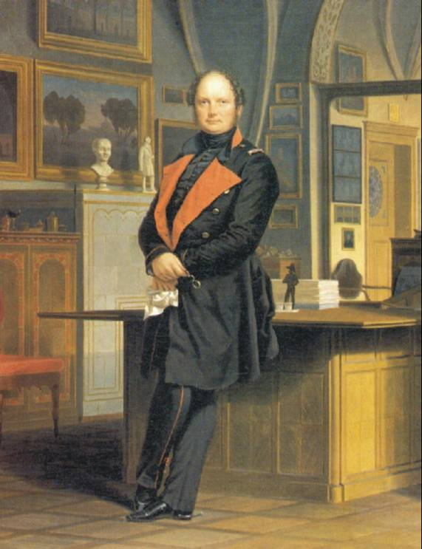
Frederick William IV of Prussia (1840-1861)
“Romanticist on the throne“
Agricultural romantic who Relied on Junker support
Nostalgic for Medieval Germany
Loathed liberalism and industrialism
Refused to create an elected legislative assembly. Refuted democracy altogether.

Slide 32
The Germans Follow the French
Demands for liberalism, nationalism, constitutionalism, and democracy trace back decades in Germany, e.g. Hambacher Festival of 1832.
After the French and Austrian revolutions, where two monarchs were forced to flee to England, many riots in German states:
Mannheim, Württemberg, Hesse-Darmstadt, Nassau, Dresden…
Even revolts in Baden & Saxony, the more liberal German states
Many German monarchs made promises. Few delivered.

Slide 33
Flashpoint Berlin
13-21 March 1848, Berlin: a week of bloody protests. War in the Tiergarten. 254 dead. Bodies laid out in Gendarmenmarkt square.
FW IV attended the funeral for the fallen civilian victims.
Wore the tricolor, demonstrating allegiance to the movement
Even promised to arm the citizens!
Promised reform in a forthcoming Parliament…

Slide 34
A Citizen Militia on Parade in Berlin

Slide 36
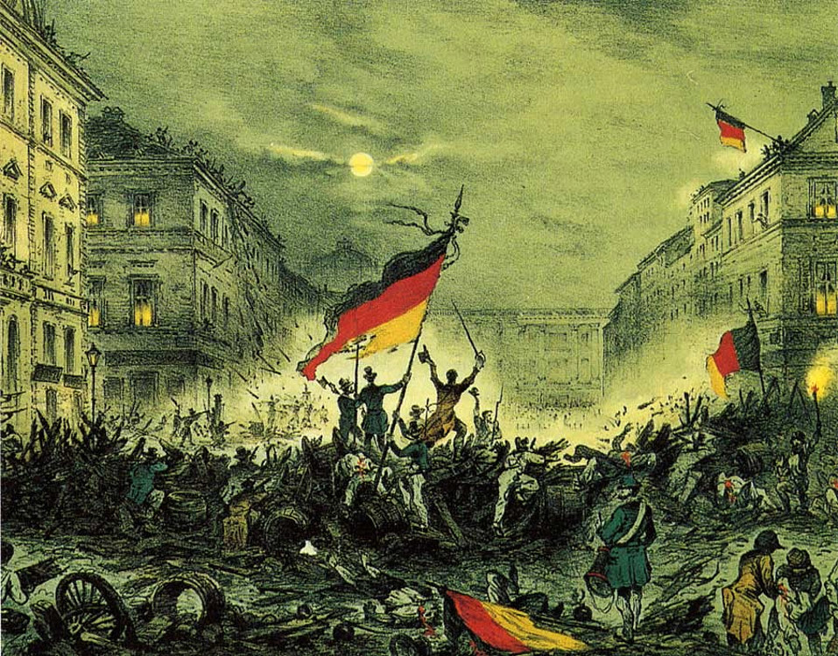
Berliners celebrate on the barricades on Breitestrasse March 18, 1848 after FW IV ordered the troops to cease fire
Notes:
In this contemporary colored lithograph, the revolutionaries of Berlin celebrate on the barricades on the Breite Strasse on the evening of March 18, 1848. King Frederick William IV, in the royal palace glimpsed in the background, had just ordered his troops to cease fire, and they evacuated the city on March 19 (much to the dismay of the king’s brother William and the Prussian generals).
SOURCE: http://www.arikah.net/enzyklopadie/Revolution_von_1848

Slide 37
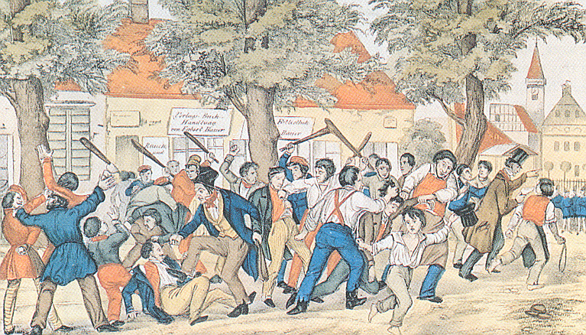
Police Breaking Up a Demonstration, Berlin, 1848

Slide 38
Funeral for Berlin Freedom Fighters, Freidrichshain

Slide 39
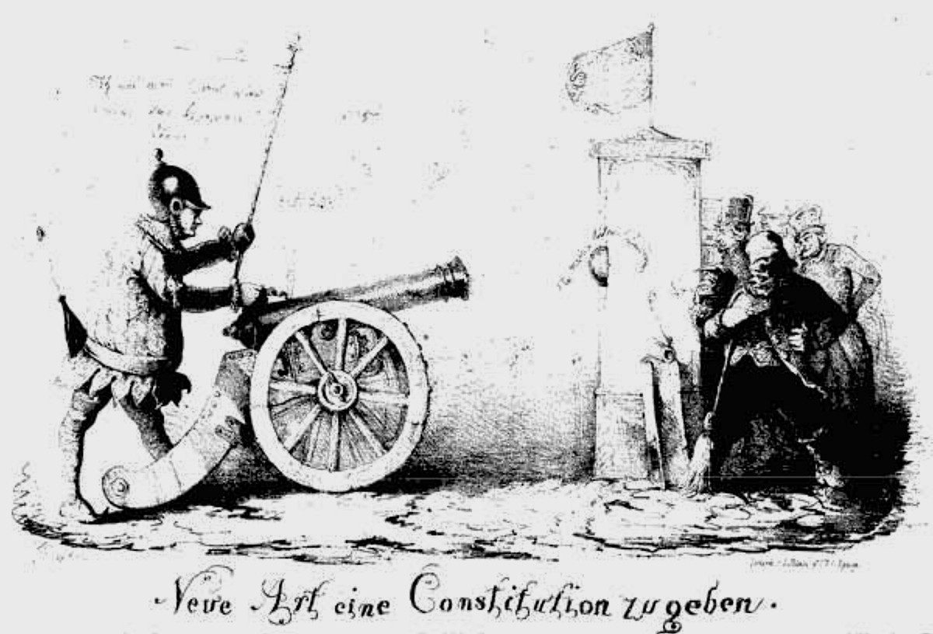
“A New Method for Granting a Constitution” (Berlin, December 1848)
Notes:
“Neue Art eine Constitution zu geben,” from www.preussen-chronik.de

Slide 40
Frankfurt Parliament (1848-49)
From Hambach on, “Germany” careened from crisis to crisis
Schleswig and Holstein problems
Poor harvests
Cholera Epidemic
Pains of industrialization and urbanization
Growth of Veriene
Bloody Revolts in Europe
In the meantime, The Bundestag was made up of representatives of the individual princes and was the only institution representing the German Confederation.

Slide 42
Demands of Frankfurt Parliament (1848-49)
Demands:
basic civil rights, regardless of property
liberal governments
creation of a German nation-state, with a pan-German constitution and a popular assembly.

Slide 43
Frankfurt Parliament (1848-49)
To meet these demands, a Vorparlament met in Paulskirche (St Paul's Church) in Frankfurt from 31 March to 3 April
585 members were elected
Each electoral district had their own voting rules and qualifications
About 85% of men could have voted
95% of deputies had the abitur
80% had been to university
50% studied law
4 were of the Gottingen 7
The “Professors' Parliament”
Famous Liberal Heinrich von Gagern was elected president of the parliament.
The Parliament faced many challenges…

Slide 44
Challenges of the Frankfurt Parliament: Law and Order
Wrote the Imperial Constitution
Basic rights: Freedom of Movement, Free Press, Free Trade, Equal Treatment for all Germans, the abolition of class-based privileges and medieval burdens, Freedom of Religion, Freedom of Conscience, the abolishment of capital punishment, Freedom of Research and Education, Freedom of Assembly…
FW IV was elected as hereditary head (he later declined)
Passed 267 against 263 votes on 28 March 1849

Slide 46
Challenges of the Frankfurt Parliament: Factionalism
Three main camps emerged:
democratic left
liberal center—the so-called Halben ("Halves")
conservative right

Slide 47
Challenges of the Frankfurt Parliament: Political Legitimacy
A Loose Confederation
Since FW IV refused to accept a crown touched by "the hussy smell of revolution“, European powers, including France and Russia, declined to recognize the Parliament.

Slide 48
"There is no power on earth that can succeed in making me transform the natural relationship between prince and people...into a constitutional relationship, and I never will permit a written sheet of paper to come between our God in heaven and this land...to rule us with its paragraphs and supplant the old, sacred loyalty." -Frederick William IV
Caricature of Frederick William IV's rejection of the imperial crown

Slide 49
Challenges of the Frankfurt Parliament: Schleswig-Holstein Question
The Schelswig-Holstein Question: Danish or German?

Slide 50
Challenges of the Frankfurt Parliament: Relations with Austria
Relations with Austria
Deputy Robert Blum arrested and executed by Austria for joining anti-monarchial revolution in Vienna. Claimed diplomatic immunity to no avail.
Kleindeutsche Lösung ("Smaller German Solution") - Germany under the leadership of Prussia and excluding imperial Austria
Großdeutsche Lösung ("Greater German Solution") supporting Austria's incorporation
October 1848, the National Assembly voted for a Greater Germany, but incorporating only "Austria's German lands"(excluding Poland and Hungary)
Austrian emperor Ferdinand I refused break up his Empire
5 April 1849, all Austrian deputies left Frankfurt.

Slide 51
Johann Gustav Droysen: Speech to the Frankfurt Assembly, 1848
“We cannot conceal the fact that the whole German question is a simple alternative between Prussia and Austria. In these states German life has its positive and negative poles--in the former, all the interests which are national and reformative, in the latter, all that are dynastic and destructive. The German question is not a constitutional question, but a question of power; and the Prussian monarchy is now wholly German, while that of Austria cannot be...We need a powerful ruling house. Austria's power meant lack of power for us, whereas Prussia desired German unity in order to supply the deficiencies of her own power. Already Prussia is Germany in embryo. She will ‚merge‘ with Germany...“

Slide 52
Austrian Prime Minister, Prince Schwarzenberg
“The formation of a unified state seems to the cabinet to be impracticable for Austria, and undesirable for Germany...We will say it once more--Austria and Germany will not have their development furthered in any way by these proposals but rather weakened and discredited, and both will be hurt deep down in their political being, perhaps incurably.”

Slide 53
Legacy of the Frankfurt Parliament:
Increase of Prussia's political importance
Frustration with Austria
Democracy, Liberalism, and Nationalism lost…for a while.
Nationalism re-emerged, but without Democracy or Liberalism

Slide 54
Frederick William's Revenge
Aristocrats including Bismarck regained power in Berlin.
General von Wrangel’s troops recaptured Berlin
FW IV dissolved the new Prussian parliament and put forth a constitution which maintained the ultimate authority of the king.
There was an assembly, but it had a three-tier voting system ("Dreiklassenwahlrecht"):
representation was proportional to taxes paid, thus 80% of the electorate controlled 1/3 of the seats.

Slide 55
Conclusions from the German Moment
The achievements of the revolutionaries of March 1848 were reversed in all of the German states by 1851
Many disgruntled German democrats moved to the U.S. (‘48ers)
Democracy did not come until 1919. And then…

Slide 56
Legacy of 1848
“We have been beaten and humiliated... scattered, imprisoned, disarmed, and gagged. The fate of European democracy has slipped from our hands.”
— Pierre-Joseph Proudho, French revolutionary, Anarchist, and member of French Parliament in 1848

Slide 57
Legacy of 1848
Austria and Prussia adopted written constitutions, but with limited suffrage and strong powers reserved to the monarch.
In the “Second Empire” (1851-1870), Napoleon III combined authoritarian rule with the quest to promote industrialization and Empire.
For nationalists, 1848 was the springtime of hope. Movements for national self-determination spread among Czechs, Poles, Magyars, Croats, and Italians.
Marxists denounced 1848 as a betrayal of working-class ideals by a bourgeoisie indifferent to the legitimate demands of the proletariat.
In short term, little changed….but everything changed.
Long-term legacy…

Slide 58
Why did the 1848 Revolutions Fail?
The middle classes led these revolutions, but as the revolutions turned radical and bloody, the middle class retracted their support.
Nationalism divided more than united
False promises often work. Monarchs are adept in this arena.
Monarchs had military power

Slide 59
France, Prussia, & Austria sweep the revolutionaries out of Europe, 1849
Notes:
A cheerful Frederick William works with Louis Napoleon and Franz Joseph to sweep the revolutionaries out of Europe in this cartoon published by F. Schroeder in the Duesseldorf Monthly in 1849.
SOURCE: Deutscher Bundestag, ed., Fragen an die deutsche Geschichte. Katalog: Historische Ausstellung im Reichstagsgebaeude in Berlin 7th edn (Bonn, 1981), p. 176.

