Slide 1
The Clinton Years 1993-2001
Mr. Daniel Lazar

Slide 2
Clinton’s Rise to Power
Clinton meets JFK as a 16 year-old delegate of Boy’s Nation on June 6, 1963

Slide 3
Clinton’s Rise to Power
Georgetown (BA in Foreign Service), Oxford as Rhodes Scholar (PPE), Yale Law
AG of Arkansas at 30
Nation’s youngest governor at 32
Positioned himself as a “New Democrat” supporting a “Third Way”
1996 SOTU declared “the era of big government is over.”
Chaired the National Governors Association in late 1980s
Focused on improving education and reforming welfare
Chaired the Democratic Leadership Council

Slide 4
Clinton’s Rise to Power
Student Council President Bid
at Georgetown
Bill Clinton and Hillary Rodham at Yale Law School, January 1972

Slide 5
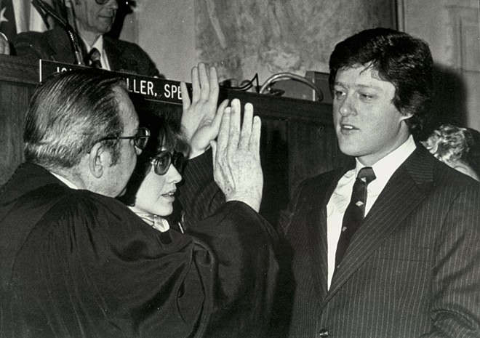
Taking the Oath of Office as the Governor of AK
January 9, 1979

Slide 6
1992 Presidential Election
Pushed for middle-class tax cuts and national health-care system
Hillary Rodham Clinton, “a 2 for 1 deal for America”
Clinton won 370 electoral votes to Bush’s 168, although Clinton won less than 50% of the popular vote.
Dems controlled both Houses until 1994 when Repubs took both Houses for first time in 40 years.
1992 Presidential Debate: Video Clip
Clinton 1992 Campaign Ad

Slide 7
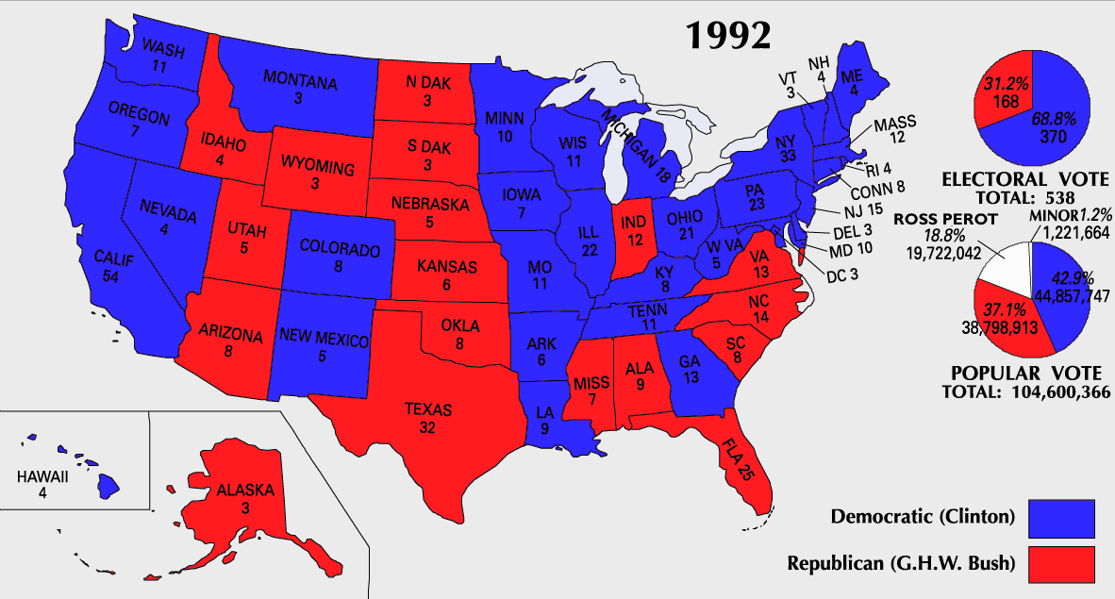

Slide 8
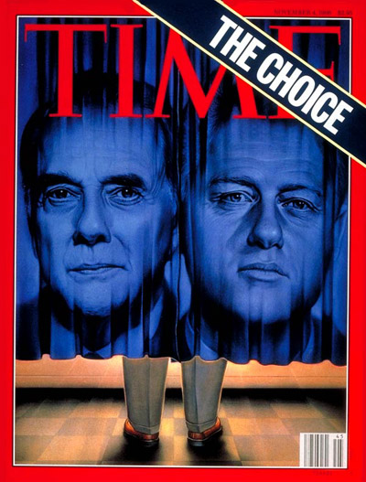
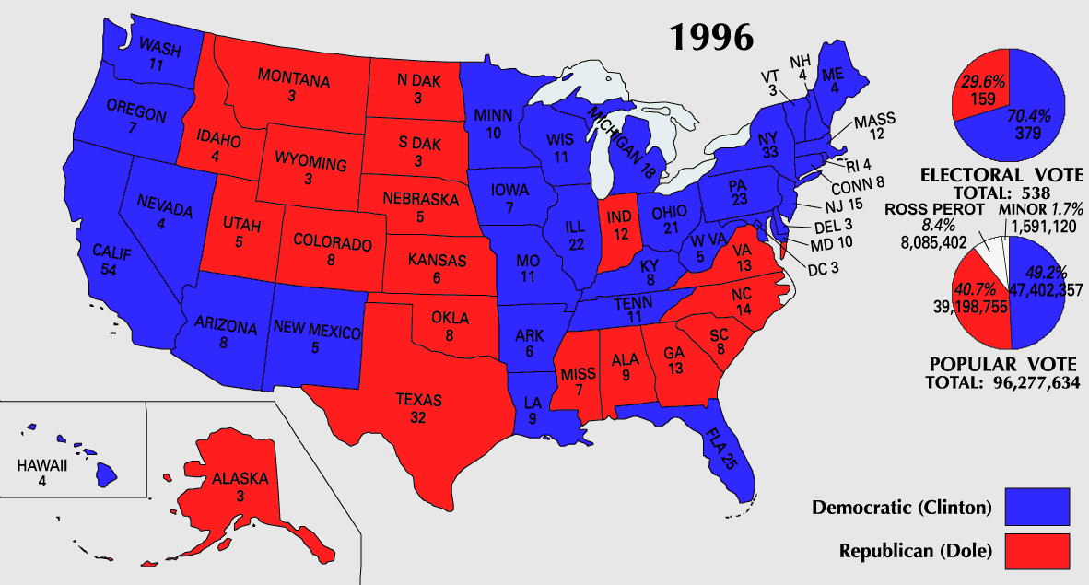
Re-election
In 1996 Clinton defeated Bob Dole of Kansas.
The only Democrat to win reelection to a 2nd term of office as president since FDR

Slide 9
Domestic Policy: The Economy
Focused on reducing the deficit rather than on cutting taxes for the middle class, which had been high on his campaign agenda
Omnibus Budget Reconciliation Act of 1993:
cut taxes for 15 million low-income families
cut taxes for 90% of small businesses
raised taxes on the wealthiest 1.2% of taxpayers
passed Congress without a Republican vote
Expanded the Earned Income Tax Credit, a subsidy for low-income workers.

Slide 10
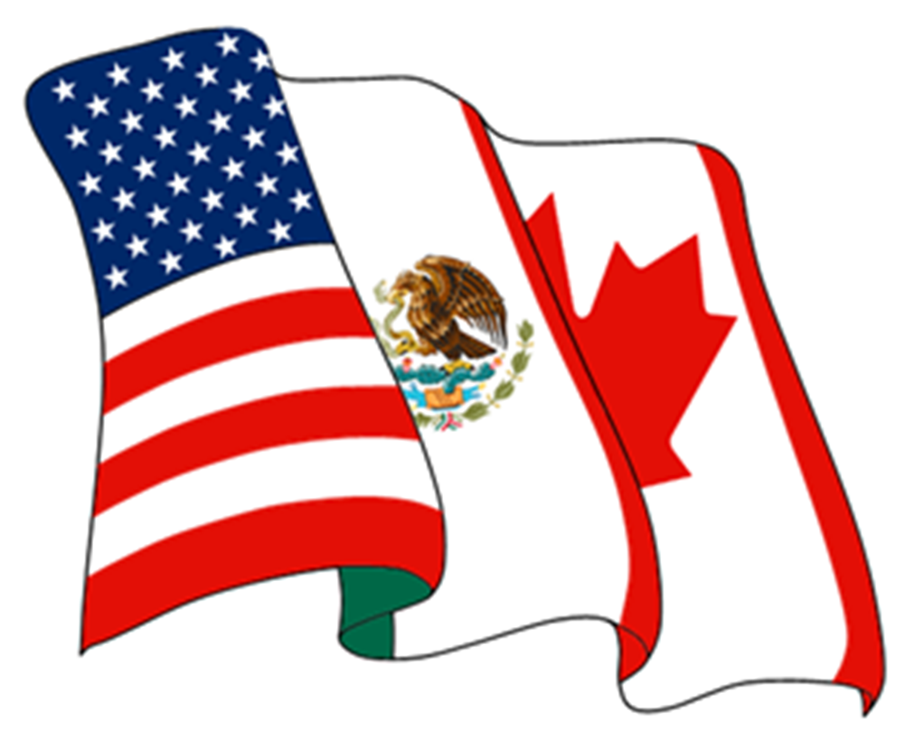
Domestic Policy: The Economy
NAFTA: eliminated nearly every trade barrier between the United States, Canada, and Mexico, creating the world’s largest free trade zone.

Slide 11
Domestic Policy: The Economy
At $248 billion for Canada and $163 billion for Mexico, they were the top two purchasers of US exports in 2010
At $276 billion for Canada and $230 billion for Mexico, they were the second and third largest suppliers of goods imports to the United States in 2010

Slide 12
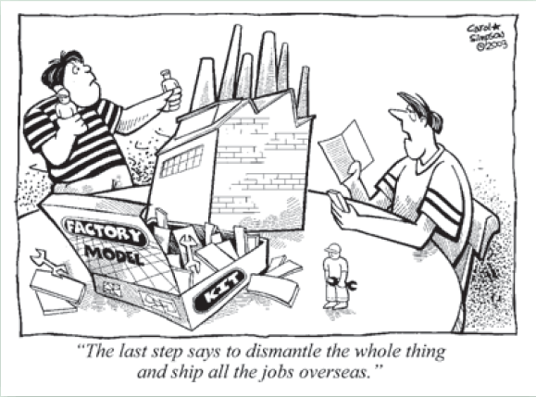
Domestic Policy: The Economy

Slide 13
Domestic Policy: The Economy

Slide 14
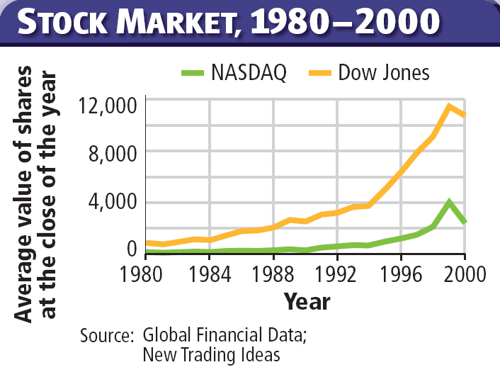
Domestic Policy: The Economy

Slide 15
Domestic Policy: Health Care
Hillary Clinton headed a special task force
Health care costs were rising
Tens of millions of Americans had little or no health insurance.
Died in 1994: well-organized opposition from conservatives, AMA, and the health insurance industry.

Slide 16
Domestic Policy: Internet
1994, launched whitehouse.gov
Encouraged federal agencies to communicate with each other and with the public via the Web
90% of schools wired to Web by 2000
People were concerned about inappropriate material on the Internet. White House campaigned to censor. Supreme Court upheld free speech.

Slide 17
Domestic Policy: Gay Rights
Clinton implemented a Department of Defense directive known as "Don't Ask, Don't Tell”
1996, Clinton signed Defense of Marriage Act (DOMA), which defines marriage as the legal union of one man and one woman
Clinton has said that DOMA was an attempt to "head off an attempt to send a constitutional amendment banning gay marriage to the states”
2013, urged the Supreme Court to overturn DOMA
Federal funding for HIV/AIDS research, prevention and treatment more than doubled.
Employment Non-Discrimination Act: Clinton pushed for hate crimes laws for gay Americans. Failed in Senate by 1 vote in 1996.

Slide 18
Other Domestic Issues
Signed Brady Bill into law 1993, imposed a five-day waiting period on handgun purchases
Violent Crime Control and Law Enforcement Act
100,000 more police
Expansion of the death penalty to cover more than 50 federal crimes.
Family and Medical Leave Act of 1993, required large employers to allow their employees to take unpaid leave because of pregnancy or serious medical conditions.

Slide 19
Other Domestic Issues
Appointed Ruth Bader Ginsburg & Stephen Breyer
Appointed Janet Reno, first female AG
Toni Morrison called Clinton "the first Black president" saying, "Clinton displays almost every trope of blackness: single-parent household, born poor, working-class, saxophone-playing, McDonald's-and-junk-food-loving boy from Arkansas."

Slide 20
Political Violence During Clinton Years
1993, truck bomb detonated below the North Tower of the World Trade Center in NYC
Attack planned by Ramzi Yousef, Mahmud Abouhalima, Mohammad Salameh, Nidal A. Ayyad, Abdul Rahman Yasin and Ahmed Ajaj. They received financing from Khaled Sheikh Mohammed
6 killed and 1,042 injured, mostly during the evacuation that followed the blast

Slide 21
Political Violence During Clinton Years
1995 - Alfred P. Murrah Federal Building in Oklahoma City
Killed 168, injured 680
Timothy McVeigh and Terry Nichols
Motivated by hatred of the federal government and angered by its handling of the 1993 Waco siege and the Ruby Ridge incident in 1992
McVeigh timed his attack to coincide with the second anniversary of the siege at Waco.
51-day standoff against a religious cult led by self-styled messiah David Koresh. The fires that destroyed the cult’s compound killed at least 75 people

Slide 22
Political Violence During Clinton Years

Slide 23
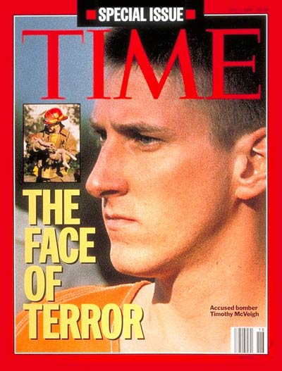

Slide 24
Political Violence During Clinton Years
1998 - US embassies bombed in two East African capitols
Nairobi, Kenya
Dar es Salaam, Tanzania
Intelligence linked the bombings to Osama bin Laden, a wealthy Saudi living in Afghanistan
Clinton ordered missile attacks on sites in Afghanistan and Sudan as retaliation and deterrent

Slide 25
Foreign Policy: Somalia

Slide 26
Foreign Policy: Somalia
1991, Somalian President Mohammed Siad Barre was overthrown.
Civil War
Power Vacuum
GHW sent aid. 90% of food stolen.
UN forces worked to end the fighting.
October 1993, Black Hawk Down
After a number of Americans died, Clinton withdrew the remaining soldiers.
Anarchy in Somalia ever since
Stopped U.S. from sending help to Rwanda…

Slide 27
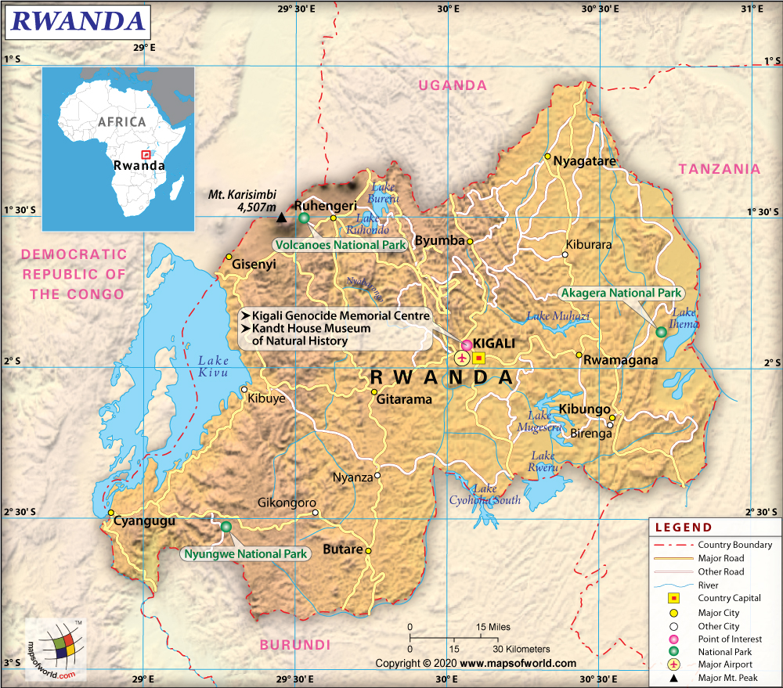
Foreign Policy: Rwanda

Slide 28
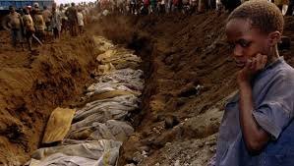
Foreign Policy: Rwanda
1994, genocide in Rwanda erupted due to a conflict between Hutu and Tutsi ethnic groups
1 mil Rwandans, mainly Tutsi, killed in 100 days
2 mil. Tutsis fled
When speaking about the Rwanda Crisis, Clinton called it his worst failure, admitting "I blew it."

Slide 29
Foreign Policy: Haiti

Slide 30
Foreign Policy: Haiti
1991 military coup, led by Lieutenant General Raoul Cédras ousted the country's elected president, Jean-Bertrand Aristide. Aristide escaped to the United States.
Clinton demanded return of Aristide.
1994 – Clinton, in opposition to Congress, sent U.S. Marines…just before they arrived, Clinton deployed Jimmy Carter-led delegation
Cédras surrendered government to Aristide, who was retuned to Haiti.
U.S. troops escorted Aristide into the capitol as part of Operation Uphold Democracy
Aristide ruthlessly mismanaged Haiti until ousted in a coup and exiled to South Africa in 2004.

Slide 31
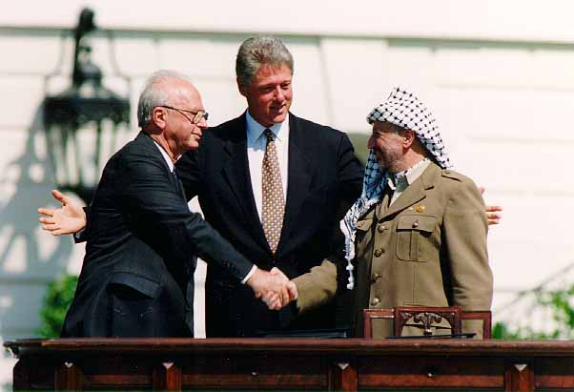
Foreign Policy: Middle East
1978: Camp David
1987: First Intifada
1993: Oslo Accords
1995: Second Intifada
2000: Camp David
All failed (?)

Slide 32
Foreign Policy: Middle East
1994, Iraq again began mobilizing troops near Kuwaiti border in response to economic sanctions imposed by UNSC.
Operation Vigilant Warrior: U.S. deployed troops in the Persian Gulf
1996, Operation Desert Strike, in response to Hussein’s Iraqi offensive campaign in Iraqi Kurdistan
1998 SOTU, Clinton warned Congress of Hussein's possible pursuit of nuclear weapons

Slide 33
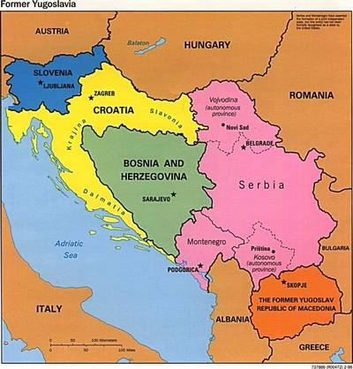
Foreign Policy: Former Yugoslavia

Slide 34
Foreign Policy: Former Yugoslavia
1992, Yugoslavia dissolved
Bosnian Serbs want to remain part of Yugo Coalition, Bosnian Croats and Muslims do not.
Bosnian Serbs and Muslims better equipped
Clinton negotiated with Western Europeans to stand against Bosnian Serbs
1994 - NATO launched Operation Deliberate Force: airstrikes against Bosnian Serb targets
1995 - Clinton hosted peace talks between the warring parties in Dayton, Ohio. Dayton Agreement left Bosnia as a single state made up of two separate entities with a central government.
1998 – Serbs attack Kosovars and Albanians. “Ethnic Cleansing”
1999 – 2 month US/NATO air operations. No UN support.

Slide 35
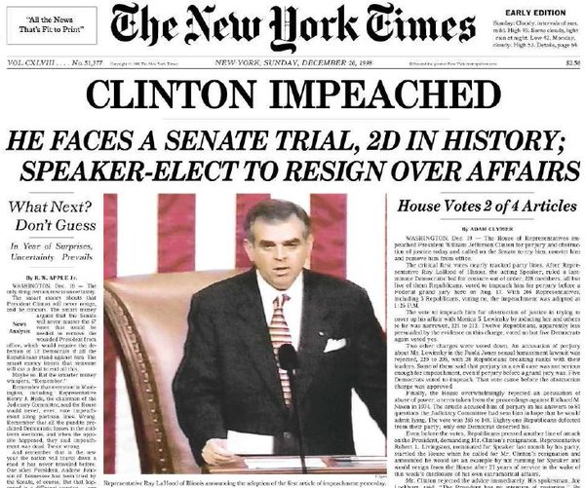
Scandal Plagues the Presidency

Slide 36
Scandal Plagues the Presidency
Whitewater real estate deal
Kenneth Starr led an investigation into a failed real estate investment the Clintons were involved in during the 1970s.
Paula Jones sexual harassment case
Jones sued Clinton for sexual harassment while he was governor of Arkansas when she was a state employee.
Information emerged suggesting that Clinton had an improper relationship with a White House intern, Monica Lewinsky.
Monica Lewinsky case
Clinton accused of lying under oath about Monica Lewinsky.
House approved two articles of impeachment but the Senate did not have the two-thirds majority necessary to convict Clinton.

Slide 37
Impeaching President Bill Clinton December 19, 1998
First article (perjury / grand jury) | Party |  |  | Total votes
 | Democratic | Republican | Independent
Yea | 5 | 223 | 0 | 228
Nay | 200 | 5 | 1 | 206
Second article (perjury / Jones case) | Party |  |  | Total votes
 | Democratic | Republican | Independent
Yea | 5 | 200 | 0 | 205
Nay | 200 | 28 | 1 | 229
Third article (obstruction of justice) | Party |  |  | Total votes
 | Democratic | Republican | Independent
Yea | 5 | 216 | 0 | 221
Nay | 199 | 12 | 1 | 212
Fourth article (abuse of power) | Party |  |  | Total votes
 | Democratic | Republican | Independent
Yea | 1 | 147 | 0 | 148
Nay | 203 | 81 | 1 | 285

Slide 38
Articles of Impeachment, U.S. Senate judgement (67 "guilty" votes necessary for a conviction)
Article One (perjury / grand jury) | Party |  | Total votes
 | Democratic | Republican
Guilty | 0 | 45 | 45
Not guilty | 45 | 10 | 55
Article Two (obstruction of justice) | Party |  | Total votes
 | Democratic | Republican
Guilty | 0 | 50 | 50
Not guilty | 45 | 5 | 50

Slide 39
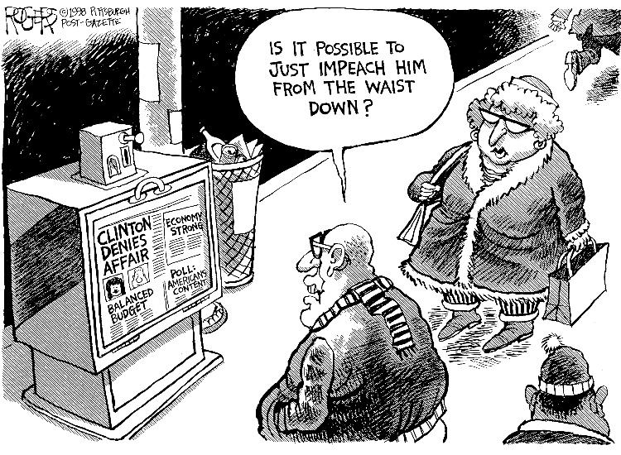
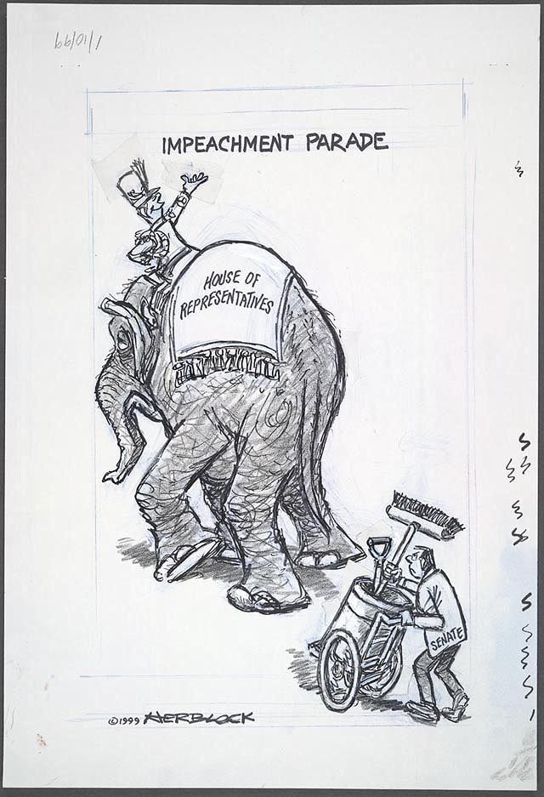
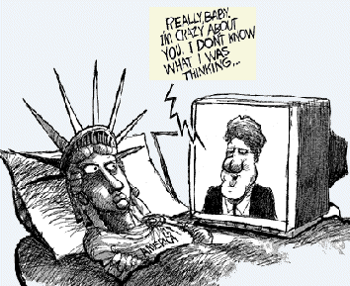

Slide 40
Scandal Plagues the Presidency?
Completed term with a 68% approval rating, similar to Reagan and FDR

Slide 42
Character
Clinton was deeply religious from a young age and regularly attended a Baptist church as an adult. Clinton's private marital issues were unrelated to his ability to govern the US. Even after the news of his affair with White House intern Monica Lewinsky broke in early 1998, his approval rating was 63 percent according to a Washington Post poll. | Constant scandals took Clinton's focus off running the country. When Paula Jones sued Clinton for sexual harassment, he became the first sitting president to testify before a grand jury investigating his own conduct. An affair with White House intern Monica Lewinsky culminated in Clinton's impeachment by the House of Representatives on Dec. 19, 1998 on charges of perjury and obstruction of justice. Some blame Clinton's moral shortcomings for disenfranchising Democratic Party members and Independents, and causing Al Gore to lose the 2000 presidential election.

Slide 43
The Economy
US went from having the largest budget deficit in American history ($290 billion) in 1992 to having a budget surplus of $127 billion when he left office in 2001. 22.5 million new jobs created Unemployment dropped from 7.5% when Clinton took office to 4.0% by the end of his second term, the lowest in 30 years. Poverty rate dropped to 11.8% in 1999, the lowest since 1979 | Clinton gets too much credit for the good economy of the 1990s, which was already growing when he took office. The Republican-controlled Congress helped improve the economy by exercising fiscal restraint. Clinton's failure to regulate the financial-services markets enabled the bad lending and Wall Street scams that led to the 2007 banking crisis

Slide 44
Taxes
The $290 billion national deficit of 1992 became a $124 billion surplus by 1999 because Clinton's Omnibus Budget Reconciliation Act of 1993 raised taxes on the top income rate from 28 percent to 39.6 percent, | The Omnibus Budget Reconciliation Act of 1993 increased the gasoline tax by 4.3 cents per gallon, which directly impacted the middle class. The 1993 tax hikes cannot be credited with the economic boom of the 1990s: it was after the Republican Congress passed tax cuts in 1997 that the economy really became stronger and the budget was balanced. Clinton designed his tax plans to place an unfair burden on the wealthy

Slide 45
Welfare Reform
In 1996, Clinton fulfilled his campaign promise to reform welfare by creating new rules that required recipients to work within two years of getting benefits and limited the time most people could spend on welfare to five years. 10 years after he signed the Personal Responsibility and Work Opportunity Reconciliation Act, welfare rolls had dropped from 12.2 million to 4.5 million. | Clinton neglected to take to steps to restructure Social Security and Medicare.

Slide 46
Education
Clinton's Goals 2000 program distributed two billion dollars between 1994 and 1999 to set uniform standards in US schools. His 1994 Improving America's School Act (IASA) received support from Republicans and Democrats and from the education and business communities. IASA required that standards and accountability be the same for economically disadvantaged students as for other students | Clinton's Goals 2000 program did not ensure uniform quality of standards among all the states because he compromised on oversight to get the program passed. The impact therefore varied by state and Clinton never fulfilled his goal of equalizing education standards and improving results for all students. By 2000, six years after IASA was implemented, only 17 states were in full compliance with the standards

Slide 47
Environment
Preserved 4.6 million acres of land in national monuments Safe Drinking Water Act Enacting tougher emissions and energy efficiency standards. The Environmental Protection Agency and Justice Department prosecuted 241 environmental-related crimes in 1999, more than twice as many as in 1992, the year before Clinton took office. | Clinton passed NAFTA despite the fact that it traded lower environmental standards for increased free trade.

Slide 48
Health
Funding for AIDS-related programs increased 150 percent during his presidency | Health care reform was Clinton's major goal when he took office…Republican opposition was insurmountable…the biggest failure of his administration. He expended a lot of political capital without getting anything in return.

Slide 49
Foreign Policy
Peace process in Northern Ireland, which culminated in the 1998 Good Friday Agreement. Helped to get former Soviet nations to give up their nuclear arsenals and improve their control of nuclear materials. Worked with NATO to bomb Serbia to end Slobodan Milosevic's ethnic cleansing campaign. | Rwanda Gave China Most Favored Nation (MFN) status despite their terrible human rights record. Israel-Palestine

Slide 50
Clinton Era SAQs
Describe one central domestic policy goal of the Clinton adminsitration.
Describe one central foreign policy goal of the Clinton adminsitration.
Explain one example of Republican opposition to the goals of the Clinton administration described in (a) or (b) above.

Slide 51
Clinton Era SAQ
During the 1990‘s the Clinton administration pursued a policy of global economic integration.
Describe the point of view of the cartoonist.
Explain one argument in favor of the point of view of the cartoonist.
Explain one argument against the point of view of the cartoonist.

