Slide 1
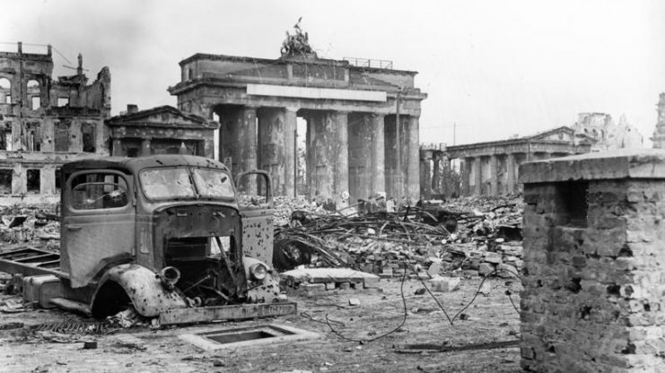
Causes of WWII in Europe
Mr. Daniel Lazar

Slide 2
Lecture Outline
My lecture offers a narrative. Consider how you would rank order the causes of WWII:
From least to most important
From least to most preventable or rectifiable
From least to most visible at the time
MAIN Causes of WWI Redux
Limits of International Cooperation
American Insularity
Two Decades of Disorder
Lies and Propaganda
Hitler, His Henchmen, Nazis, und das deutsche Volk

Slide 3
MAIN Causes of World War I Redux
Militarism
Alliances
Imperialism
Nationalism
…and Germany
Interwoven Causes:
M + N = I
M + I = A
N + I = M

Slide 4
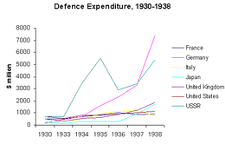
Militarism

Slide 5
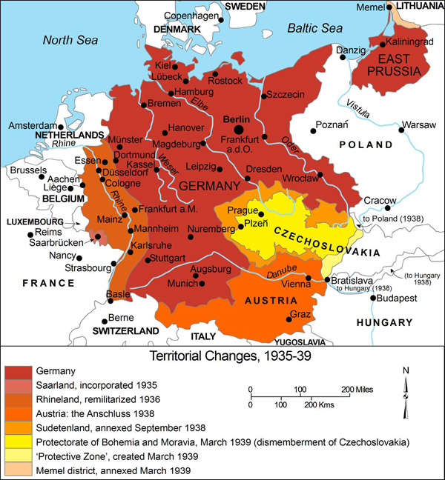
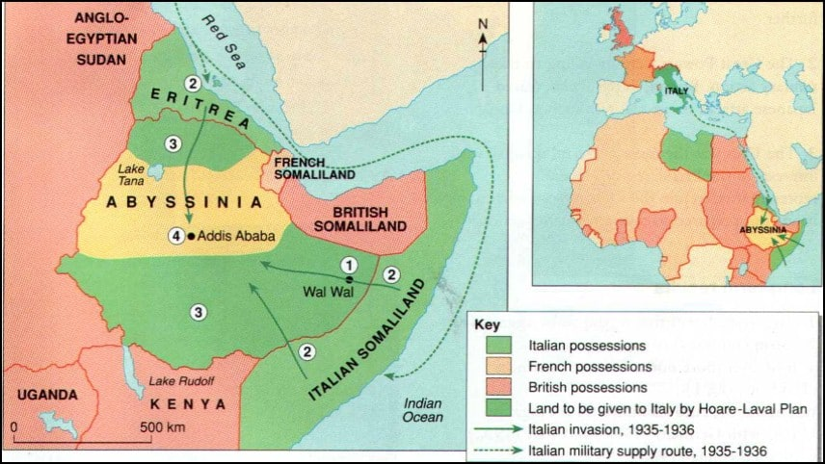
Militarism

Slide 6
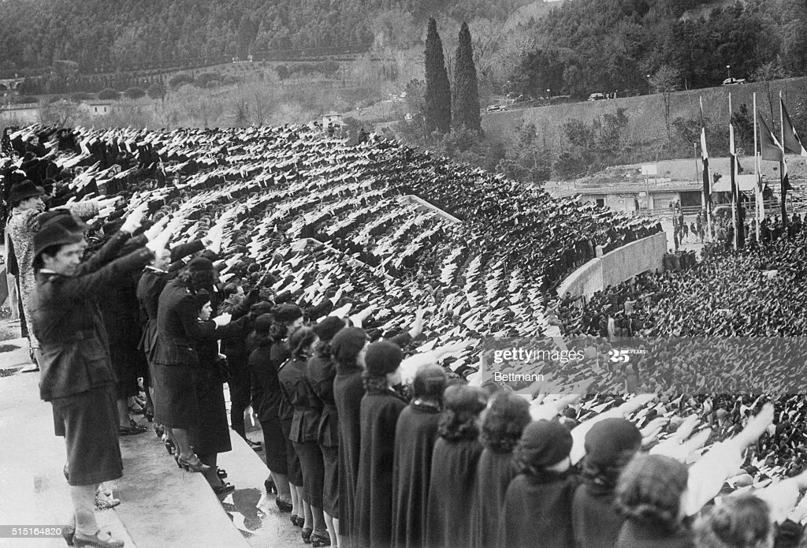
Nationalism → Fascism

Slide 7
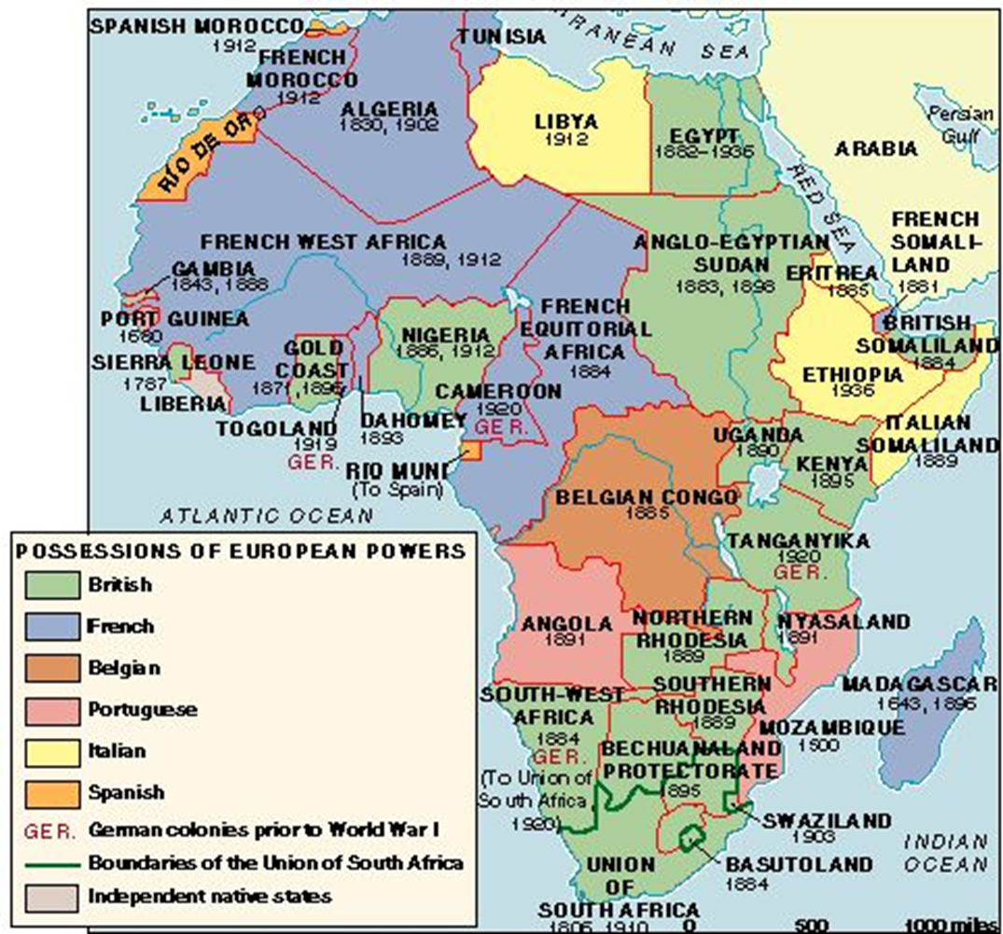
Imperialism

Slide 8
Alliances

Slide 9
Limits of International Cooperation
League of Nations, 1919: global security and free trade
Locarno Pact, 1925: normalized relations with Germany, promised European peace
Kellogg-Briand Pact, 1928: condemned “war for the solution of international controversies and renounce it as an instrument of national policy”
Japanese invade Manchuria, 1931: League condemned, but did little; Japan exited League anyway
Italy invades Ethiopia, 1935: League of Nations condemned and issued sanctions (but not on oil!). UK didn’t support mil action, so League hamstrung

Slide 10
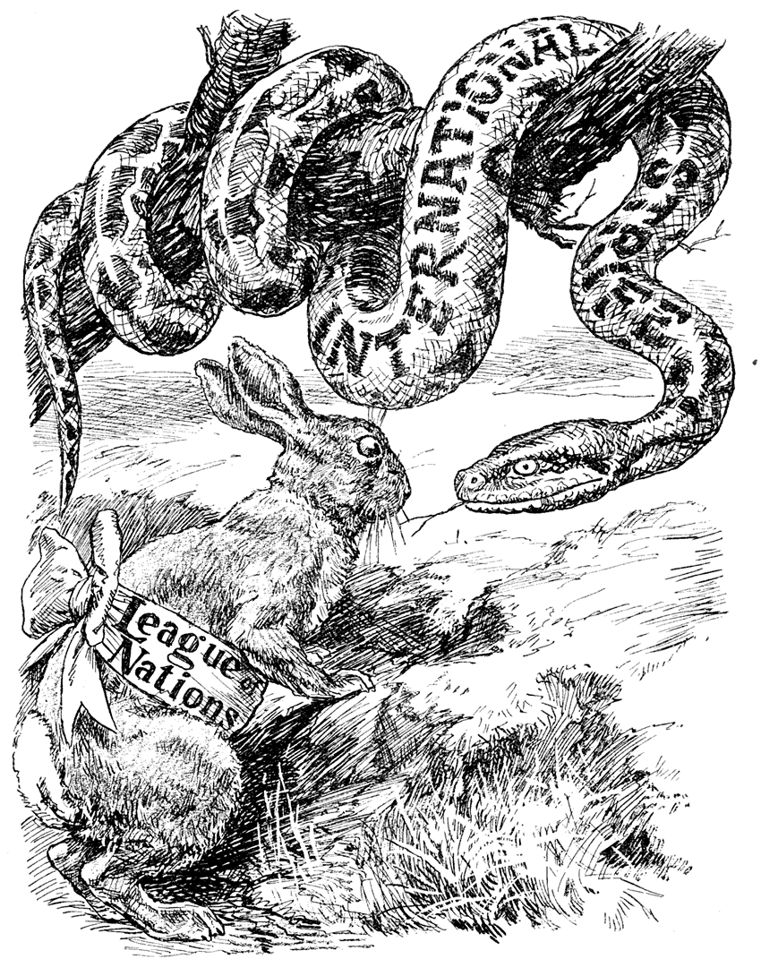

Slide 11
Annexation of Sudetenland
“I am asking neither that Germany be allowed to oppress three and a half million Frenchmen, nor am I asking that three and a half million Englishmen be placed at our mercy. Rather I am simply demanding that the oppression of three and a half million Germans in Czechoslovakia cease and that the inalienable right to self-determination take its place.”
— Hitler's speech at the NSDAP Congress 1938

Slide 12
Limits of International Cooperation
Anschluss, 1938: Germany annexed Austria
Munich Conference, 1938 arranged by PM Chamberlain
Britain, France, Italy, Germany
Czechoslovakia and Russia not invited
Appeasing Germany, Chamberlain returned a hero
“We have secured peace in our time.”
“How horrible, fantastic, incredible it is that we should be digging trenches and trying on gas-masks here because of a quarrel in a far-away country between people of whom we know nothing!”

Slide 13
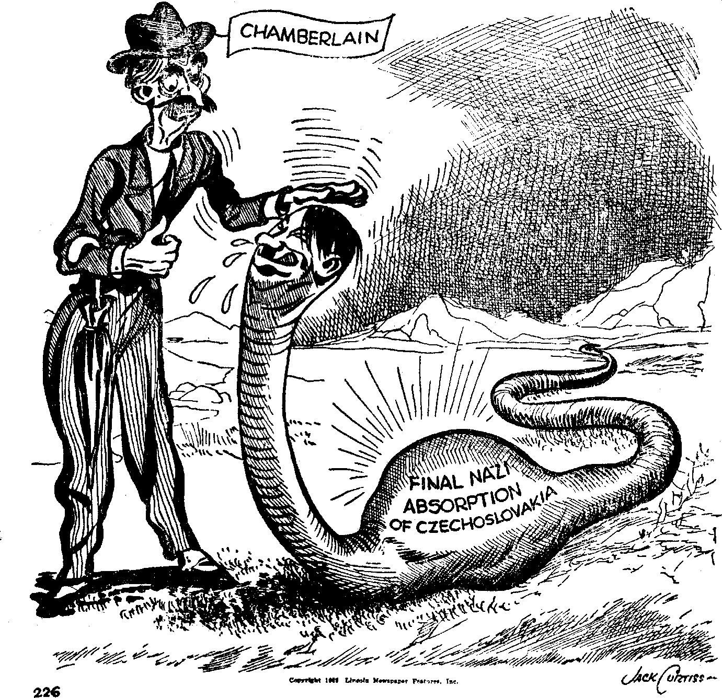
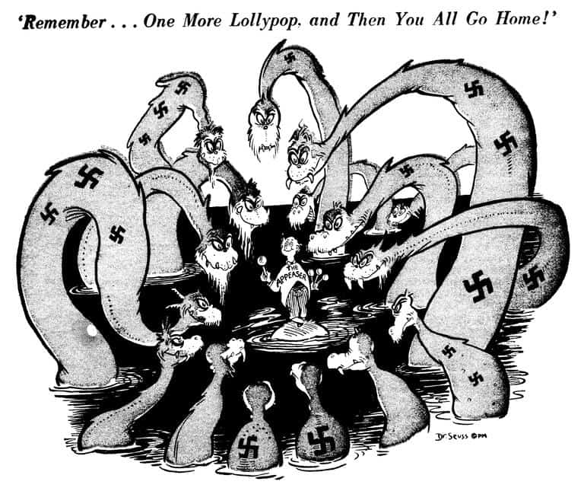
Limits of International Cooperation

Slide 14
Limits of International Cooperation: Nazi-Soviet Pact, 23 August 1939
Article I. Both High Contracting Parties obligate themselves to desist from any act of violence, any aggressive action, and any attack on each other.
Article II. Should one of the High Contracting Parties become the object of belligerent action by a third Power, the other High Contracting Party shall in no manner lend its support to this third Power.
Secret Additional Protocol:
Article I. In the event of a territorial and political rearrangement in the areas belonging to the Baltic States (Finland, Estonia, Latvia, Lithuania), the northern boundary of Lithuania shall represent the boundary of the spheres of influence of Germany and U.S.S.R.
Article II. In the event of a territorial and political rearrangement of the areas belonging to the Polish state, the spheres of influence of Germany and the U.S.S.R. shall be bounded approximately by the line of the rivers Narev, Vistula and San.
Article III. With regard to Southeastern Europe attention is called by the Soviet aside to its interest in Bessarabia. The German side declares its complete political disinterestedness in these areas.
Article IV. This protocol shall be treated by both parties as strictly secret.

Slide 15
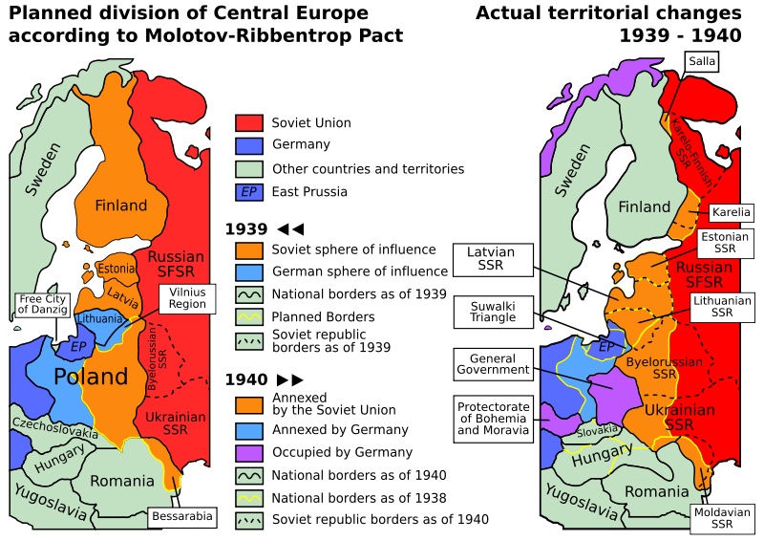
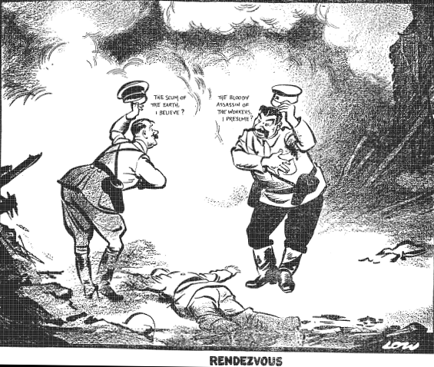
Limits of International Cooperation: Nazi-Soviet Pact, 23 August 1939
“Rendezvous”, by David Low, The Evening
Standard, 20 September 1939

Slide 16
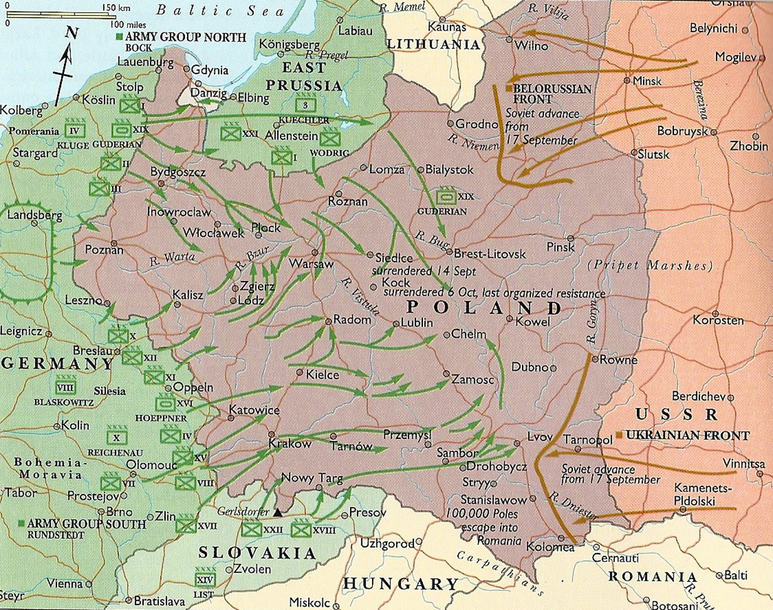
Limits of International Cooperation: Poland
Spring 1939, Hitler demanded Polish port city of Danzig (Gdansk)
Germany invaded Poland, Sep 1, 1939; beginning of WWII in Europe
Sep 3, Britain & France declare war on Germany

Slide 17
American Insularity
1934 - Nye Committee - investigated armament sales and manufacture during WWI, revealing huge profits made by American financiers and munitions manufacturers.
1934 - Johnson Debt Default Act - Banned loans to foreign governments in default to the US on their WWI debts (Finland was the only nation not in default).
1935 - Ludlow Amendment - high point of isolationist sentiment. If passed, the US Congress could not have declared war without a nationwide public referendum, unless the US or one of its possessions were directly attacked. Defeated 202-200.
1937 - Quarantine Speech - "When an epidemic of physical disease starts to spread, the community approves and joins in a quarantine of the patients in order to protect the health of the community against the spread of the disease.“ FDR moved ahead of public opinion.
1937 – Cash & Carry

Slide 18
American Insularity
September 1939 responding to invasion of Poland
During "fireside chat," FDR pledged neutrality, limited travel to Europe
Began neutrality patrol around the Western Hemisphere
In 1940
Germany captured Norway, Denmark, Netherlands, Luxembourg, Belgium, France
Sept - Tripartite Pact - Germany, Italy and Japan
Dec - Lend-Lease Act, garden hose analogy; $50.6 billion by war’s end
Dec 1941 - Pearl Harbor attack

Slide 19
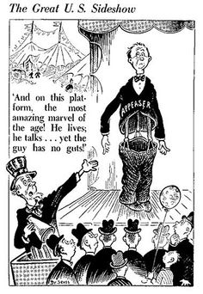
American Insularity

Slide 20
Decades of Disorder: Nations and Boundaries

Slide 21
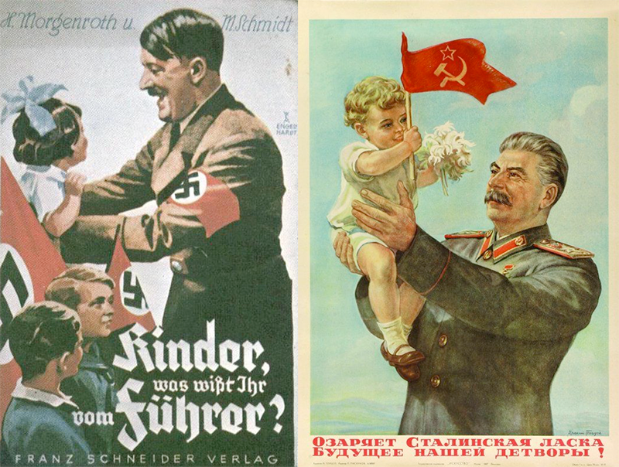
Decades of Disorder
Ideological tensions
Revolutions & Civil Wars: Russia, Germany, Italy, Hungary, Spain, Greece, Egypt...

Slide 22
Lies & Propaganda: Reparations Myths
 | German gold marks (billions) | Gold standard U.S. dollars (billions) | 2013 US$ (billions)
Inter-Allied Reparations Commission, 1921 | 269 | 64.0 | 834
Young Plan, 1929 | 112 | 26.6 | 360
Lausanne Conference, 1932 | 20 | 4.8 | 86

Slide 23
Lies & Propaganda: Reparations Myths

Slide 24
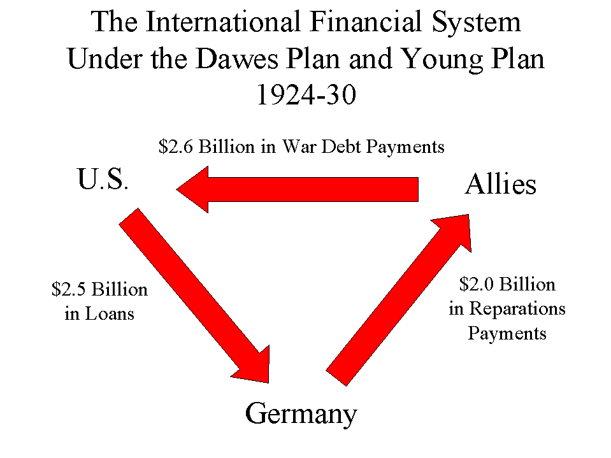
Lies & Propaganda: Reparations Myths

Slide 25
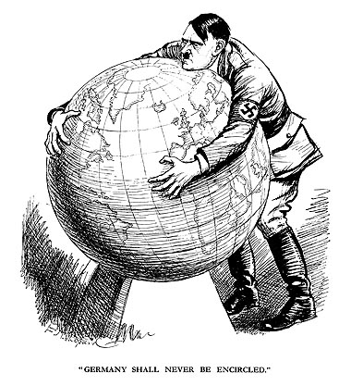
Lies & Propaganda
Stab in the Back Myth
Lebensraum; 1933 pop. 65 mil.
Enemies of the State
Jews
LGBTQ+
Roma
Slavs
Jehova’s Witnesses
The deaf, the blind, the physically challenged

Slide 26
Lies & Propaganda: State as Cultural Hegemon
Reich Ministry of
Propaganda and
Enlightenment
Reichskulturkammer
(Reich Chamber of Culture)
Theatre
Film
Press
Fine Arts
Music
Literature

Slide 27
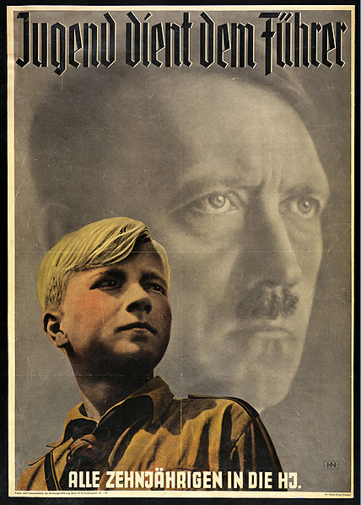
Lies & Propaganda: Youth
Education
Politically unreliable teachers fired
Nazified curriculum
Youth Organizations:
Deutsches Jungvolk& Hitler Jugend for Boys
Jungmädelbund & Bund Deutscher Mädel for Girls

Slide 28
Lies & Propaganda: Broadcasting
1932: 25% of German households owned a radio; 1939 70%
1933: Reich Radio Company
Volksempfängear (People’s Receiver)

Slide 29
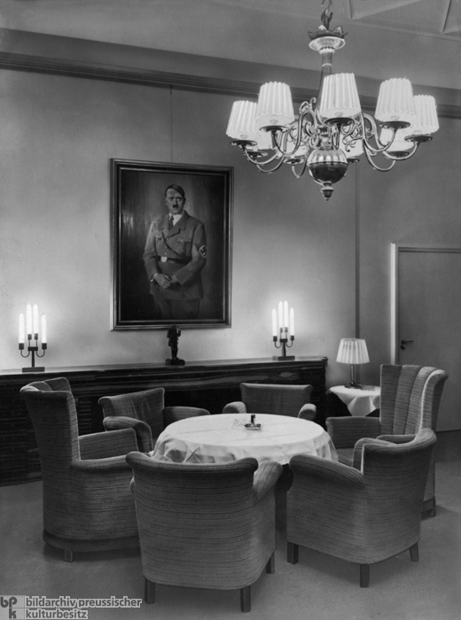
Lies & Propaganda: The Press
Germany had nearly 5,000 daily newspapers in 1933
“Editor’s Law” (1933) made editors personally responsible for content
Eher Verlag (Nazi publisher) owned 2/3 of the German press by 1939
State news agency, DNB
Lounge at the German press club in Berlin

Slide 30
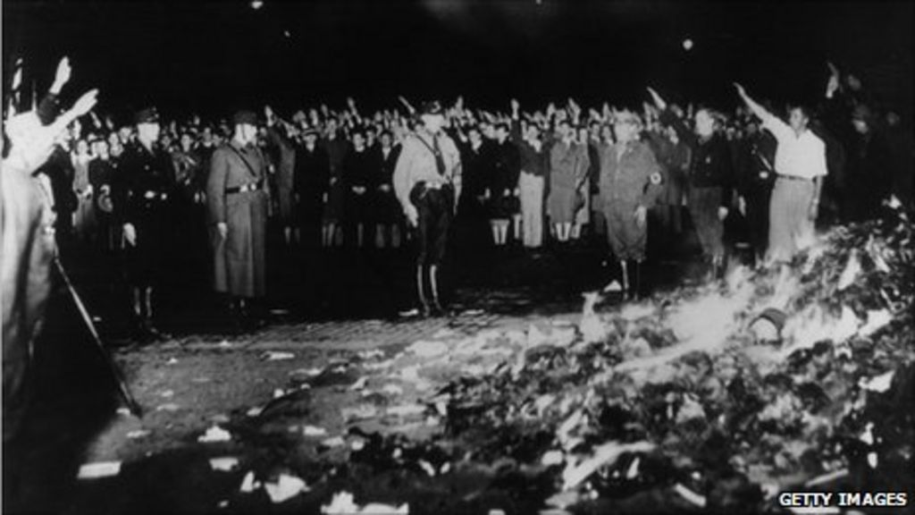
Lies & Propaganda: Book Burning & Degenerate Art

Slide 31
Hitler, His Henchmen, Nazis, und das deutsche Volk

Slide 32
Timeline: The Road to WWII
Oct. 1933 | Germany leaves League of Nations and Disarmament Conference
Jan. 1934 | Non-Aggression Pact with Poland
Jan. 1935 | Saar region votes to return to Germany
Mar. 1935 | Hitler announces reintroduction of conscription
Apr. 1935 | Stresa conference, Britain, France, and Italy protest German infringement of Versailles
June 1935 | Anglo-German Naval Agreement on an enlarged German Navy
Oct. 1935 | Italy invades Abyssinia
Jan. 1936 | Mussolini ends Italian guarantee of Austrian independence
Mar. 1936 | German troops reoccupy the demilitarised Rhineland
July 1936 | Germany sends military to help the nationalist rebels in Spain
Nov. 1936 | Rome-Berlin Axis announced
Nov. 1937 | Italy joins Anti-Comintern Pact

Slide 33
Timeline: The Road to WWII
Mar. 1938 | Invasion of Austria (Anschluss)
Sep. 1938 | Munich Conference
Oct. 1938 | Germany takes Sudetenland
Mar. 1939 | Germany occupies Czechoslovakia
Mar. 1939 | Germany occupies Memel
Mar. 1939 | Britain and France guarantee Poland
One woman’s reaction to the German entry into the Sudetenland, Sept. 1938.

