Slide 1
World War One
The War to End All Wars
Mr. Daniel Lazar

Slide 2
Lecture Outline
Causes of WWI
The War (in brief)
Casualty Analysis
Legacy of WWI
Versailles & League of Nations

Slide 3
MAIN Causes of World War I
Militarism
Alliances
Imperialism
Nationalism
…and Germany
Let’s take this route…
Imperialism
Nationalism
Militarism
Alliances

Slide 4
MAIN Causes of World War I
MAIN Defined
Interwoven Causes:
  M + N = I
  M + I = A
  N + I = M

Slide 5
The Age
Of
Imperialism

Slide 6
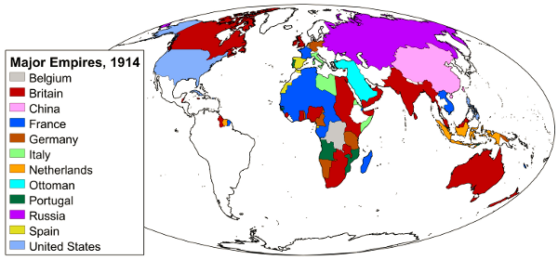

Slide 7
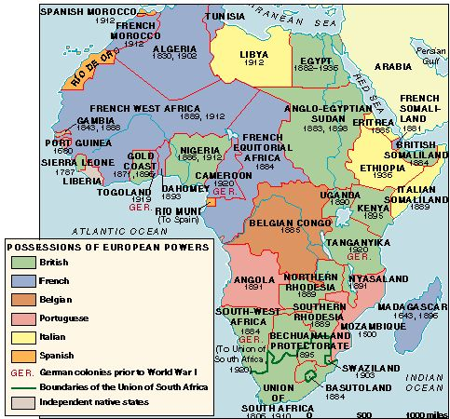

Slide 8
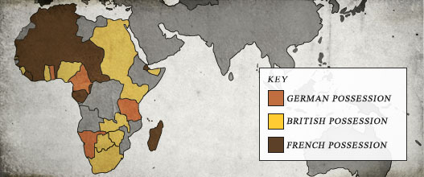

Slide 9
The Age
Of
Nationalism

Slide 10
The Age Of Nationalism
What is a nation?
  attitudes that the members of a nation
  actions that the members of a nation take in seeking to achieve (or sustain) some form of political sovereignty.
Nation vs. Nation-State (Country)

Slide 11
The Age Of Nationalism
When did nations first appear?
  Nationalists argue that nations are timeless and organic phenomena. When man climbed out of the primordial slime, he immediately set about creating nations.
  Perennialists argue that nations have been around for a very long time, though not necessarily forever
  Postmodernists (including Marxists) see nations as modern and synthetic
What nations deserve a state?

Slide 12
The Age Of Nationalism
From Genocide, World Order, and State Formation:
Nations together include all humans. There is no human who does not belong to a nation.
Nations are natural units of humanity. Nations and national identity are organic.
Nations exist, therefore they should.
  Nations have a substantial historical continuity and should be continued.
  Because nations have shaped the lives of those who now live in them, they should continue to exist.
  National cultures have value; therefore nations must exist to preserve them.
Nations are sacred and unique
Antiquity confers special national status (Egypt? Israel? China?)
Nations may not be ended, singly or collectively.

Slide 13
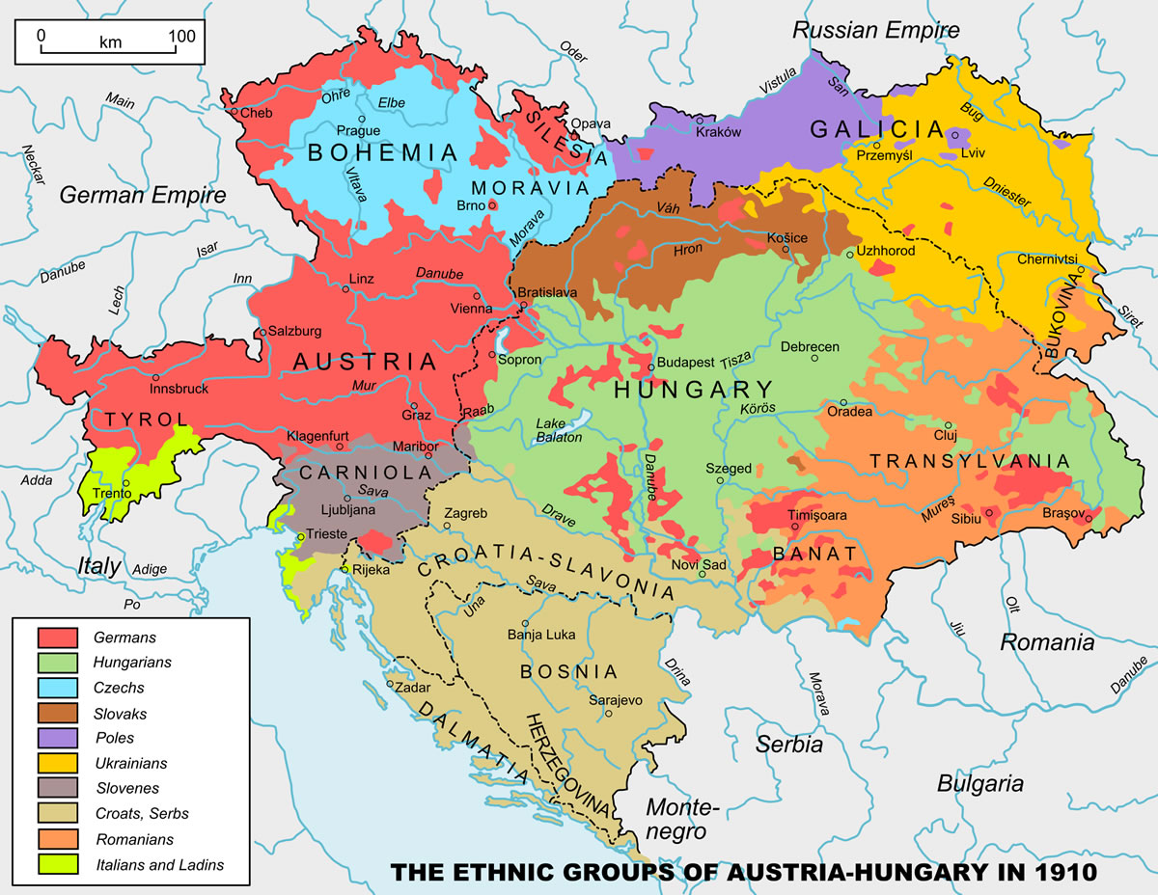

Slide 14
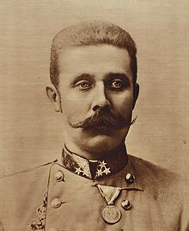
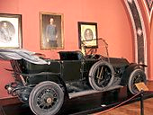
Nationalism: Assassination of Ferdinand
Archduke Francis Ferdinand of A-H visits Sarajevo, Bosnia-Herzegovina which A-H annexed in 1908
Sarajevo was a hotbed of pan-Serbian nationalism
June 28, 1914, 7 Black Hand assassins…
  Nationalists
  Terrorists?

Slide 15
I look upon the People and the Nation as handed on to me as an responsibility conferred upon me by God, and I believe, as it is written in the Bible, that it is my duty to increase this heritage for which one day I shall be called upon to give an account. Whoever tries to interfere with my task I shall crush.
-German Kaiser Wilhelm II, 1913

Slide 16
The Age
Of
Militarism
…Where might makes right

Slide 17
Comparative Figures of Army Increase
 | 1870 | 1914
Russia | 700,000 | 1,300,000
France | 380,000 | 846,000
Germany | 403,000 | 812,000
A-H | 247,000 | 424,000
UK | 302,000 | 381,000
Italy | 334,000 | 305,000
Japan | 70,000 | 250,000
U.S.A. | 37,000 | 98,000

Slide 18
“You cannot simultaneously prevent and prepare for war.” -Albert Einstein

Slide 19
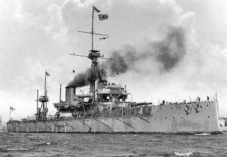
Arms Race
HMS DREADNOUGHT

Slide 20
Tangled Web:
The Alliance System

Slide 21
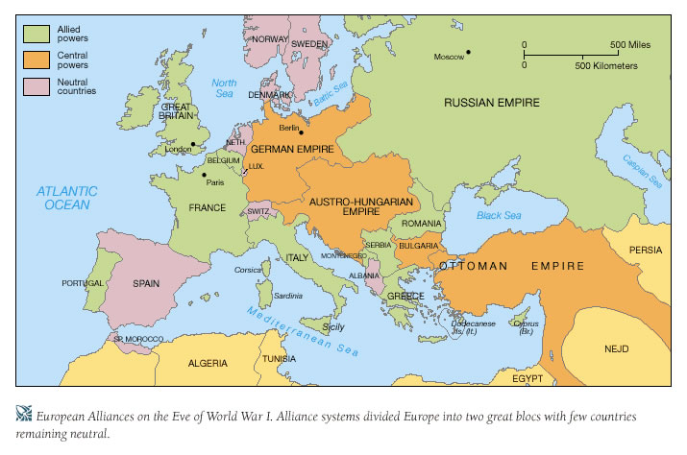

Slide 22
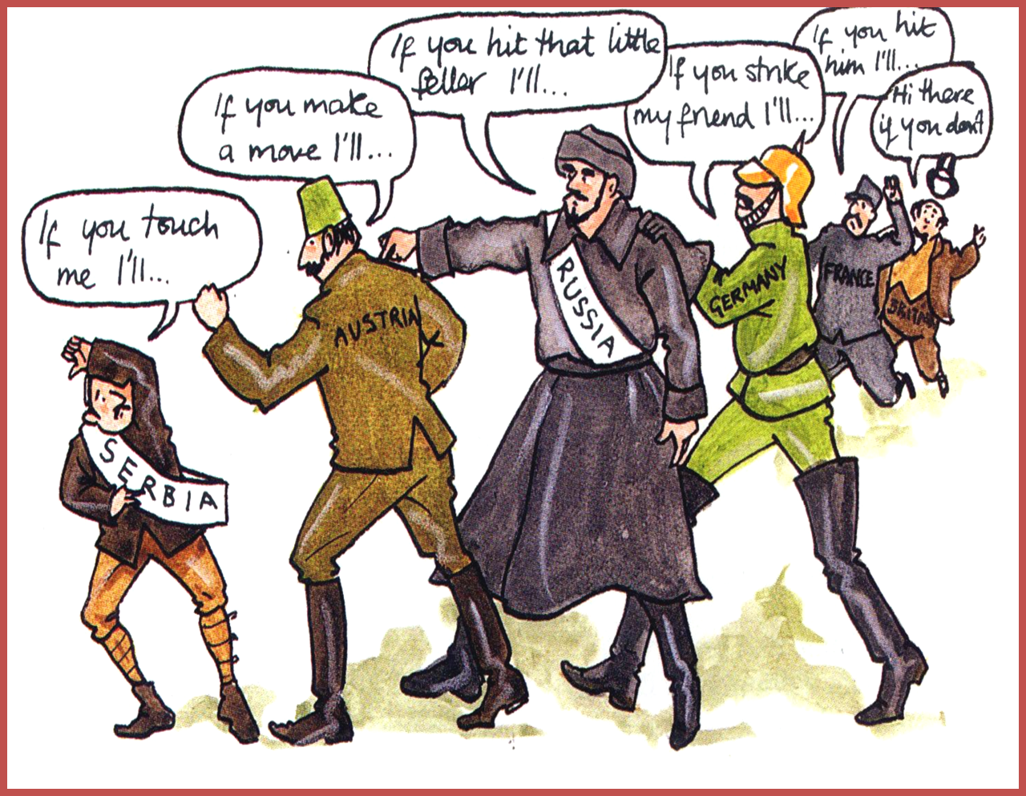

Slide 23
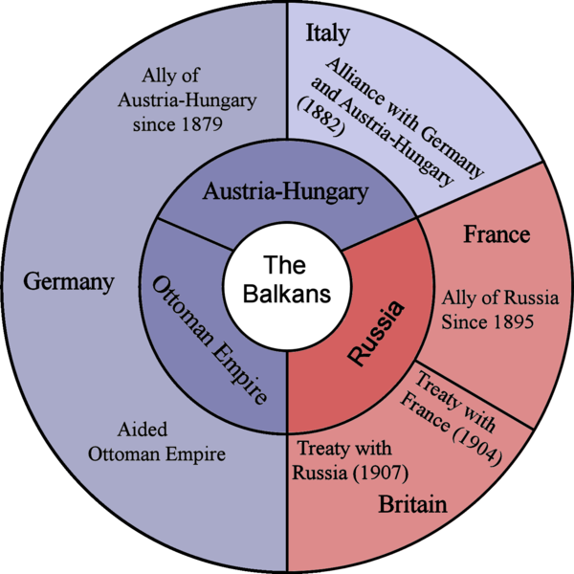

Slide 24
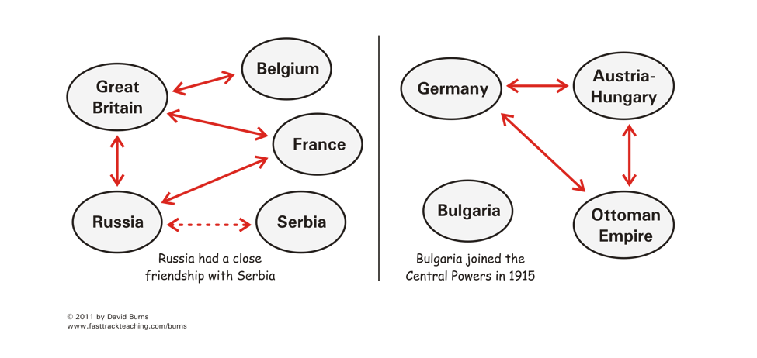

Slide 25
Triple Alliance
Dual Alliance, 1879
  Germany and A-H
  In the event of attack by France or Russia.
Triple Alliance,1882
  Italy joined…then neutral…then joined Alllies

Slide 26
Leaders
Triple Alliance
Kaiser Wilhelm II (Germany)
Franz Joseph I
(Austria-Hungary)
Vittorio Orlando
(Italy)
Triple Entente
David Lloyd George
(England)
Raymond Poincare
(France)
Czar Nicholas II
(Russia)

Slide 27
Countdown to World War: The Guns of August
6/28 ADFF assassinated
7/23 A-H Presents Serbia with an ultimatum
  accept an A-H inquiry into the assassination
  suppress anti-Austrian propaganda
  root out and eliminate terrorist organizations
  demanded an answer to the note within 48 hours
7/28 A-H declares war on Serbia. France and Russia back Serbia
7/30 Britain and Russia mobilize forces
8/1 Germany declares war on Russia
8/2 Germany invades Belgium
8/3 Germany declares war on France
8/4 Britain declares war on Germany
8/5 A-H declares war on Russia and Great Britain
9/6 Battle of the Marne, 10/18 Battle of Ypres
10/29 Ottomans join Dual Entente –=Triple Entente
4/6/17 - US declares war on Germany
3/3/18 - Treaty of Brest-Litovsk signed between Russia and Germany.

Slide 28
And all this madness, all this rage, all this flaming death of our civilization and our hopes, has been brought about because a set of official gentlemen, living luxurious lives, mostly stupid, and all without imagination or heart, have chosen that it should occur rather than that any one of them should suffer some infinitesimal rebuff to his country`s pride.
-British philosopher Bertrand Russell, 1914

Slide 29
They wrote in the old days that it is sweet and fitting to die for one's country. But in modern war there is nothing sweet nor fitting in your dying. You will die like a dog for no good reason.
-Ernest Hemingway

Slide 30
You will be home before the leaves have fallen from the trees
-Kaiser Wilhelm II to his troops, August 1914
This war is really the greatest insanity in which white races have ever been engaged.
-German Admiral von Tirpitz, in a letter to his wife, October 1914

Slide 31
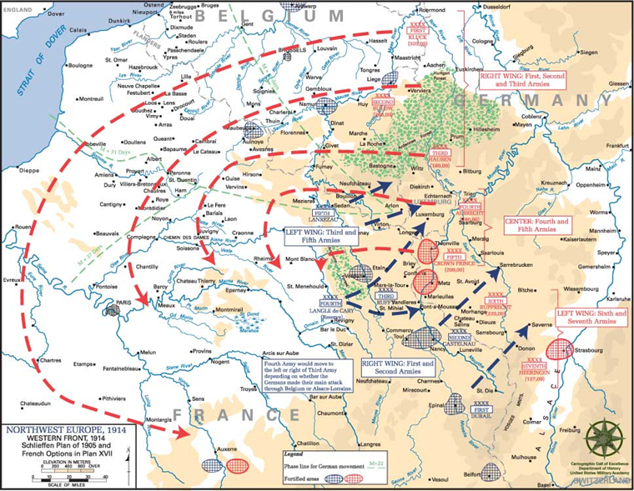

Slide 32
Moltke’s Modifications to the Schlieffen Plan
Helmuth von Moltke replaced Schlieffen (d. 1913) as chief of the general staff in 1906 and modified Schlieffen’s 1894 plan
  Weakened the right wing and strengthened the left
  Violated Schlieffen’s dying words to “Keep the right wing strong”

Slide 33

Problems with the German Plan
Committed Germany to a 2 front war
Became inflexible “war by timetable”
Necessitated attacking before Russia or France could seize the initiative (even if Germany wasn’t ready)

Slide 34
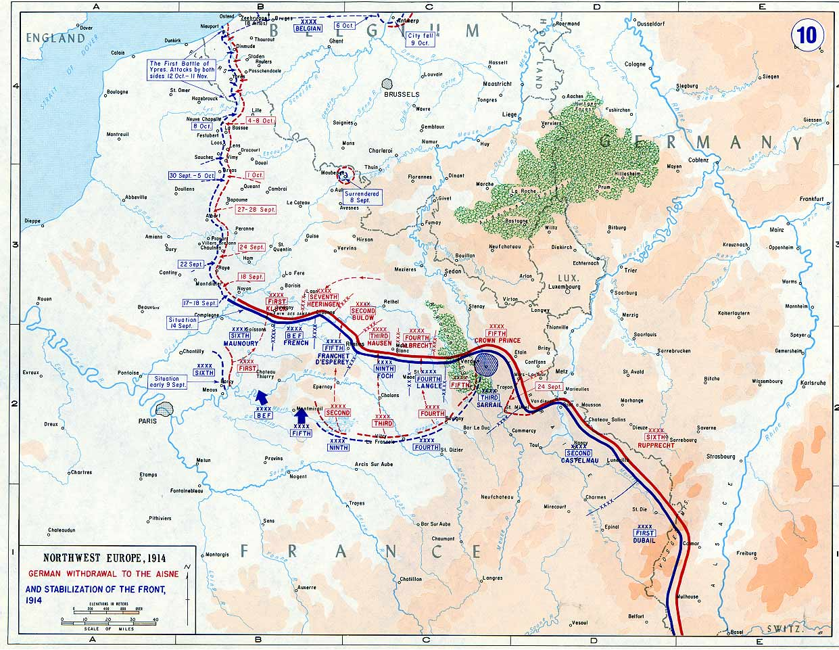
Result: Stalemate

Slide 35
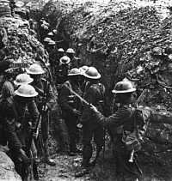
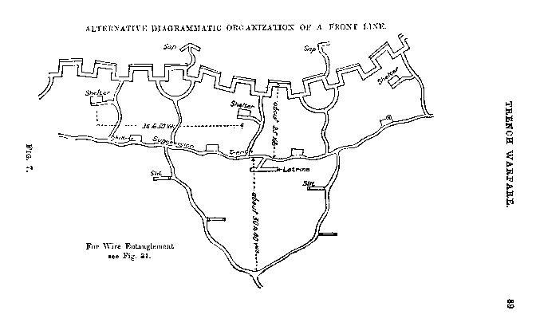
Trench Warfare

Slide 36
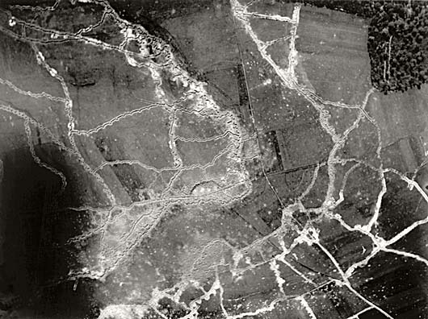

Slide 37
There were many words that you could not stand to hear and finally only the names of places had dignity. Abstract words such as glory, honor, courage, or hallow were obscene.
-American novelist and WWI veteran Ernest Hemingway, in 'A Farewell to Arms', 1929

Slide 38
Technological Advances to Break the Stalemate
In 1915 British Admiral Jacky Fisher wrote, “The war is going to be won by inventions.”
Machine gun
Rapid fire artillery
Airplanes
Internal combustion engine
Tanks
Zeppelins
Gas
Flamethrowers

Slide 39
You can't say civilization don't advance, however, for in every war they kill you in a new way.
-Will Rogers, New York Times, 23 December 1929

Slide 40
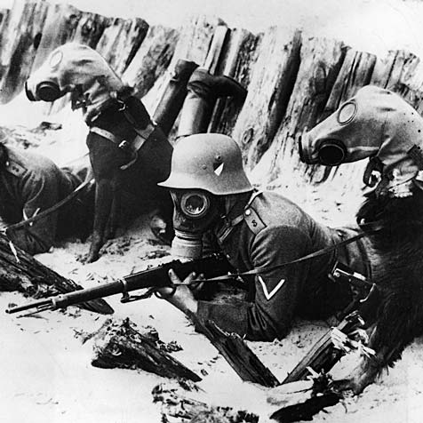
Attempts to Break the Stalemate: Gas
Germans first used gas against the Russians on 1/1/15. No real effect.
More successful at Ypres on 8/15

Slide 41
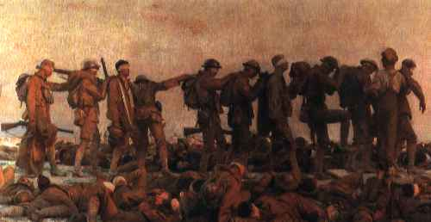
Dulce et Decorum Est
(“Sweet and Fitting it is to Die for One’s Country”)
Gas! GAS! Quick boys! – An ecstasy of fumbling,
Fitting the clumsy helmets just in time:
But someone still was yelling out and stumbling
And floundering like a man in fire or lime. –
Dim, through the misty panes and thick green light
As under a green sea, I saw him drowning
-- Wilfred Owen
“Gassed” by John Singer Sargent

Slide 42
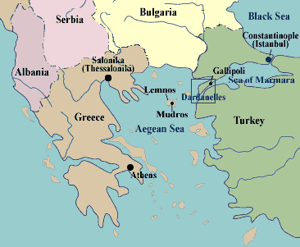
Peripheral Operations: Gallipoli
10/31/14 Ottomans joined Central Powers on
4/25/1915, Allies launched Gallipoli campaign
Mustafa Kemal told the Turkish defenders, “I am not ordering you to attack. I am ordering you to die. In the time it takes us to die, other forces and commanders can come and take our place.”
On January 16, 1916, the Allies admitted defeat and withdrew.

Slide 43
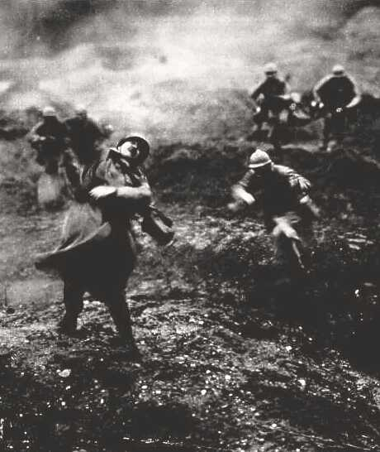
Attempts to Break the Stalemate: Frontal Attacks
2/21/1916, Germans launched a massive attack at Verdun
10 month battle
700,000+ dead, wounded and missing
Battlefield <10 km sq.

Slide 44
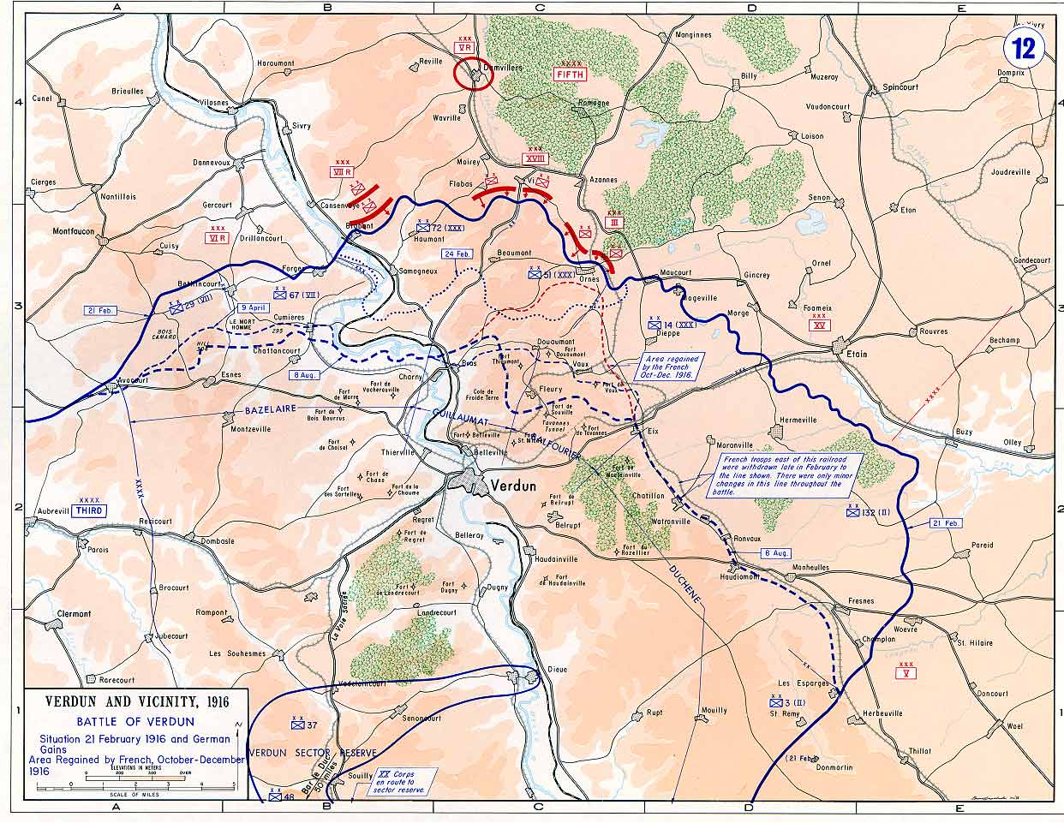

Slide 45
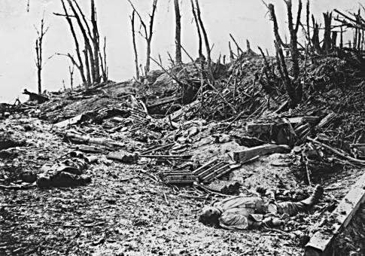
Attempts to Break the Stalemate: Frontal Assaults
7/11/16, Brits launched offensive along the Somme River to try to divert German troops from Verdun
On Day 1, 60,000 British soldiers killed, wounded, or captured.
By 11/11/15, 600,000+ casualties
German casualties at the Battle of the Somme

Slide 46
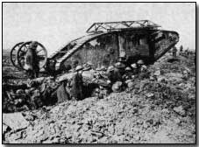
Attempts to Break the Stalemate: Tanks
British began developing tanks in 1914 and used them in small numbers at the Somme on Sept 15, 1916
  Achieved little at first
Battle of Cambrai on 11/20/17 marked the first large scale use of tanks with 474

Slide 47
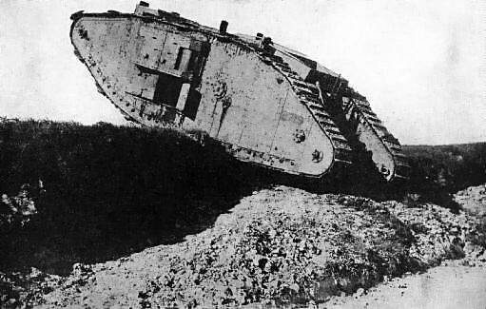
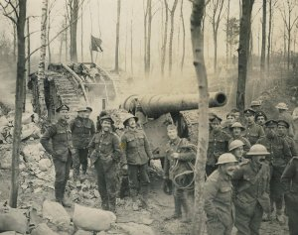
Attempts to Break the Stalemate: Tanks
11/20/17 at Cambrai, near Belgian border.
British advanced 3 miles in a day
Deepest penetration into German lines since trenches
Day 2: Germans bring 4 divisions
Day 3: Brits lose ground

Slide 48
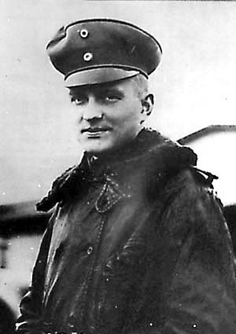
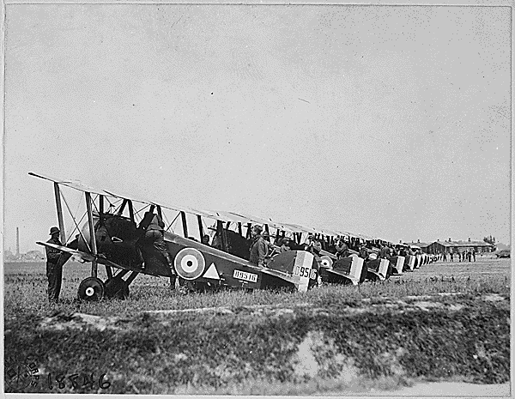
Attempts to Break the Stalemate: Airplanes
148th American Aero Squadron
Petite Sythe, France
Baron Manfred von Richthofen, the Red Baron, credited with 80 kills

Slide 49
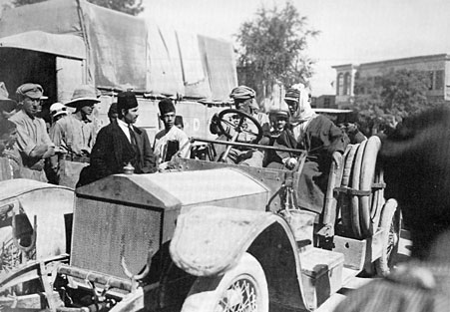
World War I Vehicles
T. E. Lawrence used a fleet of nine Rolls-Royce armored cars and adapted for desert warfare

Slide 50
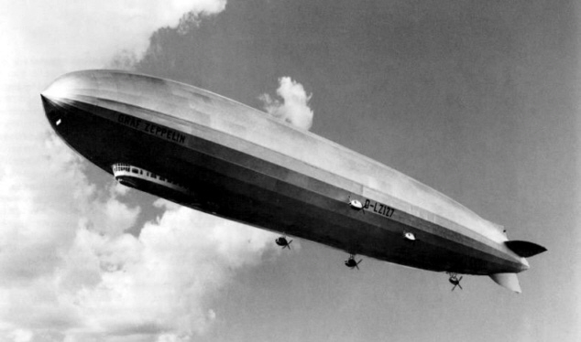
World War I Zeppelin

Slide 51
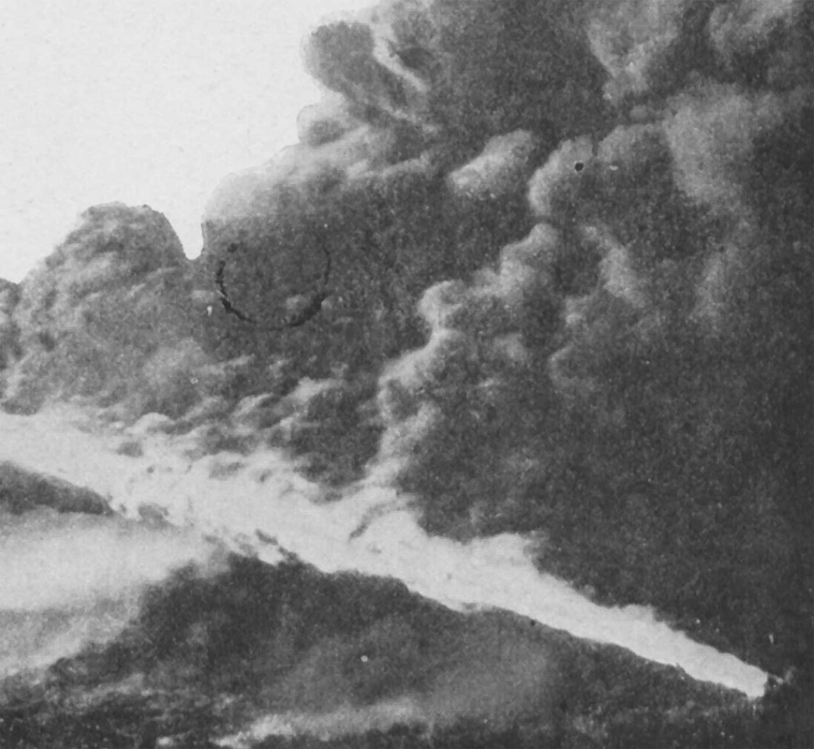
World War I Flamethrower

Slide 52
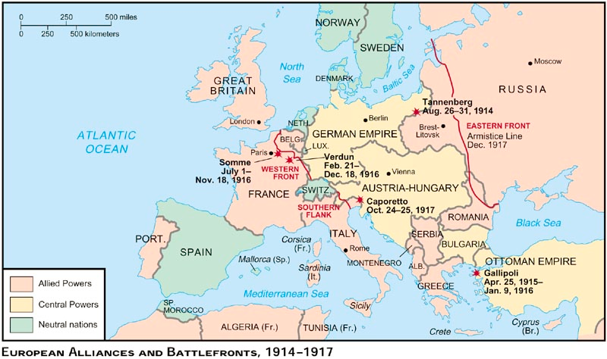
Summary: Fronts & Major Battles

Slide 53
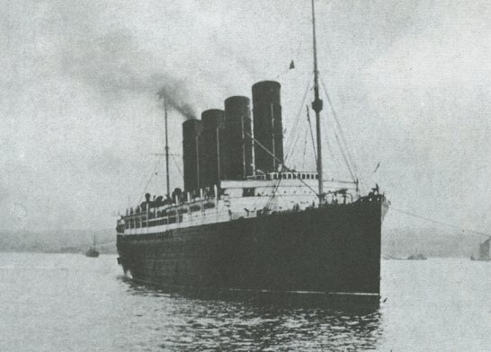
Breaking the Stalemate: American Entry
In 1914, American public was firmly opposed to intervention
1915, Germans sunk the British passenger liner Lusitania, killing 1,198, including 128 US citizens
1916, Wilson reelected with the slogan, “He Kept Us Out of War”
Feb 14 - Sept 18, 1915, Germans practiced unrestricted submarine warfare

Slide 54
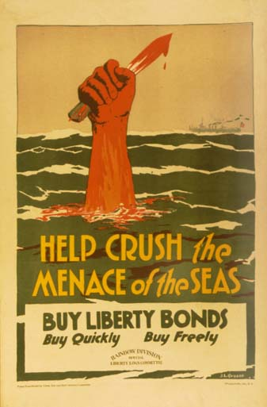
Breaking the Stalemate: American Entry
4/6/17 US declared war
British and French wanted the Americans attached to armies of other nations (Amalgamation)
John J. Pershing, commander of the American Expeditionary Force, resisted

Slide 55
Surrender
  Eventually “Americans and tanks” overwhelmed the Germans with men and equipment
9/30 Bulgaria surrendered
10/30 Ottomans
11/4 Austria-Hungary
11/11 Germany
  “Armistice Day” (replaced by “Veterans’ Day” by Act of Congress on May 24, 1954)

Slide 56
Casualties
of War

Slide 57
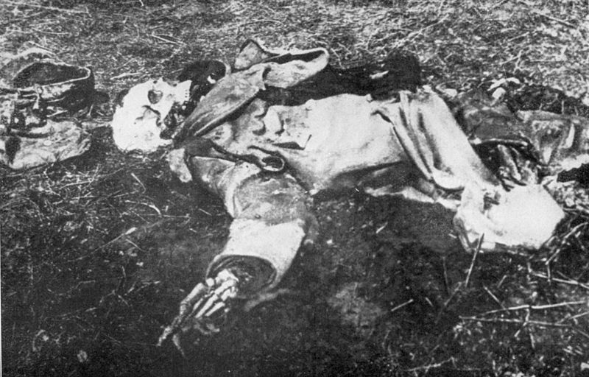
Casualties of War

Slide 58
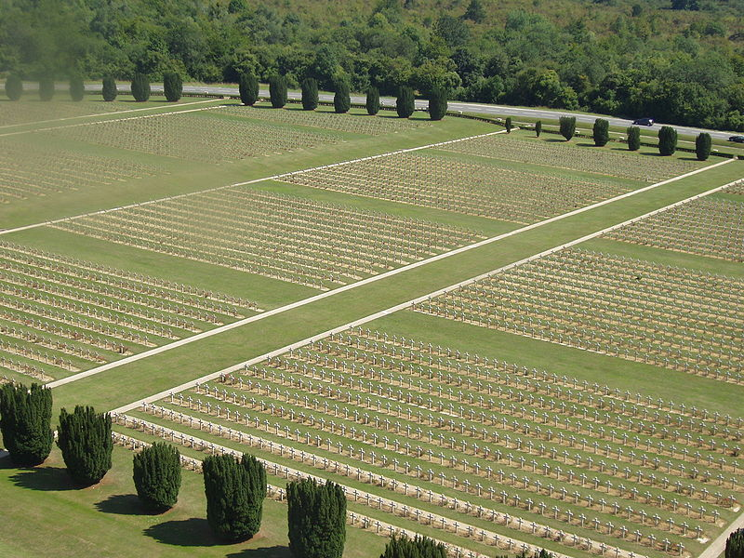

Slide 60
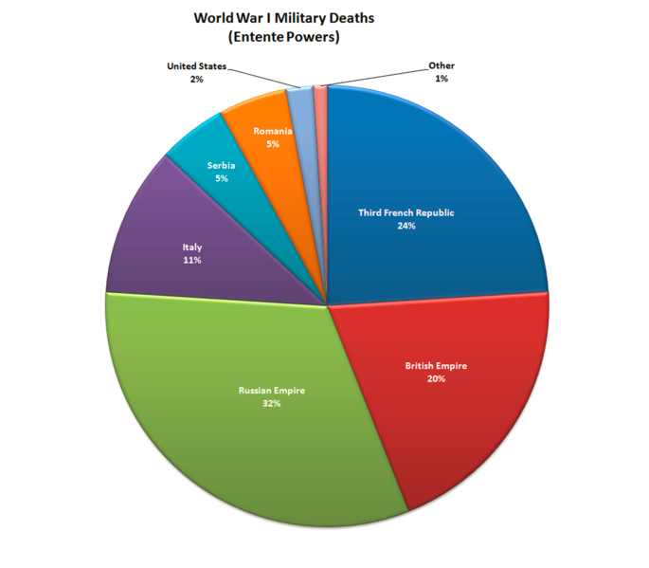
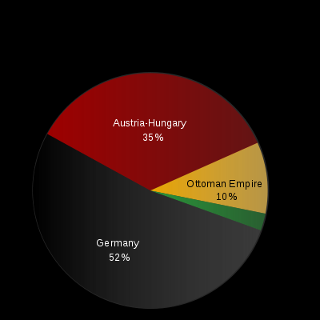

Slide 61
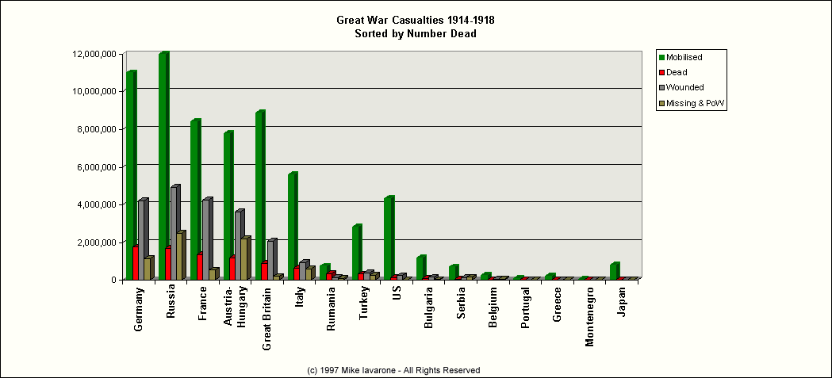

Slide 62
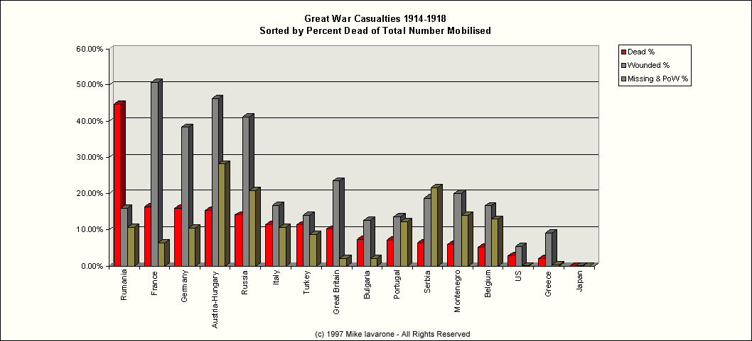

Slide 63
Legacy
of
WWI

Slide 64
Human Life
The Walking Wounded
  Limbless
  Blind
  Shell Shocked
  Families in Ruin
Armenian Genocide: 1 million Armenians suffered in concentration camps and were left to die in the desert

Slide 65
Economic Cost
Immeasurable
Hunger
Unemployment
America enters the “Roaring Twenties”
Germany experiments in Weimar
Europe disillusioned

Slide 66
Effects of World War I
Before WWI, feeling of optimism and progress of human kind
After WWI, pessimism and disillusionment
New NWO, new worldview
  Surrealism
  Lost Generation
  Psychoanalysis
  Existentialism

Slide 67
New and Old
In with the New
Out with the Old
Baltic: Estonia, Lithuania, Latvia,
Eastern Europe: Poland, Czechoslovakia, Yugoslavia, Austria, Hungary
Middle East
  Britain: Palestine, Iraq & Jordan
  France: Lebanon & Syria
  Ottoman Empire
  German Empire
    Northern Schleswig to Denmark
    W. Prussia, Posen and Upper Silesia given to Poland
  Russian Empire (Baltic)
  Austro-Hungarian Empire
  …Colonies

Slide 68
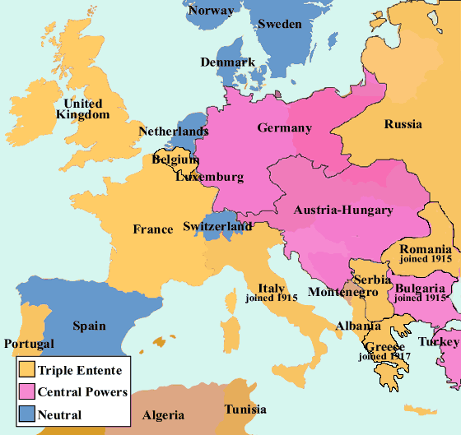
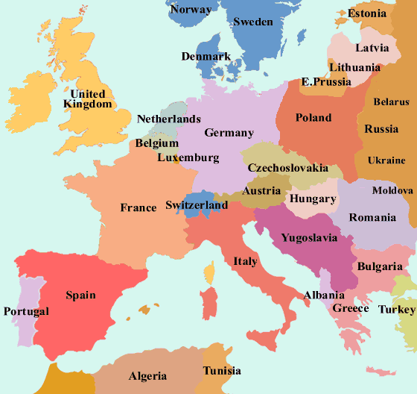
Europe Before and After World War I

Slide 69
The First World War killed fewer victims than the Second World War, destroyed fewer buildings, and uprooted millions instead of tens of millions - but in many ways it left even deeper scars both on the mind and on the map of Europe. The old world never recovered from the shock.
-Edmond Taylor, in "The Fossil Monarchies"

Slide 70
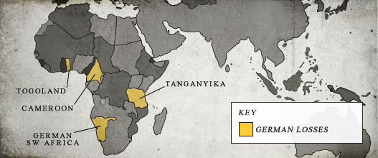
Africa Before and After World War I

Slide 71
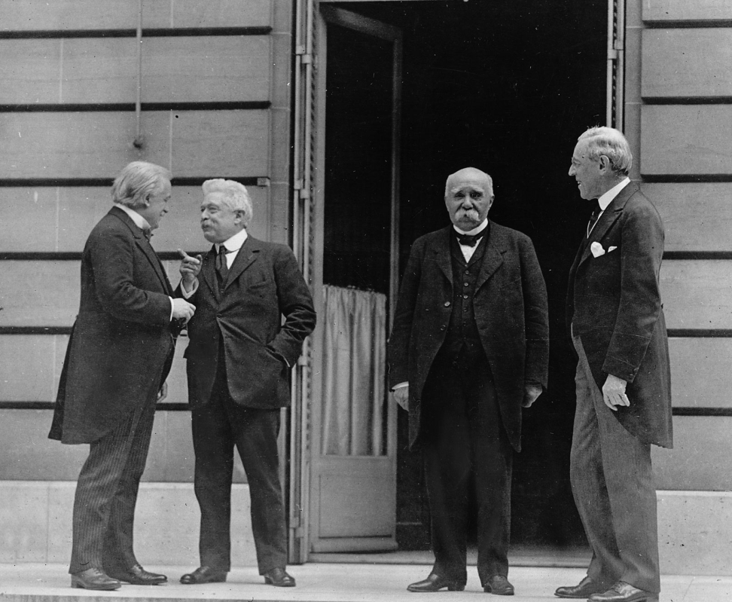
Paris Peace Conference
Big 4 met in Paris in 1919 to determine the postwar settlement
Central Powers not invited
Russians not invited
French, British, and Americans dominated the conference
Georges Clemenceau (France), Lloyd George (Britain), and Woodrow Wilson (US) at Versailles

Slide 72
Germany: Reparations & Resentment
France wanted Germany crippled. Wilson tried to negotiate
Admit guilt in starting war
$5 million + “blank check” reparations
Turn over leaders as war criminals
French reclaim Alsace-Lorraine. Lost coal mines
Germany colonies divided among the victors
Germany demilitarized
  Conscription abolished
  German army was reduced to 100,000 men and was not allowed to use tanks or submarines
  No air force
  Only 6 battle ships.
  Blockaded.
“Defeat Imposes Passivity on a people, its shock paralyzes at first”

Slide 73
This is the end and the beginning of an age. This is something far greater than the French Revolution or the Reformation and we live in it.
-H.G. Wells, in 'Mr Britling Sees It Through', 1916

Slide 74
"This is not peace. It is an armistice for 20 years."
- French Marshall Ferdinand Foch, Supreme Allied Commander during World War I, upon seeing the final draft of the Treaty of Versailles.

Slide 75
Man is the only animal that deals in that atrocity of atrocities, War. He is the only one that gathers his brethren about him and goes forth in cold blood and calm pulse to exterminate his kind. He is the only animal that for sordid wages will march out... and help to slaughter strangers of his own species who have done him no harm and with whom he has no quarrel.... And in the intervals between campaigns he washes the blood off his hands and works for "the universal brotherhood of man" - with his mouth.
-Mark Twain

Slide 76
I don't know whether war is an interlude during peace, or peace an interlude during war.
-Georges Clemenceau

Slide 77
Everyone's a pacifist between wars. It's like being a vegetarian between meals.
-Colman McCarthy, American journalist and pacifist

Slide 78
Wilson’s Fourteen Points
Wilson’s Fourteen Points as excessively idealistic?
Conflicted with Allied secret wartime agreements to divide and conquer Central Power territories and colonies
The Treaty violated the spirit of the Fourteen Points

Slide 79
Wilson’s Fourteen Points
Open covenants of peace, openly arrived at
Absolute freedom of navigation upon the seas
Removal of all economic barriers and the establishment of an equality of trade conditions
Adequate guarantees for a reduction in national armaments,
Adjustments of colonial disputes to give equal weight to the interests of the controlling government and the colonial population
A call for “a general association of nations”

Slide 80
League of Nations
42 original members
This NWO was flawed
  Perceived as "League of Victors”: Germany & USSR barred.
  League's neutrality tended to manifest in indecision
  Required a unanimous vote of all 15 Council members
  U.S. never joined
  National interests remained paramount
  Designed to solve international disputes through arbitration, it had no power to enforce its decisions
  At any given time one or more of the great powers did not belong to the League
1943 Tehran Conference → United Nations

Slide 81
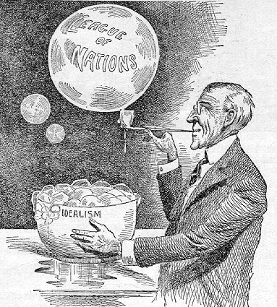
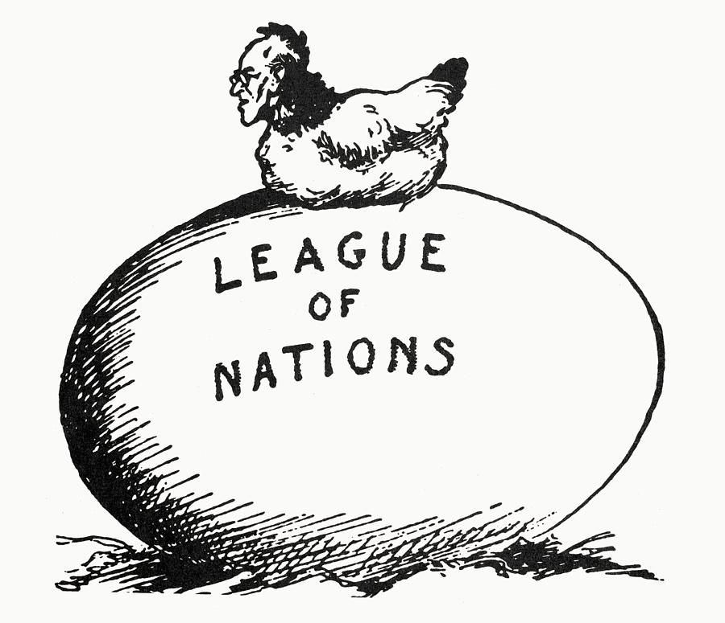

Slide 82
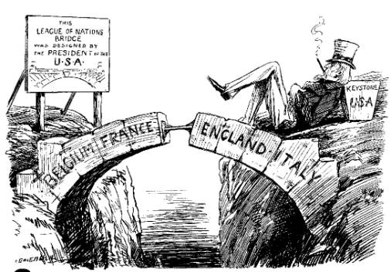

Slide 83
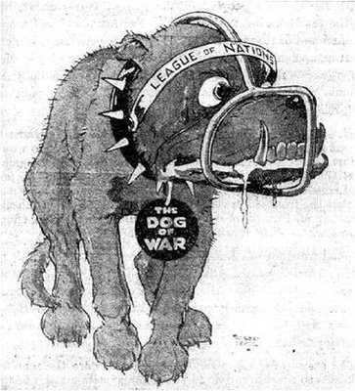

Slide 84
