Slide 1
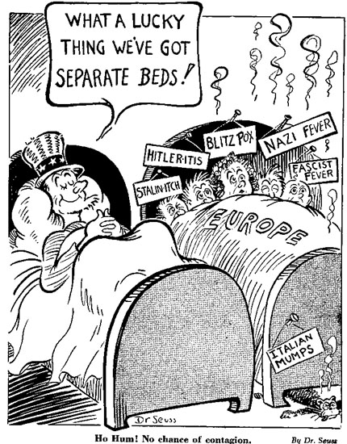
World War II on the American Home Front
The Road to War
War Socialism
Minorities in WWII
African-Americans
Mexican-Americans
Native Americans
Women in at War and at Work
Japanese [American] Internment
Atomic Bombs

Slide 2
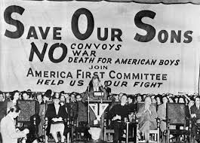
The American Road to War

Slide 3
Nye Committee,1934
Context of anti-business sentiment
Senator Gerald P. Nye (R-ND) investigated arms sales and manufacture during WWI, revealing huge profits made by American financiers and manufacturers
“The Committee produced a sordid report of intrigues and bribery; of collusion and excessive profits; of war scares artificially fostered and [disarmament] conferences deliberately wrecked.“ (Appointment On The Hill, Dorothy Detzer)
93 hearings, 200+ witnesses
Furthered isolationist sentiment
Shutdown in 1936 when Nye went on tirade against Wilson

Slide 4
Neutrality Acts, 1935-37
First Neutrality Act - Aug 1935 - Feb 1936
Created a federal agency to consider arms sales
Still an arms embargo
US citizens could travel on belligerent vessels or into war zones at their own risk
Second Neutrality Act - Feb 1936 - May 1937
Prohibited extending loans or credit to belligerents
Non-interference in Spanish Civil War; recognized Franco’s fascist government.

Slide 5
Ludlow Amendment,1937
Louis Ludlow (D-IN) – dies in committee by vote of 209-188
If passed, Congress could not declare war without a nationwide referendum, unless US or one of its possessions was attacked.
Showed depth of isolationist sentiment
“[The amendment would do more to] keep American boys out of slaughter pens in foreign countries than any other measure that could be passed. It is based on the philosophy that those who have to suffer and, if need be, to die and to bear the awful burdens and griefs of war shall have something to say as to whether war shall be declared.” (Ludlow)

Slide 6
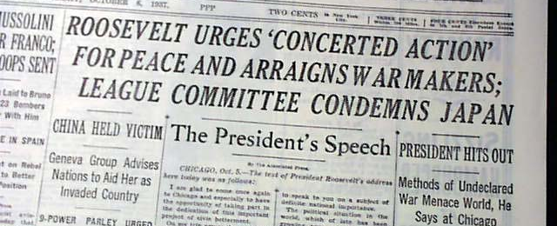
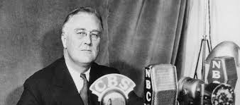
Quarantine Speech, 5 Oct 1937
FDR moved ahead of public opinion polls that revealed growing fear the US was moving toward war.
"When an epidemic of physical disease starts to spread, the community approves and joins in a quarantine of the patients in order to protect the health of the community against the spread of the disease.“
Mar 1938 - speaking before the Council on Foreign Relations, Hoover rebuked FDR,

Slide 7
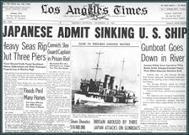
USS Panay Incident, 12 Dec 1937
Japan, at war with China, attacked USS Panay on the Yangtze River near Nanjing, killing 2 Americans
“Remember the Maine”
Instead of demanding action against Japan, US public demanded to know what the Panay was doing escorting Standard Oil tankers to Asian war zone.
14 Dec - Japan apologized, agreed to pay damages, promised no future attacks

Slide 8
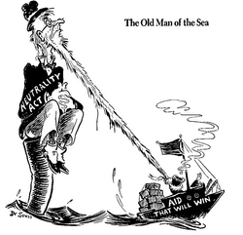
Third Neutrality Act, May 1937
Est. Cash & Carry system
U.S. ships were prohibited from transporting any passengers or articles to belligerents
Oct 1937, Japan invaded China. Japan did not officially declare war. So FDR did not apply Cash & Carry to China. Sent direct aid.

Slide 9
Fourth Neutrality Act, Nov 1939
Nov 1939 - After Germany invaded Poland, repealed arms embargo; Allowed belligerents to purchase munitions via Cash & Carry. End of Neutrality?
WWII Deteriorated:
By June 1940: Germany defeated Norway, Denmark, Netherlands, Luxembourg, Belgium
By June 1940: Vichy France
Sept 1940: Tripartite Pact - Germany, Italy, Japan

Slide 10
Enlisting Men, Sep 1940
FDR enlisted two Warhawks to his cabinet
Henry Stimson, Secretary of War
Frank Knox, Secretary of the Navy
Burke-Wadsworth Selective Training and Service Act
First Peace Time Draft
Registered all men 18-35
Authorized training of 1,200,000 and 800,000 reservists
16 Oct - First registration began - 16,400,000 registered
29 Oct - First draft numbers selected

Slide 11
The AFC: Another Voice of Isolationism
America First Committee – Founded at Yale by Quaker Oats heir, Robert Stuart
Slogan: "England will fight to the last American."
Peaked at 800,000 members including Henry Ford, Alice Roosevelt Longsworth, JFK, Gerald Ford, BUT…
AFC Spokesman was eugenicist, anti-Semite, world class racist…and national hero, Charles Lindberg, whose speeches stressed:
Impossibility of a German attack across the Atlantic
French and UK conspiracies against Germany
German-dominated Europe was not detrimental to Western hemisphere
Nazi themes, like the Jewish press conspiracy. “We must ask who owns and influences the newspaper, the news picture, and the radio station... If our people know the truth, our country is not likely to enter the war."

Slide 12
WWII in an Election Year
10 July - 31 Oct 1940 - Battle of Britain
29 Dec 1940 poll revealed 39% believed US made a mistake participating in WWI; down from 64% in 1937
Wendell Willkie was a political nobody (and a Democrat) in 1939. In 1940 he contested FDR.
Sen Watson (R-IN) argued it’s fine if the town whore joined the church, but she might not try to lead the choir the first week.
FDR won 55 to 45% (449:82 in EC)

Slide 13
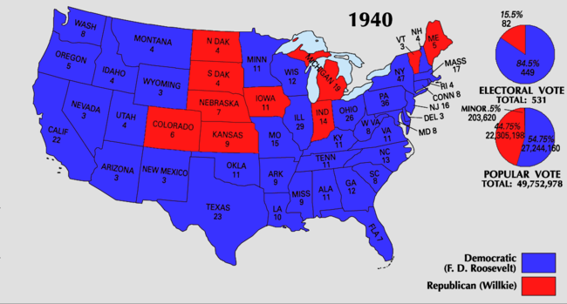

Slide 14
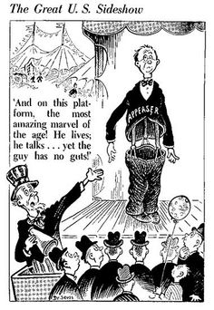
Turning Tides of Insularity in 1940-41

Slide 15
Lend Lease Act, Dec 1940
In a fireside chat, FDR proposed Lend-Lease with his garden hose analogy
"Suppose my neighbor's house catches fire, and I have a length of garden hose four or five hundred feet away. If he can take my garden hose and connect it up to his hydrant, I may help him to put out the fire. Now what do I do? I don't say to him before that operation, 'Neighbor, my garden hose cost me $15. You have to pay me $15 for it.' What is the transaction that goes on? I don't want $15 - I want my garden hose back after the fire is over.”
11 Mar - Congress approved Lend-Lease appropriation of $7 billion
Lend-Lease terminated in Sept 1946 after $50.6 billion ($900 bil today)

Slide 16
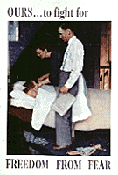
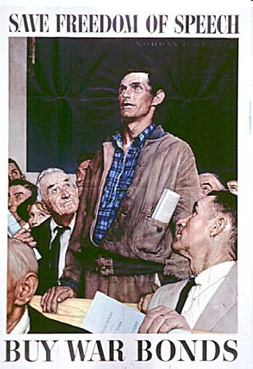
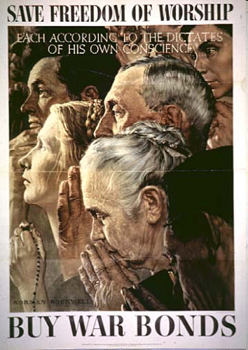
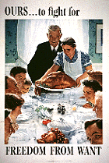
Four Freedoms Speech, SOTU 1941

Slide 17
The Atlantic Charter, Aug 1941
US sought no territorial gains
Disarmament
Renunciation of aggression
Self-determination for all
Reduction of trade barriers
Freedom of seas
Freedom from want and fear
Global cooperation (UN Model)

Slide 18
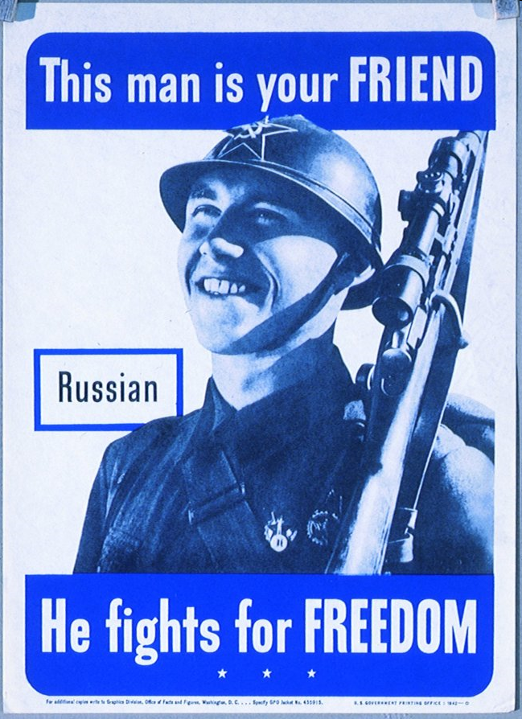
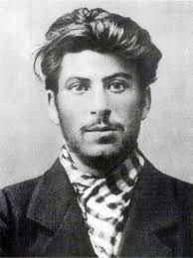
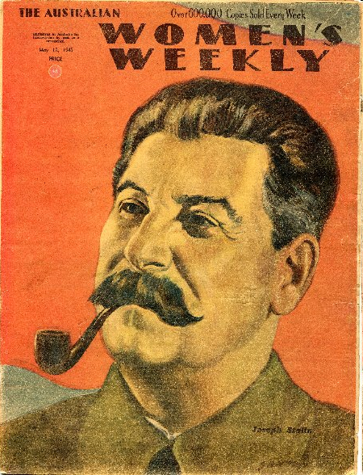
The Enemy of Your Enemy
22 June 1941 - Germany violated Non-Aggression Pact
24 June 1941 - US aid to USSR

Slide 19
Japanese-American Relations
FDR’s 1937 Quarantine Speech called for Japan to be “treated like a disease”; sanctions regime
Trade treaty with Japan not renewed, Jan 1940
Aviation fuel, scrap iron, and steel embargoed, Sep 1940
Japanese assets frozen in American banks, July 1941
Aid to China
$125 million lent to China by 1940
US fleet to Pearl Harbor in 1940
Lend-Lease extended to China, April 1941
The Flying Tigers “volunteers” arrived in China, April 1941

Slide 20
Japanese-American Relations
Sep 1941 - Japan occupied French Indochina. US
Mobilized forces in the Philippines under MacArthur
Warned Japan against further aggression
3 Nov - US Ambassador to Japan, Joseph Grew, warned of possible attack on US positions, but suggested the Philippines, not Hawaii

Slide 21
Attack on Pearl Harbor
Sunday 7 Dec 1941 at 7:55am
2,403 civilian and military personnel killed and 1,178 wounded.
19 ships sunk or disabled, 170 planes lost,
Simultaneous attacks on Philippines, Wake Island, Guam, Midway Islands, and British in HK
That evening Japan declared war on the US

Slide 22
America Goes to War
8 Dec - FDR asked Congress to declare war on Japan
Senate - 82-0
House - 388-1
11 Dec - Under the terms of the Tripartite Pact, Germany and Italy declared war on the; Reciprocated w/o debate in Congress.

Slide 23
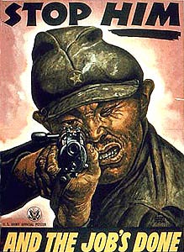
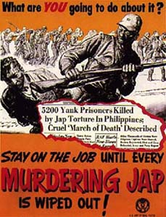
War Socialism

Slide 24
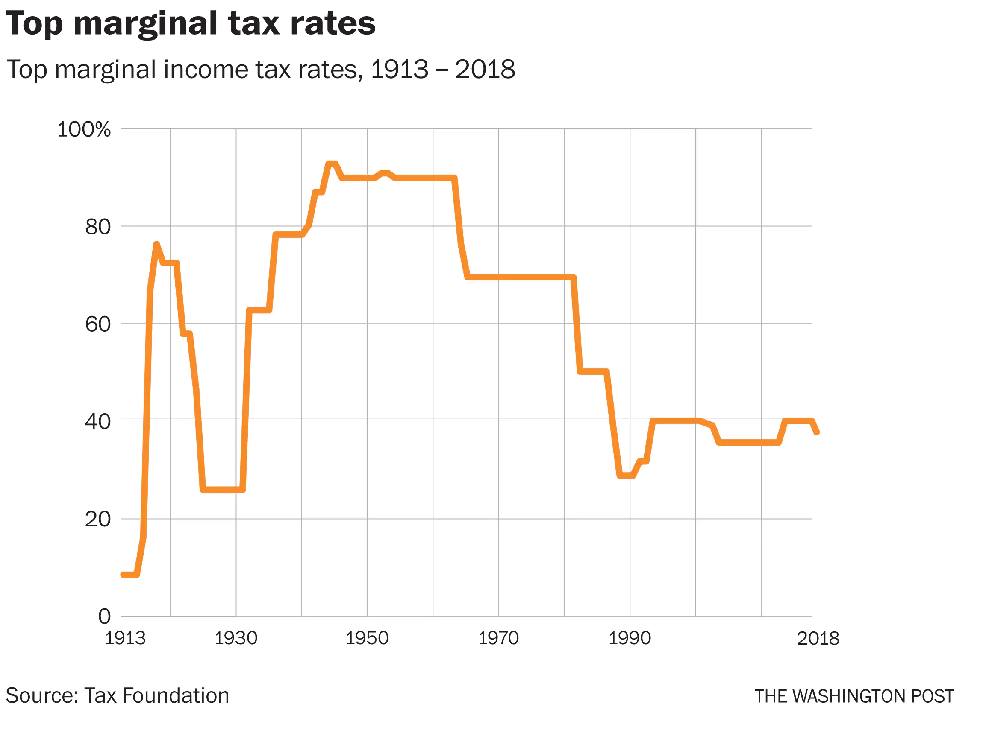
War Socialism: Office of Price Administration (EO 8875, 1941)
Taxes: Pay to Win
Corporate taxes at 40%
Taxes raised 46% of war costs
1939 - 4 million filed tax return; 1945 - 50 million!

Slide 25
War Socialism: Office of Price Administration (EO 8875, 1941)
Price and rent controls
Sold War Bonds
Encouraged Victory Gardens
Est. Office of Economic Stabilization…

Slide 26
War Socialism: Office of Economic Stabilization
Rationing
Certificate Plan: cars, tires, typewriters, etc.
Coupon Plan: meat, coffee, sugar, gas, etc.
Anti-inflation measures were successful
WWI cost of living rose 170%
WWII < 29%
National Debt: 1941 = $50 billion; 1945 = $260 billion

Slide 27
War Socialism: War Production Board (EO 9042, 1942)
Inefficiencies of profit motives hurt US production
Allocated scarce materials, established priorities, distributed materials and services, and prohibited nonessential production.
Rationed gas, heating oil, metals, rubber, paper, plastics
Converted civilian industry to war production
6,000 military aircraft in 1940; 85,000 in 1943
Factories that made silk ribbons now produced parachutes, auto factories built tanks, typewriter companies made rifles, undergarment manufacturers sewed mosquito nets…
Supervised production of $183 billion worth of weapons and supplies
About 40% of the world output of munitions
Produced twice as many goods as Axis countries combined

Slide 31
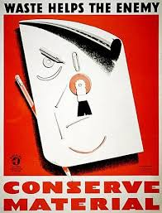

Slide 32
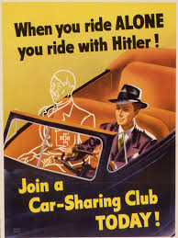
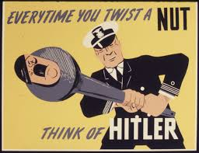

Slide 33
Minorities During WWII African-Americans Mexican-Americans Native-Americans

Slide 34
Minorities in the Armed Forces
African-Americans - 1,000,000+. Segregated. Largely spared front line action.
Latinos - 500,000. Much front-line action.
Jewish-Americans - 550,000
Asian-Americans - 55,000
Native-Americans- 25,000

Slide 35
Minorities in the Armed Forces
Why did they fight?
The Draft
Steady income and the GI Bill
Double V Campaign: against fascism abroad and racism at home
Dubois Support
Propaganda works
As a path to equality and justice

Slide 36
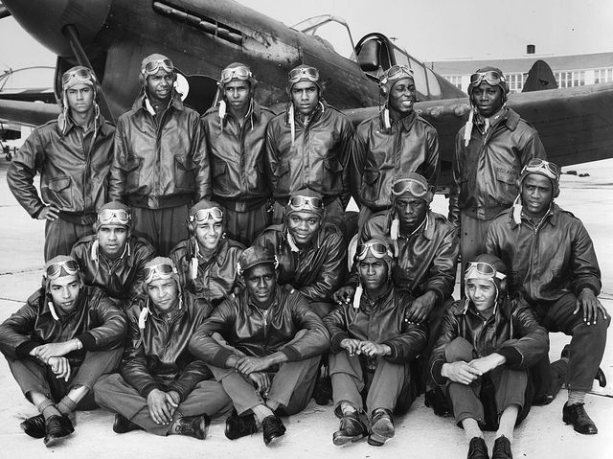
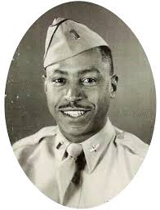
African-Americans at War: Tuskegee Airmen
"We shared the sky with white pilots, but
that's all we shared. We never had contact
with each other. German prisoners lived
better than black servicemen
The Germans treated us better than the
Americans did. Our service is something
that just never got into history books. It
was just ignored."
-Joseph Gomer

Slide 37
African-Americans & The War at Home
During WWII, mass migration of Blacks to industrial centers
Competition for scarce resources, esp. housing
Workplace tensions
Violence plagued 50+ cities…

Slide 38
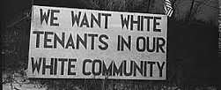
African-Americans & The War at Home Detroit Race Riot, 1943
Detroit's pop grew by 350,000, 1941-43
6,000 federal troops called in
$2 million in property damage
25 Blacks dead, 9 Whites; 433 wounded

Slide 39
African-Americans & The War at Home
Blacks excluded from lucrative war jobs
A. Philip Randolph, President of the Brotherhood of Sleeping Car Porters made three demands of FDR
Equal access to defense jobs
Desegregation of armed forces
End segregation in federal agencies
Randolph proposed a March on Washington in 1941 if his demands were not met….

Slide 40
African-Americans & The War at Home
FDR issued Executive Order 8802 in June, 1941 stablishing the Fair Employment Practices Committee to end segregation in defense industries.
FDR did not agree to other 2 demands
Randolph canceled the March
Randolph dubbed “Father of the Civil Rights Movement"

Slide 41
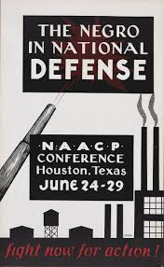
African-Americans & The War at Home
Congress of Racial Equality
Est. 1942 by Chicagoan James Farmer
Nonviolent action to promote equality and end discrimination
NAACP grew from 50,000 to 500,000 during WWII

Slide 42
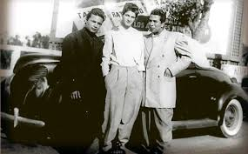
Latinos & The Zoot Suit Riots
Context of Depression-era illegal repatriation of Latinos
Young Latinos attacked by sailors on leave in LA
War Frauds Division sought injunction forbidding one shop to sell Zoot Suits.
Claimed that the shopkeeper had contributed to "hoodlumism” and wasted precious fabrics.

Slide 43
Los Braceros
US promised Mexican gov decent living conditions, minimum wage of 30 cents/hour, protection from draft
Oh, promises
Operation Wetback under IKE

Slide 44
Native Americans
Natives drafted. Mixed reactions.
Navajo code talkers essential to war in the Pacific; Navajo linguistic complexity made it perfect for code talk
1940, 5% of Natives lived in cities; 20% in 1950

Slide 45
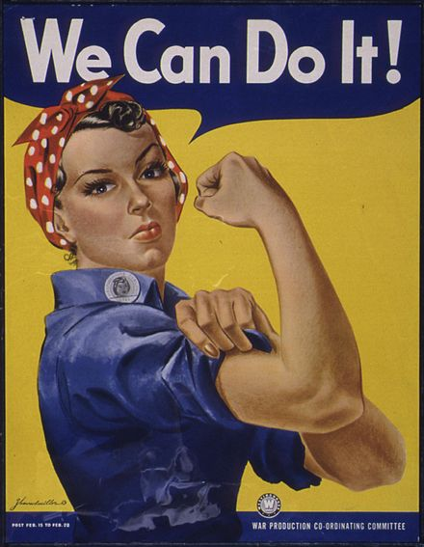
American Women at War

Slide 46
American Women at War
350,000 women joined the military; worked as nurses, drove trucks, repaired planes, clerical work
60,000 Army nurses; 14,000 Navy nurses
25,000+ women applied for WASP service, <1,900 accepted.
No gunnery training and very little formation flying
38 WASPs died
4500 spied for OSS

Slide 47
American Women at Work: The Data
> 5 million women joined the labor force during WWII, often relocating for aircraft, munitions, and auto jobs
25% of aviation workers were women
1944, 37% of all adult women were employed; 35% of the civilian labor force.
1940 to 1945
Female labor force grew 50%
% women workers employed in factories up 20 to 30%
Women in domestic work down from 18 to 10%
Married women working outside home up from14 to 23%
1944, skilled female workers avg $31/week; skilled men $55/week

Slide 48
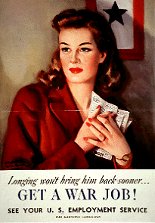
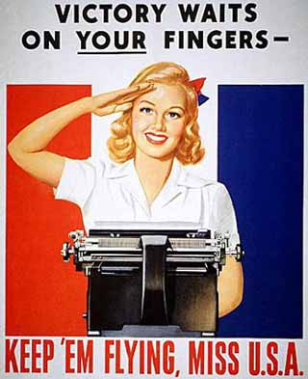
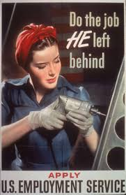

Slide 49
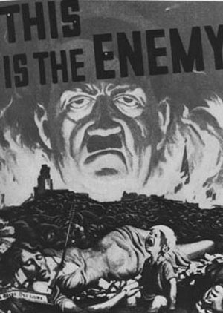
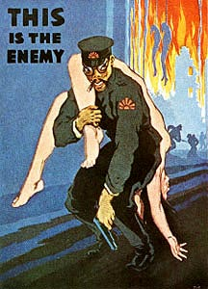

Slide 50
American Women at Work
Fostered post-War boom
Post-war domestication pressures. 1944 polls found 65-80% of women hoped to keep war jobs.

Slide 51
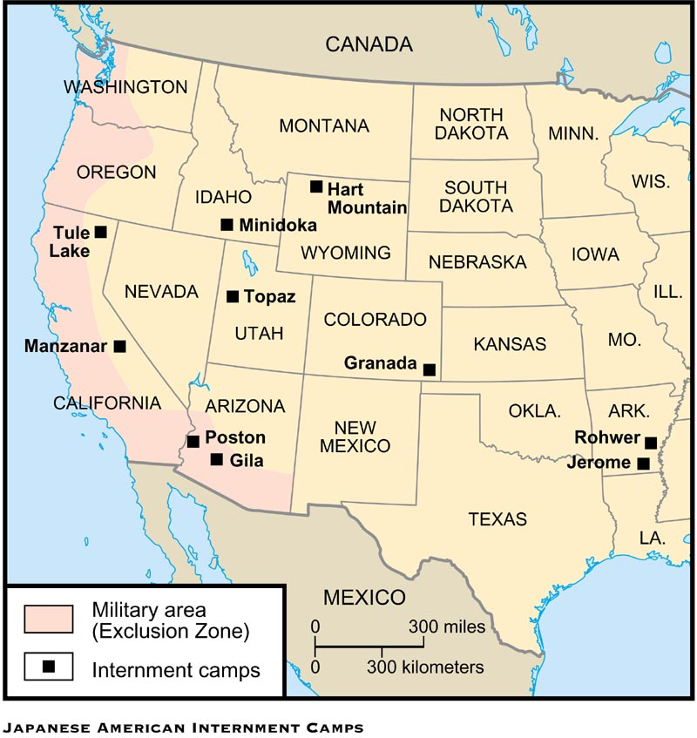
Japanese [American] Internment

Slide 52
Japanese [American] Internment
1942 was a critical year for Allied powers
Japan controlled SE Asia and most of China
Germany controlled W. Europe, N. Africa, and were deep inside USSR
23 Feb - Oil refinery near Santa Barbara, CA was shelled by Japanese sub; In June failed Japanese attack on mil base in OR. Psychological toll on Americans.

Slide 53
Japanese [American] Internment
29 Feb 1942 - FDR authorized EO 9066
Declared West Coast a “War Theater”
Removed Japanese-Americans from Western states
110,000 forcibly interned
1/3 Issei (foreign born)
2/3 Nisei American born
48 hours to tend to belongings. Most families abandoned worldly goods.

Slide 55
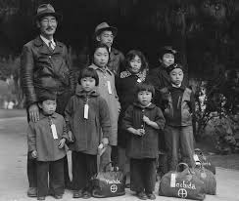
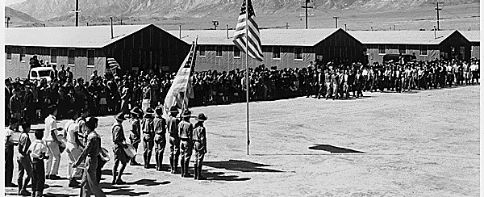
Japanese [American] Internment
War Relocation Authority removed people of Japanese ancestry to 10 locations in 7 states
Camps in desolate areas
Conditions harsh, most remained loyal to US; 17,600 fought in US Army

Slide 56
Japanese [American] Internment
Hirabayashi v. US - June 1943 - unanimously upheld internment citing Exec Authority to wage war
Court also ruled that persons couldn’t be held once loyalty was established.
Korematsu v. US - 18 Dec 1944 - 6 to 3 upheld exclusion of Japanese from the West Coast (a military decision).
Note: Korematsu and Hirabayashi have not been overturned

Slide 57
Japanese [American] Internment
$105 mil of farmland lost
$500 mil in yearly income; unknown personal savings.
No act of sabotage ever proven against any Japanese-American
Camps closed in March 1946
1988 - Reagan apologized and approved reparations to camp survivors totaling $1.25 billion; 1990 Congress appropriated funds to pay $20,000 to each internee.

Slide 58
The Atomic Bombs & The End of the War

Slide 59
Developing the Bombs
Office of Scientific Research and Development was established by executive order
J. Robert Oppenheimer chief scientist
To develop radar, proximity fuses, sonar, etc.
…and an atomic bomb.
May 1943 - Manhattan Project team est.
16 July 45 - First atomic bomb, code-named Trinity, detonated in Alamogordo, NM

Slide 60
Dropping the Bombs
July 1945 - Potsdam Conference, Allies demanded the unconditional surrender of Japan; 29 July - Japan formally rejected Allied demand
When realizing a land assault on mainland Japan would likely result in untold Allied casualties, Truman's decided to:
Revenge Pearl Harbor
Expedite war’s end
Save American lives
Intimidate USSR, set stage for “inevitable” Cold War

Slide 61
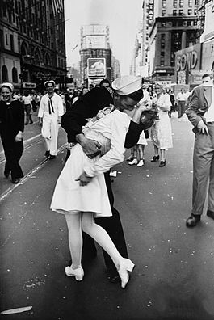
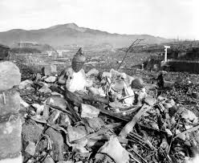
Dropping the Bombs
6 Aug – Fat Man dropped on Hiroshima; 70,000 dead and 110,000 wounded or missing
8 Aug - USSR declared war on Japan, 90 days after VE Day
9 Aug – Little Boy dropped on Nagasaki - 80,000 casualties
20% of victims were Korean conscript workers
14 Aug - Japan accepted Allied terms of surrender
15 Aug - VJ Day

