Slide 1
Freedom v. Order
A Problem-Based Exploration
of an Enduring Theme in USH
Mr. Daniel Lazar

Slide 2
Alien and Sedition Acts (1798)

Slide 3
Impact of The French Revolution
Republicans applauded the revolutionaries' destruction of aristocratic privileges, the overthrow of the monarchy, and the implementation of constitutional government.
Federalists saw the French Revolution as the degeneration into mob rule, particularly during the bloody "Reign of Terror" when "counterrevolutionaries" faced the guillotine.
Rumors were rampant in 1798 about a possible French invasion of America, one that allegedly would be supported by American traitors and a population of French émigrés

Slide 4
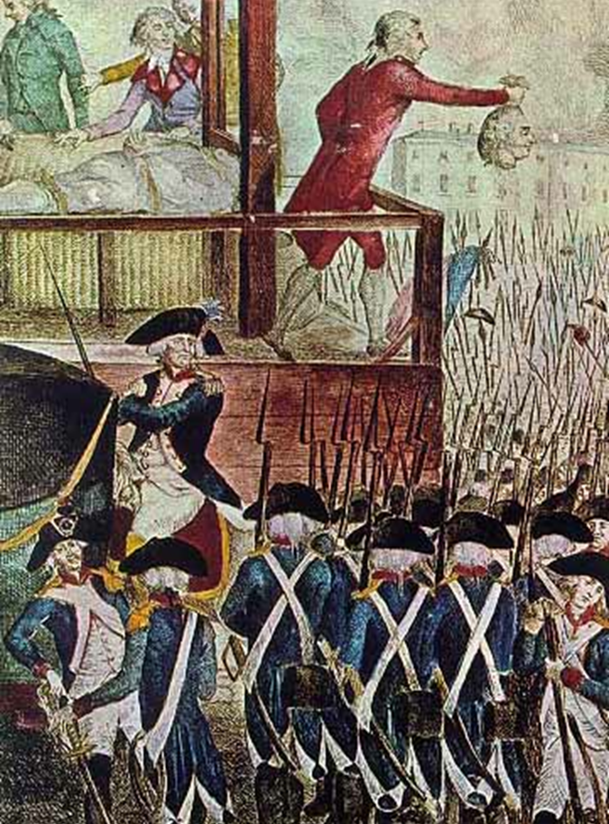

Slide 5
The Quasi War, 1798-1800
Prior to the French Rev the US had a strong political and economic relationship with France.
1789: After the French monarchy fell, the US refused to pay her Rev War debts to the “illegitimate” revolutionary gov
1792-1974: Reign of Terror
1795: US allied with England in Jay Treaty
1796-1797: French privateers seized US vessels
  316 vessels from May 1796-June 1797
  1,600 more by 1800
1798: President Adams informed Congress of the XYZ Affair, in which French agents demanded bribes for the restoration of diplomatic relations with the U.S.

Slide 6
Four Pieces of Legislation, 1798
Naturalization Act — extended the duration of residence required for aliens to become citizens to 14 years. Exp. 1802.
Alien Friends Act — authorized the President to deport any resident alien considered "dangerous to the peace and safety of the United States." Created in fear of French sympathizers. Exp 1800.
Alien Enemies Act — authorized the President to apprehend and deport resident aliens if their home countries is at war with the United States. Remains in effect today as 50 U.S.C. § 21-24.
Sedition Act — made it a crime to publish "false, scandalous, and malicious writing" with the "intent to defame" or to bring Congress or the President into "contempt or disrepute." Exp. March 3, 1801.

Slide 7
Legislation Enforced…On Some
TJ feared "to write what I think.”
Federalists were hardly models of decorum when describing Republicans.
  Republicans were, one Federalist wrote, "democrats, mobocrats and all other kinds of rats."
  Federalist Noah Webster characterized Republicans as, "the refuse, the sweepings of the most depraved part of mankind from the most corrupt nations on earth.“
17 indicted under the Sedition Act. 10 were convicted. Most were journalists. All were Republicans.
While no justice imposed the statute's maximum penalties of a $2,000 fine or a jail sentence of 2 years, they often jailed the “guilty” for 3-4 months.

Slide 8
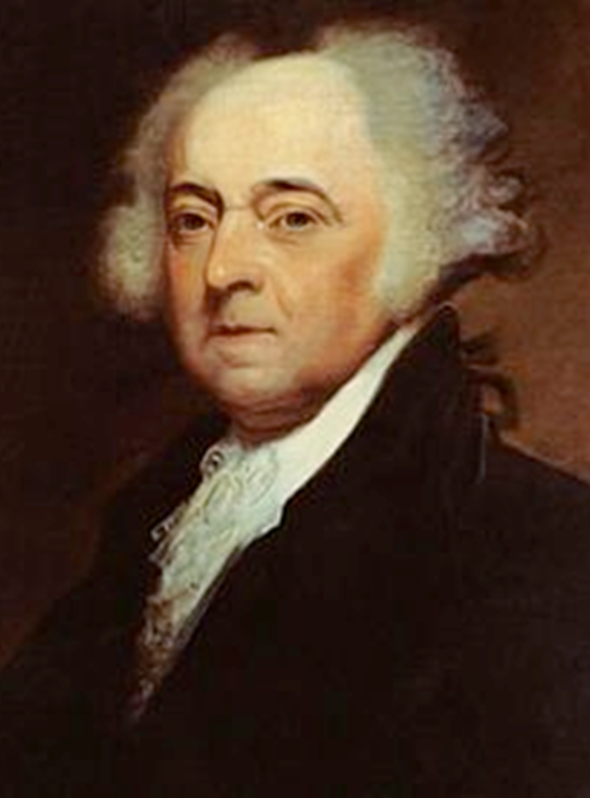
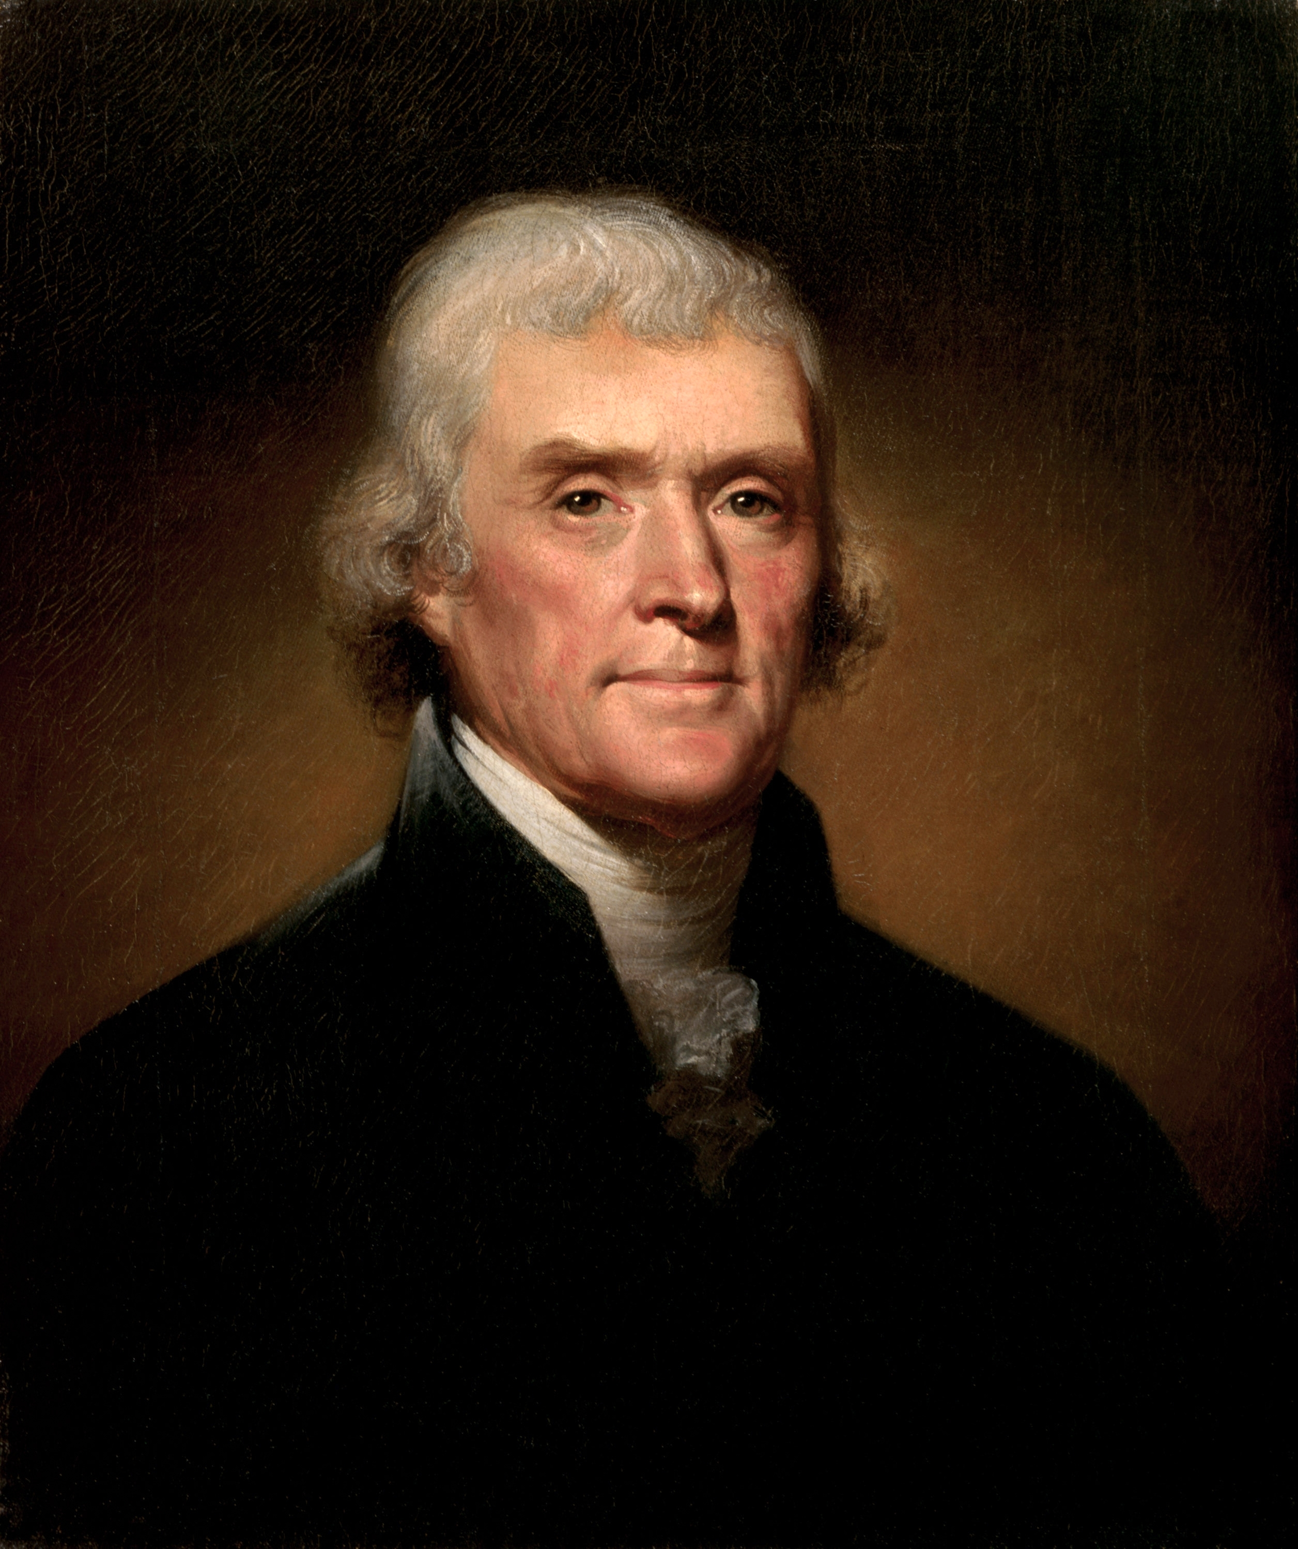
Freedom vs. Order? Or…
Federalists vs.
Republicans

Slide 9
Rebellion: VA and KY Resolutions
Declared that the Constitution was a "compact”, an agreement among states.
Federal government had no right to exercise powers not specifically delegated to it
  should the federal government assume such powers, its acts under them would be void.
  The right of the states to decide as to the constitutionality of such laws passed by Congress.
VA & KY invoked “nullification and interposition”
  Madison asserted states are "duty bound to interpose" (or stand between) federal encroachment on the rights of a sovereign state.
Alexander Hamilton, then building up the army, suggested sending it to VA “to act upon the laws and put Virginia to the Test of resistance.”

Slide 10
Espionage & Sedition Acts (1917-18)

Slide 11
The Espionage Act (1917)
Made it illegal to….
“convey information with intent to interfere with the operation or success of the armed forces of the United States or to promote the success of its enemies.”
  Punishable by death or imprisonment for < 30 years
“cause or attempt to cause insubordination, disloyalty, mutiny, refusal of duty, in the military or naval forces of the United States, or to willfully obstruct the recruiting or enlistment service of the United States.”
  Punishable by a maximum $10,000 fine (~$200,000 today) and 20 years in prison.

Slide 12
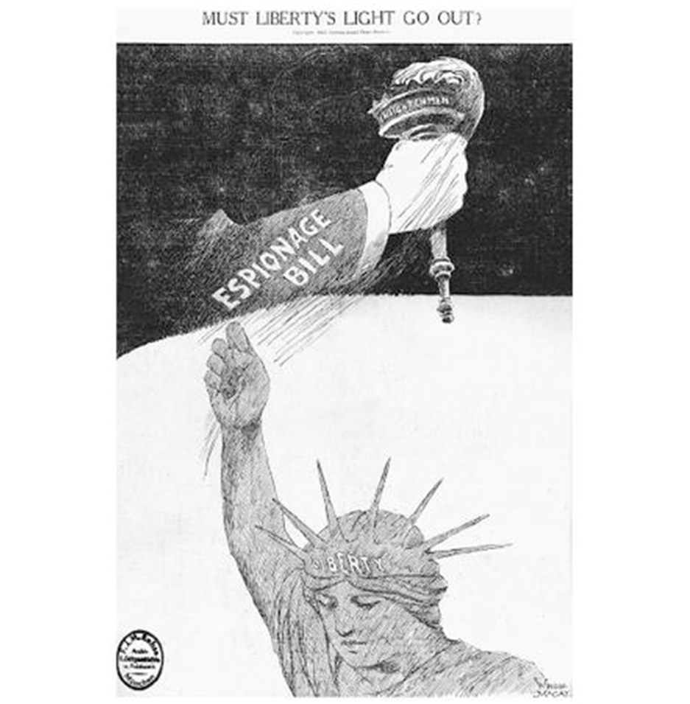
The Sedition Act (1918)
Forbade the use of "disloyal, profane, scurrilous, or abusive language" about the United States government, its flag, or its armed forces or that caused others to view the American government with contempt.
Passed HOR 293-1
Repealed Dec 13, 1920

Slide 14
Enforcement…on Some
Eugene V. Debs, Socialist Party presidential candidate in 1904, 1908, and 1912 was arrested and sentenced to 10 years for making a speech that "obstructed recruiting".
A section of E&S Act allowed the Postmaster General to declare all letters, newspapers, pamphlets, packages, and other materials that violated the Act to be un-mailable.
  75 newspapers either lost their mailing privileges or were pressured to print nothing more about WWI between June 1916 and May 1918.
  German-American and German-language newspapers, pacifist publications, and Irish nationalist publications were denied mailing and/or shut down.

Slide 15
Enforcement…on Some
Schenck v. United States, (1919)
  Schenck was an anti-war Socialist, convicted of sedition after he published a pamphlet urging resistance to the WWI draft.
  SC Justice Oliver Wendell Holmes joined the Court majority in upholding Schenck's conviction in 1919
    He also introduced the theory that punishment in such cases can only be limited to political expression which constitutes a "clear and present danger" to the government action at issue.

Slide 16
Freedom v. Order: A Persistent Theme
Suspension of habeas corpus in Civil War (1863)
Japanese Internment during WWII (1942-45)
Anti-communist hysteria (McCarthyism and HUAC) (1947-53)
Silencing anti-war protesters at the Chicago DNC (1968)
USAPA (Uniting and Strengthening America by Providing Appropriate Tools Required to Intercept and Obstruct Terrorism Act (2001)

Slide 17
From the Record
“They who would give up an essential liberty for temporary security, deserve neither liberty or security.”
-Benjamin Franklin
“The average man does not want to be free. He simply wants to be safe.”
-H.L. Mencken

