Slide 1
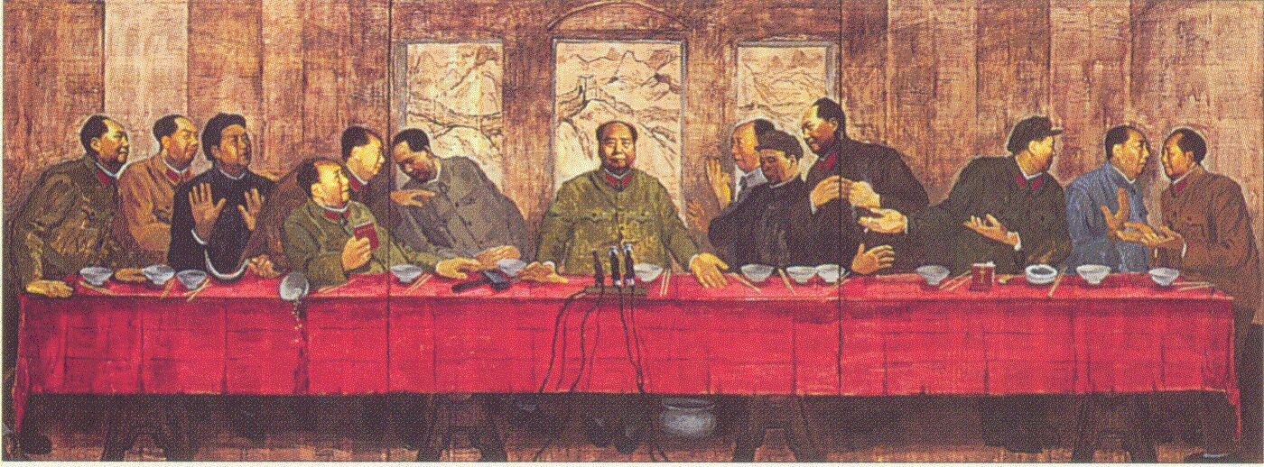
Mao’s China 1949 - 1976

Slide 2
Presentation Outline
Theoretical Maoism
Snapshot of the Chinese Civil War
Great Leap Forward
100 Flowers Campaign
Cultural Revolution
Maoist Propaganda
Conclusions

Slide 3
Brief Sketch of the Mao Years
KMT-CCP Civil War (1912-1937, 1945-1949)
Recovery and Socialism (1949-1956)
100 Flowers Campaign (1956-1957)
Great Leap Forward (1957-1961)
Recovery & Growing Elite Division (1962-65)
Proletarian Cultural Revolution (1966-1976)
Reign of Deng Xiaoping (1978)

Slide 4
Maoism in Theory
The Little Red Book contains the thoughts of CCP Chairman Mao Zedong.
Assembled by CCP editors from speeches and writings of Mao, it was intended as a guide for the Cultural Revolutionaries of 1966-1976.
It was one of the most intensely studied books in the world.

Slide 5
Theoretical Maoism
Classes struggle, some classes triumph, others are eliminated. Such is history, such is the history of civilization for thousands of years. To interpret history from this viewpoint is historical materialism; standing in opposition to this viewpoint is historical idealism.
"Cast Away Illusions, Prepare for Struggle" (August 14, 1949)
A well-disciplined Party armed with the theory of Marxism-Leninism, using the method of self-criticism and linked with the masses of the people; an army under the leadership of such a Party; a united front of all revolutionary classes and all revolutionary groups under the leadership of such a Party - these are the three main weapons with which we have defeated the enemy.
"On the People's Democratic Dictatorship" (June 30, 1949)

Slide 6
Theoretical Maoism
A revolution is not a dinner party, or writing an essay, or painting a picture, or doing embroidery; it cannot be so refined, so leisurely and gentle, so temperate, kind, courteous, restrained and magnanimous. A revolution is an insurrection, an act of violence by which one class overthrows another.
"Report on an Investigation of the Peasant Movement in Hunan" (March 1927)
The socialist system will eventually replace the capitalist system; this is an objective law independent of man's will. However much the reactionaries try to hold back the wheel of history, sooner or later revolution will take place and will inevitably triumph.
"Speech at the Meeting of the Supreme Soviet of the U.S.S.R. in Celebration of the 40th Anniversary of the Great October Socialist Revolution" (November 6, 1957)

Slide 7
Theoretical Maoism
We must have faith, first, that the peasant masses are ready to advance step by step along the road of socialism under the leadership of the Party, and second, that the Party is capable of leading the peasants along this road. These two points are the essence of the matter, the main current.
On the Question of Agricultural Co-operation (July 31, 1955)
By overall planning we mean planning which takes into consideration the interests of the 600 million people of our country. In drawing up plans, handling affairs or thinking over problems, we must proceed from the fact that China has a population of 600 million people, and we must never forget this fact.
On the Correct Handling of Contradictions Among the People (February 27, 1957)

Slide 8
Theoretical Maoism
"Don't you want to abolish state power?" Yes, we do, but not right now; we cannot do it yet. Why? Because imperialism still exists, because domestic reaction still exists, because classes still exist in our country. Our present task is to strengthen the people's state apparatus - mainly the people's army, the people's police and the people's courts - in order to consolidate national defense and protect the people's interests.
"On the People's Democratic Dictatorship" (June 30, 1949)
In all the practical work of our Party, all correct leadership is necessarily "from the masses, to the masses." This means: take the ideas of the masses (scattered and unsystematic ideas) and concentrate them (through study turn them into concentrated and systematic ideas), then go to the masses and propagate and explain these ideas until the masses embrace them as their own, hold fast to them and translate them into action, and test the correctness of these ideas in such action. Then once again concentrate ideas from the masses and once again go the masses so that the ideas are persevered in and carried through. And so on, over and over again in an endless spiral, with the ideas becoming more correct, more vital and richer each time. Such is the Marxist theory of knowledge.
"Some Questions Concerning Methods of Leadership" (June 1, 1943)

Slide 9
War Against Japan (1937-1945)
The United Front: Myth vs. Reality
BOTH US and USSR gave aid before, during, and after the Japanese invasion

Slide 10
Civil War (1945 - 1949)
KMT: Kuomintang (Nationalists)
Chiang Kaishek (President)
Nationalist
Modernist/Westernist
Stronghold in the East
CCP: Chinese Communist Party
Mao Zedong Chairman
Marxist-Leninist
Stronghold in western, rural areas

Slide 11
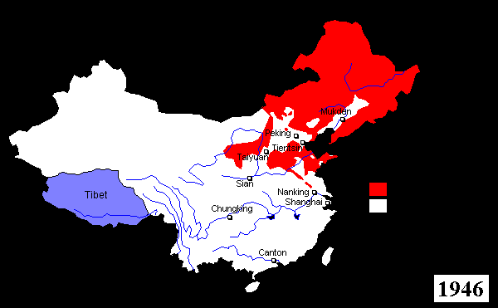
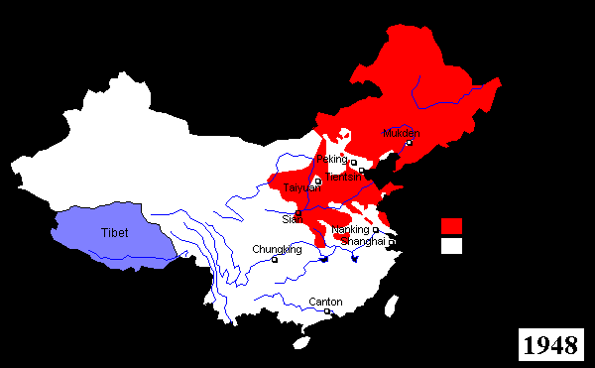
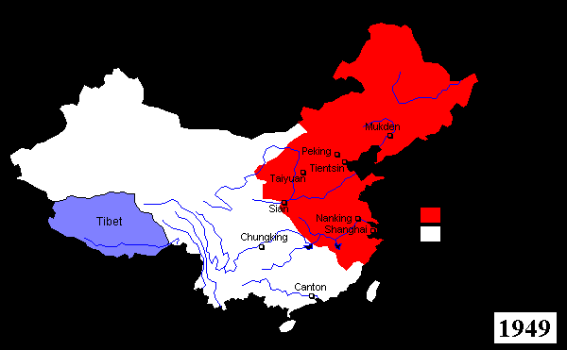
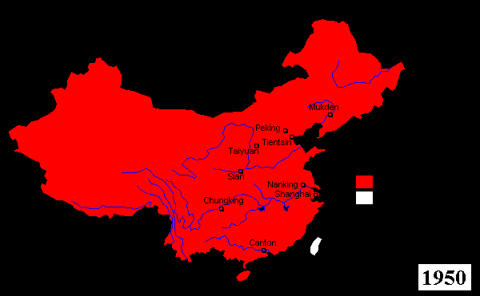
Civil War (1945 - 1949)

Slide 12
Mao’s Basic Goals
Revolution from above to remove “3 big mountains”
imperialism
feudalism
bureaucratic-capitalism
United Front of …
workers
peasants
petty bourgeoisie

Slide 13
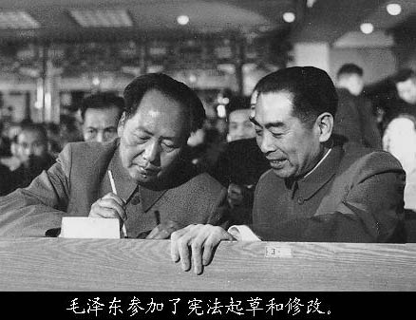
1950’s Economic Reconstruction
Soviet model and assistance
Land reform (eliminate landlords)
Heavy industry (state-owned enterprises)
First National People’s Congress (1954)
PRC Constitution
Zhou Enlai
Premiere
Foreign Minister
Vice Chairman of CCP

Slide 14
100 Flowers Campaign (1956-1957)
Zhou & CCP encouraged a variety of solutions to ongoing problems, launched under the slogan:
"Letting a hundred flowers blossom and a hundred schools of thought contend is the policy for promoting progress in the arts and the sciences and a flourishing socialist culture in our land."

Slide 15
100 Flowers Campaign (1956-1957)
Embolden intellectuals to discuss the country's political and cultural problems
Mao & Zhou believed it would be obvious to the people that socialism was superior to capitalism and the HFC would thus propel socialism

Slide 16
Effects of the HFC
Spiralled out of control. Millions of critical letters arrived in government offices:
“We protest against CCP control over intellectuals, the harshness of previous mass campaigns such as that against counterrevolutionaries, the slavish following of Soviet models, the low standards of living in China, the abolition of foreign literature, economic corruption among party cadres, and the fact that Party members enjoyed many privileges which make them a race apart.”
“The country should separate with each Political Party controlling a zone of its own.”
"Each political party in China should rule in transitional governments, each with a 4 year term."

Slide 17
Effects of the HFC
July 1957, Mao ordered a halt to the HFC.
Mao had witnessed Khrushchev denouncing Stalin and the Hungarian Revolution of 1956, events by which he felt threatened.
Mao's earlier speech, On the Correct Handling of the Contradictions Among the People, was meaningfully changed and appeared later as an anti-rightist piece.

Slide 18
Effects of the HFC
Bureaucracy vs. Intelligentsia vs. Mao. Moderates vs. Radicals. Urban vs. Rural…
Flowers turned to “weeds”
The result of the HFC was the persecution of intellectuals, officials, students, artists and dissidents labeled "rightists"
550,000+ identified as "rightists" were humiliated, imprisoned, demoted or fired from their positions, sent to labor and re-education camps, tortured, or killed.
Deng was operative in the purge. Zhou lost credit.
Led to Cultural Revolution…

Slide 19
The Great Leap Forward 1958-63 (2nd 5YP)
Mao’s early experiences with peasant revolution convinced him of the immense potential of peasant strength. He believed if properly organized and inspired, the Chinese masses could accomplish amazing feats.
Mao called upon all Chinese to engage in zealous physical labor to transform the economy and overtake the West in industrial and agricultural production within a few years (“walking on two legs”)
In mid-1950s Mao demanded rapid formation of agricultural communes

Slide 20
The Great Leap Forward 1958-63 (2nd 5YP)
1959 - 1962 were known as the Three Bitter Years and the Three Years of Natural Disasters.
If the weather was better…?
Many local officials were “tried” and publicly executed for falsifying grain production numbers. Culture of fear from HFC.
Massive famine
2-3 million dead

Slide 21
Great Leap Forward 1958-63 (2nd 5YP)
Vast initiatives implemented in 5 months…too rapid… unprepared
Organizational chaos
USSR withdrew support
CCP forced to abandon the effort due to falling agricultural and industrial output.

Slide 22
Great Leap Forward 1958-63 (2nd 5YP)
Entered a period of “Readjustment, Consolidation and Repair” (1961-65)
With the abandonment of the GLF, moderates in the CCP fostered sharp changes in policy to restore order and to repair economic damage
Particular emphasis given to agriculture communes to reduce threat of mass malnutrition and starvation.

Slide 23
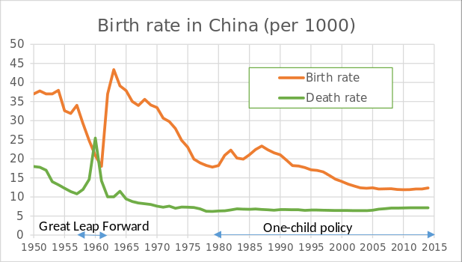
Great Leap Forward 1958-63 (2nd 5YP)

Slide 24
Great Leap Forward 1958-63 (2nd 5YP)
GLF is now widely seen – both within China and outside – as a major economic and humanitarian disaster.
Official toll of excess deaths during the GLF is 14 million
Scholars have estimated the number of famine victims to be 20-45 million, with the mean around 30 million in a population of 600 million, or 5%.
The HFC & GLF were among the underlying causes of the Cultural Revolution…

Slide 25
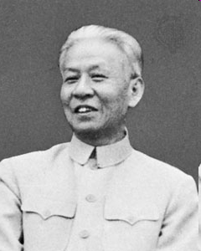
GLF Divided the CPC
Mao Zedong versus:
Liu Shaoqi
Peng Dehuai
Deng Xiaoping
Charismatic leadership vs. bureaucracy
Sino-Soviet Split, 1960

Slide 26
GLF Divided the CPC
Mao’s relationship with intellectuals was uneasy. He was critical of the gap between the lives of the urban educated elite and the rural masses.
GLF failed. Those who criticized Mao were humiliated and purged.

Slide 27
GLF Divided the CPC
Liu Shaoqi:
Chairman of the NPC SC (1954-59), PRC Chairman 1956-66.
Liu was the third most powerful man in China
“The economic disaster [of the GLF] was 30% fault of nature, 70% human error.” Arrested in 1967. Publicly beaten and tortured for 2 years. Died in 1969.

Slide 28
GLF Divided the CPC
Peng Dehuai: Defense Minister. Spoke out in 1959.
Argued the CCP can’t "jump into communism in one step."
Peng alleged to have been encouraged by Khrushchev to oppose Mao.
Mao increasingly felt that all criticism of the CCP were attacks on him personally.
Mao purged Peng from all influential positions for the rest of his life.
Lived in obscurity until 1965. Brought back. Purged again in 1970. He was formally tried, sentenced to life imprisonment, died in prison in 1974.
…Deng resuscitated Liu and Peng

Slide 29
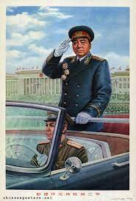
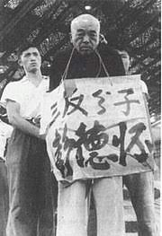
GLF Divided the CPC
Grain scattered on the ground, potato leaves withered;
Strong young people have left to make steel;
Only children and old women reap the crops;
How can they pass the coming year?
Allow me to raise my voice for the people!
In 1958 Peng wrote and circulated this poem in response to what he saw touring the countryside.
“Everybody had a share of responsibility [for the GLP] including Comrade Mao". (Peng)

Slide 30
Great Proletarian Cultural Revolution (1966-1976)
To renew the revolutionary spirit…
Mao’s Red Guards raided houses looking for “Four Olds”
Customs, Cultures, Habits, Ideas
Mao declared the Chinese people “blank”
Before the drama had played itself out, it consumed, physically or spiritually, virtually all of its original promoters as tens of millions of innocents.

Slide 31
Great Proletarian Cultural Revolution (1966-1976)
“There is no period in China’s history so complex and contradictory or so lacking in historical precedents, no other period where all historical analogies fail. Rarely has any society revealed itself so openly with all its contradictions and scars, and rarely have events unfolded in ways so strange, torturous and bizarre.” (293)
“The main responsibility for the movement rests with Mao himself.” (292)

Slide 32
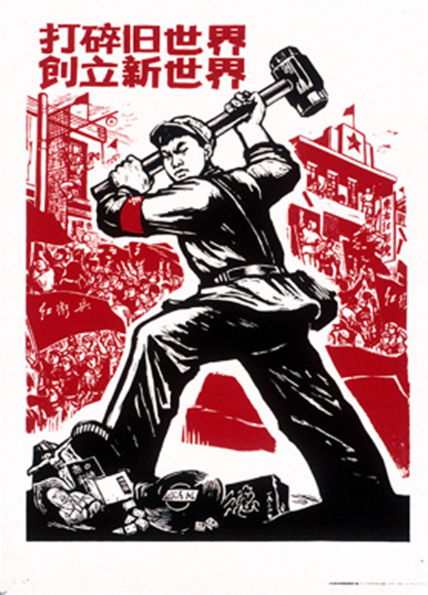
Red guards raided houses. They destroyed museums, homes, and works of art. They ruined lives and reputations in order to extinguish the Four Olds.

Slide 33
Cultural Revolution (1966-1976)
Mao wanted to solve 3 main problems:
Growing inequality
Fading socialist vision
Entrenchment of bureaucratic elites
To do so, Mao sought to co-opt
Intellectuals, who also rejected traditionalism
Peasants, who rejected urban elites
...and arm them with revolutionary consciousness

Slide 34
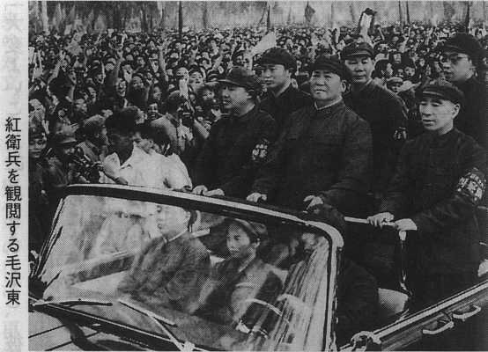
Red Guards (1966-69)
Renamed streets and buildings
Lined streets with pictures of Mao
Attacked and humiliated those in Western or traditional clothing
As early as 1967, Red Guards were seen as a liability by many in the Party

Slide 35
Cultural Revolution (1966-1976)
I. Public struggle sessions:
Places where the accused struggled:
Workplace or school of the accused (ordinary people)
Huge stadiums (famous people, like Liu Shaoqi)
Participants:
Accusers
Spectators (twisted entertainment for the masses)
Process of struggle:
Verbal attacks by colleagues, students, friends, relatives
Physical humiliation
Subordinates were pitted against superiors, students against teachers, friends against friends, colleagues against colleagues, spouse against spouse

Slide 36
Cultural Revolution (1966-1976)
II. Against the Four Olds
Red Guards were mostly teens
Sacking, looting, beating, killing
Destroyed (and stole) public and personal property, and anything somehow representing the Four Olds.
A vague and vast array of victims: landlords, reactionaries, counterrevolutionaries, rightists, bad elements, traitors, spies, capitalist-roaders, all of them “ox ghosts and snake spirits”

Slide 37
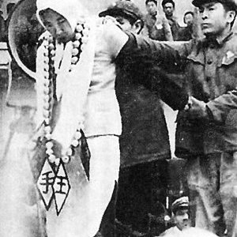
Cultural Revolution (1966-1976)
III. Self-Destruction
Self-criticism, including false confession
Suicide
Despair
Fear
Save one’s family
Protest against CCP
IV. Psychological Terror
Some 12 million young people sent to the countryside to “study”
Deng sent for “xuexi” (re-education) three times.
Wang Guangmei (Liu’s wife) criticized by the Red Guards in April 1967

Slide 38
Mao and Zhou Died in 1976

Slide 39
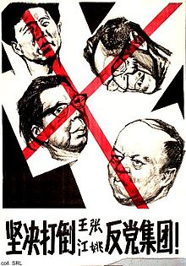
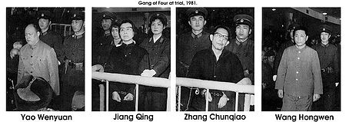
Cultural Revolution died with Mao
“Gang of Four” arrested in 1976 and tried in 1981
No executions. Life imprisonment.
Deng criticized Mao’s “cult of personality” (sound familiar?)
"Decisively Throw Out the Wang-Zhang-Jiang-Yao Anti-Party Clique!"

Slide 40
“Long Live Chairman Mao”

Slide 41
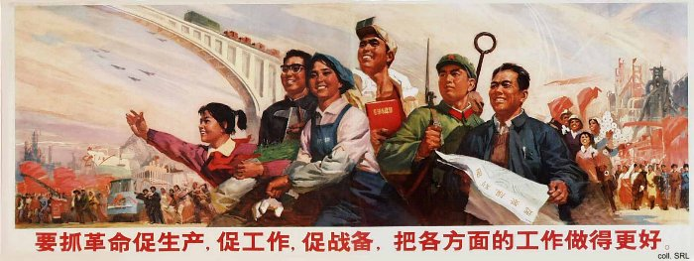
“We must grasp revolution. Increase production!

Slide 42
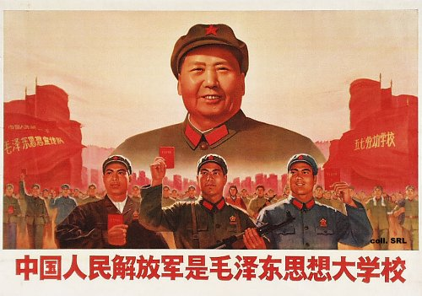
“The People's Liberation Army represents the great school of Mao Zedong Thought”

Slide 43
“Criticize the old world and build a new one with Mao Zedong Thought as our guide”

Slide 44
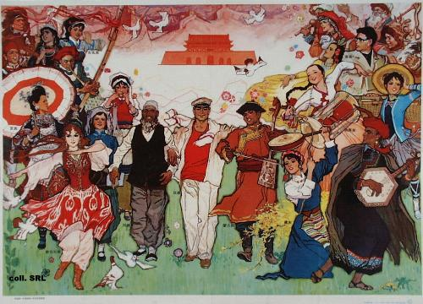
“Our country is a united, multicultural nation”

Slide 45
“Awakened people! You will certainly attain the ultimate victory”

Slide 46
“We are proud to participate in the industrialization of the nation”

Slide 47
“Thoroughly engage in revolutionary criticism”

Slide 48
“Strike the battle drum of the Great Leap Forward even louder”

Slide 49
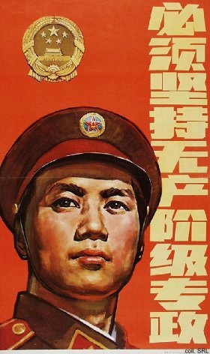
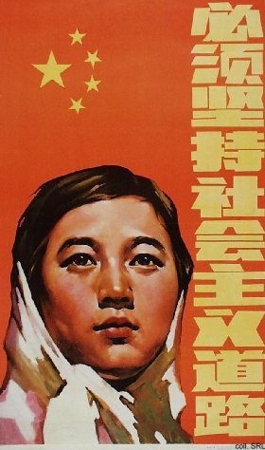
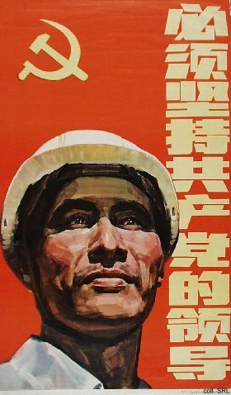
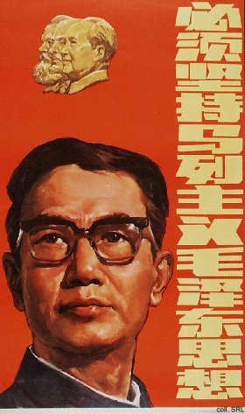
Post-Mao Propaganda (1979)
Deng Xiaoping introduced "Four Basic Principles in March 1979.
We must keep to the socialist road
We must uphold the dictatorship of the proletariat
We must uphold the leadership of the Communist Party
We must uphold Marxism-Leninism-Mao Zedong Thought

Slide 50
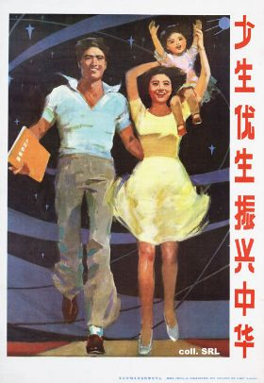
“Less births, better births to develop China vigorously.” (1988)

Slide 51
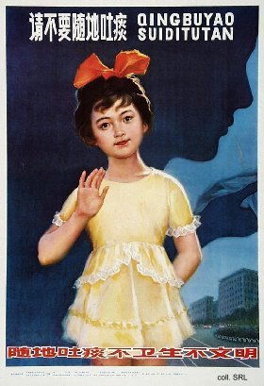
“Do not spit freely. Spitting is neither hygienic nor civilized” (1986)

