Slide 1
Paradoxes of the American Experience
Mr. Daniel Lazar

Slide 2
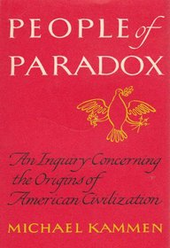
Kammen (1936-2013) was professor of American cultural history in the Department of History at Cornell University. He was awarded the 1973 Pulitzer Prize in history for this book.

Slide 3
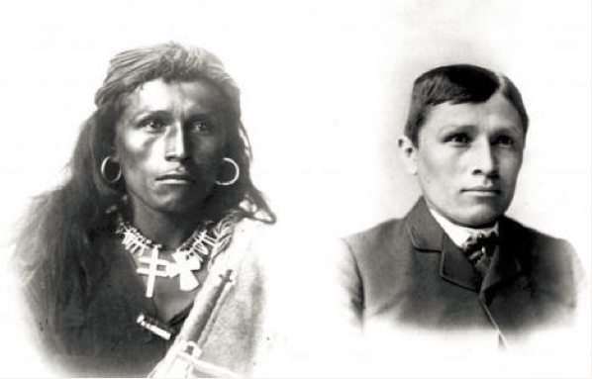
Paradox of the Natives
To civilize is to ruin him
Before and after of Tom Torino, Navajo

Slide 4
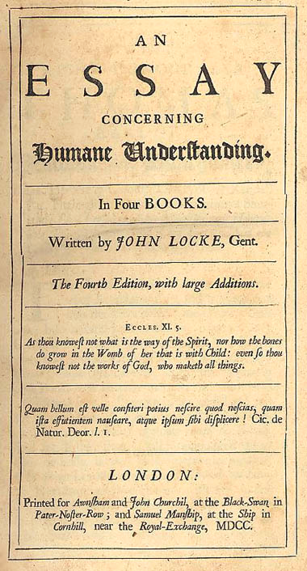
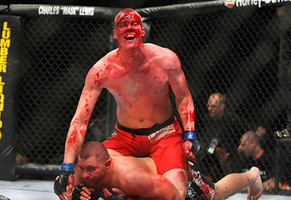
Savagery & Civilization
Man must be entitled to his natural state. But what is his natural state?

Slide 5
..... Savagery & Civilization?

Slide 6
Old World/New World
Europe as:
Stern Father/Kind Mother
Enemy/Ally
Teacher/Pupil

Slide 7
Paradoxes of the Revolution
Rebellion & Legitimacy
Calculated Fanaticism
How far should the dogs of anti-authoritarianism be unleashed?
Radical & Conservative

Slide 8
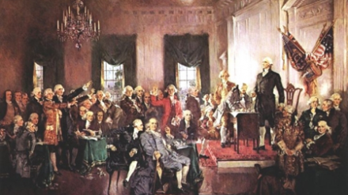
Paradoxes of the Constitution
“A more perfect Union”
A Well Regulated Democracy
Vague yet Legitimate
Weak yet Strong
Supreme Law?

Slide 9
Freedom & Order
“Freedom can both elevate and demoralize. It is a blessing and a curse for it means both liberty and lawlessness.” (p. 90)
“Liberty without obedience is confusion; Obedience without liberty is slavery.” –William Penn

Slide 10
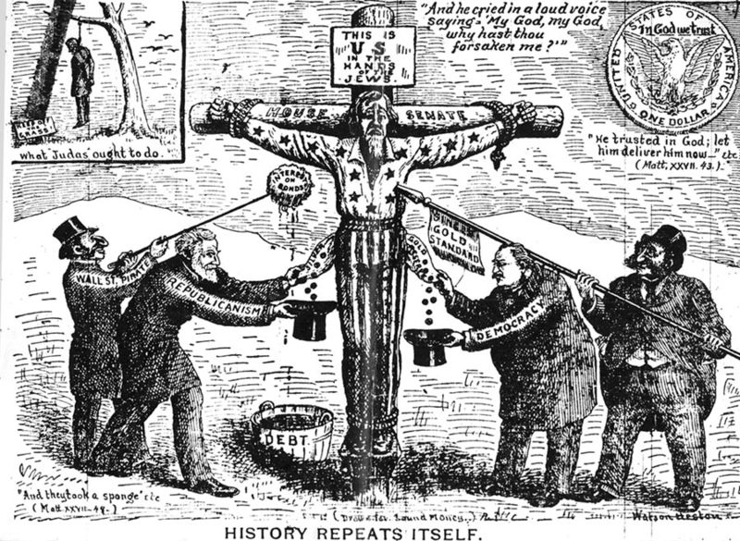
Majority Rule & Minority Rights
Slavery in Freedom
Gag Rule
Race, Ethnicity, Religion…

Slide 11
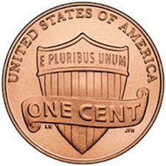
Heterogeneous & Homogenous
E Pluribus Unum
Pluralistic Society as an Oxymoron?
Unstable pluralism can have a stabilizing effect; it can also place the US in a permanently fragile condition
Melting Pot/Garden Salad
“The melting pot has been a boiling cauldron all along” (p. 73)

Slide 12
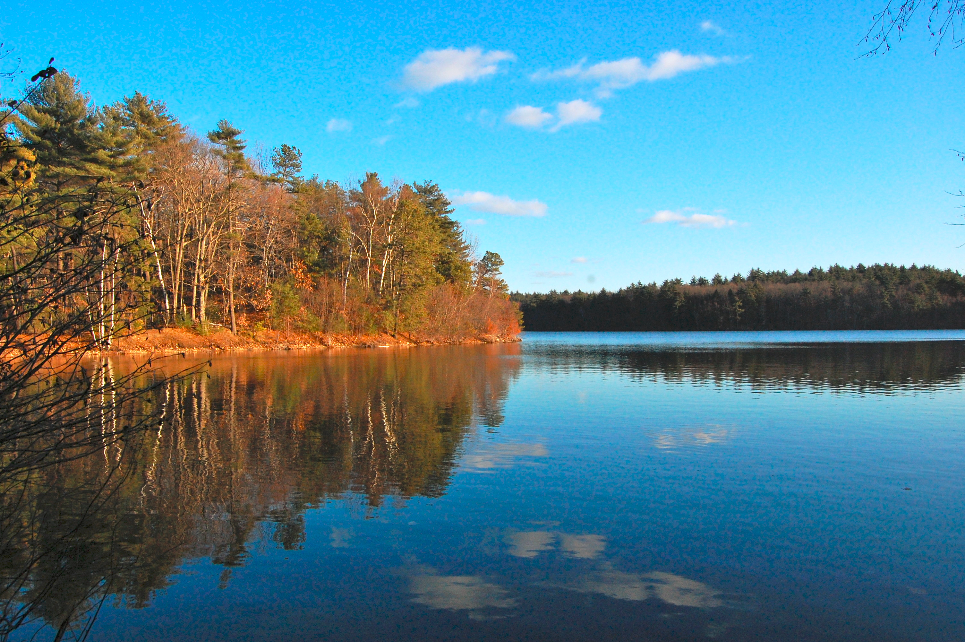
Collective Individualism
“Solitude is a sublime mistress but an intolerable wife.” - Emerson
Personal Privacy vs. Public Accountability
Competitive Cooperation
Walden Pond

Slide 13
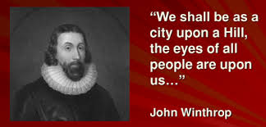
Human Intellect & Divine Transcendence
Science and Faith
Godly Materialism
Puritan Idealism-Divine Utopianism vs. Yankee Pragmatism

Slide 14
Democratic Elitism
Hierarchy vs. Egalitarianism
Justice vs. Equality
Poverty amidst Plenty
“Going to the poor house in an automobile.” (Will Rogers)
Political Inclusiveness and Economic Exclusiveness

Slide 15
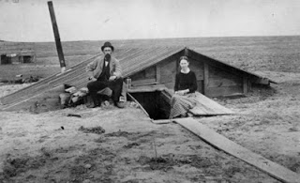
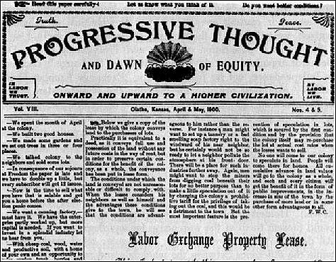
Paradox the West
Nostalgic & Regressive vs. Utopian & Progressive

Slide 16
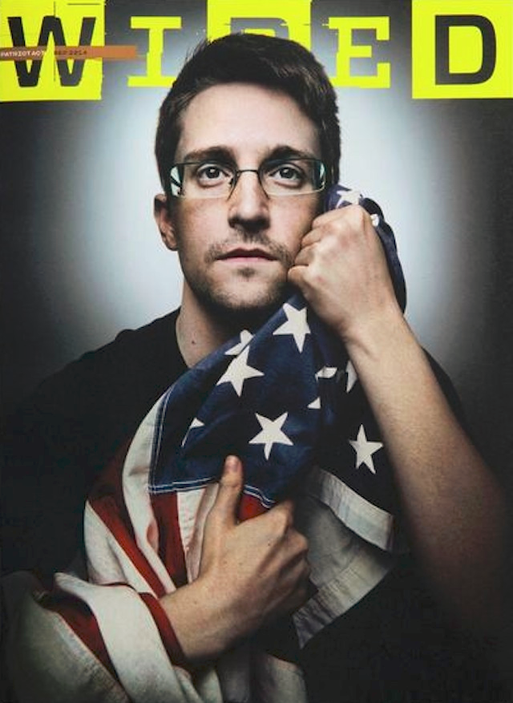
Paradox of Patriotism
Love to Hate/Hate to Love the USA
Pride and Guilt

Slide 17
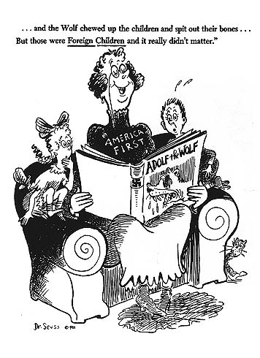
Isolationism & Interventionism

Slide 18
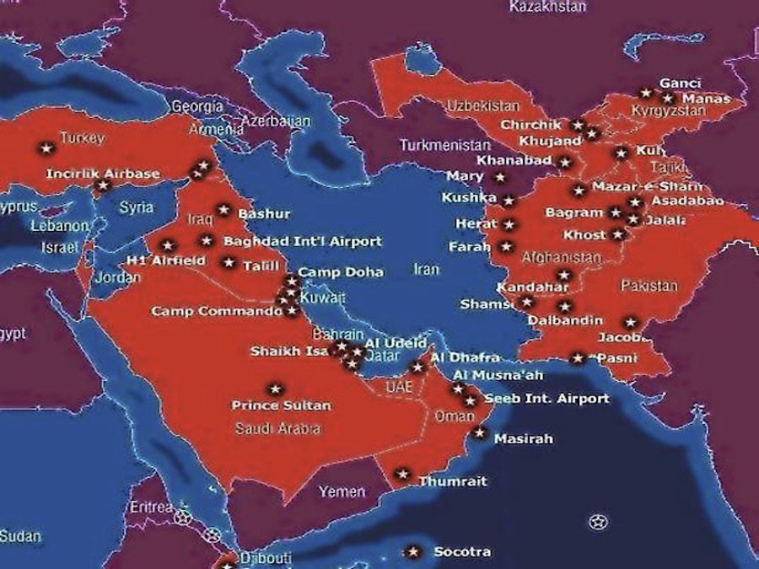
Waging Peace

