Slide 1
Reconstruction: 1863-1877
Mr. Daniel Lazar

Slide 2
Introductory Questions
What constitutional issues are raised by secession and reunion?
Who should be responsible for Reconstruction?
Federal or State?
Legislative or Executive lead?
What to do with 4,000,000 freed Blacks?
Can government legislate morality?
How, if at all, should the South be punished?

Slide 3
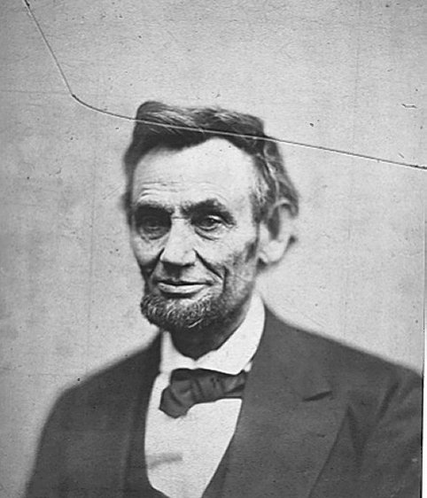
Presidential Reconstruction: Lincoln’s 10% Plan (1863)
“With Malice toward none, with charity for all, with firmness in the right as God gives us to see the right, let us strive on to finish the work we are in, to bind up the nation's wounds, to care for him who shall have borne the battle and for his widow and his orphan, to all which may achieve and cherish a just and lasting peace among ourselves and with all nations.”

Slide 4
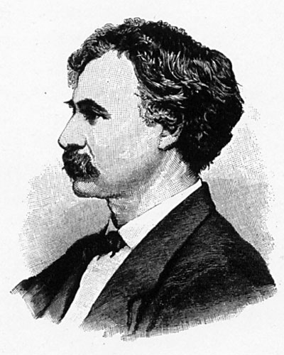
Radical Reaction: Wade-Davis Bill (1864)

Slide 5
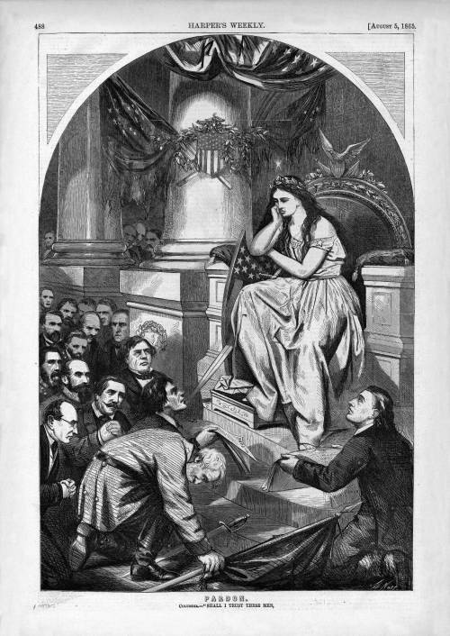

Slide 6
"Franchise: And Not This Man?" Harper's Weekly, August 5, 1865.

Slide 8
Johnson’s Plan
“You know perfectly well it was the wealthy men of the South who dragooned the people into secession.”
“The South is a white man’s country…It must be acknowledged that in the progress of nations Negroes have shown less capacity for government than any other race of people. No independent government of any form has ever been successful in their hands. On the contrary, wherever they have been left to their own devices they have shown a constant tendency to relapse into barbarism.”

Slide 9
Congressional Reconstruction
1865 - 13th Amend: Emancipation
1865 - Freedmen’s Bureau (defunded in 1869, died in 1872)
1866 - Civil Rights Act of 1866 to combat Jim Crow Laws
1868 - 14th Amend: Equal Rights
1870 - 15th Amend: Voting Rights
Enforcement Acts 1870-1871
1867 - Tenure in Office Act
1867 - Reconstruction Act of 1867…

Slide 10
Congressional Reconstruction

Slide 11
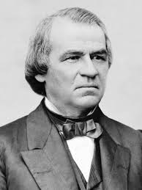
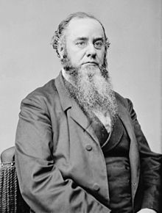
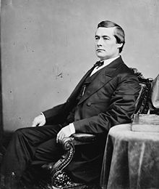
Congressional Reconstruction: Tenure in Office Act, 1867
Edwin Stanton Andrew Johnson Edmund Ross

Slide 12
Reconstruction in the South
De jure and De facto segregation
Jim Crow Laws (Black Codes)
Gradualism vs. Confrontationalism
Washington vs. DuBois
Sharecropping…

Slide 14
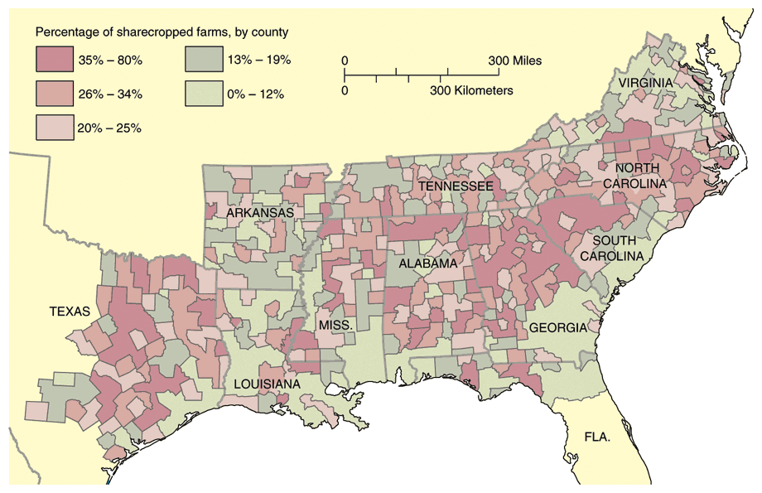

Slide 15
Race of delegates to 1867 state constitutional conventions
State | White | Black | White (%) | Statewide white population (%)
Virginia | 80 | 25 | 76 | 58
North Carolina | 107 | 13 | 89 | 63
South Carolina | 48 | 76 | 39 | 41
Georgia | 133 | 33 | 80 | 54
Florida | 28 | 18 | 61 | 51
Alabama | 92 | 16 | 85 | 52
Mississippi | 68 | 17 | 80 | 46
Louisiana | 25 | 44 | 36 | 50
Texas | 81 | 9 | 90 | 69

Slide 16
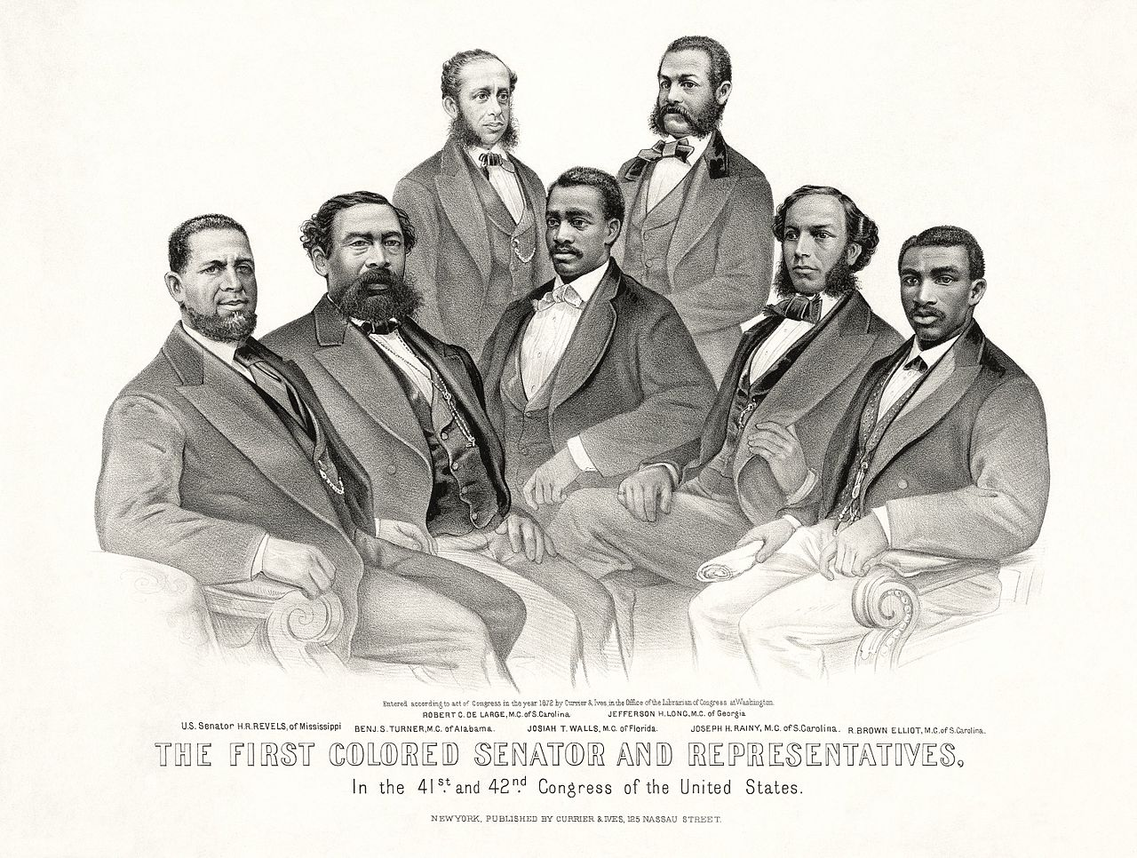

Slide 17
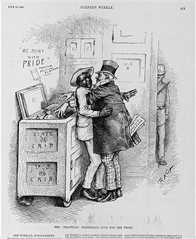
Reconstruction in the South Carpetbaggers & Scalawags

Slide 18
Why Did Reconstruction End?
Johnson’s impeachment hurt Republicans
Redemption, aka “Home Rule”
Rise of White Leagues, including the KKK (est. 1866)
Corruption under Grant (1868-76) → Radical Repub Influence Declined
Republicans were not Holy Men
Freedmen’s Bureau abandoned in 1872
Amnesty Act of 1872
Panic of 1873
Election of 1876

Slide 20
