Slide 1
Introduction to Propaganda & Soviet Propaganda Posters
Mr. Daniel Lazar

Slide 2
Operation Definition of Propaganda
"Propaganda is neutrally defined as a systematic form of purposeful persuasion that attempts to influence the emotions, attitudes, opinions, and actions of specified target audiences for ideological, political or commercial purposes through the controlled transmission of one-sided messages (which may or may not be factual) via mass and direct media channels.”
-Richard Alan Nelson

Slide 3
Quotations on Propaganda
“Only the mob and the elite can be attracted by the momentum of totalitarianism itself. The masses have to be won by propaganda.”
-Hannah Arendt

Slide 4
Quotations on Propaganda
“The conscious and intelligent manipulation of the organized habits and opinions of the masses is an important element in democratic society.”
-Edward Bernays

Slide 5
Quotations on Propaganda
“If you tell a lie big enough and keep repeating it, people will eventually come to believe it. The lie can be maintained only for such time as the State can shield the people from the political, economic and/or military consequences of the lie. It thus becomes vitally important for the State to use all of its powers to repress dissent, for the truth is the mortal enemy of the lie, and thus by extension, the truth is the greatest enemy of the State.”
-Joseph Goebbels

Slide 6
Quotations on Propaganda
"The 20th century has been characterized by three developments of great political importance: the growth of democracy, the growth of corporate power, and the growth of corporate propaganda as a means of protecting corporate power against democracy.“
-Noam Chomsky

Slide 7
Types of Propaganda
Ad Hominem: attacking one’s opponent, as opposed to attacking their arguments.
Appeal to authority: Appeals to authority, cites prominent figures to support a position, idea, argument, or course of action.
Appeal to fear: to build support by instilling anxieties and panic
Bandwagon: to persuade the target audience to join in and take the course of action that "everyone else is taking."

Slide 8
Black-and-White fallacy: Presenting only two choices, with the product or idea being propagated as the better choice. ("You are either with us or against us")
Big Lie: The repeated articulation of a complex of events that justify subsequent action.
Demonizing the enemy: Making individuals from the opposing nation, ethnic group, etc. the subhuman nemesis

Slide 9
Types of Propaganda
Direct order: to simplify the decision and eliminate other options. Eg - Uncle Sam "I want you"
Euphoria: The use of an event to generate euphoria or happiness, or using an appealing event to boost morale. Eg - declaring a holiday, mounting a military parade
Disinformation: The creation or deletion of information from public records. Includes outright forgery of photographs, motion pictures, broadcasts, and sound recordings as well as printed documents.

Slide 10
Types of Propaganda
Faulty Logic, where a is said to = x, and b is said to = x, then, therefore, a = b. (Lazar likes sushi, fascists like sushi, thus Lazar is a fascist)
Intentional vagueness: deliberately vague generalities so that the audience may supply its own interpretations. (e.g. “Fight for Freedom”)
Quotes out of Context: Selective editing of quotes which can change meanings.
Red herring: Presenting data or issues that, while compelling, are irrelevant to the argument at hand, and then claiming that it validates the argument.

Slide 11
Types of Propaganda
Scapegoating: Assigning blame to an individual or group
Slogans: A slogan is a brief, striking phrase that may include labeling and stereotyping.
Virtue words: These are words in the value system of the target audience which tend to produce a positive image when attached to a person or issue. Peace, happiness, security, wise leadership, freedom,

Slide 12
With shock labor we will ensure prompt delivery of the giants of the Five Year Plan

Slide 13
Directed to members of Komsomol, the communist youth organization.
Civilized life - productive work

Slide 14
The first Five Year Plan aims to build up heavy industry from virtually nothing.
This poster advertises a state loan for the building of large factories.

Slide 15
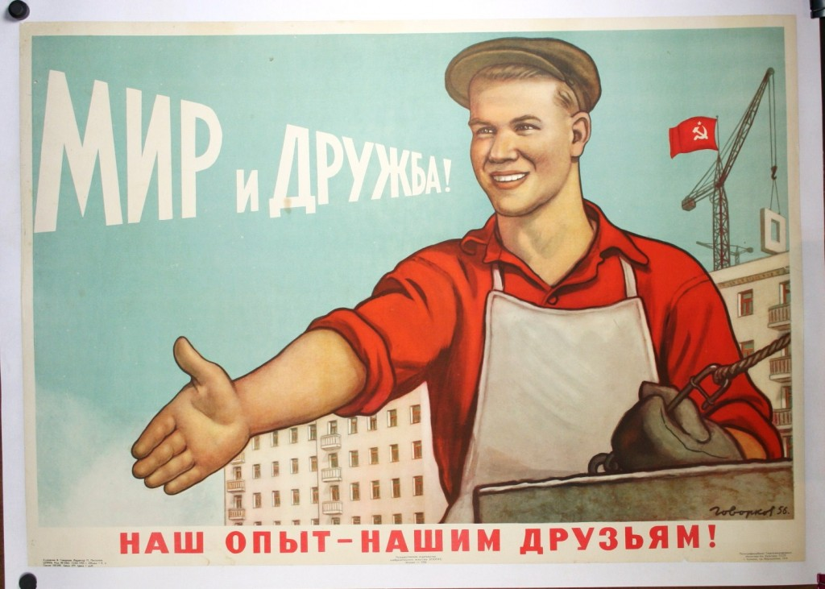
“Peace and Friendship”.
Subtitled “Our Experience – Our Friendship”

Slide 16
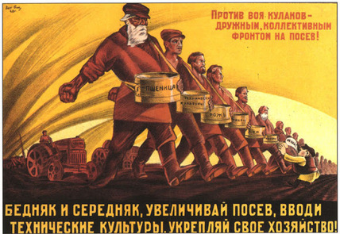
" Poor and middle class, increasing crops, establishing a technological culture"

Slide 17
Poster directed at women farmers, delegated to the meeting of 'the crack brigade of forewomen of Sots-Stroitelstva' to promote 'the realization of full collectivization and the liquidation of the kulaks as a class'.
Female delegate, stand to the fore!

Slide 18
Women, adhere to the cooperation

Slide 19
The text in the book reads 'Proletarians of all countries'
Literacy is the path to communism

Slide 20
One of Klutsis' most famous photomontages. With the heavily emphasized diagonal, the dynamic composition and the strong contrasts, this poster is one of the classics of Constructivism.
The USSR is the crack brigade of the world proletariat

Slide 21
Long Live The Man of Steel!

Slide 22
Stalin Revised…
When Stalin's purges claim the reputations and the lives of the once-loyal, Klustis reworked his material
Hacked two army marshals from Stalin's side. Marshal Yegorov, who remains in the poster, is tortured to death in 1939.
Klustis also suffered under Stalin's regime; he was arrested in 1938 and is eventually killed.

Slide 23
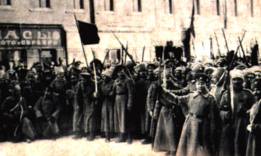
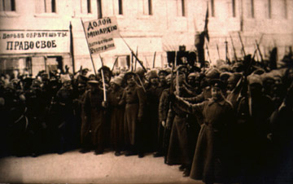
Postcard, 1917. Soldiers with sign
stating, "Watches of gold and silver."
Same photo, but signboard is
replaced with slogans, "Struggle for your rights."
The flag being waved says, "Down with the monarchy - long live the Republic!" has no visible words in the original.

Slide 24
The CPSU is Not Alone…
1947 comic book published by the Catechetical Guild Educational Society warning of "the dangers of a Communist takeover".

Slide 25
The CPSU is Not Alone…

Slide 26
Stalin is Not Alone…

Slide 27
The CPSU is Not Alone…

Slide 28
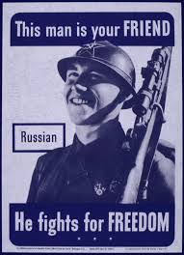

Slide 29
The End ???

