Slide 1
Hard Times in the Great Depression: Challenges to American Ambition
Mr. Daniel Lazar

Slide 2
Lecture Outline
The Numbers
The Better Angels of Our Nature
“Natural” Disasters, Manmade Disasters & Exodus
The Ordeal of Herbert Hoover
The 1932 Election

Slide 4
GDP in Billions

Slide 5
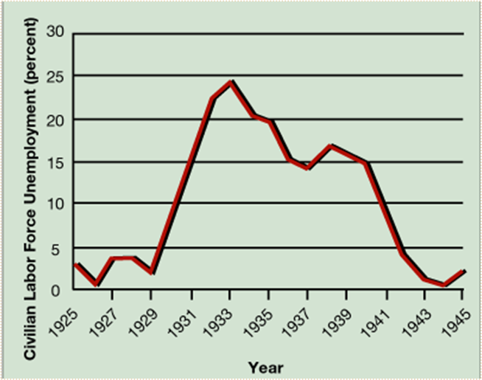
Population in 1933: 123 million, 13 million unemployed

Slide 6
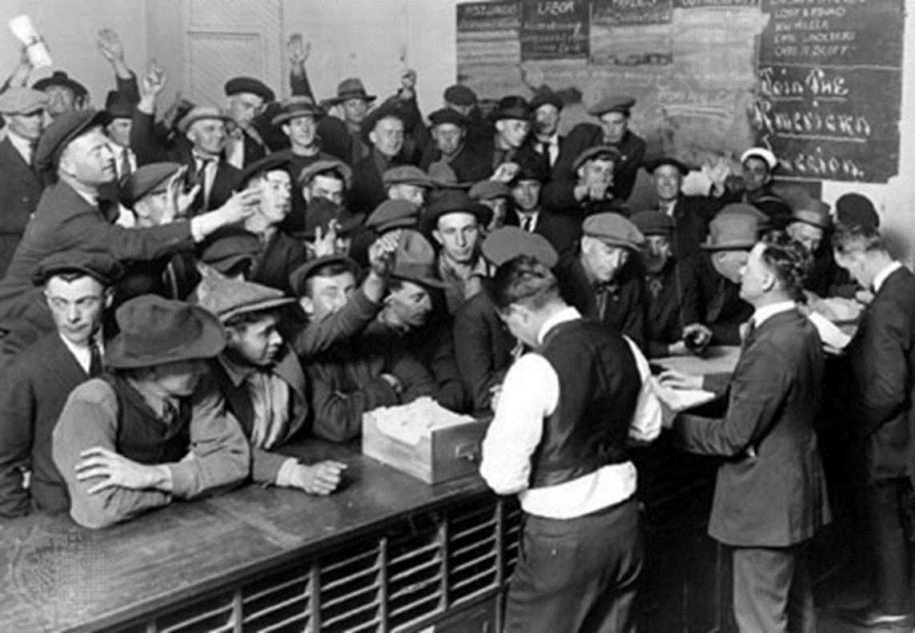

Slide 7
Average Weekly Earnings in Manufacturing
1928- $27.80
1929- $28.55
1930- $25.84
1931- $22.62
1932- $17.05
1933- $17.71

Slide 8
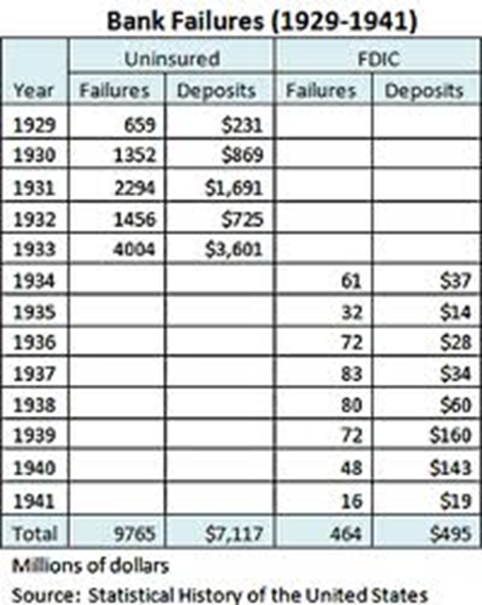

Slide 10
Life & Death
Fertility rate declined 20% from 1928-1935
Fun Fact: Life expectancy rose from 57.1 in 1929 to 63.3 years in 1932. Any guesses?
Death by suicide (per 100,000)
1920-1928: 12.1
1929: 18.1
1930-1940: 15.4

Slide 13
Capone's Soup Kitchen on South State St. in 1930

Slide 14
Dorthea Lange, “White Angel Breadline”, 1933

Slide 15
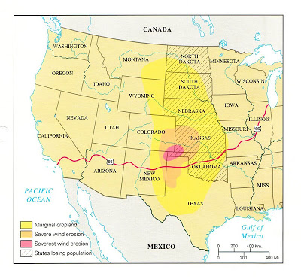

Slide 16
Strafford, TX

Slide 17
Elkhart, Kansas 1937

Slide 19
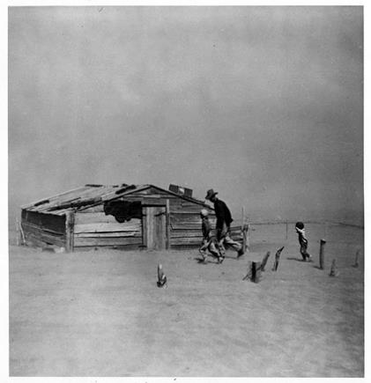

Slide 21
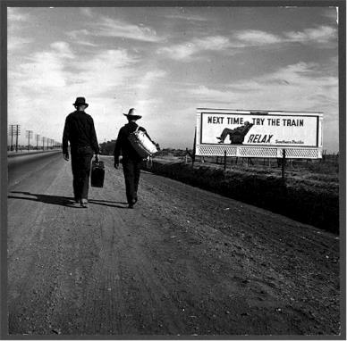
Mass Exodus: 2.5 million fled Great Plains by 1940
Lange in CA, 1936 and 1937

Slide 22
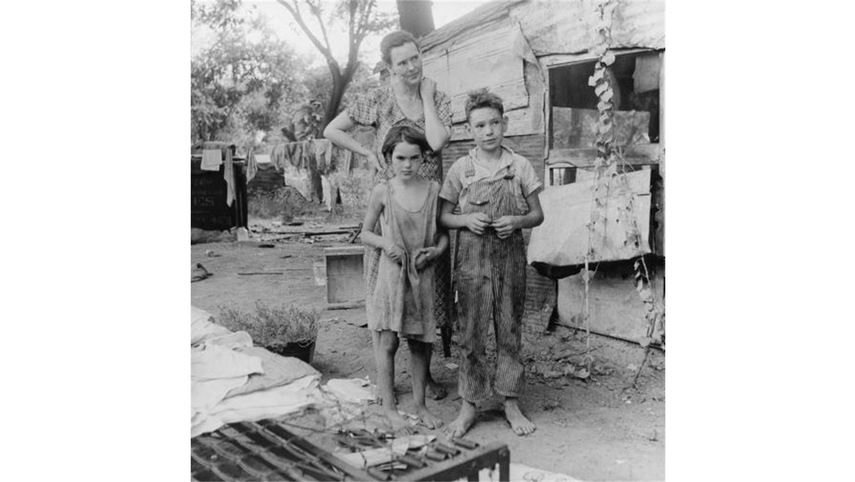
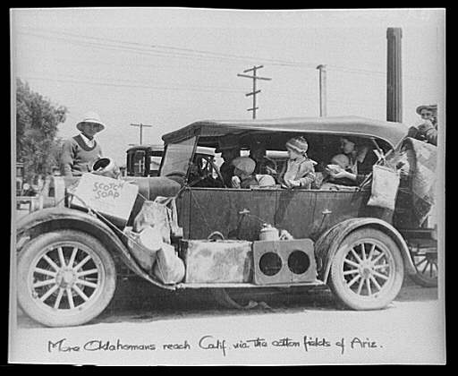
Okies & Arkies

Slide 23
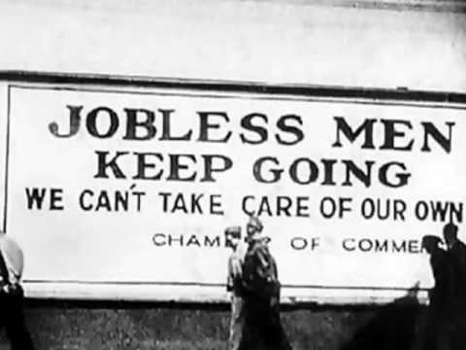
The Road

Slide 24
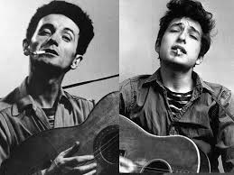
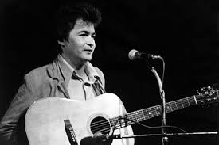
The Road

Slide 25
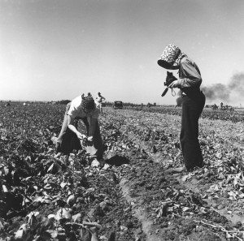
Migrant Farmers

Slide 26
Lange, “Migrant Mother”, 1936

Slide 27
Ohio River Flood, Louisville in 1937

Slide 28
"The Ordeal of Herbert Hoover“*
1874 -1964
Iowa Quaker Family
Orphaned at 10
Self-made
Inaugural Stanford Class of ‘95
“The Great Engineer”
Made a million in mining
Led WWI European relief effort
Commerce Sec: 1921-1928
31st President: 1929-1933
Fourth Quartile; Currently #36
*In 1958, Hoover penned “The Ordeal and Tragedy of Woodrow Wilson”

Slide 29
Hoovervilles
Central Park, 1933
Seattle, 1934

Slide 30
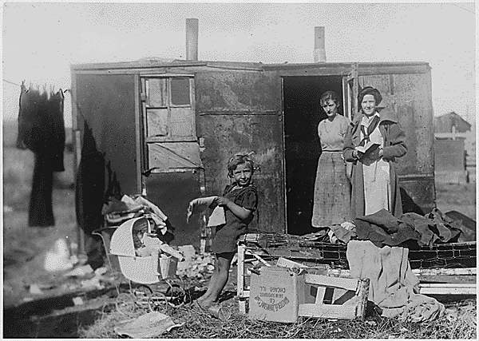

Slide 31
Lange, 1932

Slide 32
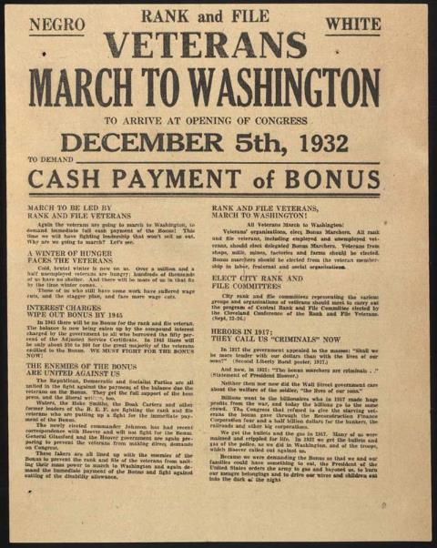
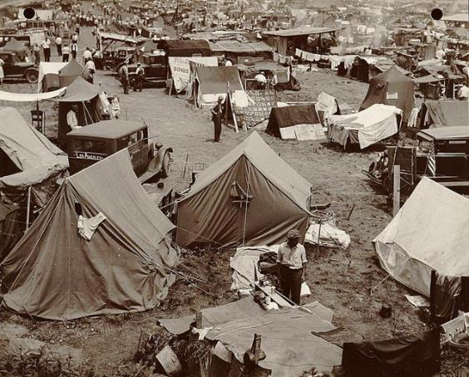
Bonus Army

Slide 33
MacArthur’s infantry beat and gassed marchers, killing two veterans and a 12-week old baby

Slide 34
“The Ordeal of Herbert Hoover”
He is certainly a wonder, and I wish we could make him President of the United States. There couldn't be a better one.
FDR on Hoover in 1920
We in America today are nearer to the final triumph over poverty than ever before in the history of any land. The poorhouse is vanishing from among us.
Speech accepting the Republican Party nomination, Stanford University, 11 August 1928

Slide 35
“The Ordeal of Herbert Hoover”
I have instituted systematic, voluntary measures of cooperation with the business institutions and with State and municipal authorities to make certain that fundamental businesses of the country shall continue as usual…
SOTU, Dec 1929
While the crash only took place six months ago, I am convinced we have now passed the worst and with continued unity of effort we shall rapidly recover.
Addressing annual Chamber of Commerce dinner, 1 May 1930

Slide 36
"The Ordeal of Herbert Hoover"
The question is whether that history shall be written in terms of individual responsibility, and the capacity of the nation for voluntary cooperative action, or whether it shall be written in terms of futile attempt to cure poverty by the enactment of law…
Address to the Gridiron Club, 27 April 1931

Slide 37
1932 Landslide

Slide 38
Inauguration Day,
4 March 1933

