Slide 1
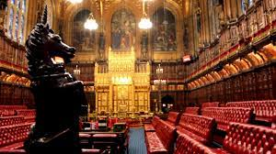
The House of Lords: Is it Broken and Can it be Fixed?
Baron Daniel Lazar

Slide 2
Outline
Current Structure & Functions
A Century of Reform
Contemporary Reform Proposals
Analysis Questions

Slide 3
Introductory thoughts…
“Every man has a House of Lords in his own head. Fears, prejudices, misconceptions - those are the peers and they are hereditary.” David Lloyd George
“The House of Lords is like a glass of champagne that has stood for five days” Clement Attlee
“I don't believe in the hereditary principle in the House of Lords. Imagine going to the dentist, sitting in the chair and he says, 'I'm not a dentist myself, but my father was a dentist and his father before him. Now, open wide!” Tony Benn
“We in the House of Lords are never in touch with public opinion. That makes us a civilized body.” Oscar Wilde
“The cure for admiring the House of Lords is to go and look at it.” Walter Bagehot
Lords Reform goes to the heart of the debate about democracy. It is an institution with a long and illustrious past, but an uncertain future…

Slide 4
Functions of the Lords
Initiate Legislation, except financial bills.
Delay legislation for up to a year (financial legislation for a month).
Expertise. Titles bestowed for achievement.
Questioning. Regular Question Times for government ministers.
Scrutinize. “The second pair of eyes”. Lords makes around 2,000 amendments a year to legislation, nearly all of which are accepted.
Debate.
No veto power.

Slide 5
Function: To Slow or Stymie “Elective Dictatorship”*
Once in power an elected government is nearly always able to pass legislation.
Westminster system stacked against confidence votes.
Party whips ensure that the government’s legislative proposals are supported at every stage in the Commons.
*Term coined by Lord Hailsham (Quintin Hogg, 1907-2011)

Slide 6
Comparisons with Commons
Similarities with Commons | Differences with Commons
Scrutinize Debate Select committees Whips Speaker (The Lord Chancellor) Check on executive | Unelected Second chamber with secondary role More impartial: less party oriented; less party disciplined Not paid Includes bishops & archbishops

Slide 7
Current Structure of the Lords
800 members
682 Life Peers – Appointed by Queen on advice of PM. Usually due to distinguished public service
92 Hereditary Peers – Title inherited (dying breed)
26 Lords Spiritual – Senior bishops from the Church of England

Slide 8
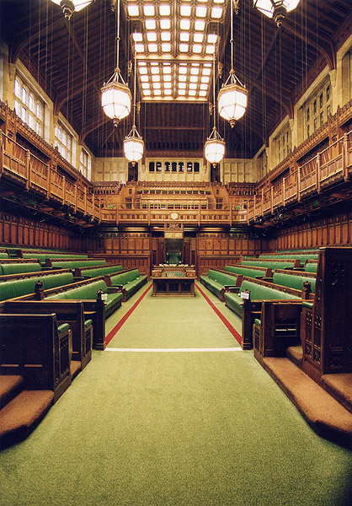
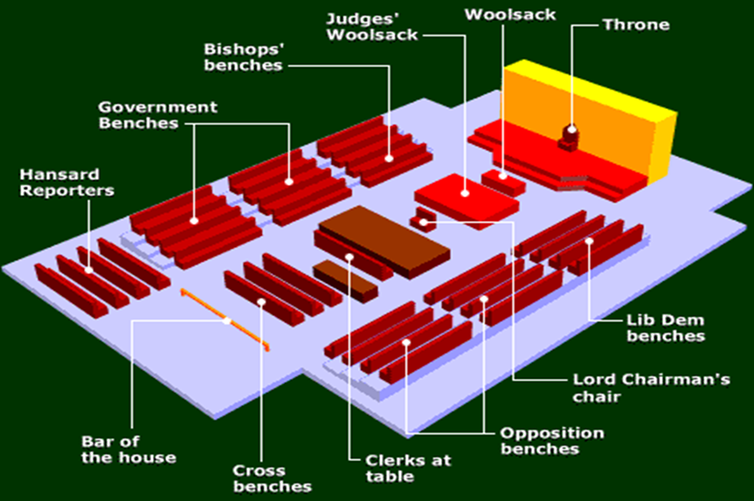

Slide 9
Timeline of Lords Reform
1911: Parliament Act. Commons can pass money bills without Lords’ advice or consent.
1949: Parliament Act. Limits the delaying powers of Lords to 1 year
1958: First female peers
1970s-80s: Labour party policy advocates abolition of Lords
1992: Labour abandons abolition in favor of reform
1999: Blair abolishes all but 92 hereditary peers
2000: Wakeham Report recommends largely appointed chamber
2001: White Paper
2003: Queen’s speech advocated end to hereditary peers
2007: White Paper
2009: Law Lords Abolished
2011: Lords Reform Bill published and debated
2017: Lord Fowler’s Report

Slide 10
The Wakeham Report, Jan 2000
Lord Wakeham (Conservative MP in Hof C, retired as Lord in 1994, Director of Enron, later Chancellor at Brunel University)
Asked by Labour government to head Royal Commission to investigate possible reforms to Lords
132 wide-ranging proposals. Its main recommendations were…

Slide 11
The Wakeham Report, Jan 2000
Largely appointed House of 450-550 members
Independent commission to appoint members, removing PM patronage
Did not recommend an elected chamber
15-year terms
30% of members should be women
Fair representation of ethnic minorities
Broader religious representation

Slide 12
2001 White Paper
White Papers allow the Government an opportunity to gather feedback before it formally presents the policies as a bill.
“A credible and effective second chamber is vital to the health of Britain's democracy... Our mission is to equip the British people with a Parliament and a constitution fit for the 21st century.”
Lords should remain subject to the pre-eminence of the Commons.
Removal of 92 hereditary peers.
Greater representation of women and ethnic minorities.
120 directly elected members to represent regions.
120 non-partisan members appointed by Appointments Commission.
Large numbers of members appointed by political parties.
2003, Lords and Commons debated the report. Results were…

Slide 13
After this series of votes
Results of Parliamentary Votes 4 February 2003
Option |  | Lords |  | Commons
Elected | Appointed | For | Against | For | Against
0% | 100% | 335 | 110 | 245 | 323
20% | 80% | 39 | 375 | – | –
40% | 60% | 60 | 358 | – | –
50% | 50% | 84 | 322 | – | –
60% | 40% | 91 | 317 | 253 | 316
80% | 20% | 93 | 338 | 281 | 284
100% | 0% | 106 | 329 | 272 | 289
Abolition |  | – | - | 172 | 390

Slide 14
2007 White Paper
New White Paper following discussions of a cross-party working group convened by Jack Straw, Labour Home Secretary.
Elected members + members appointed by Statutory Appointments Commission.
Elected element would be elected under a regional list system.
All elections and appointments would take place on a 5-year cycle, with 1/3 of the House admitted on a 15-year non-renewable term.
Gradual transition with no life peers forced to retire, but with the possibility of a redundancy package should they choose to do so.

Slide 16
2012 Reform Bill
2010 Lib-Dem Manifesto demanded a full elected Lords.
Conservative Manifesto demanded a mainly elected Lords.
120 elected members
30 appointed members
up to 21 bishops
Detailed proposals for Lords reform including a draft House of Lords Reform Bill were published on 17 May 2011. These include…

Slide 17
2012 Reform Bill
300-member hybrid house, of which 80% are elected.
20% would be appointed, some Church of England bishops.
Single non-renewable term of 15 years.
Elections to take place at the same time as elections to the Commons.
Elected by proportional representation.
Independent Members will be appointed by the Queen after being suggested by the PM acting on advice of Appointments Commission.
Current powers of the House of Lords would not change; Commons shall retain its status as the primary House.

Slide 18
Where are we now? Lord Fowler’s 2017 Committee Report
The Lord Speaker’s committee recommended:
600 members. “Two-out, one-in" program of departures to make reductions towards the target size
15-year terms
At least 20% would be independents/crossbenchers and no party would have a majority
Party appointments would be tied to General Election results

Slide 19
Where are we now?

Slide 20
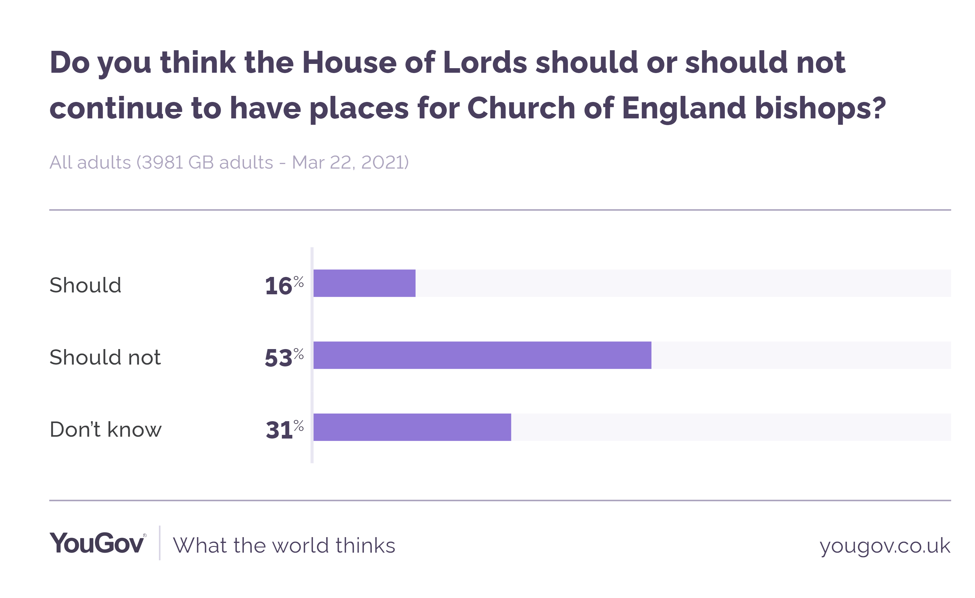
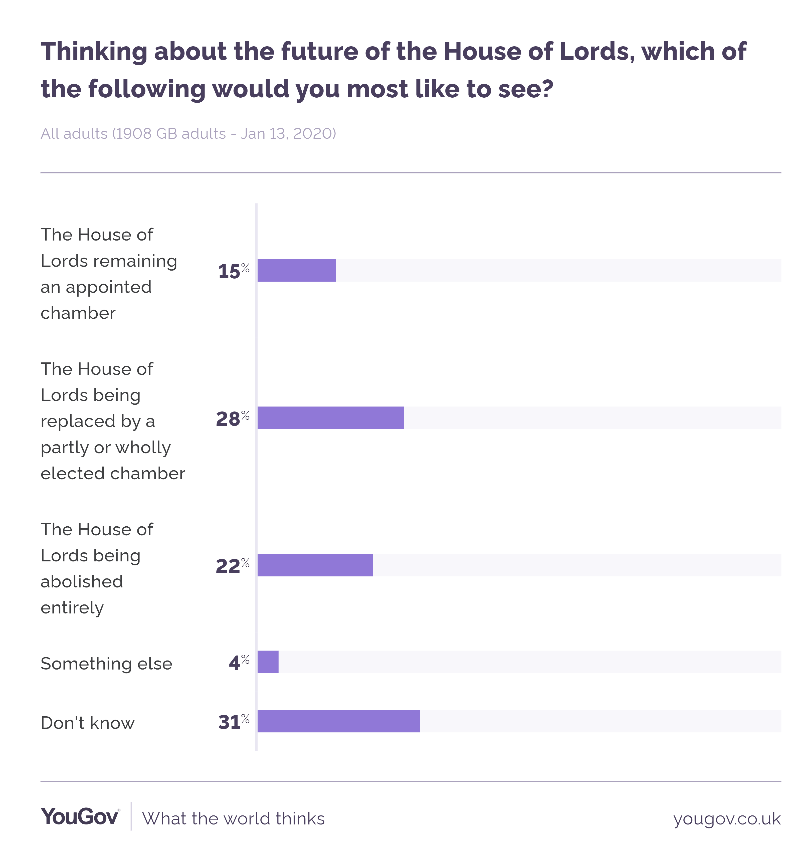
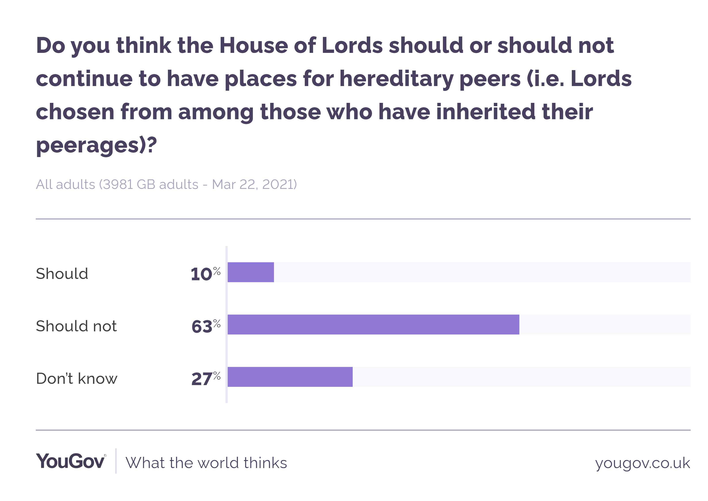
Analysis Questions
What does the British electorate think?
…and how much should this matter?

Slide 21
Analysis Questions
What is most democratic and what weight should the implications on democracy bear?
"Electing the second chamber is not self-evidently the democratic option. By dividing accountability it can undermine the capacity of the people to hold government to account…and can sweep away the very benefits that the present system delivers.
-Lord Norton, March 2012

Slide 22
Analysis Questions
If both Houses are wholly or largely elected, will Commons lose its primacy?
Balance of Power?
Gridlock of two elected Houses?
Shouldn’t expertise and achievement count for something in politics?
How big should the Lords be? 150? 300? 450? Does it matter?
Change the name? To what?

Slide 23
Analysis Questions
How should elected members be elected? PR? FPP SMDP?
Why not just abolish the second House? Unicameral legislatures can work just fine (half of the world’s states are unicameral, as are all the devolved governments in the UK).
Does this tradition warrant preservation? If it ain’t broke…

