Slide 1
The Nixon Years, 1969-1973
Mr. Daniel Lazar

Slide 2
Lecture Outline
Biographical Sketch
Elections of 1968 and 1972
Domestic Policies
Foreign Policies
Watergate

Slide 3
Nixon‘s Background
1913-1994
Humble Quaker upbringing in CA
BA Whittier, JD Duke
1942 Navy in WWII
1946 House
1950 Senate – Hiss case
1953 – VP
1960 – Lost to JFK
1962 – Lost to Pat Brown in CA
1964 - Supported Goldwater
Nixon in the Navy, 1942

Slide 4
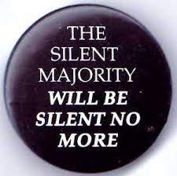
1968 Election
Context of tumult of 1960‘s
FBI, CIA, and IRS took on the New Left: wiretapping, infiltration and subversion, tax audits, fear and intimidation
Nixon appealed to the Silent Majority on a Law and Order platform, capitalizing on his Southern Strategy
Realigning election. Disrupted the New Deal Coalition.

Slide 5
1968 Election
In March, LBJ chose not to run.
Under 35% approval.
In poor health. Died in 1973.
Wide Dem field – RFK, Humphrey, Eugene McCarthy were top 3.
RFK assasinated in June 1968.
1968 Dem Convention was a bloodbath. Humphrey nominated.
Defeating Reagan, Romney, and Rockefeller, Nixon nominated.
George Wallace ran on "segregation now, segregation forever."

Slide 6
1968 Election
Nixon 43.4% (301)
Humphrey 42.7% (191)
Wallace 13.5% (46)
House – D 243, R 192
Senate – D 63, R 37
Dems had both Houses through Nixon Years

Slide 7
1972 Election
520-17 vs. McGovern
His VP, Tom Eagleton, was fired for his mental health record, which showed he‘d been hospitalized for depression and bipolarity
McGovern charged as the candidate of "amnesty, abortion, and acid.“
47 to 29 million in popular vote
Fourth largest margin in presidential election history

Slide 8
Nixon’s Domestic Policies
Economic policy
Stagflation
OPEC
Welfare
New Federalism
Race
Gender
Environment
Supreme Court
“We face an urban crisis, a social crisis-and at the same time, a crisis of confidence in the capacity of government to do its job.
A third of a century of centralizing power and responsibility in Washington has produced a bureaucratic monstrosity, cumbersome, unresponsive, ineffective.
A third of a century of social experiment has left us a legacy of entrenched programs that have outlived their time or outgrown their purposes.
A third of a century of unprecedented growth and change has strained our institutions, and raised serious questions about whether they are still adequate to the times.” – Nixon in August 1969

Slide 9
Nixon‘s Economic Policies – Stagflation & ESA
Stagflation is a portmanteau of stagnation and inflation. In this case caused by:
Baby Boomers entered job market
Rise of West Germany, Japan, etc.
Dependence on foreign oil
Deficit Spending from Great Society + Vietnam

Slide 11
Nixon‘s Economic Policies – Stagflation & ESA
With inflation and unemployment both at 6%, made more troubling by the highest interest rates in a century, Nixon issued the Economic Stabilization Act of 1970, which imposed three key mandates.
Took the U.S. off the Gold Standard.
Executive Order 11615 - 90-day freeze on wages and prices to counter inflation; first time gov enacted peacetime wage and price controls
10% import surcharge to force other countries to revalue their currencies against the dollar. Lasted 4 months.

Slide 12
Nixon‘s Economic Policies – Stagflation & ESA
In allaying fears about ESA, aka The Nixon Shock, Nixon spoke to the public:
“Now, what is this action—which is very technical—what does it mean for you?
Let me lay to rest the bugaboo of what is called devaluation.
If you want to buy a foreign car or take a trip abroad, market conditions may cause your dollar to buy slightly less. But if you are among the overwhelming majority of Americans who buy American-made products in America, your dollar will be worth just as much tomorrow as it is today.
The effect of this action, in other words, will be to stabilize the dollar.”
…Despite the ESA and the PR campaign, markets reacted. Starting in February 1973 the S&P 500 declined by over 50% and the Dow declined by 45% over 21 months.

Slide 13
Nixon‘s Economic Policies - OPEC
In 1973, Oil Producing Exporting Countries placed an oil embargo on Israeli allies, creating US oil shortage.
Long lines and short tempers at gas stations
1974 - embargo was lifted, having failed to alter US Middle East policy
1979 - oil was at peak $80/barrel
Nixon did little to seek alternative fuel sources

Slide 14
Nixon‘s Economic Policies - OPEC

Slide 15
Nixon‘s Economic Policies – Welfare Reform
Nixon was born and raised poor.
“The present system often makes it possible to receive more money on welfare than on a low-paying job. This creates an incentive not to work, and it also is unfair to the working poor. It is morally wrong for a family that is working to try to make ends meet to receive less than a family across the street on welfare. This has been bitterly resented by the man who works, and rightly so–the rewards are just the opposite of what they should be. Its effect is to draw people off payrolls and onto welfare rolls–just the opposite of what government should be doing. To put it bluntly and simply–any system which makes it more profitable for a man not to work than to work, or which encourages a man to desert his family rather than to stay with his family, is wrong and indefensible.” (Nixon)

Slide 16
Nixon‘s Economic Policies – Welfare Reform
Nixon shared many Americans' conviction that the welfare system had grown into an inefficient bureaucracy which fostered dependency.
With Urban Affairs Council secretary Daniel Patrick Moynihan, Nixon created the 1969 Family Assistance Plan.
Sought to replace bureaucratically-administered programs such as Aid to Families with Dependent Children, Food Stamps, and Medicaid, with direct cash payments to those in need.

Slide 17
Nixon‘s Economic Policies – Welfare Reform
$1600 per year for a family of 4 + up to $4000 in benefits
In 1970 the minimum wage was $1.60 per hour
Able-bodied adults would have to register for work and be willing to accept “suitable work” (?) or the family would suffer a reduction in benefits.
Mothers with children under school age exempt from this.
Required the federal government to provide child care vouchers as a precondition for single mothers’ working

Slide 18
Nixon‘s Economic Policies – Welfare Reform
Conservatives disliked the idea of a guaranteed annual income. They were also concerned about federal power: previously states paid 2/3 and the federal government 1/3 of welfare benefits.
Liberals thought $1600 insufficient
Caseworkers opposed FAP fearing that many of their jobs would be eliminated.
Liberals killed it. Conservatives killed it. Southerners killed it. The distrust of Nixon engendered by SE Asia policies killed it.
FAP divided Americans. Nixon knew a bad campaign issue when he saw one, and let FAP expire before the 1972 election.

Slide 19
Nixon‘s Economic Policies – Welfare Reform
Increased Social Security, Medicare, and Medicaid payments and made food stamps more accessible
1971, Nixon proposed health insurance reform; a private health insurance employer mandate

Slide 20
Nixon‘s Economic Policies – New Federalism
Revenue Sharing Act: 5-year program to return to state and local governments $30 billion in federal tax revenues
Gov gives block grants to states. Fed monitors outcomes but offers state and local discretion.
Although revenue sharing was anathema to federal bureaucrats, whose jobs it threatened, and to Congressmen who made careers of dispensing federal “pork” to their districts, it appealed to states and locales.

Slide 21
Nixon & Race
Context of Wallace, King, RFK…in 1968
In 1968, 70% of Black children in the South attended all-black schools.
As part of New Federalism, set up biracial state committees to implement school desegregation.
By 1971, with little fanfare, about 15% of Black children in the South attended all-black schools.

Slide 22
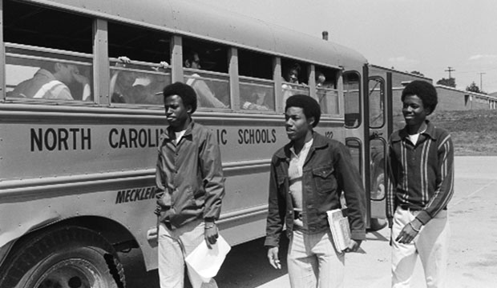
Nixon & Race
1971 - Swann v. Charlotte-Mecklenburg Board of Education, SC upheld constitutionality of busing to help integrate the schools.
Nixon publicly expressed his disapproval of busing—as did 80% of polled voters—but he carried out the SC ruling.

Slide 23
Nixon & Women
Momentum of Feminism (see previous lecture)
Equal Rights Amendment, proposed 1972. Nixon quietly supported it; Phyllis Schafly headed a movement kill it.
Roe v. Wade 1973
Nixon increased the number of female appointments
Created Presidential Task Force on Women's Rights
Asked the Justice Department to bring sex discrimination suits under Title VII of the Civil Rights Act

Slide 24
Nixon & The Environment
1970 - Federal programs were consolidated into the Environmental Protection Agency (EPA)
1970 - Water Quality Improvement Act - authorized the federal government to clean up oil spills and prosecute those responsible for negligence
1970 - Clean Air Act - comprehensive air pollution control program which included more car emission controls for model years 1975 and beyond.

Slide 25
Nixon and the Supreme Court
Chief Justice Earl Warren retired. Nixon appointed Warren E. Burger to replace Warren. Burger was a vocal critic of Warren and an advocate of strict-constructionism.
Appointed 3 Associate Justices: Harry Blackmun, Lewis F. Powell, and William Rehnquist.
Nixon twice failed to get Senatorial approval. First time since Hoover.
Nixon appointed a total of 231 federal judges, surpassing the previous record of 193 set by FDR.

Slide 26
Other Significant Events in Nixon Years
1969 - Apollo 10 Moon Landing - Neil Armstrong first man to walk on the moon, followed by Buzz Aldrin
1969- Nixon launched War on Drugs
1970 - Occupational Safety and Health Act - work environments "free from recognized hazards to employees"
1971 - 26th Amendment - lowered the voting age to 18

Slide 27
Nixon’s Foreign Policies
Southeast Asia
China
USSR
Chile
Middle East
Reality vs. Legacy?

Slide 28
Nixon Doctrine 1970
Secretary of State, Henry Kissinger, chief architect of the Grand Design
Acknowledged limits of US power
US allies must rely more on their own resources for their own defense
Repudiated Truman

Slide 29
Nixon and Southeast Asia
Nixon campaign interfered in LBJ’s negotiations with South Vietnam
Vietnamization: Nixon Doctrine applied to Vietnam
1970 invasion of Cambodia
Mad Man Theory: “I call it the Madman Theory, Bob [Haldeman]. I want the North Vietnamese to believe I've reached the point where I might do anything to stop the war. We'll just slip the word to them that, ‘for God's sake, you know Nixon is obsessed about communism. We can't restrain him when he's angry—and he has his hand on the nuclear button’ and Ho Chi Minh himself will be in Paris in two days begging for peace.”

Slide 30
Nixon and Southeast Asia
1970-1973 - Operation Freedom Deal
In 1973 alone, US dropped 250,000 tons of bombs on SE Asia, more than on the US campaign in Japan
Kent State protests in response. “Massacre“? “Riots?“
1971 – Military incursions into Laos
1971 – Pentagon Papers leaked to NYT by Daniel Ellsberg. The Johnson Admin "systematically lied, not only to the public but also to Congress."
1971 – 156,000 troops in Vietnam; 71% of Americans against the Vietnam War. Nixon loathed protestors!

Slide 31
Nixon and Southeast Asia
Jan 1973 – Paris Peace Accords. NVN’s Le Duc Tho and Kissinger win Nobel Peace Prize. Tho refused to accept prize.
1973 – War Powers Resolution passed over Nixon‘s veto.

Slide 32
Nixon and China
Normalization of the US-PRC Relationship
1960 Sino-Soviet Split; 1969 Sino-Soviet Border Clashes.
Ping Pong Diplomacy – Mao invited US table tennis players
Kissinger’s Realpolitik provided a balance of power via triangulation and offered an incentive to Soviets

Slide 33
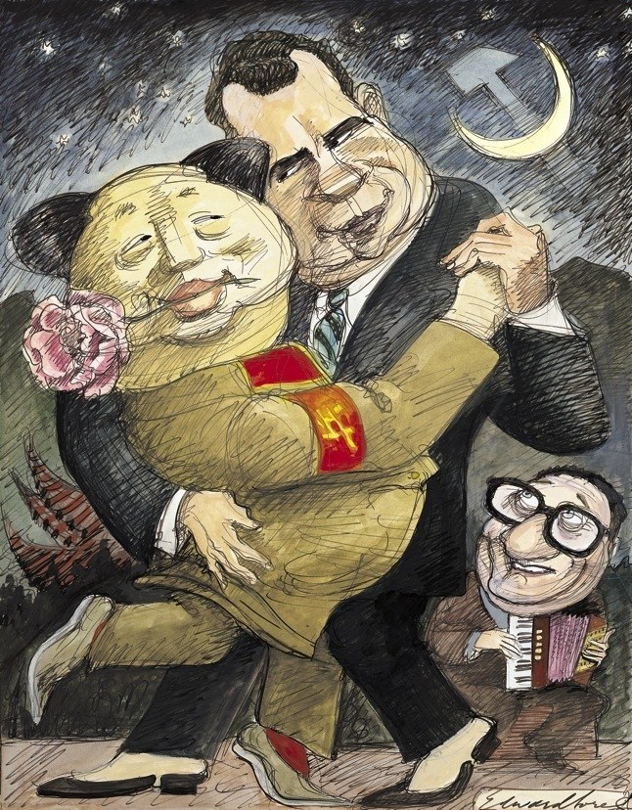
Nixon and China
After Kissinger made a secret trip to PRC in 1971, Nixon visited China in 1972.
Diplomatic relations were established between China and the US, while not severely weakening US commitment to Taiwan.

Slide 34
Nixon and the USSR
New era of Peaceful Coexistence a relaxation of tensions between the East and West
US and USSR could come to mutually beneficial terms
1972 and 1974 - Nixon visited Moscow.
1972 Anti-Ballistic Missile Treaty (ABM)
1972 - S (trategic) A (rms) L (imitation) T (reaty)

Slide 35
Nixon and Chile
Chile was among the more democratic nations in Latin America
1970 - Nixon Administration, despite the efforts in “Phase 1”, failed to prevent democratic election of Socialist, Salvador Allende
3 years of meddling…
1973 Parliamentary elections - US gave $8 million in aid to the Right to, "create pressures, exploit weaknesses, magnify obstacles, and hasten Allende's ouster." (Letter of Deputy CIA Director to Kissinger, from NSA Archives)
Allende’s Popular Unity coalition gained more support in Congress.
Castro’s 1971 visit with Allende

Slide 36
Nixon and Chile
1973 CIA coup of Allende
Kissinger's told CIA station chief in Santiago, Henry Hecksher, “it is firm and continuing policy that Allende be overthrown by a coup."
The "American hand" was hidden from US Ambassador to Chile, Edward M. Korry.
Allende killed himself with an AK 47 as the Presidential Palace was being stormed.
1975 - In response to Watergate, Church Committee convened to review roles of CIA, NSA, and FBI.
Est. U.S. Senate Select Committee on Intelligence
US supported a military junta in Chile under Augusto Pinochet, whose dictatorship reigned until 1990.

Slide 37
Nixon and the Middle East
Nixon substantially increased U.S. aid to Iran, Israel, and Saudi Arabia
1973 Yom Kippur War - Arab coalition led by Syria and Egypt attacked Israel, supported by USSR.
Israel lost lots of ground.
Nixon sent airlifts which put Israel on the offensive.
Brezhnev threatened to unilaterally enforce a peacekeeping mission.
Nixon ordered the U.S. military to DEFCON3! Brezhnev backed down.
After the war the USSR practically ended it’s Middle Eastern ambitions
OPEC then refused to sell crude oil to US, resulting in an oil crisis

Slide 38
Watergate and Resignation
Nixon bid the nation farewell as he boarded a Presidential helicopter after resigning from office on August 9, 1974.

Slide 39
Watergate and Resignation
June 1972 - Nixon’s campaign used FBI and CIA to break into DNC offices at the Watergate complex. Stole documents. Tapped phones. Bugged offices.
Burglars were caught. Nixon covered up. Destroyed evidence. Defied the Supreme Court.
Exposed by Washington Post.
69 indicted. 48 found guilty.
April 1973 – Nixon removed Haldeman, Ehrlichman, Dean…the Slow Burn
Oct 1973 – Nixon fired the Special Prosecutor. “I’m not a crook.”
Feb 1974 – Impeachment proceedings begin.
August 1974 - Nixon resigned because he did not want to be impeached.
September 1974 - Ford pardoned him.

