Slide 1
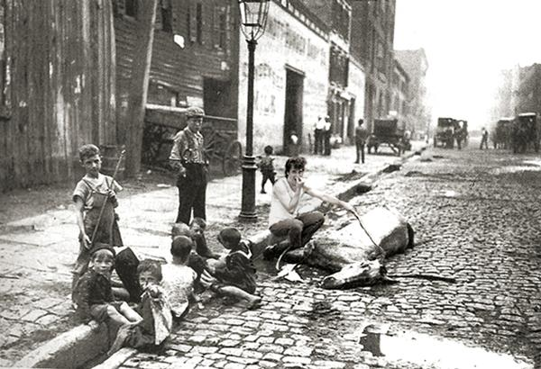
Immigration, Urbanization, Social Reform, and Political Machines in Gilded Age America
Mr. Daniel Lazar

Slide 2
Context
1820-1860: Antebellum / Manifest Destiny Era
1861-1865: American Civil War
1865-1877: Reconstruction Era
1870-1900: The Gilded Age
Growth of industry, mass immigration, urbanization, political corruption
1900-1920: Progressive Era

Slide 3
Lecture Outline
Immigration
Push and Pull Factors
Responses to Immigration
Nativism & APA
Organized Labor
Anti-Immigrant Legislation
The Reformist Reaction
Americanization
Social Gospel Movement
Settlement House Movement
Socialism?
III. Urbanization & The Shame of Cities
IV. Political Machines

Slide 4
Key Themes of this Lecture
The enduring immigration dilemma
Evolution of the American Dream
Social Movements and Religious Activism
Transition from Producers to Consumers
Mixed Blessings of the Metropolis: The Pain of Progress
Race, Ethnicity, and Gender in Industrial-Capitalism
Paradoxes of the Political Machine
…Action and Reaction, Cause and Effect

Slide 5
Etymology
"The golden gleam of the gilded surface hides the cheapness of the metal underneath.”
-The Gilded Age: A Tale of Today, 1873 novel by Mark Twain and Charles Dudley Warner that satirizes greed and political corruption in post-Civil War America

Slide 6
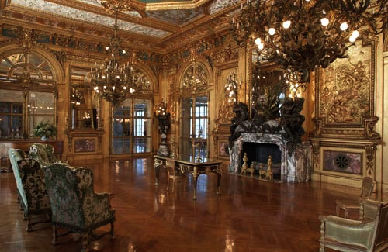
Etymology
Opalescent, gleaming, ornate, capitalist excess…
Built on the backs of the exploited and oppressed working class
Built in 1892 by for William K. Vanderbilt

Slide 7
The Gilded Age Trifecta
URBANIZATION
INDUSTRIALIZATION
IMMIGRATION

Slide 8
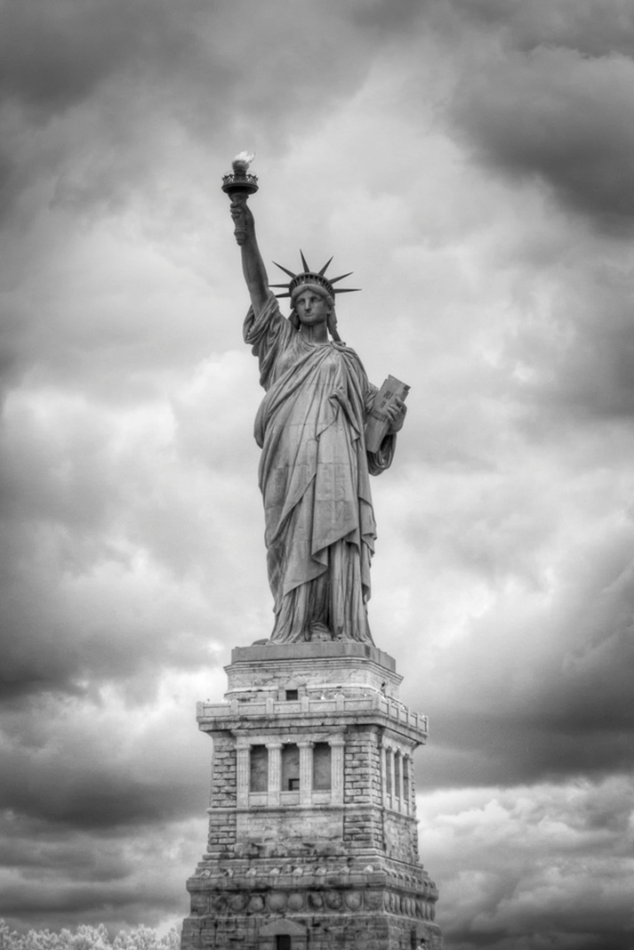
Immigration

Slide 9
The Numbers
Between 1870-1900, US pop doubled!
3.5 million in NYC, 2nd most populous city (London)
Flood from S and E Europe
1851-1883, ≈ 300,000 Chinese arrived
By 1920 ≈ 200,000 Japanese on West Coast
1880-1920 ≈ 260,000 from Caribbean

Slide 10
In 1815, mathematician Elkanah Watson predicted census numbers for the 19th century

Slide 12
Immigration until Civil War primarily from NW Europe

Slide 14
Push Factors
Europeans:
Chinese:
1845-50: Irish Potato Famine
1848 Revolutions create turmoil
Escape religious persecution
Jewish driven out of Russia by programs
Catholics escape Bismarck’s Germany
1800-1900: Population of Europe doubles to 400 million
1839-42: Opium War with Britain
1850-64: Taiping Rebellion
Agricultural crisis, rice shortage
Mexicans:
Mexican Revolution 1910 → Political turmoil
Relatively open borders until 1920

Slide 15
Pull Factors: De Jure Encouragement
Immigrants satisfy US economic needs
1864 Immigration Act (to encourage immigration)
exempted immigrants from compulsory military service
1868: Burlingame Treaty between U.S. and China allowed unrestricted immigration to work on the transcontinental railroad
Sec. of State Seward hoped to open Chinese markets to U.S. goods.
By 1870, Chinese were 10% of CA pop
1870s: Companies recruited in Mexico in part to replace Chinese
1901 National Reclamation Act irrigated new farmland in Western States (west of Iowa)
Japanese recruited by Hawaiian Planters. Once Hawaii was annexed in 1898, Japanese immigrated to the West Coast.

Slide 16
Pull Factors: Business Supported Immigration
“It is an easy and patriotic matter for the lawyer, minister, professor, employer, or investor, placed above the arena of competition, to proclaim the equal right of all races to American opportunities; to avow his own willingness to give way should even a better Chinaman, Hindu, or Turk come in to take his place; and to rebuke the racial hatred of those who resist this displacement. His patriotism and world-wide brotherhood cost him and his family nothing, and indeed they add to his profits and leisure.”
-JOHN R. COMMONS, PROFESSOR OF POLITICAL ECONOMY, UNIVERSITY OF WISCONSIN, 1907

Slide 17
Pull Factors: Opportunity
Large tracts of open land, abundant natural resources, excellent soil, Homestead Act of 1862
“Can Do” Spirit
Government encouraged “rugged individualism” and free enterprise

Slide 18
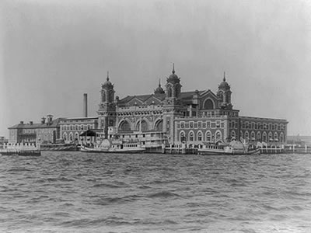
Ellis Island
1892 – 1924: thousands entered daily, 20% rejected

Slide 19
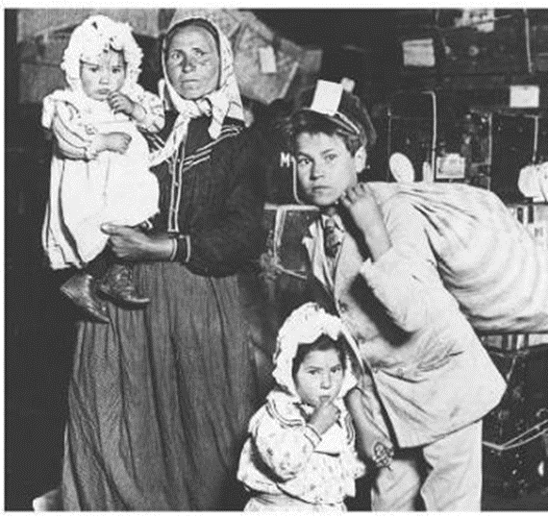
Ellis Island

Slide 20
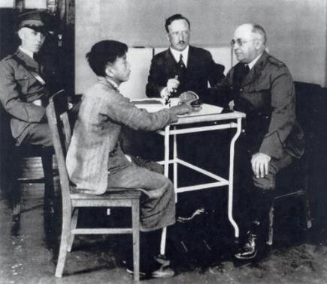
Angel Island
Immigrants at Angel Island faced harsh questioning and long detention in filthy buildings before finding out if they could immigrate.

Slide 21
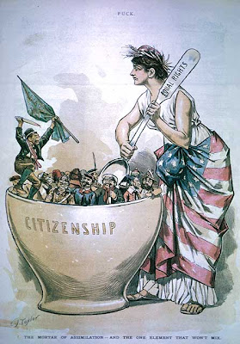
Challenges to the Melting Pot Theory
To what extent would immigrants relinquish their cultural identities and assimilate to “American” culture?
Cooperation for survival meant many groups remained in communities of origin
25-30% of those who came between 1870-1900 returned to country of origin.

Slide 22
Reactions to Mass Immigration: Nativism
Nativists viewed Eastern and Southern Europeans as culturally and religiously exotic/inferior and often treated them inhumanely.
Concerned about “foreign doctrines” e.g. Catholicism, Socialism, Anarchism
Perceived threat to Anglo-Saxon America
Alarmed at high birthrates of the poor and the Catholic
Blamed immigrants for degrading cities
Angry at immigrant willingness to work for "starvation" wages
Alarmed at prospect of “mongrelized” America with a mixture of "inferior" South European blood

Slide 23
Reactions to Mass Immigration: APA
American Protective Association, est. 1887
Urged voting against Roman Catholic candidates
1 million members
Strongest in the Midwest
Came under heavy attack from Democrats until its collapse in the mid-1890s.

Slide 24
Reactions to Mass Immigration: Labor
Organized Labor infuriated at use of immigrants as strike breakers.
Argued if American industry was entitled to protection from foreign goods, American labor was entitled to protection from foreign laborers.

Slide 25
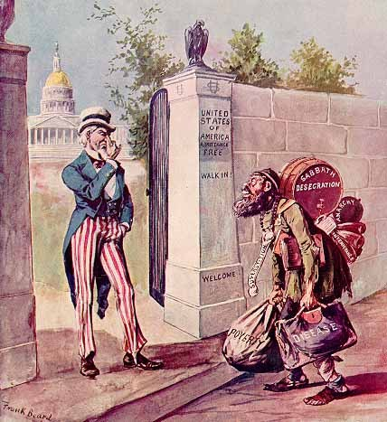

Slide 26
Thomas Nast, 1867

Slide 27
Reactions to Mass Immigration: Social Gospel
Rev. Josiah Strong: Our Country: Its Possible Future and Its Present Crisis (1885)
Loathed immigrant impact on cities
Condemned cities as wicked places
Condemned low wages, gambling, robbery, and corruption
Seven "perils" facing the nation: Catholicism, Mormonism, Socialism, Intemperance, Wealth, Urbanization, and Immigration.
More on SGM later in lecture…

Slide 28
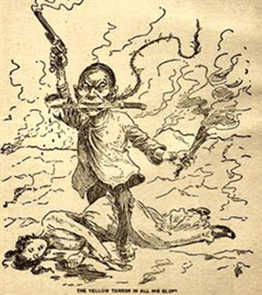
Reactions to Mass Immigration: Anti-Chinese Sentiment
Anti-Chinese sentiment intensified after Panic of 1873
1882 Chinese Exclusion Act ended Chinese immigration for 10 years (with exceptions for some students, teachers, government officials, and merchants)
1892 extended for 10 years
1902 extended indefinitely
Repealed in 1943 (WWII)

Slide 29
Thomas Nast

Slide 31
Reactions to Mass Immigration: Anti-Japanese Sentiment
1906 local boards of education (esp San Francisco) segregated Japanese children. Japan protested.
TR’s 1907 Gentleman’s Agreement
US would not impose restriction on Japanese immigration; Japan would not allow further emigration to the U.S
SF segregation order was repealed, largely unenforced
Nullified by the Immigration Act of 1924, which banned almost all Asians from migrating to the US

Slide 32
Reactions to Mass Immigration: Anti-Immigrant Legislation
1897- Congress passed a bill requiring a Literacy Test for immigrants that would refuse entry to those who could not read 40 words any language
Vetoed by President Cleveland. Taft vetoed a similar bill in 1913. Wilson’s 1917 veto was overridden.
The Russian Rev & WWI changed the tone and content of immigration debates:
1921 Emergency Quota Law & 1924 Immigration Quota Act
Reduced non-NW Euro entries to a mere drip
No major immigration legislation until 1965

Slide 33
…just an update
Legal U.S. Immigrants by Decade and Region of Origin, 1960-2009
U.S. Population by Race and Ethnic Group, 1970, 2010, 2050
Graphs from census.gov

Slide 35
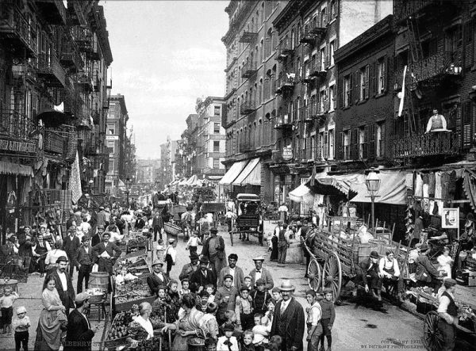
Urbanization

Slide 36
The Numbers
Urban pop: 10 → 54 million 1870-1920
By 1910, immigrant families comprised > 50% of the population of 18 major American cities
By 1890, 2x as many Irish residents in NY than Dublin
1890-1910, 200,000 Blacks moved North: NYC, Detroit, Chicago
1910-1930, 6 million more
See Great Migration lecture…

Slide 39
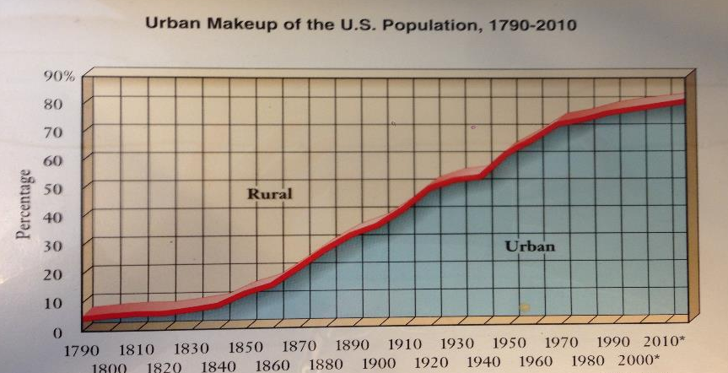

Slide 41
Urbanization: Pull Factors
Immigration + Internal Migration
Farm foreclosures (see Populism lecture)
Natural and economic disasters made industrial jobs attractive. The allure of steady work.
Economic and social opportunities lured people: Rural America could not compete
Department stores emerged
Allure of endless entertainment
“Bread & Circus” - Barnum & Bailey Circus, est. 1881
Amenities: electricity, plumbing, telephones

Slide 42
The Shame of Cities: Muckrakers
TR credited with popularizing the term in a 1906 speech, but the challenge from the Fourth Estate preceded the speech by decades
Watchdog Function: Journalists, novelists, and critics during who expose abuse and corruption in business and politics
Harper’s, Atlantic Monthly, Scribner’s, The Nation
Fine line between muckrakers and yellow journalists
Expose vs. Sensationalism

Slide 43
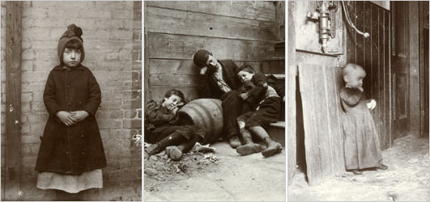
The Shame of Cities: Housing
Muckraker Jacob Riis used “flash power”, a new photography technique, in How the Other Half Lives.

Slide 44
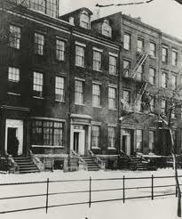
The Shame of Cities: Housing
Row Houses
Tenements: multiple families in one residence, dark, poorly ventilated, vermin ridden…

Slide 45
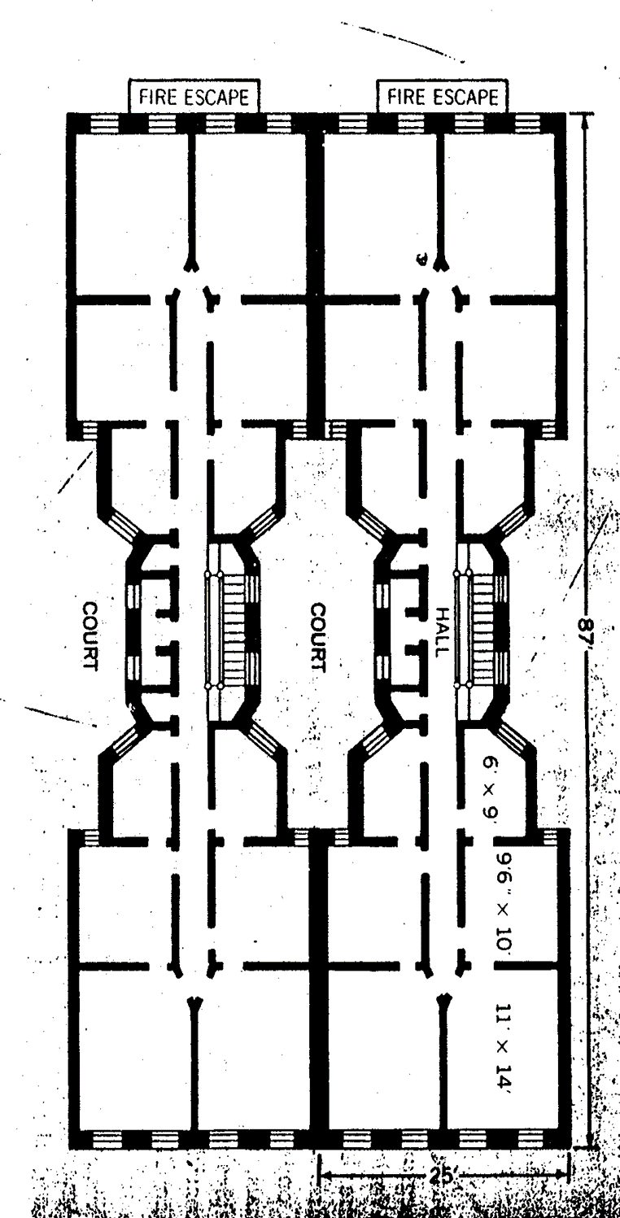

Slide 46
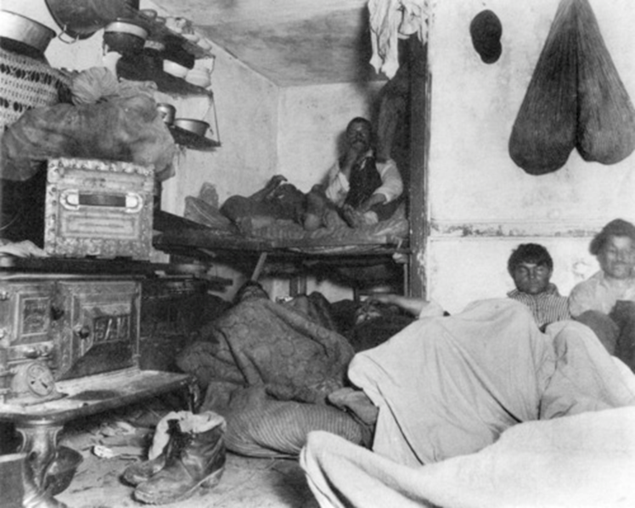

Slide 48
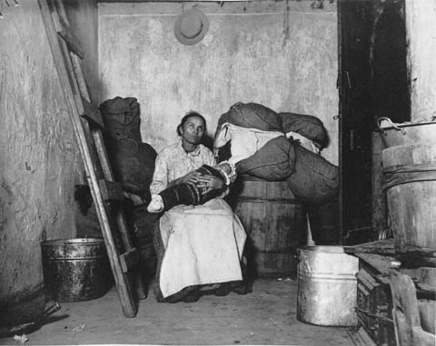

Slide 49
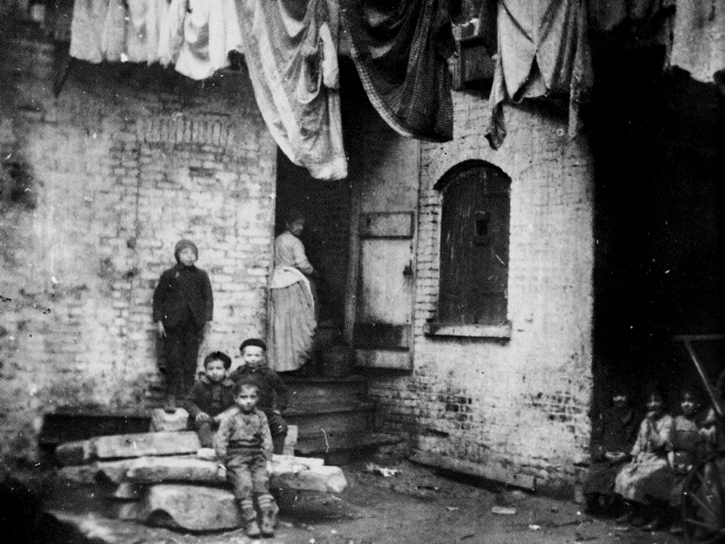

Slide 51
From How the Other Half Lives
“All life eventually accommodates itself to its environment, and human life is no exception…..But the slum is the measure of civilization.”

Slide 52
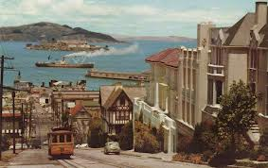
The Shame of Cities: Transportation
Innovations in mass transit developed to move people from home to factories
1873 street cars in SF
1897 electric subways in Boston
By 1900 most cities had a system connecting the inner city to new suburbs, the bourgeoisie escape

Slide 53
The Shame of Cities: Water
Problem of supplying safe drinking water
1840s and 1850s cities built public waterworks to handle demand, then post-war immigration boom…
Typhoid and cholera
1870s Filtration introduced
1908 Chlorination

Slide 54
The Shame of Cities: Sanitation
Horse manure and human sewage flowed through open gutters
By 1900 many cities developed sewer lines
Factory pollution
Trash collection was a racket

Slide 56
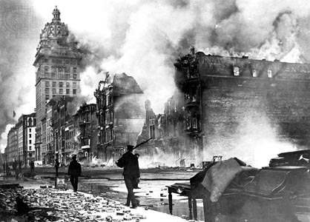
The Shame of Cities: Fire
Limited water supply
Candles and kerosene lamps
Wood frame construction
Volunteer fire service
1871 Chicago Fire - 17,500 buildings destroyed
1906 San Francisco Earthquake and Fire - 28,000 buildings destroyed
1911 Triangle Shirtwaist Factory Fire in Manhattan - deadliest industrial disaster in the history of NYC. 146 dead garment workers. 123 women and 23 men, mostly recent Jewish and Italian immigrants ages 16-23

Slide 57
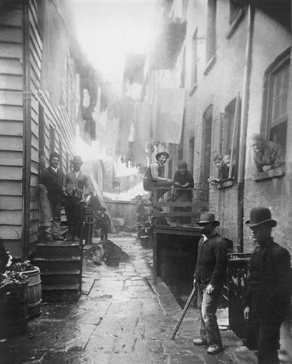
The Shame of Cities: Crime
Pickpocketing
Gangs
Violent crime
Prostitution, cocaine, gambling…
1844 NY first to organize a full-time salaried police force

Slide 58
Races and Immigrants in America, by John R. Commons

Slide 59
Impact of IIU on Class & Gender
Class distinctions became more pronounced by 1900
1. New super-wealthy bourgeoisie: the nouveau riche
1890 in US
Top 12% of families had 86% of wealth.
Bottom 44% of families had 1.2% of wealth.
Today:
In US: Top 1%; 45% (Zakaria)
Globally: 85 people control the same amount of wealth as half the world's population. 85 people compared with 3.5 billion. (Oxfam)

Slide 60
Impact of IIU on Class & Gender
2. Middle class
Upper: lawyers and doctors
Lower: salesmen, some gov workers, and teachers
Mostly WASP

Slide 61
Impact of IIU on Class & Gender
3. Working Class (the proletarian)
Skilled northern mechanics at top; miners and RxR workers at bottom
Often Catholic, S/SE European immigrants, Blacks
25-30% of workforce unemployed for some period every year
In 1900, nearly 20% of children under 15 worked in non-agricultural work.
About 20% of urban women worked outside the home…

Slide 62
Impact of IIU on Class & Gender
Middle and upper-class married mothers rarely worked outside the home; social workers and teachers
In 1900…
6% of married women worked outside the home
17% of the labor force was female
5 million women worked for wages
45% of single women worked
20% worked textiles
40% domestic servants

Slide 63
Impact of IIU on Class & Gender
Hierarchy of female workers
Secretaries, store clerks, telephone operators, bookkeepers; "American" girls (WASPs)
Factory work
Immigrant women
Farm girls/women who sometimes returned to farm
1900 - International Ladies' Garment Workers' Union
1903 - Women’s Trade Union League
Domestic servants
Usually foreign-born (esp Irish) or Black
Often worked 12+ hours/day, 6 days/week
No protection, no union

Slide 64
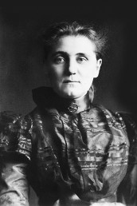
Reformist Reactions
Jane Addams

Slide 65
Who were the reformers and what did they want?
Mostly middle-class whites, informed and inspired by Muckrakers, concerned with:
Immigration
Urban squalor
Unchecked influence of Big Business
Direct democracy
Women’s Suffrage
Child Labor
Reformed tax code
Labor unrest
Crime and corruption

Slide 66
Reform: Americanization Movement
Local ad hoc movements formed to assimilate ethnic minorities
Promoted by entities such as:
NGOs provided programs to teach skills for citizenship such as:
Language
Literacy
American history and government
Cooking
Social Etiquette
School boards
YMCA / YWCA
Labor unions
Knights of Columbus
National Chamber of Commerce
Ford Motor Company

Slide 67
Reform: Social Gospel Movement
Churches stepped in where government failed
Insisted that—in addition to preparing for the afterlife—churches tackle burning social issues: poverty, alcoholism, crime, racial tensions, slums, bad hygiene, child labor, poor schools….
Motivations:
Fear of violent working-class Revolution
Human decency. Christian Ethics. Service.
Spread the Gospel

Slide 68
Reform: Social Gospel Movement
Salvation Army: uplift and Save the poor. Soup kitchens, clothing donations, etc.
YMCA
Dwight Lyman Moody, Moody Bible Institute, 1889
Associated with Progressive Movement

Slide 69
Reform: Settlement House Movement
England’s Toynbee Hall, 1884.
New York’s Stanton Hall, 1886
Primarily white, educated, well-to-do Northeastern and Midwestern women
Teaching or volunteerism were almost the only permissible occupations for young well-to-do women
Settlement houses became centers of women’s activism and social reform. Politicization of women, roots of second Suffrage Movement.
Jane Addams’ Hull House in Chicago, 1889…

Slide 70
Reform: Settlement House Movement
Jane Addams (1860-1935) ("St. Jane")
Believed living among the poor would give meaning to lives of young, educated, humane women
Hull House in Chicago (with Ellen Gates Starr) taught immigrants English, nutrition, health and childcare. Discussed current events.
1892, Addams published her thoughts on "the three R's" of the settlement house movement: residence, research, and reform.
These involved “close cooperation with the neighborhood people, scientific study of the causes of poverty and dependence, communication of [these] facts to the public, and persistent pressure for [legislative and social] reform...“ (Adams in The Forum)

Slide 71
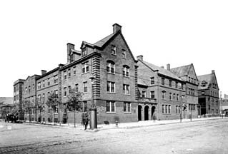
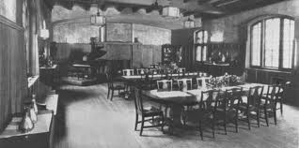
Hull House
Daycare and one meal/day
Free Kindergarten
Boy’s club
Coffee shop for adult men
Established the city's first public playground
Social, educational, and artistic programs
Medical clinic

Slide 72
Saint Jane, Beyond Hull House
1893, Illinois passed landmark underage worker protection laws
Juvenile Court of Chicago advocated by Addams
During WWI (1914-18) she organized the Women's International League for Peace and Freedom, which worked to end WWI
1931 Nobel Peace Prize for her work with WILPF

Slide 73
Reform? Or Revolution. Creeping Socialism…
The Collective has deep roots in American history
Utopianism is quintessentially America.
City on a Hill
Brook Farm, New Harmony, Shakers, Oneida…
German, Italian, and Jewish immigrants…

Slide 74
Reform? Or Revolution. Creeping Socialism…
Unions & Socialism / Social Democracy
1866 - National Labor Union (William H. Sylvis)
1876 - Workingmen's Party/Socialist Labor Party (Terence Powderly)
1886 - American Federation of Labor (Samuel Gompers)
1886 - Haymarket & International Workers’ Day (May Day)
1893 – American Railway Union (Eugene Debs)
1901 - Socialist Party; Florence Kelley
Various socialist mayors, congressmen, etc.
1920, Socialist Party presidential candidate Eugene V. Debs won nearly 1m votes…from prison
Progressive Era (1900-1920) curtailed Socialist impulses
Two Red Scares coming right up…

Slide 75
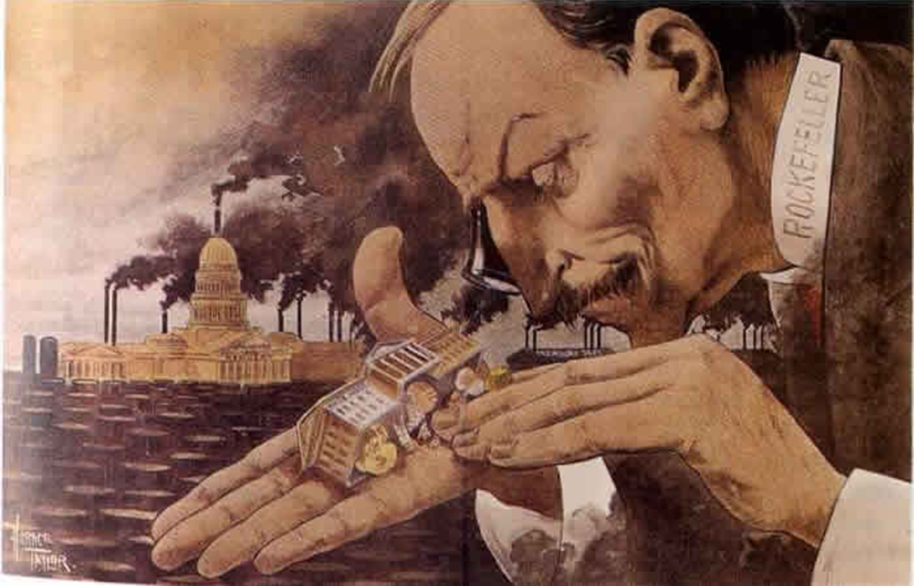
Politics of the Gilded Age
What a Funny Little Government, 1900

Slide 76
Political Machines
During Gilded Age, many cities run by political machines.
Controlled by a city boss and his party
Where Americanizers, Nativists, the APA, The Salvation Army, and Reformers failed…
Machines offered services to voters and businesses in exchange for political or financial support

Slide 77
Political Machine Organization

Slide 78
Political Machines: Bosses
Ran local business and politics
Controlled access to municipal jobs and business licenses
Influenced the courts
Gained voter loyalty through providing jobs to build cities: waterworks, roads, sewers, parks, schools, hospitals, orphanages….
Corrupt! But…

Slide 79
Political Machines: Immigrants and the Machine
Many precinct captains and bosses were 1st or 2nd generation immigrants
Spoke the immigrants’ language and helped find jobs, housing, loans, lawyers…
Favors for Votes: “democracy at its finest”

Slide 80
Political Machines: Tactics
Many Bosses got rich through
Graft - illegal use of political influence for personal gain
Kickbacks – extorting cash in exchange for favors (jobs, insider info, friendly judges…)
Gambling
Loan sharking
Until 1900s, police forces were hired and fired by city bosses

Slide 81
Political Machines: Tammany and Tweed
William Magear Tweed (1823-78), a.k.a. Boss Tweed, one of the most powerful political bosses.
Head of Tammany Hall, NY Democratic machine
His path
1853-55 – HOR, D-NY-5th
1858 – NY Board of Supervisors & Ward Boss
1862 – Chair of Dem General Committee
1867-73 - NY State Senate
Got buddies elected to office. They became Tweed Ring
Swindled NYC in the 1860s and 1870s

Slide 82
Political Machines: Fraud!
Tweed Ring milked NYC via: fake leases, padded bills, false vouchers, unnecessary repairs, and overpriced goods and services bought from suppliers controlled by the ring. Examples:
Bought 40 old chairs and three tables: $179,792 ($2 million today)
Carpenter paid $360,751 for one month's labor ($5 million today)
Plasterer's wages for 9 month job: $2,870,464 ($34 million today)
30 months of advertising paid to a Tweed-controlled printing company: $7,168,212 (about $87 million today)

Slide 83
Political Machines: Fraud!
Bought undeveloped property in Harlem, used city funds to develop it (run water and roads to it), then sell the property.
Tweed was 3rd largest property owner in NYC
Tweed’s masterpiece was a three-story courthouse in Lower Manhattan originally budgeted at $250,000. By Tweed’s death, the city had spent more than $13 million ($180 mil today) – and the building was still not finished.
In the end he plundered $50-200 million.
$365 million - $2.4 billion today

Slide 84
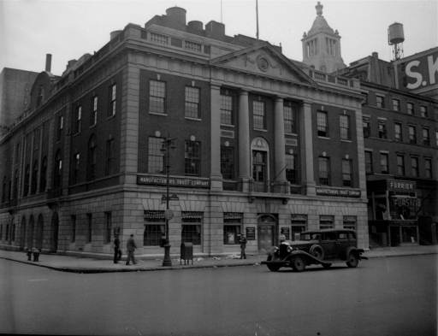
Tammany Hall: The Epicenter of Fraud

Slide 85
Political Machines: Voting Fraud
No voter identification
Shave and return
Dogs and the dead
Counting

Slide 86
Nast vs. Tweed Ring
Thomas Nast
William Tweed

Slide 87
Thomas Nast vs. Tweed Ring
"Stop them damned pictures. I don't care so much what the papers say about me. My constituents don't know how to read, but they can't help seeing them damned pictures!"
–Tweed

Slide 88
Going Through the Form of Universal Suffrage, 1871
Caption: (Boss) "You have the Liberty of Voting for any one you please; but we have the Liberty of Counting in any one we please."

Slide 89
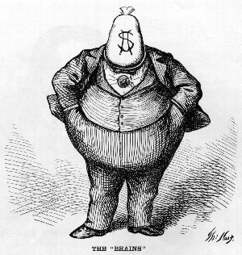
One of Nast’s most famous cartoons speaks for itself on
“The Brains” of Tammany Hall.

Slide 90
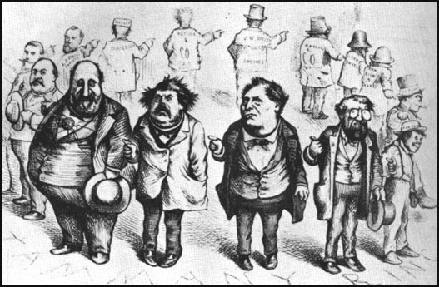
Caption (not pictured) says:
“Who Stole the People’s Money? -- Do Tell.‘TWAS HIM.”

Slide 91
New York Corruption – “The City Treasury - Empty to the Workmen, and the Four Masters who Emptied It”

Slide 94
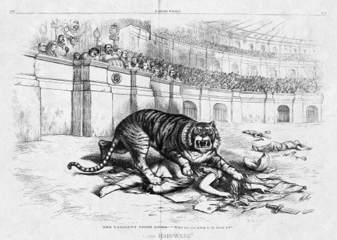
Published on the eve of the 1871 NYC elections.
Caption says:
“The Tammany Tiger Loose-What Are You Going to Do About It?”

Slide 95
Nast vs. Tweed Ring
Tweed sent someone to inform Nast that some admirers of his work wanted to send him to Europe to study art.
When Nast, suspicious, replied that he could not possibly afford to leave his work at Harper's, the reply was that $100,000 was set aside for him. Nast responded it would take more than that to make it worth his while. When the figure was raised to $500,000 , Nast said he'd rather see Tweed and his gang in jail first.
"Be careful Mr. Nast," his caller replied, "that you do not find yourself in a coffin first." Then suspicious characters were lurking outside of Nast's home in Manhattan, so he moved his family to NJ

Slide 96
Nast vs. Tweed Ring
Failing to bribe Nast, Tweed tried to intimidate Harper’s Brothers Publishing by threatening to have the NY Board of Education throw out all Harper textbooks and never buy any more.
This could bankrupt Harper’s; but they voted to stand by Nast

Slide 97
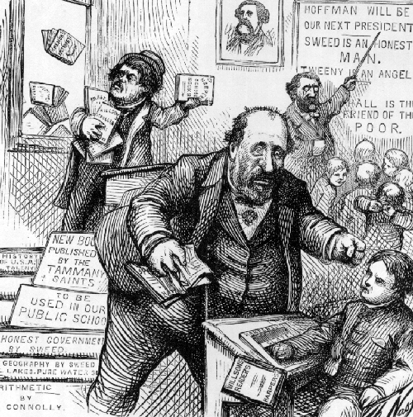
Following the threats against himself and Harper’s, Nast published The New Board of Education.

Slide 98
Nast vs. Tweed Ring
Nast and other muckrakers brought Tweed down in 1871
220 counts
Hung jury
Re-tried, convicted to 1 year. Does time.
Civil suit > fled to Spain > recognized due to a Nast cartoon > extradited > agreed to tell all in a plea
Died in the Ludlow Street Jail in 1878

Slide 99
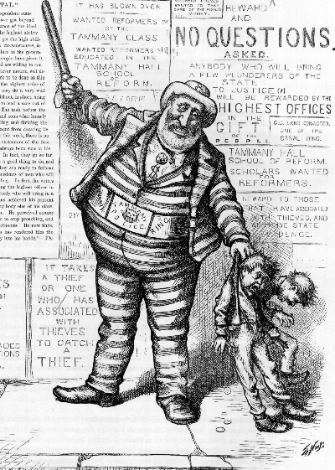
Spanish police hoped for a reward for extraditing Tweed

Slide 100
Mystic chords of memory: 1908 hit song.
Tammany Tiger (and ex-NY governor) Teddy Roosevelt

Slide 101
Terry Golway. Machine Made: Tammany Hall and the Creation of Modern American Politics. 2014.
Tammany courted immigrants because “they knew how to count”
Tammany provided relief for Irish immigrants/refugees
Though sympathetic to the plight of Black and Chinese Americans, German-born Nast loathed Catholics. His criticism of Tammany was informed by his bigotry
In 1871, The American River Ganges portrayed Catholic bishops as crocodiles waiting to attack American school children.
In 2011 Nast denied entrance into the NJ Hall of Fame for his bigotry

Slide 102
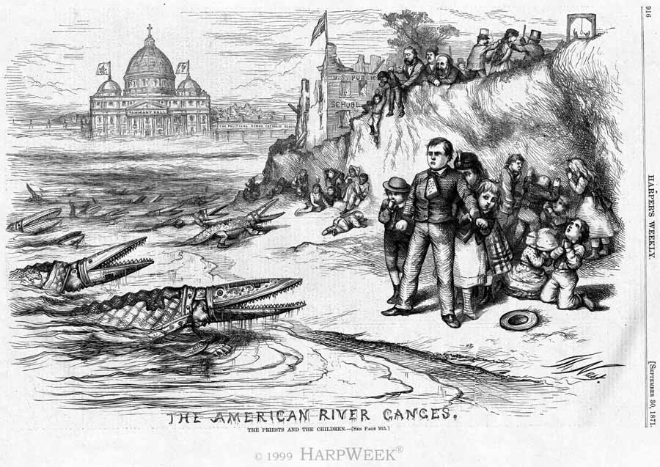

Slide 103
From the Record
The politician who steals is worse than a thief. He is a fool. With all the grand opportunities around for the man with a political pull, there's no excuse for stealin' a cent.
-Boss Pendergast of Kansas City, MO
Politics is a business just like anything else.
-George Washington Plunkett (Tammany Democrat)
Don't worry if they're Democrats or Republicans. Give them service and they'll become Democrats
-Richard J. Daley

Slide 104
From the Record
A political machine is a united minority working against a divided majority -Will Durant
Mothers all want their sons to grow up to be president, but they don't want them to become politicians in the process -JFK
Politics is supposed to be the second-oldest profession. I have come to realize that it bears a very close resemblance to the first. -Reagan
Politicians are like diapers. They should both be changed frequently and for the same reason. -Twain

Slide 105
Coming Soon…. Cleaning Up in the Progressive Era

