Slide 1
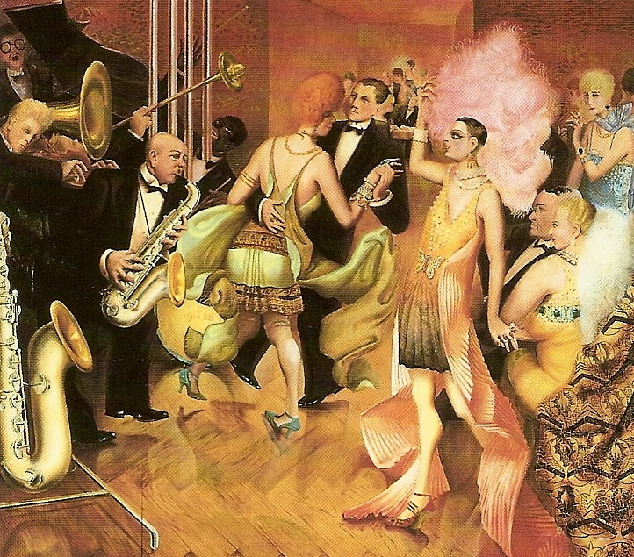
Weimar Society and Culture
MR. DANIEL LAZAR

Slide 2
Outline
Socioeconomic Setting
Education and Intelligentsia
Gender Revolution
Crime & Punishment
Cinema
Expressionism
Dada
New Objectivity
Music
Architecture
→ Consider the political setting (see lecture)
→ Synthesize the relationships between the “battles” of this “Culture War”

Slide 3
Historical context
Germany's defeat in WWI, the fall of the Hohenzollerns and the abolition of censorship in Weimar Constitution begat radical experimentation in the arts
Russian Rev and its constructivist art was also influential
Manifestation of the Age of Anxiety
Crises can produce cultural flowering
Cultural War: Modernism vs. Traditionalism
Third Reich has overshadowed Weimar for three generations. But…

Slide 4
“Weimar was berlin, berlin was Weimar”
Berlin became Germany’s cultural and social center
1924: Tempelhof opened
1925, Berlin pop = 4 mil.
Grew 80-100,000 per year
1928 Berlin 3rd largest city after London and NY
1926: Funkturm Radio Tower built

Slide 5
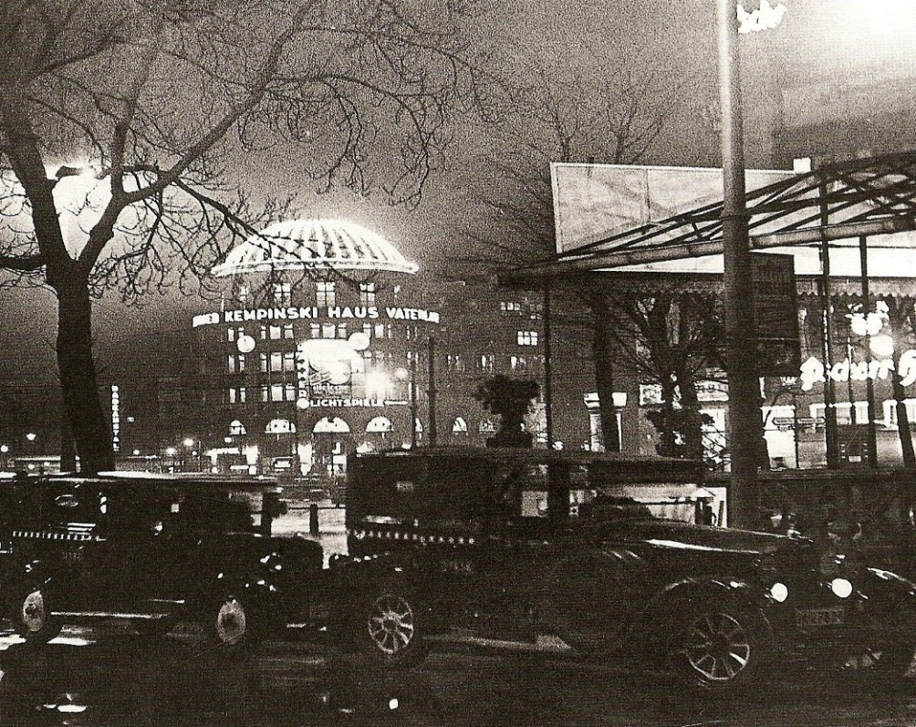
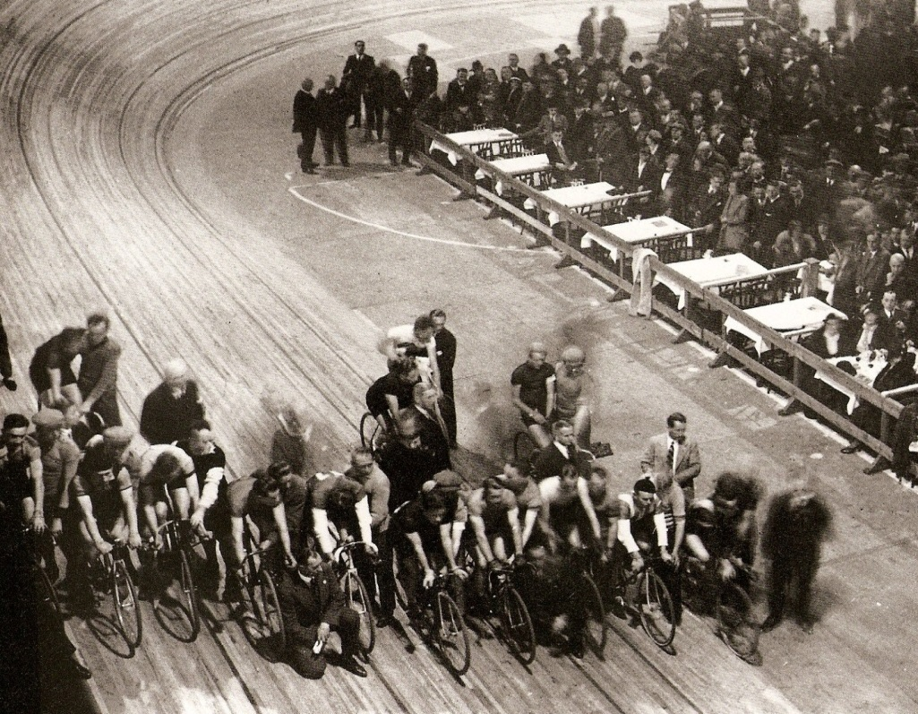
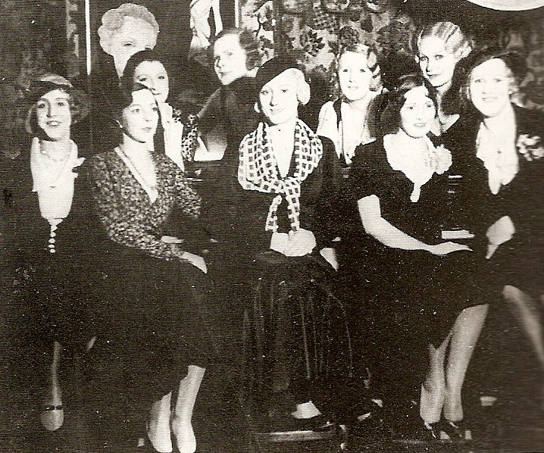
Potsdamer Platz by night
Six-day bicycle races
Eldorado, Berlin transvestite bar

Slide 6
Socioeconomic setting
No fundamental change to economic structure after 1918
No redistribution of wealth
No nationalization of industry
Industrialists and landowners still powerful
Old elites represented in the Reichstag by the DVP and DNVP.
But some socioeconomic change: Aristocracy dislodged. Aristocratic ranks and titles banned after 1918; many families incorporated their titles into their surnames.

Slide 7
Weimar Constitution: Economic Rights
151 - The economy must be based on the principles of justice, with the goal of achieving life in dignity for everyone. Within these limits the economic liberty of the individual is to be secured.
153 - Property is guaranteed
157 - Labor enjoys the special protection of the Reich
159 - The right to form unions and to improve conditions at work is guaranteed to every individual and to all occupations.
165 - Workers and employees are called upon to participate on an equal footing and in cooperation with the employers in the regulation of wages and working conditions

Slide 8
Socioeconomic setting
Small businesses struggled in Weimar economy
Many middle class families continued to fear revolution from extreme left and/or right
Lacked identification with the Republic and with Republican values
Even those who came to accept it often had little love for it – they came to be known as Vernunftrepublikaner, “rational republicans”
Family of the Lawyer Dr. Fritz von Glaser
(1920) by Otto Dix

Slide 9
Socioeconomic setting
Stinnes-Leigen Agreement - between labor (represented by trade unionist Karl Legien) and capital (represented by industrialist Hugo Stinnes) reached on 15 Nov 1918
Unions agreed not to interfere with private ownership
In return, were granted full legal recognition and an 8 hour day
SPD government in Prussia invested in public works, affordable housing, increased benefits, education etc.

Slide 10
Socioeconomic setting
Slow improvement in living standards after 1924:
Not “Roaring”
Inflation under control
Stable and sane

Slide 11
Education & intelligentsia
Weimar Constitution: State committed to free compulsory education
Primary and secondary schools were prerogative of state governments
Universities controlled by central government
Hoped education would create a sense of civic responsibility, foster commitment to democracy, and provide greater social mobility

Slide 12
Education & intelligentsia
Attempts to reform secondary education in Prussia: more opportunities for girls, raised the age at which testing took place, and allowed for more movement between educational streams.
But resistance from Centre Party and from the educational establishment
Many teachers and professors, recruited from the middle classes, remained hostile to the Republic. Old educational methods (learning by rote etc.) remained standard.
Challenged by Philosopher Rudolf Steiner who established the first Waldorf School in 1919 in Stuttgart

Slide 13
Education & intelligentsia
Institute for Social Research at the University of Frankfurt am Main (The Frankfurt School)
Dissident Marxists
Interdisciplinary: Sought to synthesize sociology, psychoanalysis, existential philosophy, history, etc.
Influenced by: Kant, Hegel, Marx, Freud, Weber, etc.
Notables: Erich Fromm, Herbert Marcuse, Theodor Adorno, Walter Benjamin
Goal: Emancipation

Slide 14
Education & intelligentsia
1918, German universities opened to Jewish scholars for the first time:
Sociologists: Karl Mannheim, Erich Fromm, Theodor Adorno, Max Horkheimer, and Herbert Marcuse
Philosophers: Ernst Cassirer and Edmund Husserl
Political Theorists: Arthur Rosenberg and Gustav Meyer
Physics: Albert Einstein
Nine German citizens awarded Nobel prizes during the Weimar era, five of whom were Jewish scientists

Slide 15
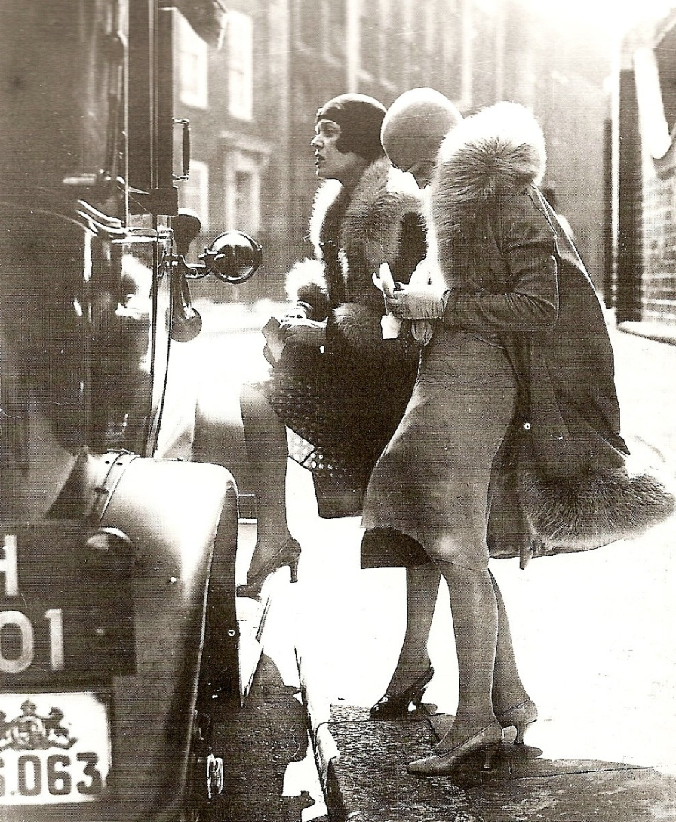
Gender revolution

Slide 16
Gender revolution
1918, all women 20+ could vote
1924, 36 female Reichstag deputies – more than in any other parliament in the world.
Many focused exclusively on “women’s issues” – child care, social policy, family issues, etc.
Bund Deutscher Frauenvereine (BDF) = the largest women’s organization with over 900,000 members
Split in women’s movement along age and class lines
Debate over reproductive rights highlights these differences

Slide 17
Gender revolution
New educational and employment opportunities for women; Young middle-class women in secretarial and other “white collar” jobs
More disposable income & interaction with the outside world reduced family influence
Wages spent on consumer goods and entertainment – fashion, cosmetics, cinema, etc.
Changes in sexual attitudes/behavior:
Freud & Jung
Age of Anxiety
International Movement

Slide 18
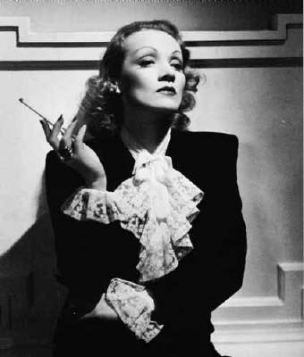
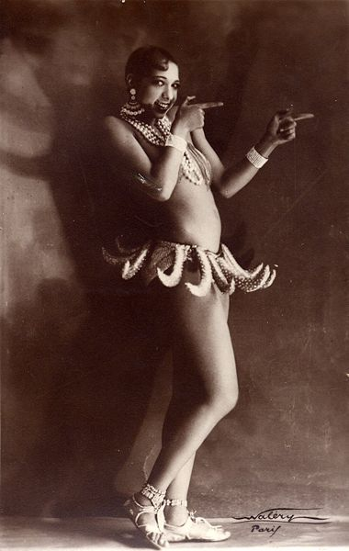
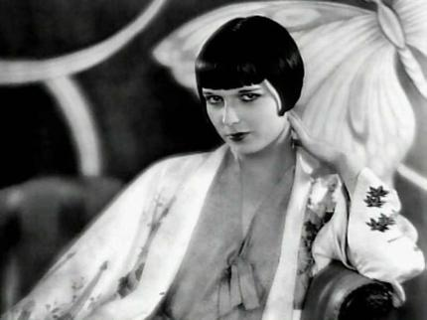
Marlene Dietrich (left),
Josephine Baker (right),
and Louise Brooks
(below).

Slide 19
Crime & PUNISHMENT
Chaotic Republic - breeding ground for crime
Prostitution – police estimated 25,000 full time prostitutes in Berlin in 1929
Drugs
Organized Crime – extortion, illegal gambling, protection rackets, etc.

Slide 20
Crime & PUNISHMENT
Murder Spike:
Fritz Haarmann, the “Butcher of Hanover”, killed 24 prostitutes between 1919-1924
Karl Grossman murdered as many as 50 women before he was arrested in Berlin in 1921
Peter Kürten, the “Vampire of Düsseldorf”, was convicted of 9 murders and 7 attempted murders in 1931
By 1929 50,000 crimes being reported annually in Berlin alone
Policing effective – the uniformed Schutzpolizei (Schupo) and the plain clothes Kriminalpolizei (Kripo)
Berlin police had a high success rate: 39 out of 40 reported murders solved in 1928
Captured public imagination

Slide 21
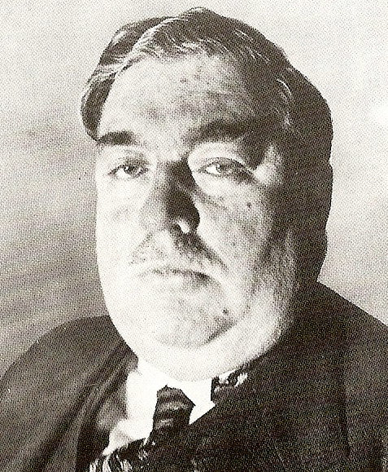
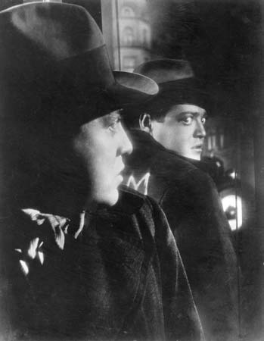
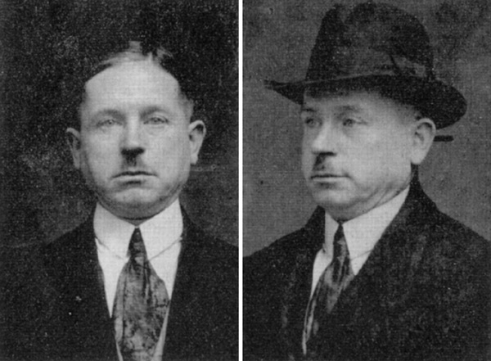
Ernst Gennat (1880-
1939), head of the
Homicide division of the
Berlin Kriminalpolizei
(1925-39) and originator
of the term “serial killer”
(Serienmörder)
Above: Peter Lorre as the child murder in
Fritz Lang’s M (1931)
Left: Peter Kürten “The
Vampire of Düsseldorf” (1883-1931),

Slide 22
Weimar Cinema
Influence of WWI propaganda film
1917: German High Command forced a merger of German production companies to form Universum Film A.G. (Ufa)
1918: The state withdrew its stake in Ufa, which continued as a private enterprise
Technological innovations, high production values, and a strong aesthetic sense put Weimar cinema at the forefront of the European avant-garde

Slide 23
Weimar Cinema
Expressionist films featured plots exploring the dark side of human nature.
Elaborate expressionist set design
Nightmarish aesthetic
Tales of corruption and chaos
Futurism
Dystopia (see Metropolis)
Since films were silent, the cast could be, and often was, international—thus further contributing to Weimar social fabric.

Slide 24
Notable German Films, 1918-33
Der Golum (1920)
Das Cabinet des Dr Caligari (1920)
Der müde Tod (1921)
Dr Mabuse, der Spieler – Ein Bild der Zeit (1922)
Nosferatu, eine Symphonie des Grauens (1922)
Der letze mann (1924)
Die freundlose Gasse (1925)
Die Abenteuer des Prinzen Achmed (1926) – the world’s first feature length animated film.
Metropolis (1927)
Der blaue Engel (1930)
Westfront 1918 (1930)
Die Dreigroschenoper (1931)
M (1931)

Slide 25
Notable Directors and Actors
Directors
Fritz Lang
F. W. Murnau
G. W. Pabst
Ernst Lubitsch
Josef von Sternbeg
Billy Wilder
Walter Ruttmann
Paul Leni
Arnold Franck
Actors
Conrad Veidt
Emil Jannings
Rudolf Klein-Rogge
Marlene Dietrich
Peter Lorre
Max Schreck
Werner Krauss
Leni Reifenstahl

Slide 26
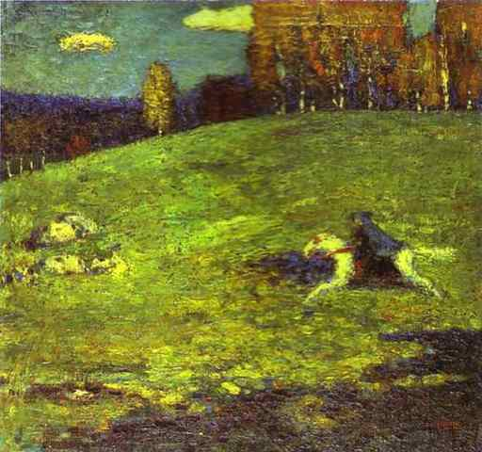
Expressionism
Expressionism distorts reality for emotional effect; it is a subjective art form hoping to express meaning or emotional experience rather than physical reality
Influential in Germany since the turn of the century
Expressionism in painting, literature, theatre, dance, film, architecture, and music
Wassily Kandinsky, Der blaue Reiter (1903)

Slide 27
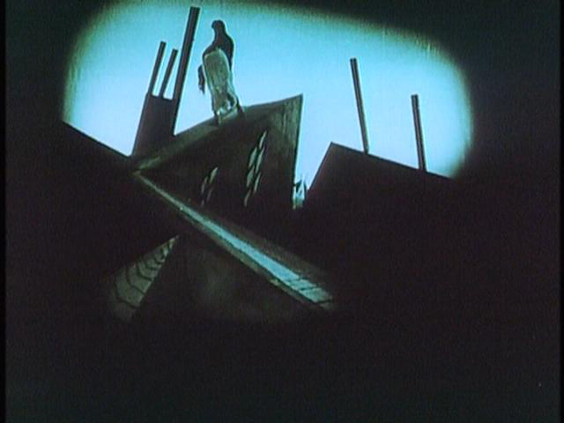
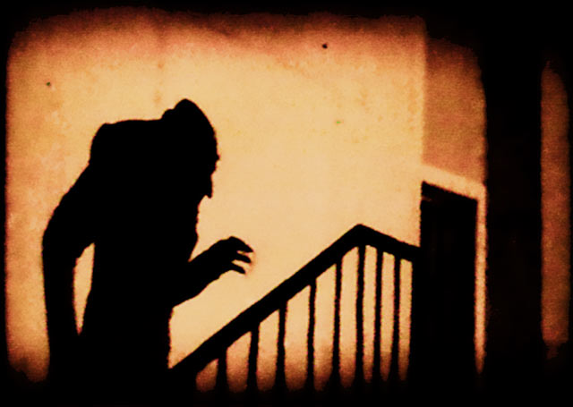
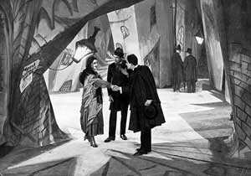
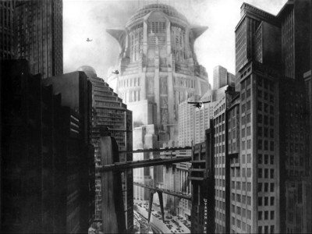
Expressionist Film
Scenes from Das Cabinet des Dr Caligari (1920)
Still from Nosferatu (1922), directed by F. W. Murnau
The ‘Tower of Babel’ from Fritz Lang’s Metropolis (1927)

Slide 28
Expressionist Theatre
Expressionist theatre was “strident and hostile, eccentric in plot, staging, speech, characters, acting, and direction.” (Peter Gay).
Ernst Toller, Die Wandlung (Transformation, 1919). Inspired by his WWI experience.
Bertold Brecht, Man Equals Man. Personality can be disassembled and reassembled, like a machine.
Max Reinhardt, Managed the German Theater in Berlin; est. the Max Reinhardt Seminar in Vienna
Max Reinhardt
(1873-1943)

Slide 29
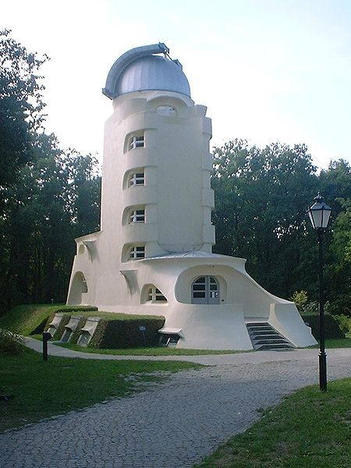
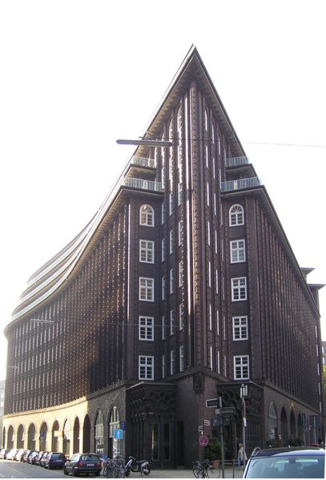
Expressionist Architecture
The Einstein Tower in Potsdam (1919-20),
designed by Erich Mendelsohn
Chilehaus in Hamburg (1922-24),
designed by Fritz Höger

Slide 30
Dada
International cultural movement founded in [neutral] Zurich in 1916
Dada was, in part, a leftist criticism of Expressionism
A response to madness of war
To Dadaists, progress (including reason and logic) led to the disaster of world war.
Argued the only way forward was through political anarchy, natural emotions, the intuitive and the irrational
Forerunner of Surrealism
Germany: A Winter’s Tale (1917-19)
by George Grosz

Slide 31
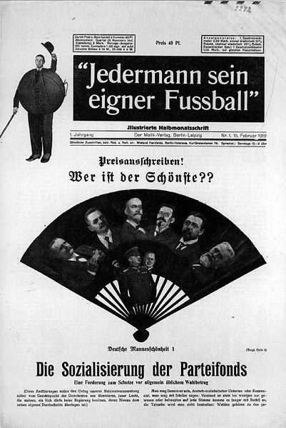
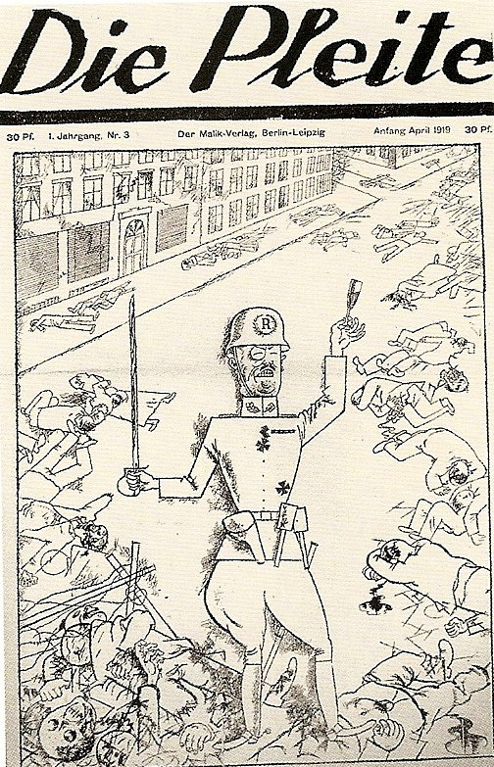

Slide 32
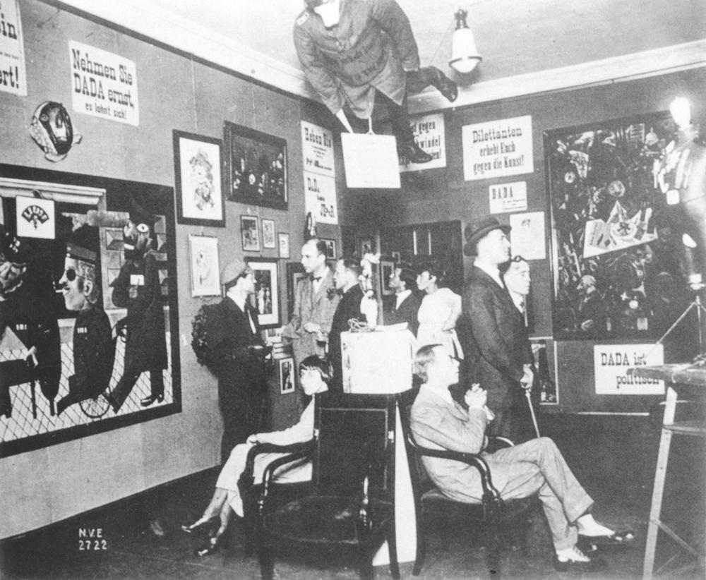
The First International Dada Fair, Berlin, 1920

Slide 33
Neue Sachlichkeit / New Objectivity
aka “New Resignation”, “New Dispassion”, “New Sobriety”
An outgrowth of and an opposition to expressionism
Rejection of sentimentality, emotional agitation, fantasy and romanticism of Expressionism
Interdisciplinary: art, literature, architecture, and cinema
A style and aesthetic or a movement?

Slide 34
Neue Sachlichkeit / New Objectivity
Schism:
Left wing: “Verists” who used the style to comment critically on society (Hartlaub, George Grosz, Otto Dix)
The madness of humanity
Cartoonlike
Satirical hyperrealism
Right wing: “Classicists” who favored a representation and realism over abstraction (Georg Schrimpf, Alexander Kanoldt, Carlo Mense)
Magical Realism School

Slide 35
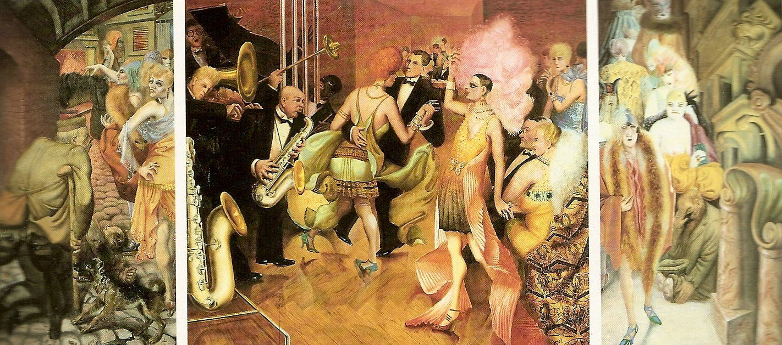
Großstadt (Metropolis) Triptych (1927-28) by Otto Dix

Slide 36
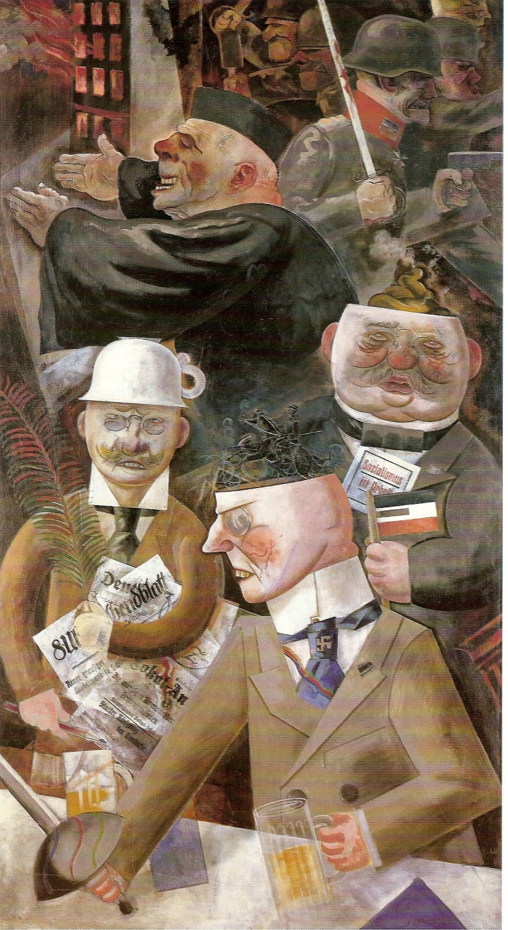
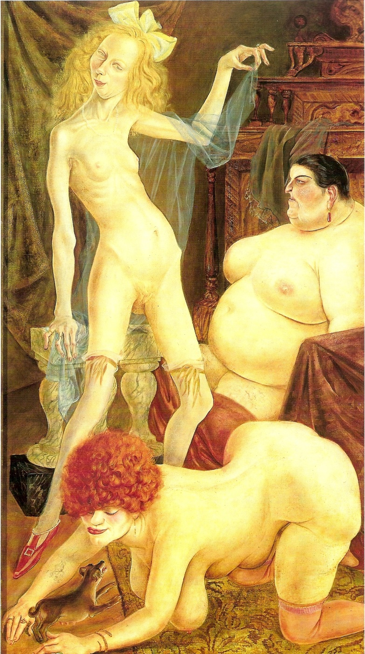
The Pillars of the Establishment (1926)
George Grosz
Three Whores (1926)
Otto Dix

Slide 37
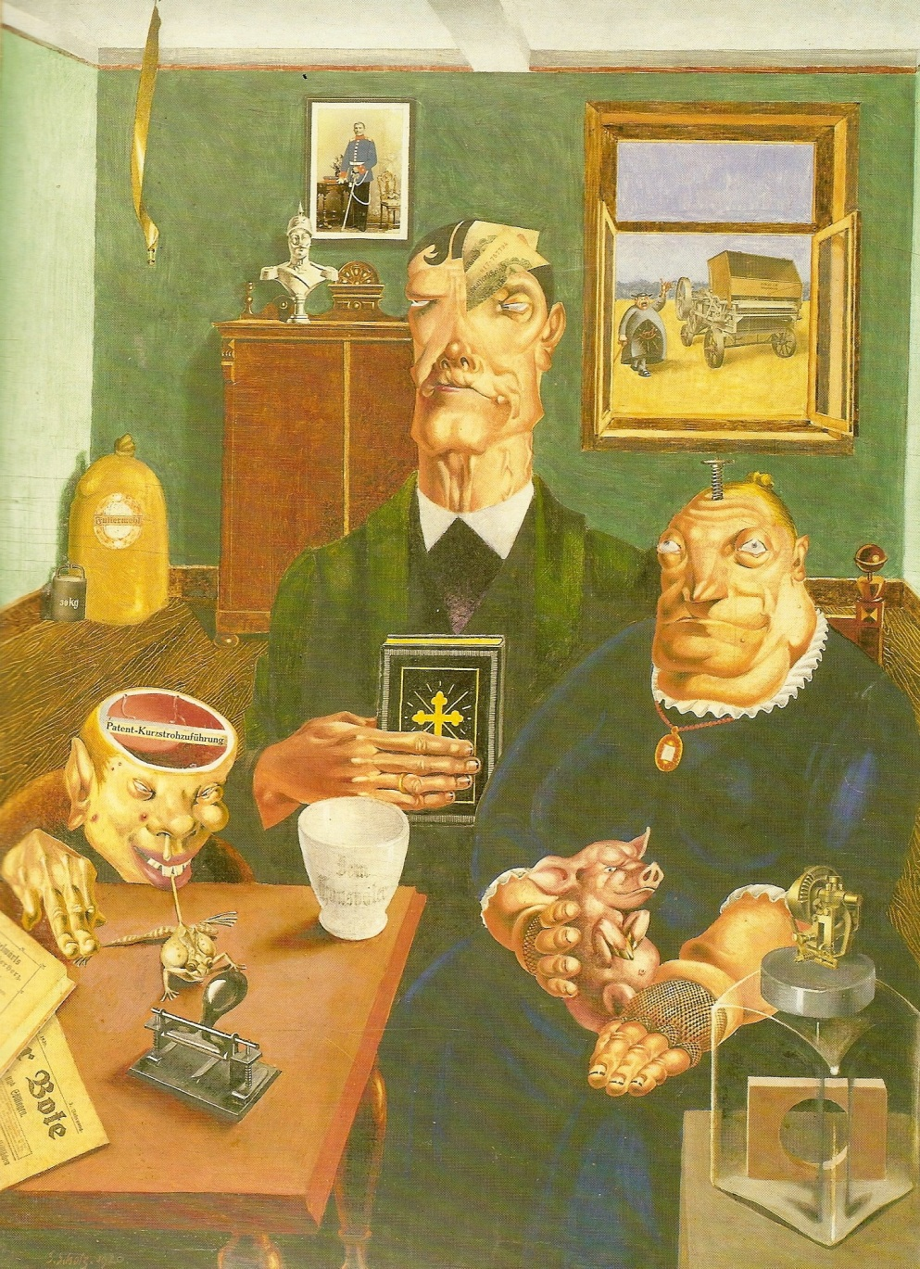
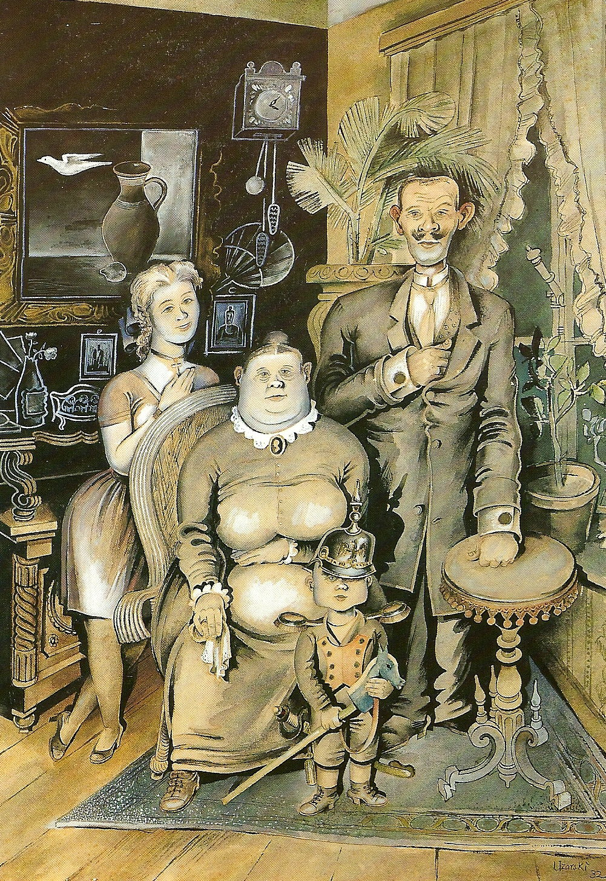
Satires of middle class family life:
Industriebauen (1920) by Georg Scholz and Deutsche Familie (1932) by Adolf Uzarski

Slide 38
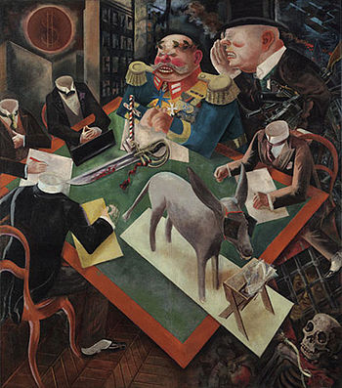
The Eclipse of the Sun
George Grosz, 1926

Slide 39
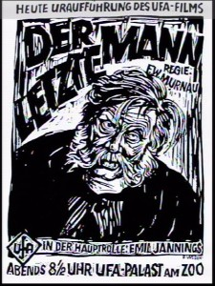
Neue Sachlichkeit Film
Posters for Berlin: Die Sinfonie der Grosstadt (1927) and Der Letze Mann (1924)

Slide 40
MUSIC
Atonality (Schoeneberg despised the term, but it stuck)
Arnold Schoenberg
Kurt Weill
Hanns Eisler
Paul Dessau
Challenging music
Deemed “degenerate“
Stravisnky reclnsidered it in the 1950‘s
Arnold Schoenberg in Los Angeles, 1948

Slide 41
Jazz
Symbolism of chaos and improvisation
Jazz is individualistic, democratic and liberating, thus threatening
“Without rules”
“Jazz is a pretty good barometer of freedom.” (Ellington)
Sexuality of Syncopation
Glorification of Blacks
Commodification by Jews
Jazz was young, new, modern, and Black
“I think that what you call ragtime is poison . A person inoculated with the ragtime fever is like one addicted to strong drink.”
Hans Muck, Director of the Boston Symphony Orchestra

Slide 42
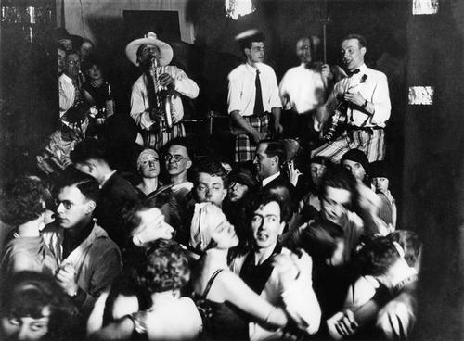
JAZZ & DANCE
Role of radio
Nightlife
Tango, Foxtrot, Charleston
Josephine Baker visited
Berlin in 1925

Slide 43
Bauhaus
Walter Gropius: Director of the Bauhaus, 1919-28
Hannes Meyer, 1928-1930
Ludwig Mies van der Rohe, 1930-33
School moved from Weimar to Dessau to Berlin
Unity of the Arts:
Architecture, Sculpture, Painting
Fine Art and Applied Arts
Monumental and Decorative Art
Art and Technology

Slide 44
Bauhaus
"Art into Industry." (Bauhaus School Slogan)
“A modern, harmonic and lively architecture is the visible sign of an authentic democracy” (Gropius)
“We want an architecture adapted to our world of machines, radios and fast cars.“ (Gropius)
“Less is more.” (van der Rohe)

Slide 45
Bauhaus
German art and design shifted from Expressionism to New Objectivity.
Functional, rational, simple, modern
Light and transparent
Created products for mass production
Emphasized white and grey accented with black or primary colors
Diaspora of “degenerate” Bauhaus designers
Van der Rohe in Chicago
Gropius and Breuer in UK, then Harvard
4000 Bauhaus buildings in Tel Aviv (“The White City”)
Steve Jobs

Slide 46
Bauhaus
Walter Groupius
Ludwig Mies van der Rohe

Slide 47
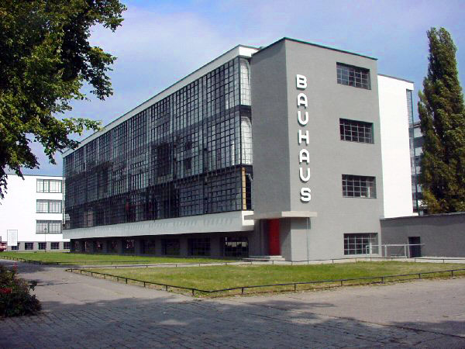
Bauhaus
Cantilever “Cesca” Chair by Marcel Breuer
The Bauhaus building in Dessau (1925-26)

Slide 48
Bauhaus at onkle toms hutte
Bruno Taut visualized a Utopian society – classless and at one with nature, and criticized the capitalist system, describing it as “a headless body, selfish, and utilitarian.”

Slide 49
Conclusions
No significant redistribution of wealth or nationalization of industry, but still a great deal of social change under the Weimar Republic:
Shorter working week, legal recognition of trade unions → time for culture
Social mobility through educational reform → taste for culture
New opportunities for women → more cultural voices.
Berlin as capital of Europe…again.
Internationalism → Multiculturalism
Third Reich persecuted “degenerate” modern forms. But artistic innovation is resilient. The post-war era built on the shoulders of Weimar giants.
Many Germans still feel alienated from the Republic and its culture.

