Slide 1
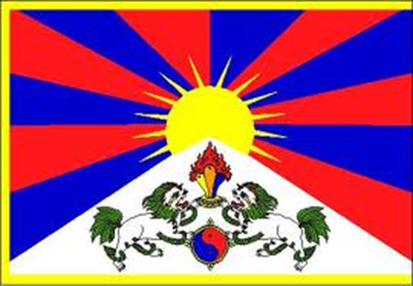
The One China Myth Xinjiang, Tibet, and Hong Kong
Mr. Daniel Lazar

Slide 2
A Guiding Thought
China has long struggled for internal sovereignty, but as the world cautiously watches the rise of China, the CCP faces its complexities and contradictions on the global stage.
Often oblivious and usually insensitive to the hopes and needs of ethnic minorities, the PRC claims they are zhong guo ren, Chinese People with Universal Values.
What casual observers perceive to be “One China” is indeed a fragmented society bound by the crushing chains of the CCP.

Slide 3
Guiding Questions
What are SARs an SEZs and how are they complicated by the history of humiliation of China?
How can the PRC effectively cope with its diversity, cumulative cleavages, and relative deprivation?
How might China have a more valid claim to exercise authority over some SARs and SEZs than others?
What might the future hold for SARs and SEZs?
How can/should the international community react to China’s sovereignty conundrums?
How do these ethnoreligious conflicts compare with conflicts in our other course case studies?

Slide 4
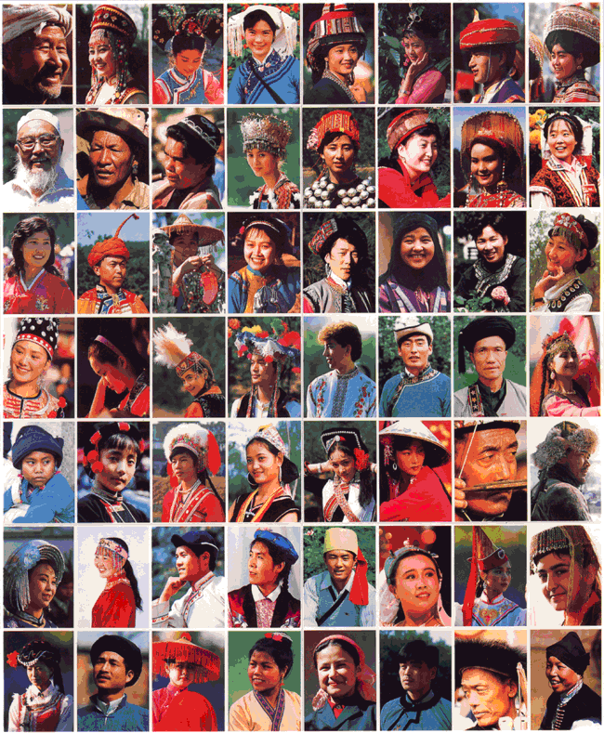
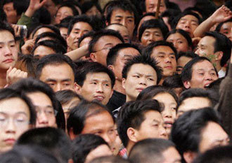
The One China Myth

Slide 5
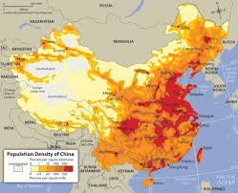
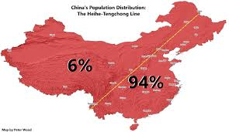
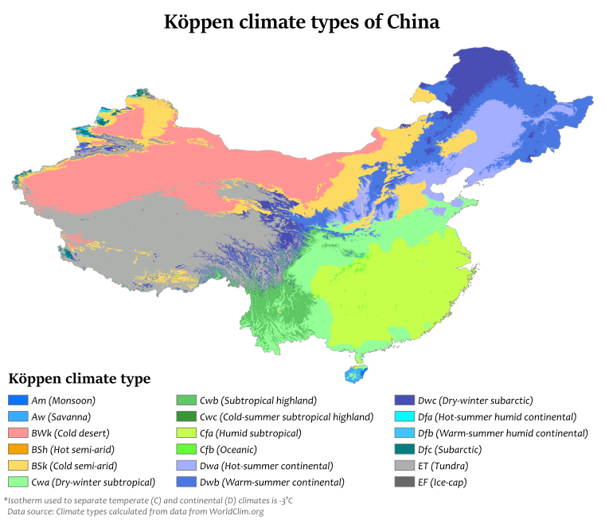
The One China Myth
92% Han (128 million non-Han)
56 official ethnic groups (xiaoshu minzu)
Zhuang (18 million), Manchu (15 million), Hui (10 million), Miao (9 million), Uyghur (8 million)
Hundreds of unofficial groups
Geographically is not destiny, but…

Slide 6
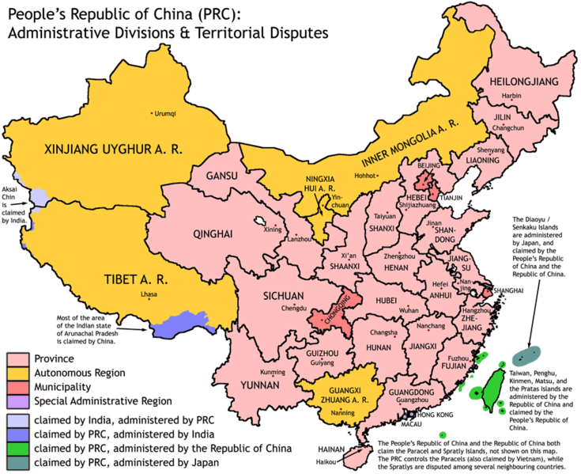
The One China Myth: Autonomy in China

Slide 7
The One China Myth: Autonomy in China
Resource rich and beautiful
GNP per capita ½ national average.
Less developed.
Deng opened the dialogue. Jiang and Hu prioritized development. Xi demands discipline.

Slide 8
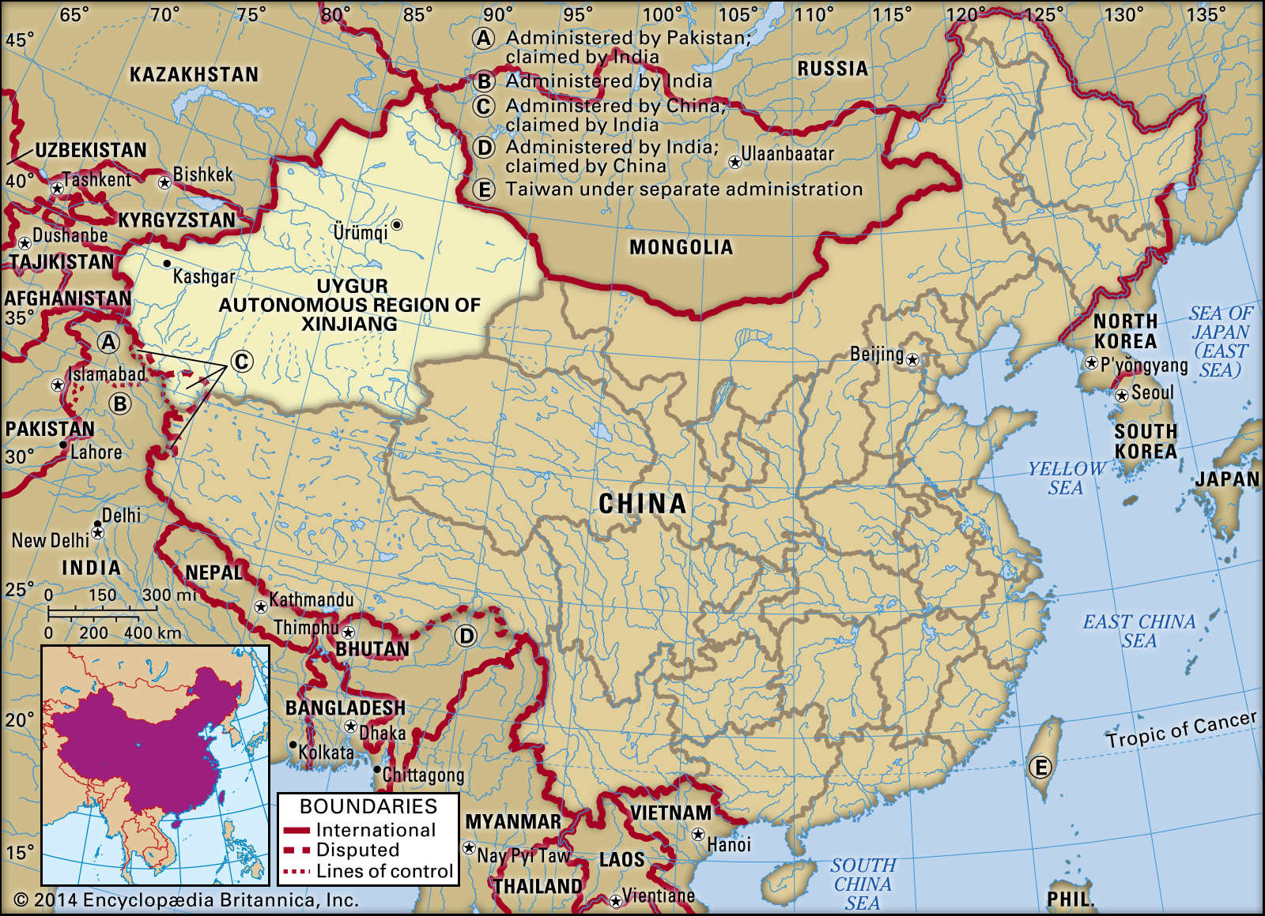
Xinjiang Autonomous Region: Just the Facts
Capitol: Urumqi
1/6 of China's territory
Largest province
4x larger than Germany
Pop: 22 million
Natural gas and oil

Slide 9
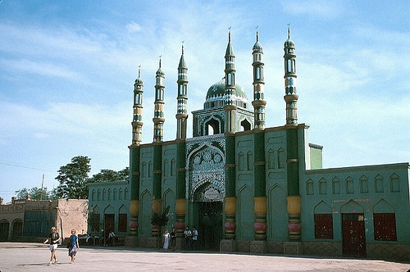
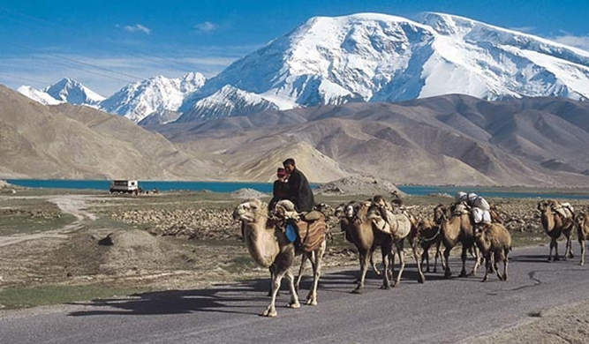
Xinjiang is Unique: Just the Facts
12 mil Muslims (half of Chinese Muslims)
Arabic-rooted language
Desert Landscape
Ethnic groups:
Han (45%)
Uyghurs (41%)
Kazakhs (6.7%)
Changing…

Slide 10
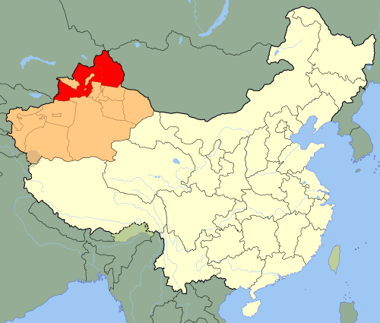
Xinjiang is Unique: More than Just Fun Facts
Urumqi is the geographical center point of Asia.
Yili is 1 of 5 Xinjiang prefectures. It shares a 2,019 km border with Mongolia, Russia, and Kazakhstan
Han use Beijing Time; Uyghurs use Xinjiang Time as a form of rebellion.

Slide 11
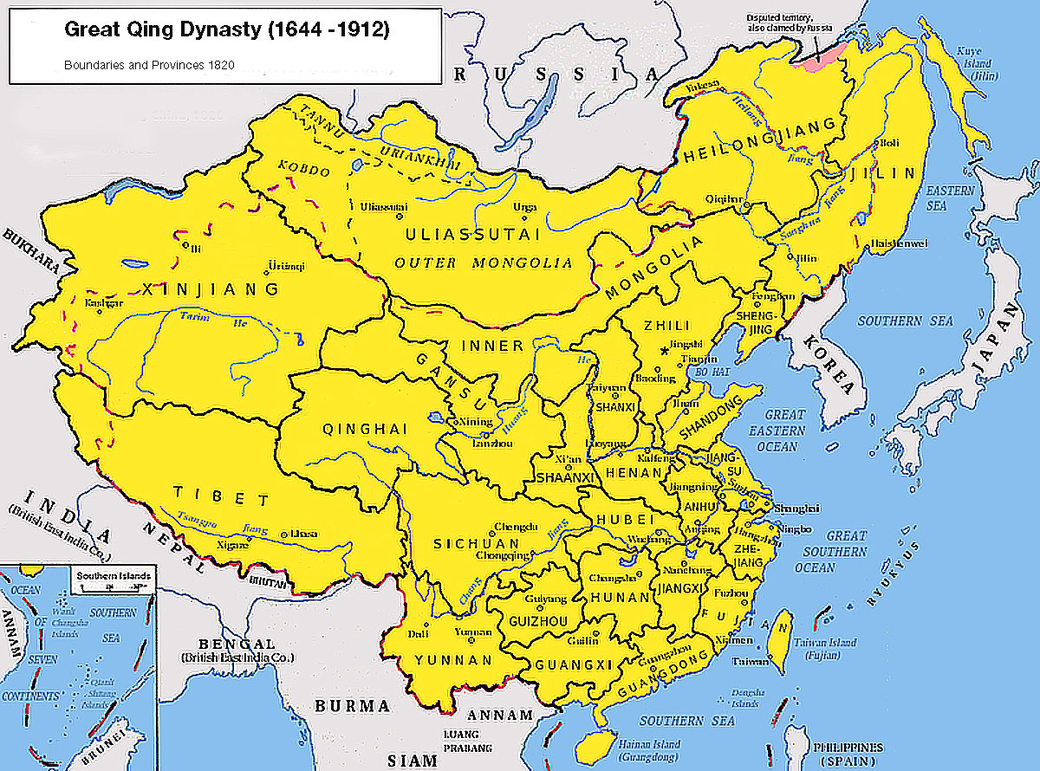
Early History
Nomadic Turkic tribes → Mongolian rule → Qing Dynasty
Province status in 1884
Han sought to educate and integrate the “savages”

Slide 12
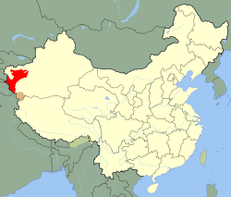
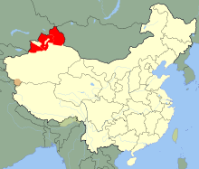
Modern History
1912 - Qing fell, ROC est.
1933 - Uyghur and Hui revolts led to formation of First East Turkestan Republic; attacked by KMT in 1934
1944-1949 - Second East Turkestan Republic
Soviet Supported
At end of Chinese Civil War, a “Peaceful Liberation” from warlords and KMT
Uyghurs were 80% of pop. in 1950

Slide 13
Modern History, Early Years of the PRC
Became an “autonomous” region in 1955
CCP built SOEs
CCP built prison camps
CCP wanted resources and a secure border
Han infiltration. Many Uyghurs fled. Others suffered. Great Leap, 100 Flowers Campaign, Cultural Revolution…

Slide 14
Xinjiang and the PRC
Regional Ethnic Autonomy Law of 1984
Guarantees rights to minorities
Self-government
Freedom to develop language, religion, culture
Greater control over economic development
Not equitably or consistently enforced
Uyghurs are classified as a National Minority rather than an indigenous group. Thus, they are considered to be no more indigenous to Xinjiang than Han.

Slide 15
Xinjiang and the PRC
To be fair...
Agricultural science has increased output
Massive road construction in the desert
More access to doctors, immunizations, and hospital beds than PRC average
 | 1949 | 2013
Primary School | 1335 | 6221
Middle Schools | 9 | 1929
Universities | 1 | 21
Public Libraries | 0 | 81
Museums | 0 | 23
Illiteracy | 45% | 2%

Slide 16
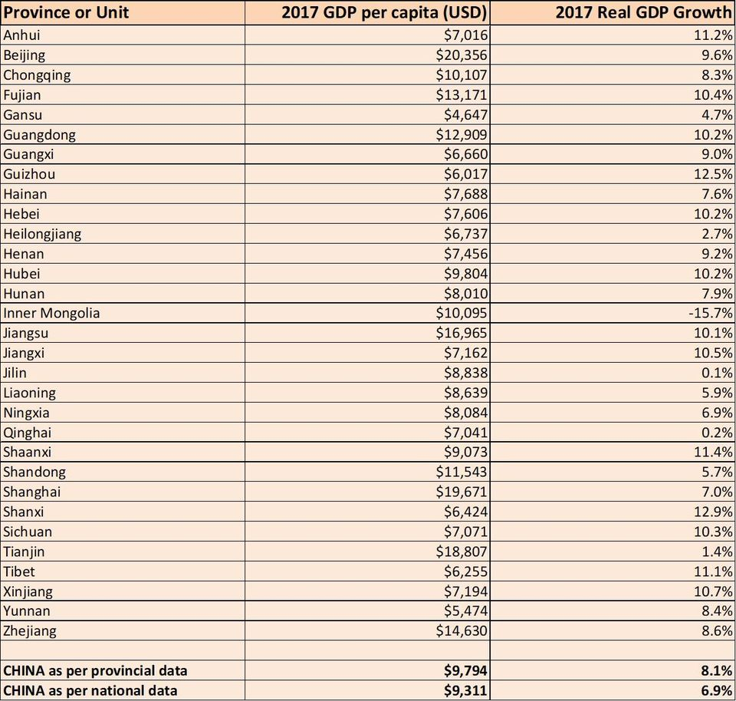
Xinjiang and the PRC
→

Slide 17
Uyghur Repression
Hanification of Xinjiang. 250,000+ Han come annually.
Better jobs reserved for Han
CCP Clientelism
Systematic discrimination
Many Uyghurs want to reap the benefits of the rapidly growing Chinese economy, which disproportionately benefits Han
Relative deprivation
Cumulative Cleavage

Slide 18
Uyghur Repression
Uyghur culture and history repressed
Islam violated. Mosques shut down, filled with pigs.
Uyghur language (Eastern Turkic) discouraged
Uyghurs with Islamic adornments are harassed and/or arrested
Illegal to refer to “Uyghurstan” or “East Turkestan” in press
Scholars and journalists persecuted

Slide 19
Uyghur Repression
Village elections often rigged
Excessive local taxation and use of violence to collect taxes
Land reforms systematically benefit Han and hurt Uyghurs
CCP gives priority to Han and foreign investors over locals
Government violence against protestors

Slide 20
Uyghur Reactions
Inspired by Tiananmen and Tibetan movements, we see a range of reactions
Violent separatists and peaceful assimilationists
Some protests demand autonomy
Most aimed at LGA and LGA corruption
“Beijing makes no distinctions between the idea of Uyghur separatism– violent or even nonviolent—and the idea of terrorism.” (Liza Steele, Princeton)
Regular uprisings: 1989, 1993, 1997, 2009, 2013

Slide 21
Uyghur Reactions: World Uyghur Congress
WUC “Represents the collective interest of the Uyghur people" inside and outside of Xinjiang
Non-violent opposition to PRC “occupation of East Turkestan”
Rejects authoritarianism, religious intolerance, and terrorism
Funded in part by US based National Endowment for Democracy
Led by five-time Noble Peace Prize nominee, Rebiya Kadeer…

Slide 22
Rebiya Kadeer & The Price of Dissent
Xinjiang Uyghur (1947 - )
Family persecuted in Cultural Revolution
Became billionaire in 1980s
Started traditional Uyghur clothing retailer
Cross-border trade with post-Soviet Russia
Then real estate
…had 11 kids in the process
Held various positions in National People’s Congress. Expelled from CCP in 1999.

Slide 23
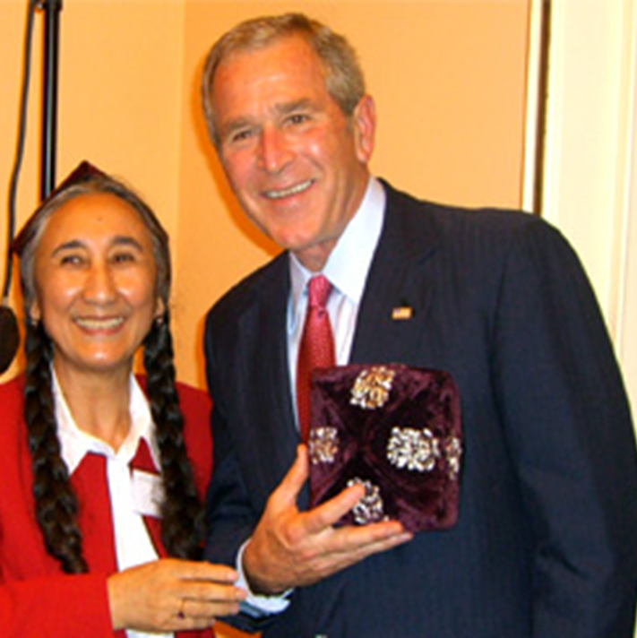
Rebiya Kadeer & The Price of Dissent
Imprisoned 2000-2005 for sending local, illegal journalism and legal briefs to her husband, who worked in the US for Voice of America & Radio Free Asia
In 2005, Condi Rice brokered compassionate/medical release. Moved to Munich.
3 of her kids have been imprisoned.
Here is a video of Kadeer’s granddaughters disavowing her in a Global Times* exclusive video. It’s the first Google result…

Slide 24
Urumqi Protests/Riots, July 2009
Causes
Uyghurs resent “Han occupation”
Years of mutual resentment and riots/protests
Han view Uyghurs as benefiting from special treatment, such as preferential admission to universities and exemption from One Child Policy
PRC allege that the riots were planned from abroad by the WUC
The Spark: 200,000+ Uyghurs were migrant workers in SE China (Shaoguan). Some Han claim that 6 women were raped by Uyghurs. No evidence found. Ethnic brawl ensued. At least 2 Uyghurs killed.
Uyghurs in Urumqi plan vigil/protest…

Slide 25
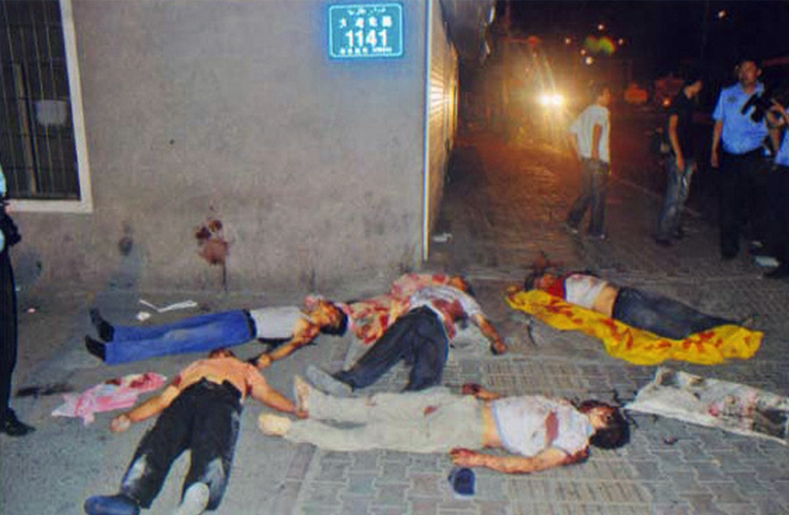
Urumqi Protests/Riots, July 2009
Uyghur exile groups claim escalation caused by excessive police force
PRC officials claim 197 dead, 1,721 injured
Human Rights Watch documented 43 disappearances in weeks following the riots
Vehicles and buildings destroyed

Slide 26
Urumqi Protests/Riots, July 2009
Misinformation War ensued
During protests phone service and internet access cut “to prevent the incident from spreading further”
State TV showed Han being beaten and Uyghurs as belligerents
PRC went on Harmony Campaign against the "three forces" of terrorism, separatism, and extremism
By November 2009, over 400 Uyghurs faced criminal charges
9 executed in 2009
26 had/have pending death sentences
The UN, EU, and US reacted. How do you suspect they reacted?

Slide 27
Uyghur Nationalism in the Post 9/11 World
PRC links Islamic separatist groups (i.e. East Turkestan Islamic Movement) with Al Qaeda
CCP capitalizes on global fear of terror to double down on Uyghur repression. Earned GW’s support.
Arrests and executions of suspected terrorists
Increased repression of Uyghur culture
Book burnings
Language prohibition

Slide 28
Uyghur Unrest, CCP Responses
2011 – Kashgar vehicular, IED, knife attack
2012 - Tianjin failed flight hijacking
2013 - 100 people on motorcycles attacked a Hotan police station
2013 - Tiananmen Square truck bomb
2013 - Shanshan police station attack, 35 killed
2014 - Urumqi rail station
2014 - Kunming Rail Station - 29 civilians dead. 140 injured.

Slide 29
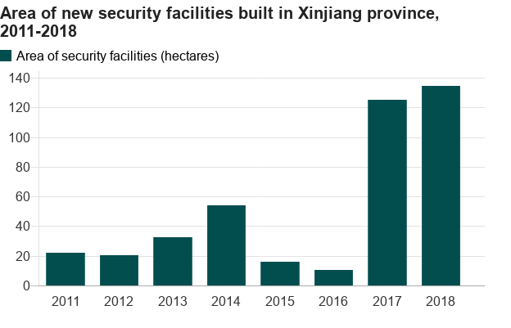
In the Age of Political Amorality

Slide 30
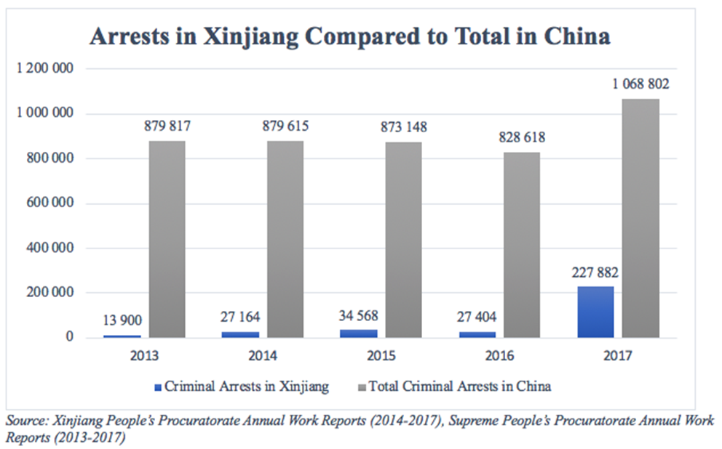
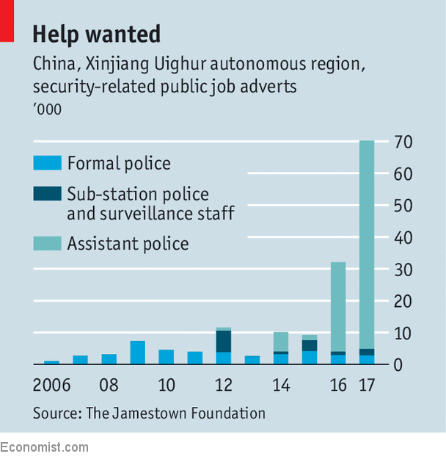

Slide 31
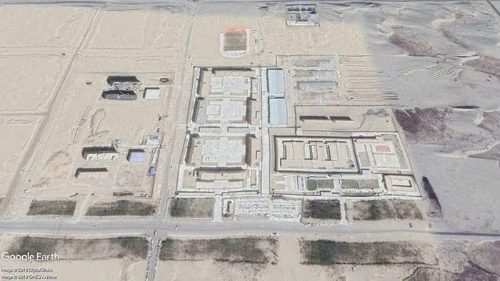
In the Age of Political Amorality
Dabanacheng, April 2018
Hotan Detention Center
Hundreds of thousands, if not millions, of Uyghurs are being detained and “re-educated”

Slide 32
In the Age of Globalization

Slide 33
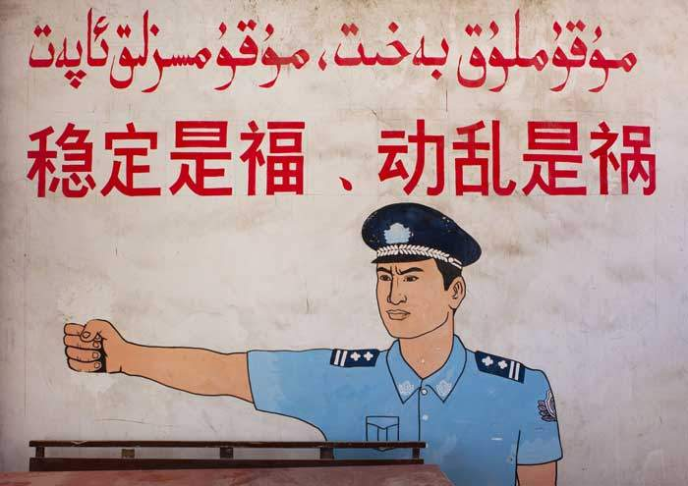
In an Age of Unrest
Poster in Xinjiang reads:
“Stability is a blessing, instability is a calamity”

Slide 34
The Struggle for Autonomy in the Tibetan SAR

Slide 35
Tibet: Just the Facts
TAR est in 1965; 2nd largest province, after Xinjiang
90 Tibetan, 8% Han
Population: 3.2 million. Least densely populated province.
3 million more Tibetans, mostly in China
No One Child Policy in Tibet; fastest growing population in China
PRC investments in education and health care

Slide 36
Timeline
1644-1912 – Qing Dynasty
1720 – Chinese Expedition: Historians disagree on degree of control
1903-04 – British Expedition to Tibet
Part of “Great Game” b/w UK and Russia
1904 – Treaty of Lhasa – demanded UK/India open borders & free trade
1907 – Britain and Russia agreed to Chinese “suzerainty” over Tibet
1912 - Tibetans seized on Qing fall to become independent; 13th Dalai Lama returned from India, Chinese troops left
Interwar Years: Britain, China, and Tibet had unsuccessful talks
USSR moved into Central Asia
UK hanged on to Big India by a thread

Slide 37
Timeline
1945-49 - Chinese Civil War
1950 - PLA forced treaty with Tibetan government
1950’s - US CIA in Tibet. Stayed until Nixon “Open Door”
1951 - 17 Point Agreement
Gradual assimilation
Language and Culture
Religion
Military area
1956 - 1959 - Revolt of Outer Tibet; Dalai Lama went into exile
1965 - TAR est.
1966-76 – Cultural Revolution. 1 million Tibetans killed.
1978 - PRC publicly apologized

Slide 38
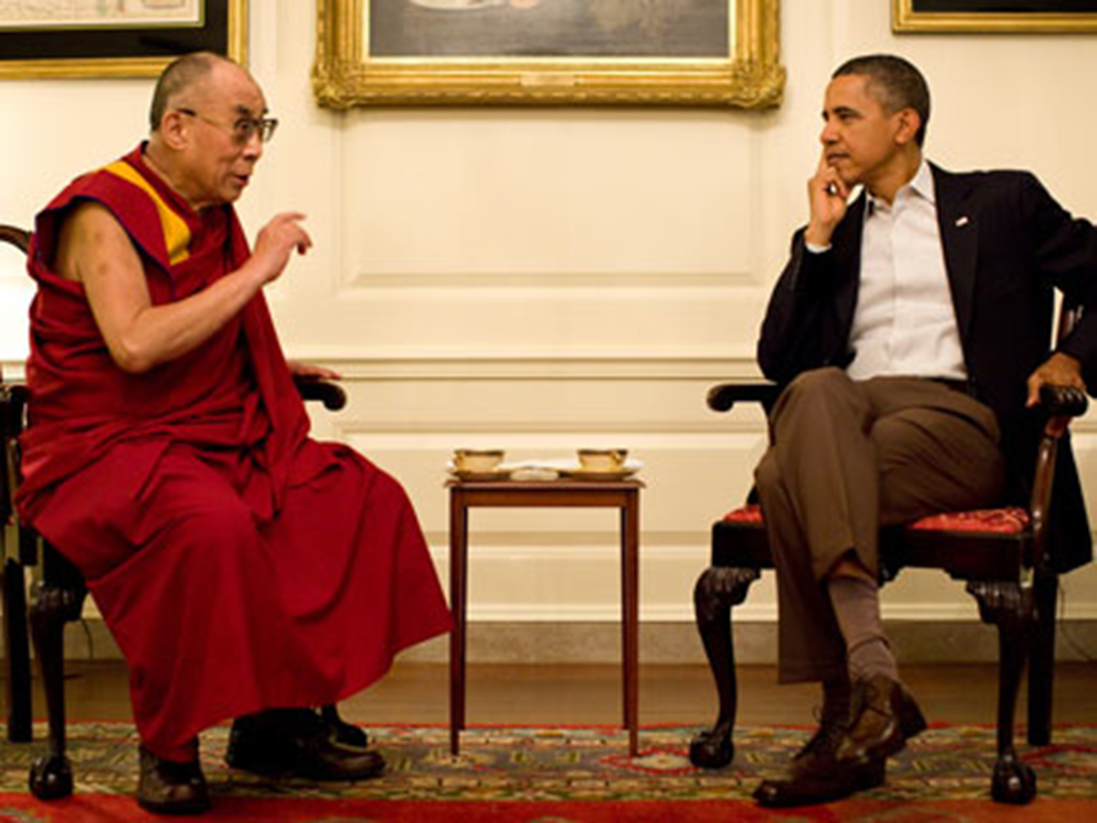
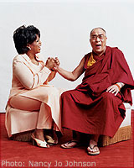
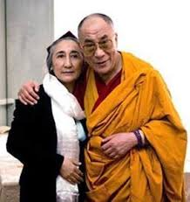
Limits of Autonomy in the TAR: The Dalai Lama
First Dalai Lama, 1391-1474
14th (Tenzin Gyatso, b. 1935)
Spiritual leader of Tibet
Head of the Tibetan government in exile
Author, speaker, global celebrity

Slide 39
Limits of Autonomy in the TAR: The Dalai Lama
Future of the Dalai Lama:
Tenzin Gyatso is “semi-retired”
He sees the future of the Dalai Lama post as spiritual, not political
PRC claims power to name "high reincarnations" in Tibet, based on precedent set by Qing Dynasty
Next Dalai Lama might come from the Tibetan cultural belt (India, Nepal, Bhutan) potentially making him even more pro-Indian and anti-Chinese

Slide 40
Limits of Autonomy in the TAR: Governance
7 TAR prefectures nominally governed by a TAR Chairman
In practice, TAR Chairman is subordinate to the CCP Party Secretary
Chairman usually Tibetan, Party Secretary always Han

Slide 41
What Do Tibetans Want?
To be safe
To be autonomous
To be heard; To be ignored
To choose the next Dalai Lama
Hardliners want independence
To reunite with Diasporic Tibetans
Exile politics and Tibetan politics often incongruent

Slide 42
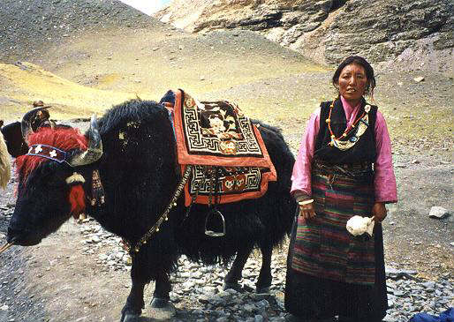
What Are The Chinese Giving Tibet?
Highest poverty rate in China
Infant mortality 2x other regions
50% children malnourished
Life expectancy: 71 years (76 in China)
Mass displacement
Development…
Notes:
Rural: farmers and herders

Slide 43
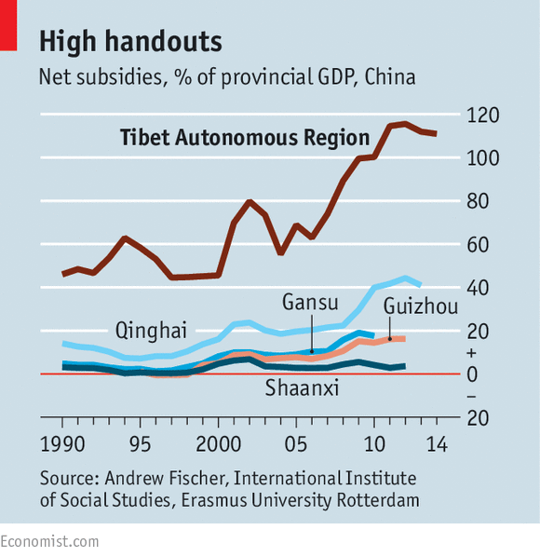
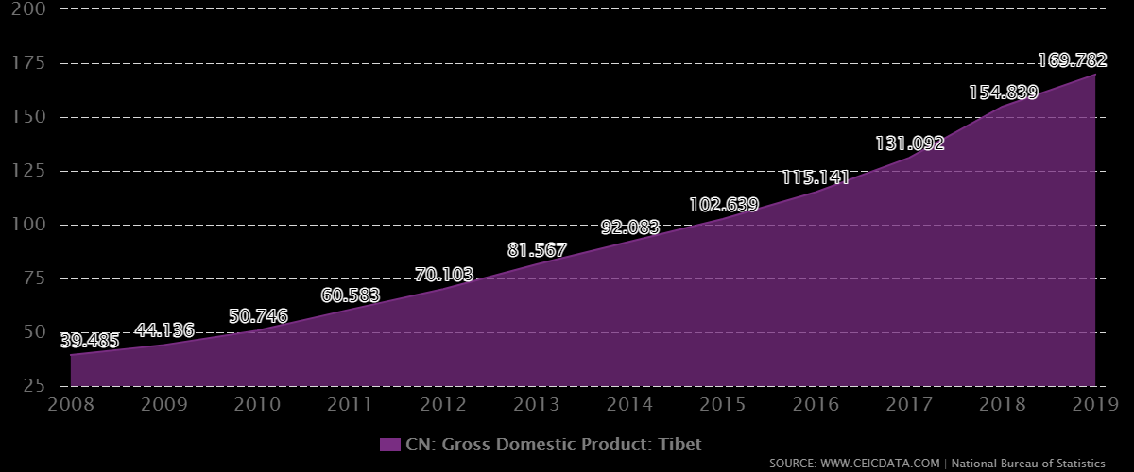
What is the CCP Giving Tibet? Development.
2019 – GDP 160 billion yuan ($23 billion)
8x increase since 2000
2010-2020, Tibet's GDP growth has averaged 11% per year

Slide 44
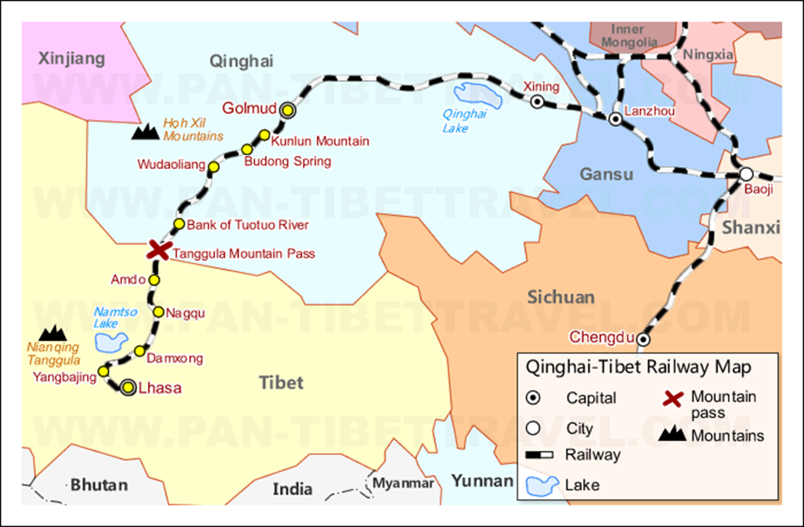
What is the CCP Giving Tibet? Development.
2006 - Qinghai-Tibet Railway from Golmud, Mongolia to Lhasa
Tanggula Pass at 16,600 feet!

Slide 45
What is the CCP Giving Tibet? Development.
2006 “Comfortable Housing” Program, part of “Build a New Socialist Countryside” Program
Housing built for 2 million
280,000 Tibetans who lived in traditional villages or as nomadic herdsmen were relocated to concrete houses alongside roads
Those living in “substandard housing” were required to dismantle their houses and remodel them to government standards
2011 - 20,000 Communist Party cadres placed in the new towns

Slide 46
What is the CCP Giving Tibet? Development.
From your pals at China Daily

Slide 47
What is the CCP Giving Tibet? Development.
Economic investment
Lithium & Copper in Tibet
Water!...Hydro Power
Education
2020 UNDP says literacy rate is 68%, lowest in China (CCP says 98%)
Fastest growing education system in China
Education as the Great Equalizer?
Education as Propaganda Agent?
Territorial Justice. Equality with rest of China?
More Han

Slide 48
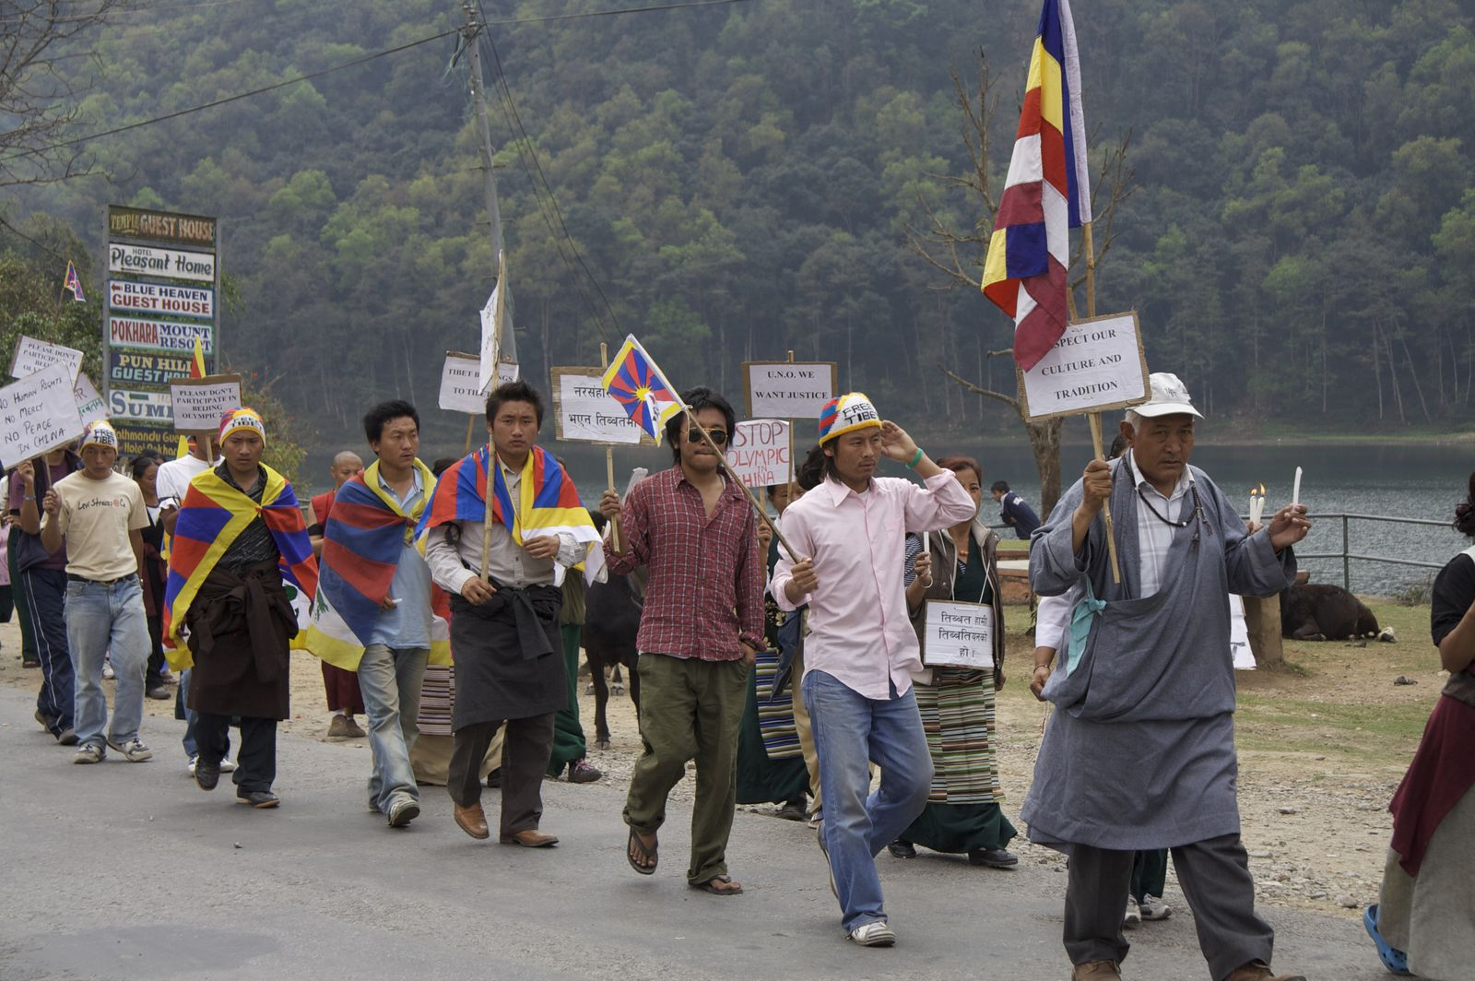
What is the CCP Giving Tibet? Development …and a refugee crisis

Slide 49
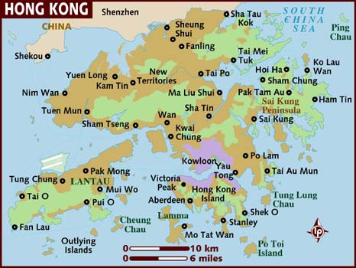
HONG KONG

Slide 50
Hong Kong: Just the Facts
Hong Kong Special Administrative Region of the People's Republic of China (HKSAR)
Hong Kong Island, Kowloon, the New Territories
1,1000 sq. km (Berlin = 890 sq. km)
Population: 7.5 million
92% Han
98% Literate
Cantonese and English
2nd highest number of billionaires in the world

Slide 51
Hong Kong: Brief Timeline
1841: Ceded to Britain (loss of first Opium war)
1860: Annexed Kowloon Peninsula
1898: 2nd Opium War. 99-year lease; HK governor subordinate to Parliament
1949: Capitalists and other “enemies” fled to HK
1984: Sino-British Joint Declaration
1997: Returned to China
2005: Lazar Visited

Slide 53
Politics in HKSAR: “One Country, Two Systems”
Proposed by Deng Xiaoping for China’s reunification & adopted by NPC to…
Maintain HK social & economic system
Maintain HK strength as international business, financial, shipping, and aviation center
Independent courts, rule of law and human rights, efficient bureaucracy…
Beijing stations troops, will not interfere HK internal affairs
Notes:
More specifically, this means that within the People's Republic of China, the mainland with its one billion people will maintain the socialist system, while Hong Kong and Taiwan continue under the capitalist system.
We shall station troops there to safeguard our national security, not to interfere in Hong Kong's internal affairs

Slide 54
Politics in HKSAR: “One Country, Two Systems”
BEIJING CAN…
NPC Standing Committee can interpret Basic Law
Control foreign affairs & defense
State Council selects the Chief Executive
HONG KONG CAN…
Apply Basic Law
Control police, immigration, customs, anticorruption efforts
- Develop trade, economic, financial, monetary, shipping, communications, tourism, etc.

Slide 55
Politics in HKSAR: “One Country, Two Systems”
"The Chief Executive of the HKSAR…selected by election or through consultations held locally and be appointed by the Central People’s Government. The ultimate aim is the selection of the Chief Executive by universal suffrage upon nomination by a broadly representative nominating committee in accordance with democratic procedures.” (45)
The power of interpretation of the Basic Law shall be vested in the Standing Committee of the National People's Congress . (158)
The power of amendment of the Basic Law shall be vested in the NPC. No amendment to the Basic Law shall contravene the established basic policies of the People's Republic of China regarding Hong Kong. (159)

Slide 56
Politics in HKSAR
Chief Executive
Selected by 1200-member Election Committee
5-year terms; 2 term limit
Advised by Executive Council (Cabinet)
Legislative
70-seat unicameral Legislative Council
Direct elections; high voter turnout
Judiciary
Based on Common Law
Standing Committee of NPC has power of final interpretation of laws effecting HK

Slide 57
Politics in HKSAR
NPC ruled in 2007 that universal suffrage might be adopted in 2017 for the chief executive election
On hold
Hot issue in HK
Competitive multiparty system
26 Parties as of 2018; none have more than 17% of LegCo
Pro-Democracy vs Pro-Beijing Camps
CCP not registered in HK but exercises considerable influence

Slide 58
Politics in HKSAR: The Early Years of “One Country, Two Systems”
“Overall, our view remains that the concept of 'One Country, Two Systems' is an everyday reality in Hong Kong. The rule of law and the independence of the judiciary, which are so vital to Hong Kong's success, are being upheld. Essential rights and freedoms are being protected, and challenges to them fully and freely debated.”
-UK Secretary of State for Foreign and Commonwealth Affairs, July-December 2001 Report on Hong Kong to the British Parliament, March 2002

Slide 59
Politics in HKSAR: The Early Years of “One Country, Two Systems”
“Most Western analysts conclude today that 'One Country, Two Systems' has permitted Hong Kong to maintain its unique character. Long-term success depends on preserving the quality and integrity of Hong Kong's outstanding cadre of civil servants, the rule of law, and an independent judiciary...”
— US Speaker's Task Force on the Hong Kong Transition, Ninth Report, January 30, 2002

Slide 60
Politics in HKSAR: Freedom
“Under Article 27 of the Basic Law, Hong Kong residents enjoy freedoms of speech, press, and publication. These rights are generally respected in practice, and political debate is vigorous…
There are dozens of daily newspapers, and residents have access to international media. Foreign media operate without interference.
However, political and economic pressures have narrowed the space for free expression. A 2012 poll conducted by the Hong Kong Journalists Association found that for the first time, journalists’ concerns about tighter government control over access to information surpassed self-censorship as the most commonly cited threat to media freedom.”
Source: Freedom House

Slide 61
Politics in HKSAR: Freedom
HKSAR
PRC
STATUS: Partly Free (59/100)
FREEDOM RATING: 3.5
CIVIL LIBERTIES: 2
POLITICAL RIGHTS: 5
STATUS: Not Free (11/100)
FREEDOM RATING: 6.5
CIVIL LIBERTIES: 6
POLITICAL RIGHTS: 7
Freedom House Ratings
(Scale 1 to 7; 1 is most free)

Slide 62
Snapshot of HK Economy
3rd on “Ease of Doing Business” rank
93% service sector
Unemployment rate <4%
Sound banking, no debt, strong legal system
HK$
HK Stock Exchange
Major Partners: China: 55 %, US 8%, Japan 3%
Closer Economic Partnership Arrangement (CEPA) with China, 2003
Zero tariff on all HK-origin goods
Preferential treatment to service sectors
Increasing use of Yuan in HK

Slide 63
HK Political Culture & Participation
58% vote in 2016 LegCo Elections
Media
Reports news that is banned on mainland
Hearty political dialogue…which hesitates to criticize Beijing
Demands for open, accountable, efficient government
Protest Culture
Direct CE Elections
Pro-Tiananmen protesters
Pro-Tibetans
Times are changing?..........

Slide 64
2014 Umbrella Movement & Reactions
Standing Committee of the NPC decision on electoral reform of HK CE (2016) and LegCo(2017) elections
NPCSC decreed that a 1200-member nominating committee would elect 2-3 candidates before the general public could vote on them.
In short, CCP candidate vetting
Hong Kong Federation of Students and Scholarism protested outside the government headquarters on 22 September 2014
Occupy Central with Love and Peace (“Occupy Central” or “OC”)
Goals: “true universal suffrage” and “one person, one vote”

Slide 65
2014 Umbrella Movement & Reactions
CCP (and their media) insists the West instigated this
100,000 Protestors. Then university classes began…Then school boycott. Then…
PLA mobilized: Containment. Clearance. Tear Gas. Detention. Martial law (roads and bridges blocked)
Arrests: 319
Injuries: 298 (treated)

Slide 66
2014 Umbrella Movement & Reactions
Trifecta of Terror – Chinese gangs, supported by police and PLA, intimidate and attack protestors
“Voice of Loving HK” – anti-protestor groups headed by business community
Trusts negotiations with CCP will work
Reminds HK that "no one died in Tiananmen Square"

Slide 67
2014 Umbrella Movement & Reactions
Member of LegCo, Albert Ho of Democratic Party said to BBC:
“The attack on protesters was one of the tactics used by the communists in mainland China from time to time. They use triads or pro-government mobs to try to attack you so the government will not have to assume responsibility.“

Slide 68
2014 Umbrella Movement & Reactions
Former Chief Executive Tung Chee-Hwa when asking the students to leave protests, said:
“You have made a great sacrifice by putting aside everything to join the movement in the pursuit of democracy. But the rule of law and obeying the law form the cornerstone of democracy.”
-Channel NewsAsia. 5 October 2014

Slide 69
2014 Umbrella Movement & Reactions
Laura Cha, UW-Madison educated, chairwoman of the HK Stock Exchange, and board member of HSBC, said:
"African-American slaves were liberated in 1861 but did not get voting rights until 107 years later. So why can't Hong Kong wait for a while?“
-The Standard. 30 October 2014

Slide 70
2019 HK Protests: Causes
Misconduct by HK Police against protesters in 2014, now 2019
HK–Mainland conflict, political screening
Economic and social inequality
Failures of the 2014 Umbrella Revolution
Implementation of anti-mask law and the invocation of the Emergency Regulations Ordinance (since 3 October)
The Spark: Proposal of the Fugitive Offenders and Mutual Legal Assistance in Criminal Matters Legislation Bill 2019
Proposed by HK CE after Chan Tong-kai killed his girlfriend while on a trip to Taiwan after learning the fetus was not from him. Fled to HK. HK couldn’t charge or extradite b/c no jurisdiction.

Slide 71
2019 HK Protests: Objectives
Withdrawal of the extradition bill
Retraction of the characterization of protests as "riots"
Release and exoneration of political protesters
Independent commission of inquiry into police behavior
Universal suffrage for LegCo & CE elections
Resignation of Carrie Lam
Dissolution and reorganization of the HK Police

Slide 72
2019 HK Protests
Occupation of the LegCo, July
Eggs on Xi on 1 Oct (70th National Day)

Slide 73
2019 HK Protests
ChiNazi Flag
Masks, now banned

Slide 74
2019 HK Protests
ERNEST, STUDENT, 16
“If we don’t stand out front today, we won’t have any chance to speak anymore. We will become real China and will not have any chance to protest.”
TANG, STUDENT, 15
“At first I thought I was not strong enough to come out, but then I started to think that everyone, no matter how small needs to come…I’m angry about police abuse against the protesters, sexual abuse and shooting tear gas for no reason.”

Slide 75
2019 HK Protests
SAKURA, 37, FROM JAPAN
CHAN, 22, FLYING THE TIBETAN FLAG
“It’s not just a Hong Kong problem. It’s an international problem. Today Hong Kong, tomorrow Japan. That’s why I come all the way from Japan to support the protest today. I want to safeguard Japan, Taiwan and Hong Kong as we are closely connected. So I feel the same as a Hong Konger and will stand with Hong Kong.”
“I want to show that Hong Kongers also support Tibet, that we are all victims of the CCP (Chinese Communist Party)...We can see the history of Tibet is repeating itself here.”

Slide 76
The State of Play in HK
Police officers in Hong Kong
Nathan Law at a protest during the visit of the Chinese foreign minister to Berlin
21 December 2020: Seeking asylum in UK

Slide 77
Guiding Questions Reprise
What are SARs an SEZs and how are they complicated by the history of humiliation of China?
How can the PRC effectively cope with its diversity, cumulative cleavages, and relative deprivation?
Does China have a more valid claim to exercise authority over some SARs and SEZs than others?
What might the future hold for SARs and SEZs?
How can/should the international community react to China’s sovereignty conundrums?
How do these ethnoreligious conflicts compare with conflicts in our other course case studies?

